Slide 1
Detector Optimization:
A Newbie’s Journey into SLIC and the org.lcsim Framework
Lawrence Bronk
MIT

Slide 2
Outline
Purpose
Methods
Results
Conclusion

Slide 3
Purpose
International Linear Collider & Search for New Physics
Senior Thesis (would like to graduate)

Slide 4
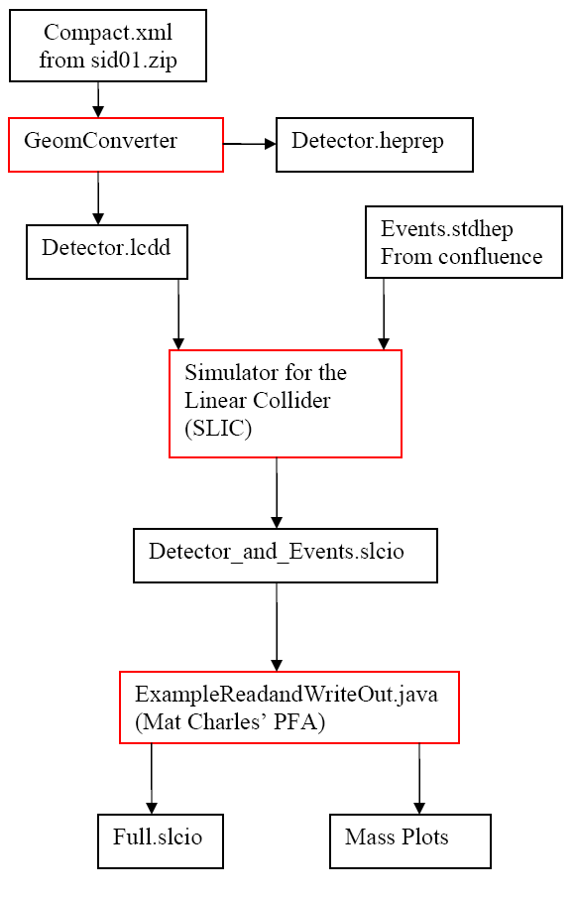
The Flow

Slide 5
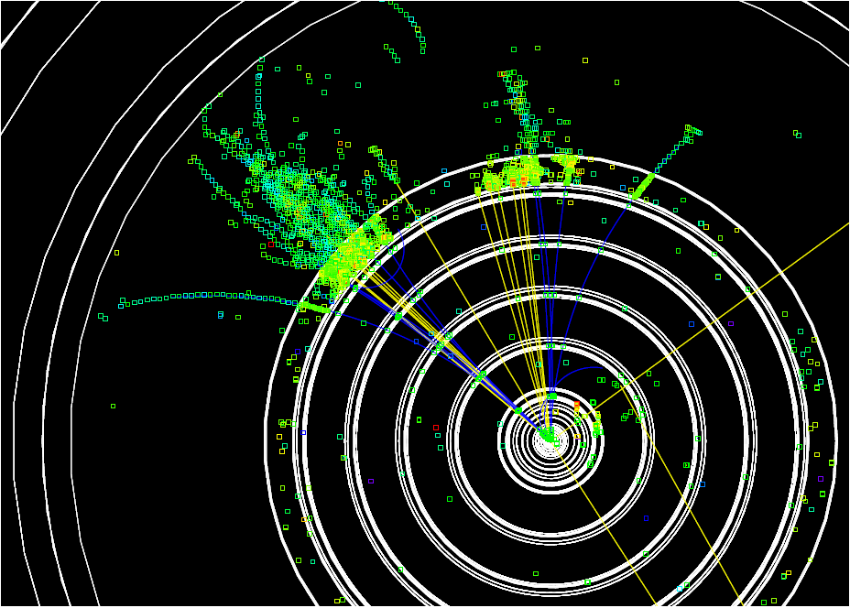
The Hadronic Calorimeter
Most difficult reconstruction
Event of choice, the beloved

Slide 6
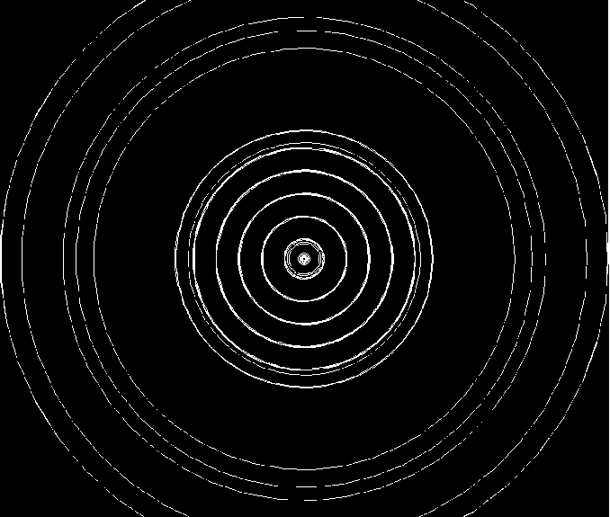
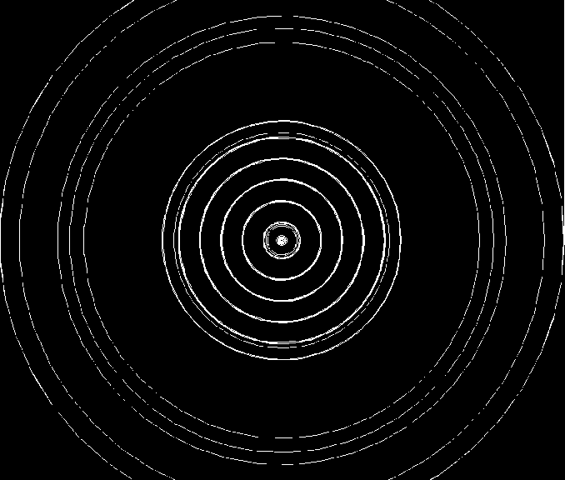
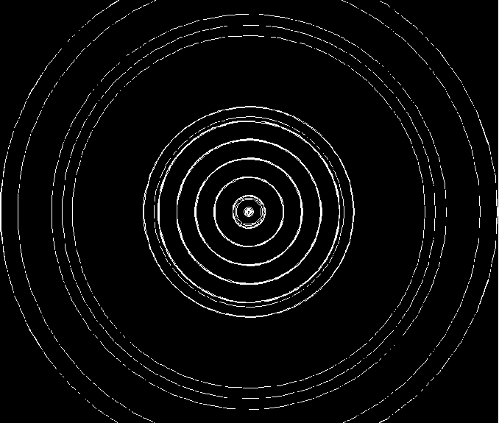
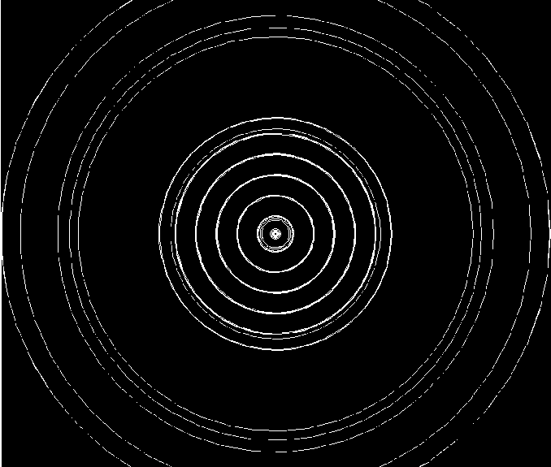
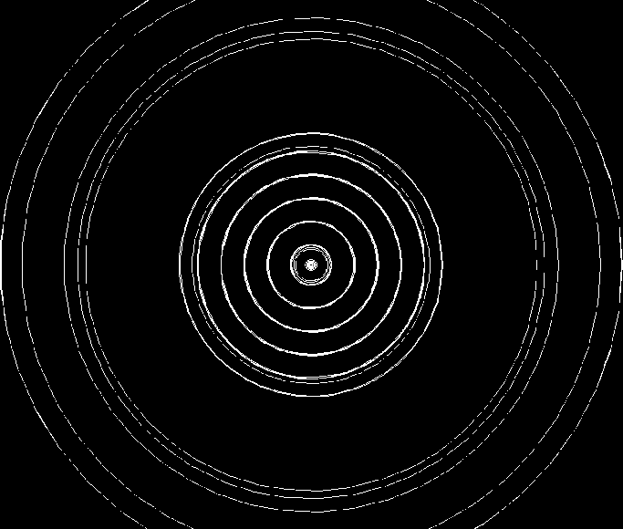
Changing the HCAL

Slide 7
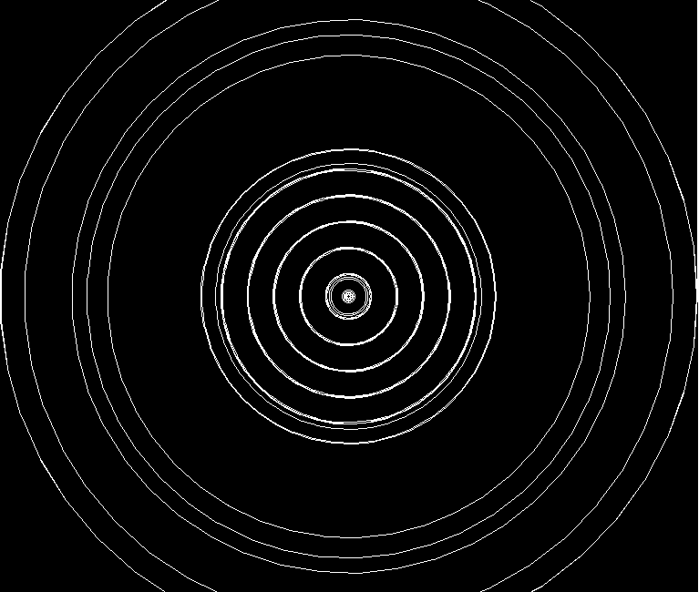
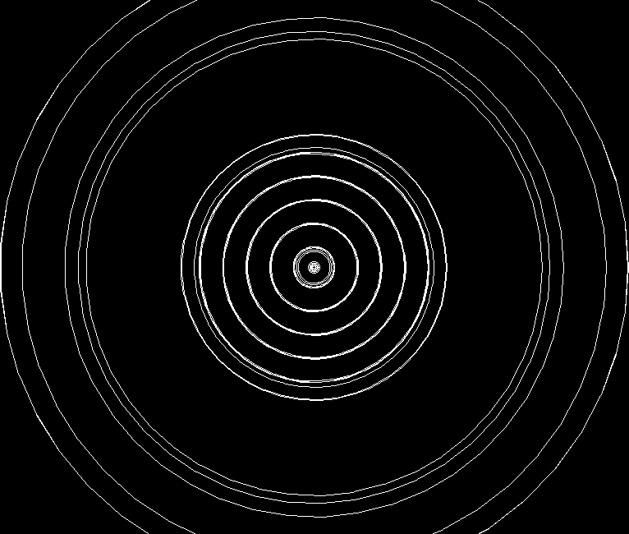
A Better Look
32 HCAL layers
36 HCAL layers

Slide 8
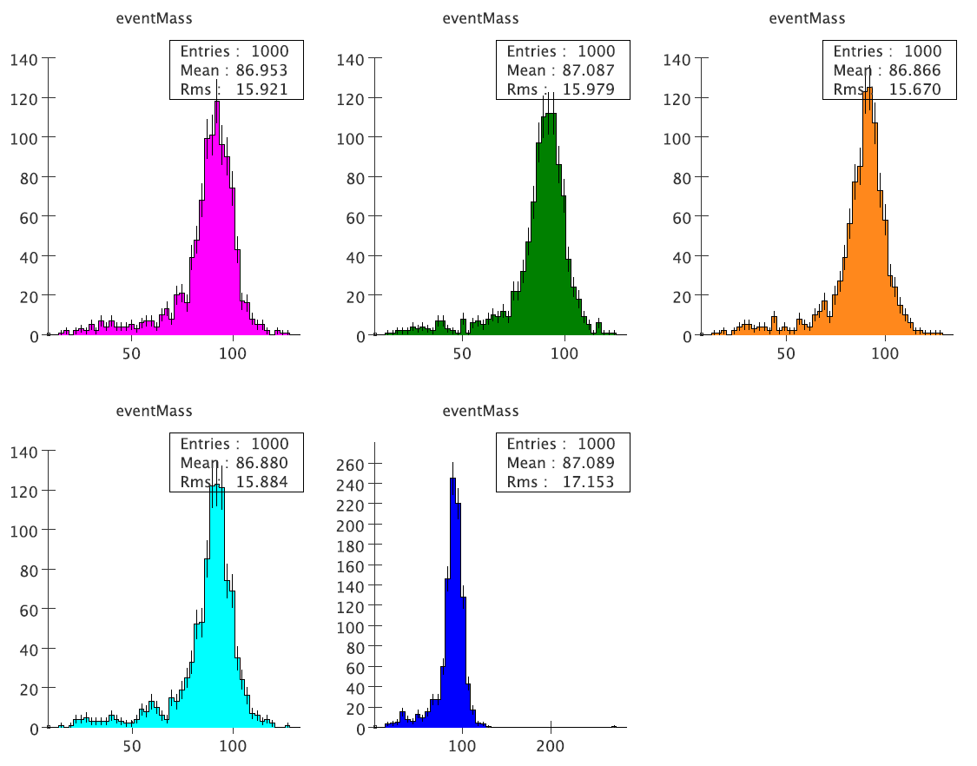
Reconstructed Mass
Need RMS90

Slide 9
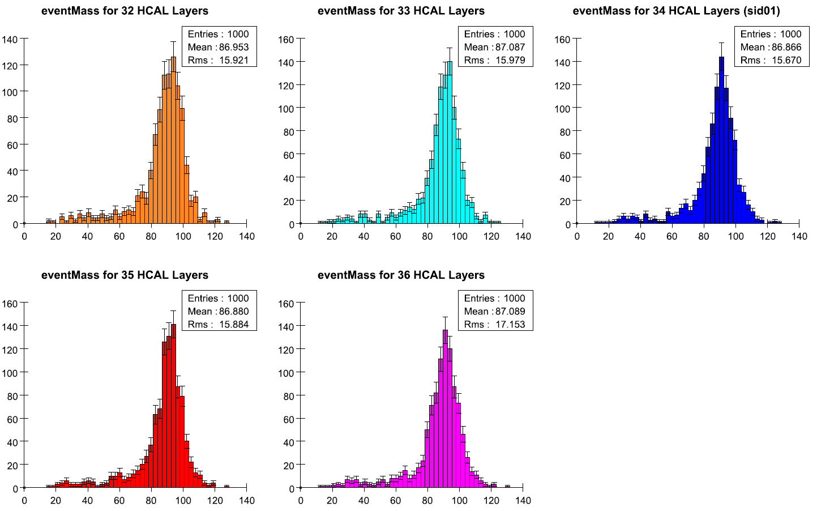
Better Plots

Slide 10
An Oversight: Wired vs Reality

Slide 11
Conclusion
Really just starting the physics, a lot of work to be done
Open to suggestions for interesting detector studies

Slide 12

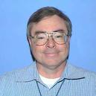
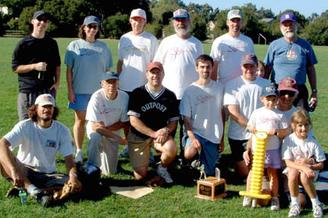
Thanks for all the help SLAC!
Mat
Ray
Ron
Jeremy

Slide 13
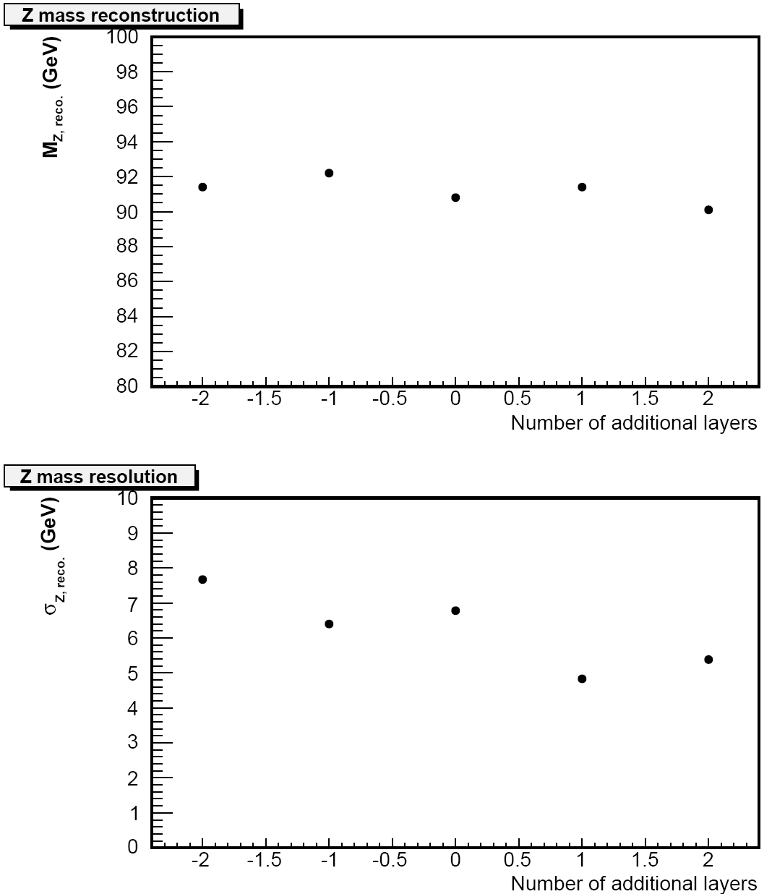
This Just In

