Slide 1





„Si-TPC“ with GEMs
Hubert Blank, Christoph Brezina, Klaus Desch, Jochen Kaminski, Thorsten Krautscheid, Walter Ockenfels, Martin Ummenhofer, Peter Wienemann, Simone Zimmermann
Andreas Bamberger, Uwe Renz, Andreas Zwerger
*renz@physik.uni-freiburg.de

Slide 2
Outline
Spatial resolution and understanding of possible systematics
Time resolution and time walk correction
Software issues -> Pixelman PlugIns

Slide 3
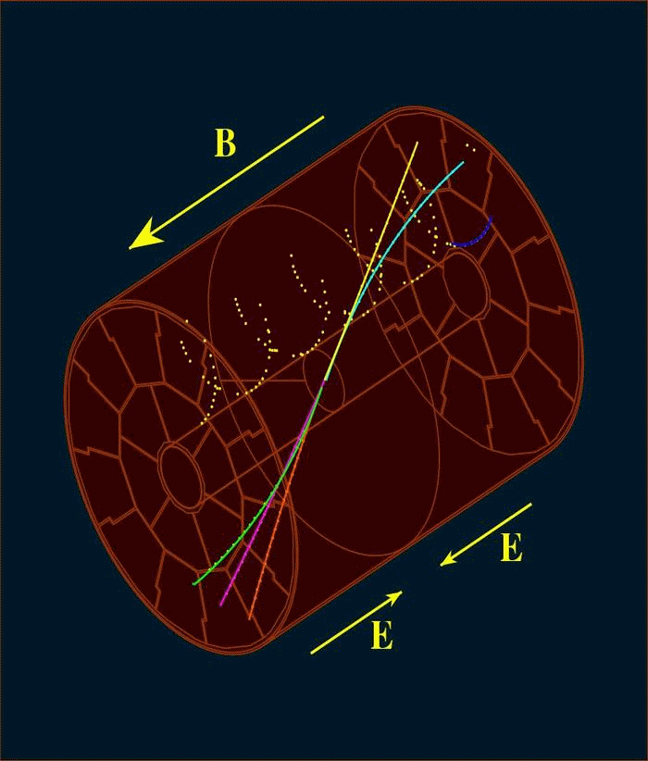
TPC – basic operation and pixelated readout
Charged particle ionizes the chamber gas
The primary charge drifts along the electric field E towards the end plates
Magnetic field parallel to E reduces transverse diffusion and allows measurement of the particle momentum
At the end plate the primary ionization is amplified
Readout of the signal
Time Projection Chamber TPC
Micro Pattern Gas Detectors (MPGD): high resolution readout and high rates
Pixilated readout offers high resolution Digital Bubble Chamber
A TPC at the ILC needs excellent momentum resolution ⇒ GEM-TimePix for end plate readout
region of interest for this talk

Slide 4
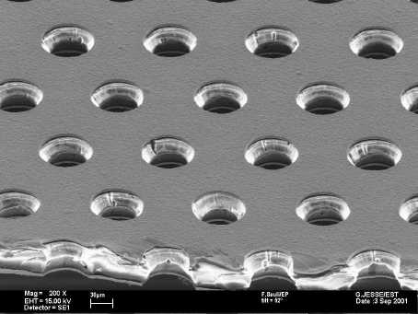
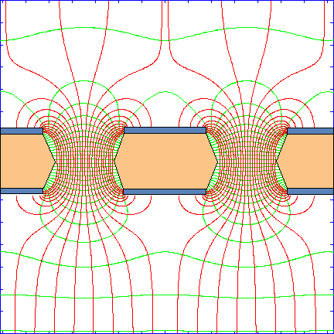
GEM - Gas Electron Multiplier
F. Sauli, Nucl. Instrum. Methods A386(1997)531
F. Sauli, http://www.cern.ch/GDD
Thin, metal coated polymer foil. Very high density of chemical pierced holes
Principle:
2 layers Cu each 5µm thick, separated from each other by 50µm Kapton.
Conical etched holes largest Ø70µm, diagonal distance of holes 140µm.
Advantages of Triple-GEM-setup
Gas gain up to 10⁵ in ArCO₂ easily achievable
Minimizing the back drift of positive ions into the drift volume (O(10⁻²))
Encapsulated region of amplification

Slide 5
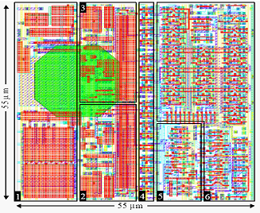
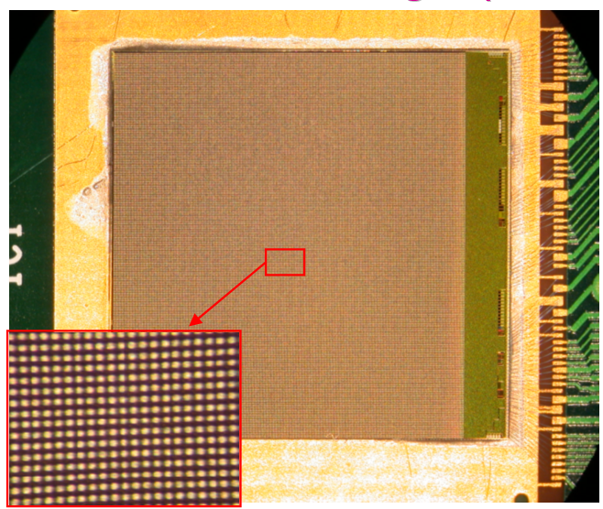
TimePix properties
TimePix properties inherited from
MediPix
Pixel size 55µm in a 256x256
Matrix
dimensions of the sensitive area: 1,4x1,4cm²
lower threshold of ≈ 700 e⁻
charge-sensitive-input
1,4cm
TimePix
Based on improved design of MediPix2 MXR
Time information on each pixel, due to an adjustable clock up to ≈100MHz, distributed to all pixels
The 2 different modes out of four available modes are used: Time over threshold TOT- (amplitude recontruction) and TIME-mode
modes individually selectable for each pixel
Mixed Mode important feature for walk correction
X. Llopart Cudie, “Design And Characterization Of 64-K Pixels Chips Working In Single Photon Processing Mode”, CERN-THESIS-2007-062
-

Slide 6
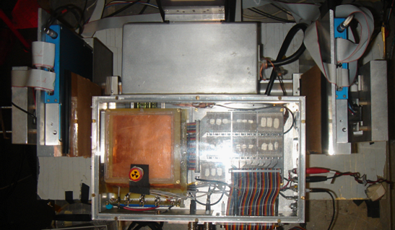
DESY Test Beam June 2007
TimePix
Failure-free and stable operation of TimePix-GEM-setup
GEM:
10 * 10 cm²
e⁻ beam DESY II
trigger (scintill.) &
Si-telescope
GEM-stack with TimePix:
Two different types of GEMs tested:
Standard 100x100mm² GEMs mit 140µm hole pitch
small GEMs 24x28mm² with a fine pitch of 50µm
Shown for fine pitched (small) GEMs
6mm drift volume
≈ 1.8mm distance between transfer and induction gaps

Slide 7
Data taking properties and reconstruction
Two independent data streams: TimePix data (Windows based readout) and SiTel.
Si-Tel allows the determination of the drift distance with ~50μm precision
Cleaning up of multiple tracks by
  double hits in the SiTel
  in projection along the track: secondary maxi-mum signals another track
Every other pixel in a row is set to the TOT property, and TIME property in between
All over the surface ordered in a checker board fashion
Reconstruction is done by mapping ½ of all pixels onto 256x256 matrix. Missing neighbors in TOT or TIME data are thereby interpolated
TOT | TIME | TOT
TIME | TOT | TIME
TOT | TIME | TOT

Slide 8
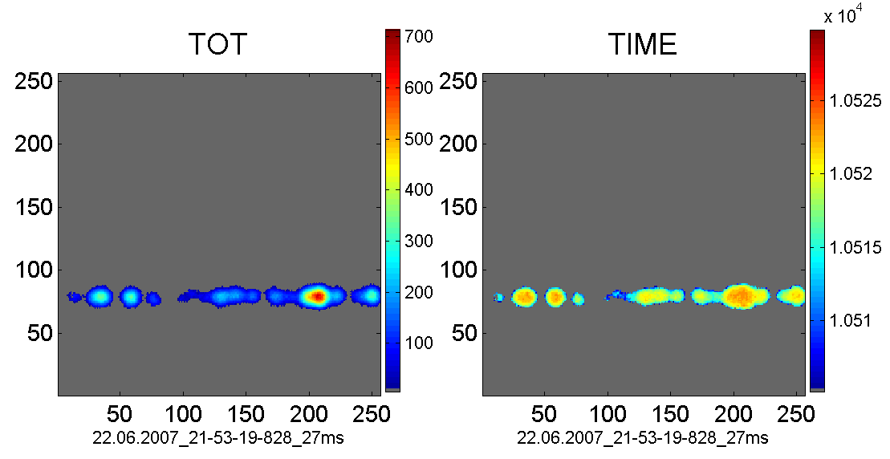
Typical events
14mm
1.5ns
merged cluster
Search contiguous areas for cluster reconstruction
Use TOT-information to separate merged clusters
      ⇒BUT diffusion smears our information of individual primary e⁻ from distinct clusters. These electrons overlap and appear to belong to the same (single) cluster.

Slide 9
Spatial properties of cluster position due to the discrete structure of GEMs
3 length scales: charge radius R_{charge}, d_{hole}, transv. diffusion R_{diff}(z)
hole of the first GEM is “perfectly mapped onto the detector. The centroid of the e⁻ avalanche remains stable.
for large drift distances R_{diff} >>R_{charge,} then centroid determination is perfect, even for multi electron clusters
for small drift distances is R_{diff} <<R_{charge} and R_{diff} < d_{hole} there is also a perfect mapping for isolated clusters (single or multi electron clusters)
for intermediate drift distances R_{diff} <<R_{charge} and R_{diff} > d_{hole} then its not any more perfect for multi-electron clusters
drift distance z
R_{diff}
d_{hole}
amplification volume
R_{charge}
pixel detector surface

Slide 10
Special case for tracks close to the first GEM
track
The clusters are arranged in a line along the track and produce overlapping charges
It depends on the direction considered for the precise mapping: rectangular to the track it may stay precise and reveal the hole structure
the position of the centroids along the track is not necessarily mapping the cluster position because of overlapping charge distributions
GEM holes
charges
precision of hole mapping is maintained in transv. direction
precision of hole mapping lost along the track

Slide 11
Orientation of GEM
“old” orientation
“new” orientation
70µm
120µm
beam
x
140µm
z
As structure of 120µm visible in FFT
Rotate GEM by 90°
Now 70µm projected hole pitch

Slide 12
GEM Struktur
Signal bei (8.39±0.04)mm⁻¹
„old“ orientation
„old“ orientation
FFT
Use Fast Fourier Transformation (FFT) ⇒periodic structure at 1/8.39mm corresponds 119μm, independent of sampling rate (number of supporting points of the FFT).
No such structure seen for drift distances > 1mm seen. This structure is smaered by transverse diffusion
After rotation by 90°: signal in FFT vanishes
Signal amplitude depends on orientation Chip vs. GEM
„new“ orientation (rotated by 90°)
No Signal

Slide 13
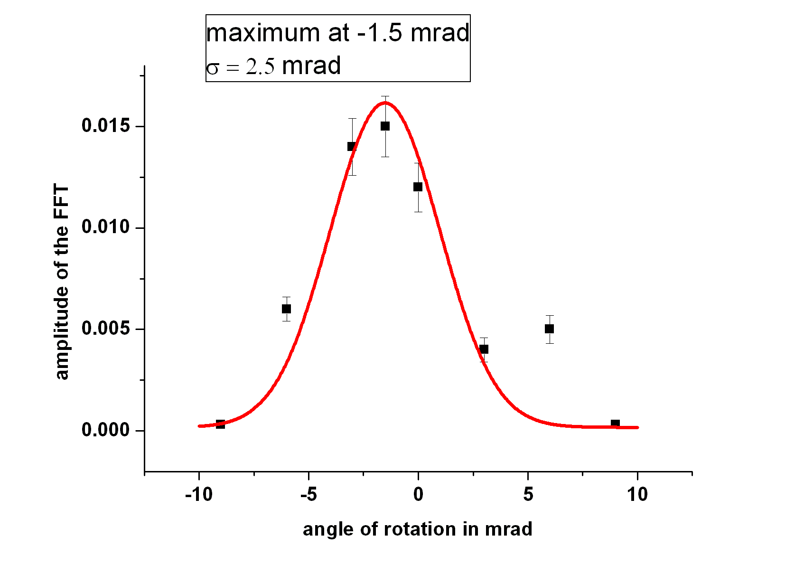
Check the angular dependance of the structured signal
signal disappears with
rotation of the coordinate system with respect to the TimePix frame α <-9 and
α > 9 mrad
“fortuitous” peak at α near zero (GEM almost coincides with the chip’s orientation)
the signal strongly depends on the drift distance z
.
Reason: the disappearance is due to the fact that the transverse diffusion smears out the structure R_{diff} > d_{hole}
.
≥2 electron cluster
2 mm
1 mm

Slide 14
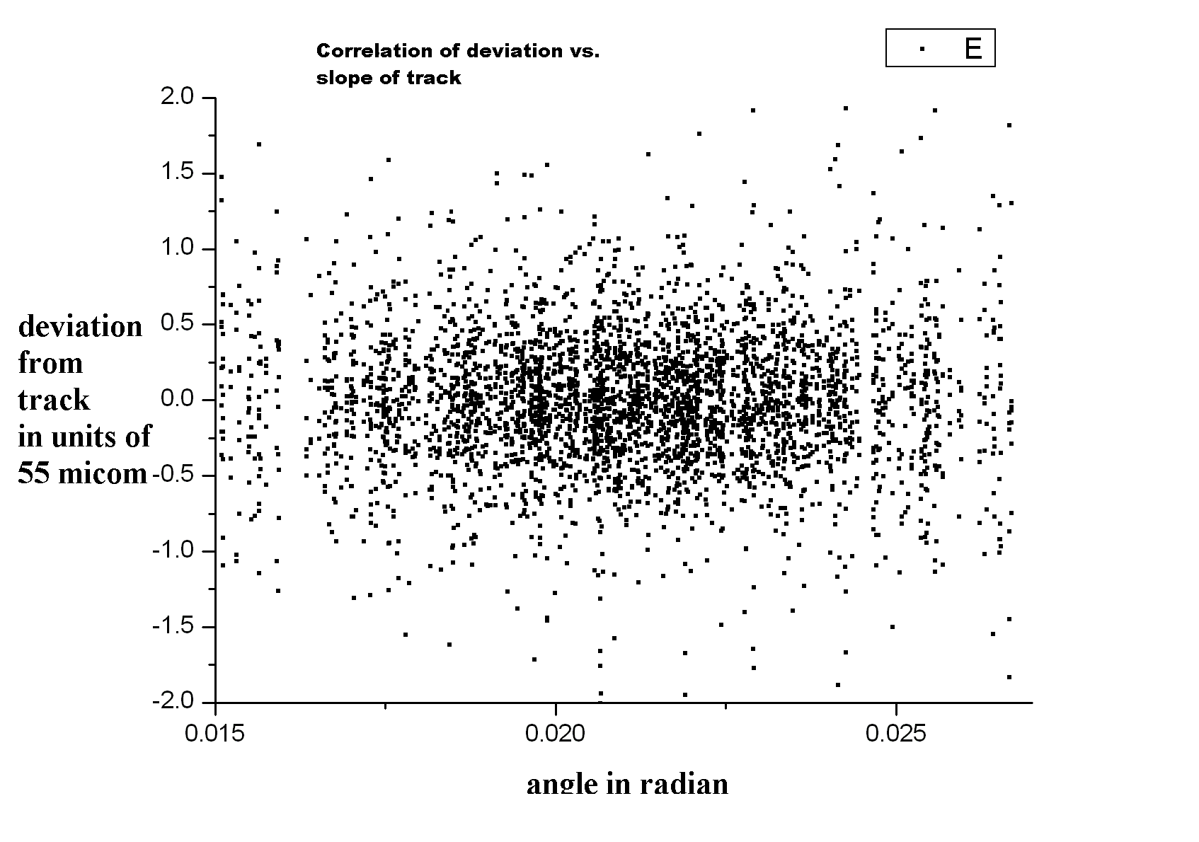
Discussion of a possible bias for the determination of the point resolution
does the orientation of the track matter with respect GEM for the point resolution given by the centroids of the clusters?
Eventually yes, if most of the tracks would run parallel to the holes
however most tracks are inclined α_{track} ~ (22±6) mrad i.e. far from zero

Slide 15
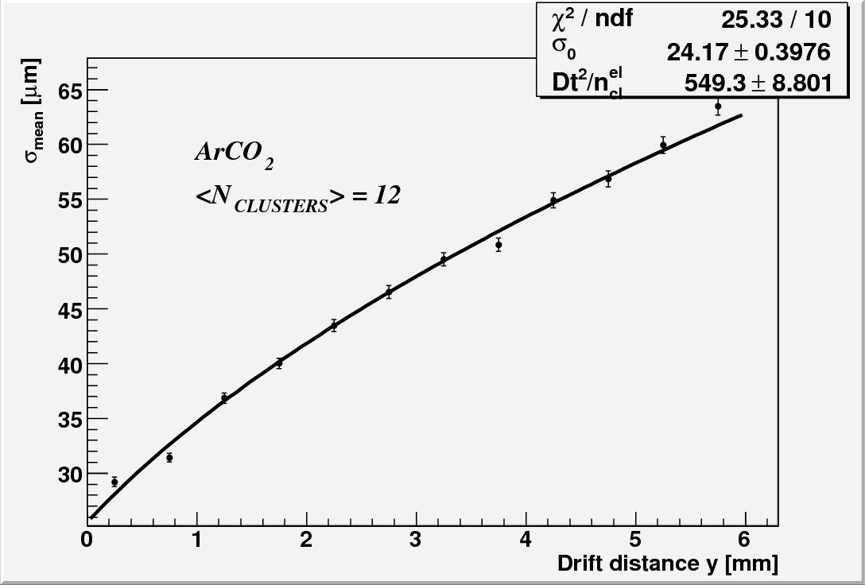
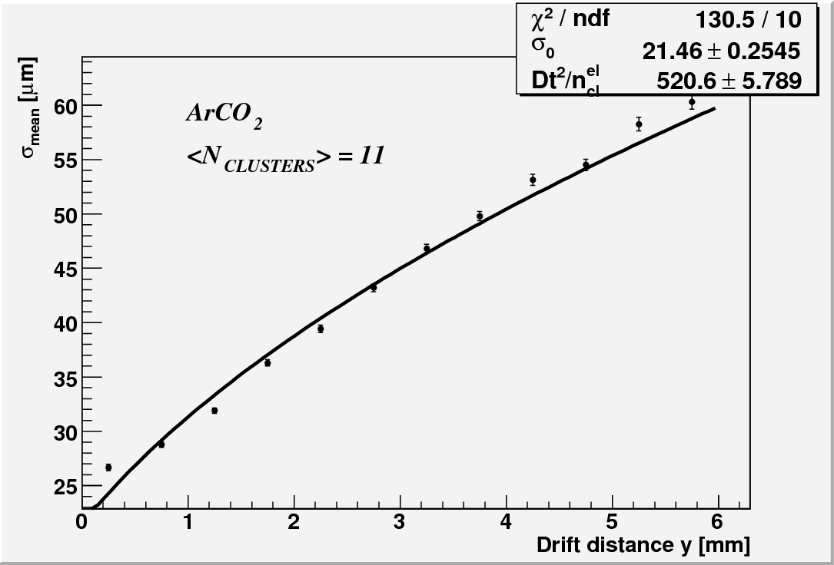
Resolution of standard
GEMs
old GEM configuration with 120 µm projected z-pitch
new GEM configuration with 70 µm projected z-pitch
≈ 2 µm improvement for σ₀ only through rotating the first GEM by 90°

Slide 16
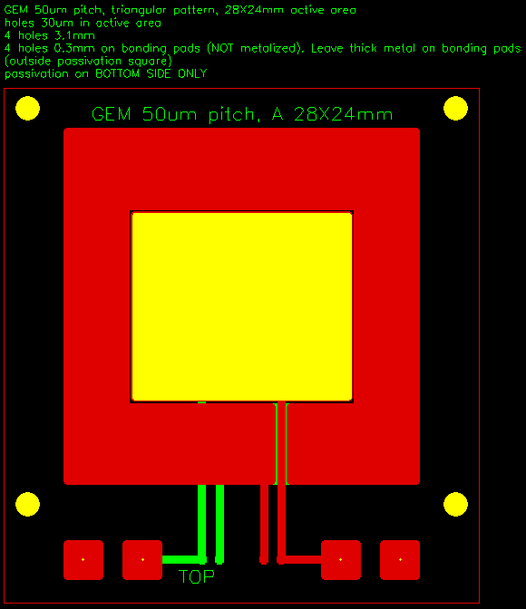

small GEMs
z
x
Referenced outer hole diameter in copper 30µm.
Inner hole diameter in the Kapton between 17µm-21µm.
Diagonal hole pitch 50µm
  Projected in x ≈ 43µm
  Projected in z ≈ 25µm
Guard rings on both sides
Active surface 28x24mm²

Slide 17
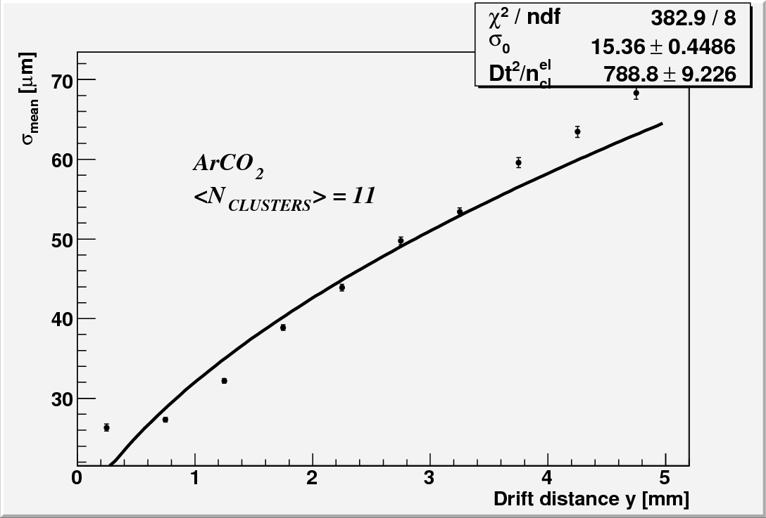


Resolution of small GEMs
Small GEMs improve σ_{o} by ≈ 5µm.
Driftlänge y [mm]
Still possible systematics ?
it is a delicate range since the fit function has an infinite slope here
…there are events below the drift region…

Slide 18
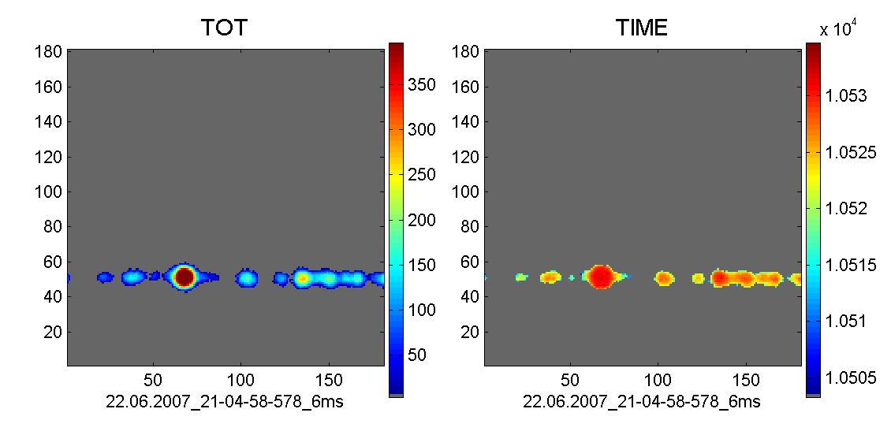
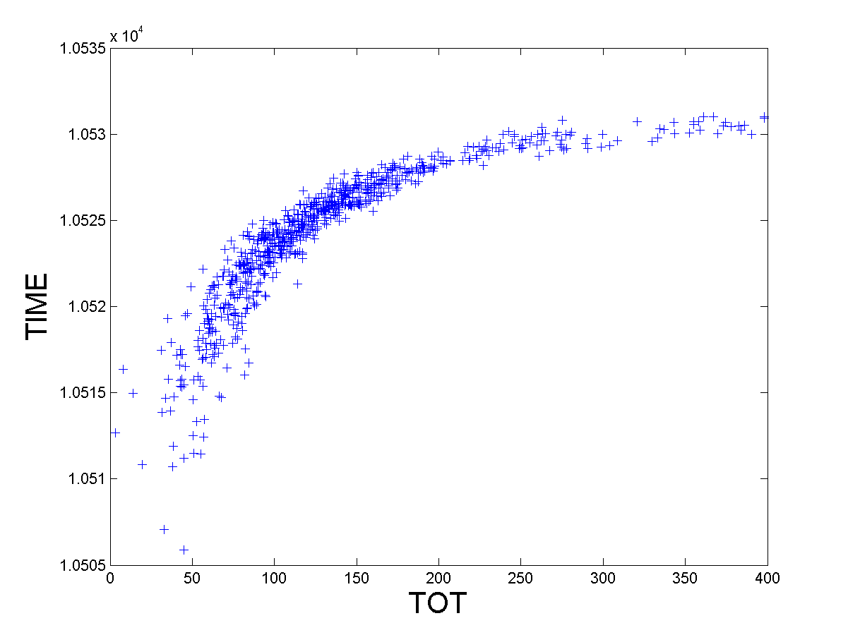
Data processing for time walk correction
original data for central column in MM
interpolation of TOT and TIME produces 2 sets of data on each pixel
for any pixels the time walk can be large
take maximum in TIME and TOT for the correction. In this case at TOT = 180 the correction amounts to +2.7 counts to be close to the asymptote, where all clusters should lie.
0
10522
93
10526
139
10526
167
10527
186
10527
170
10526
118
10522
35
0
asymptote
selected cluster
correction
10 counts
TOT range for this cluster

Slide 19
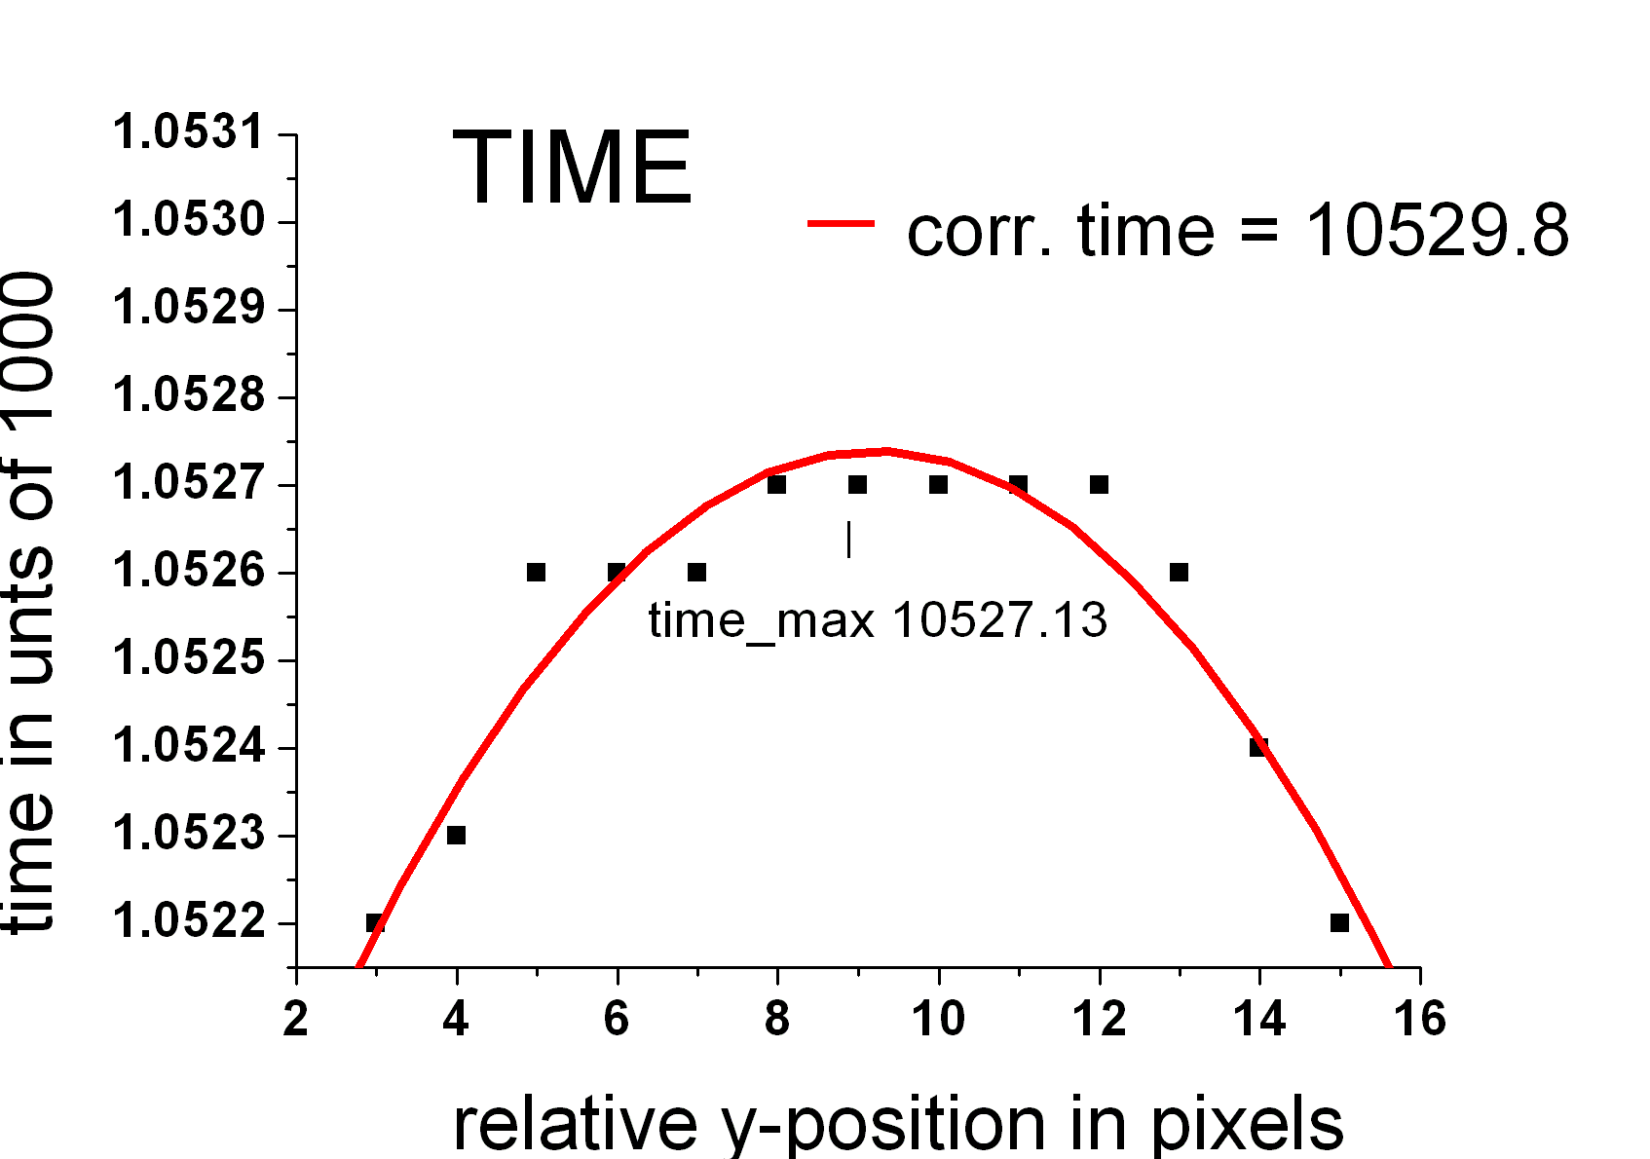
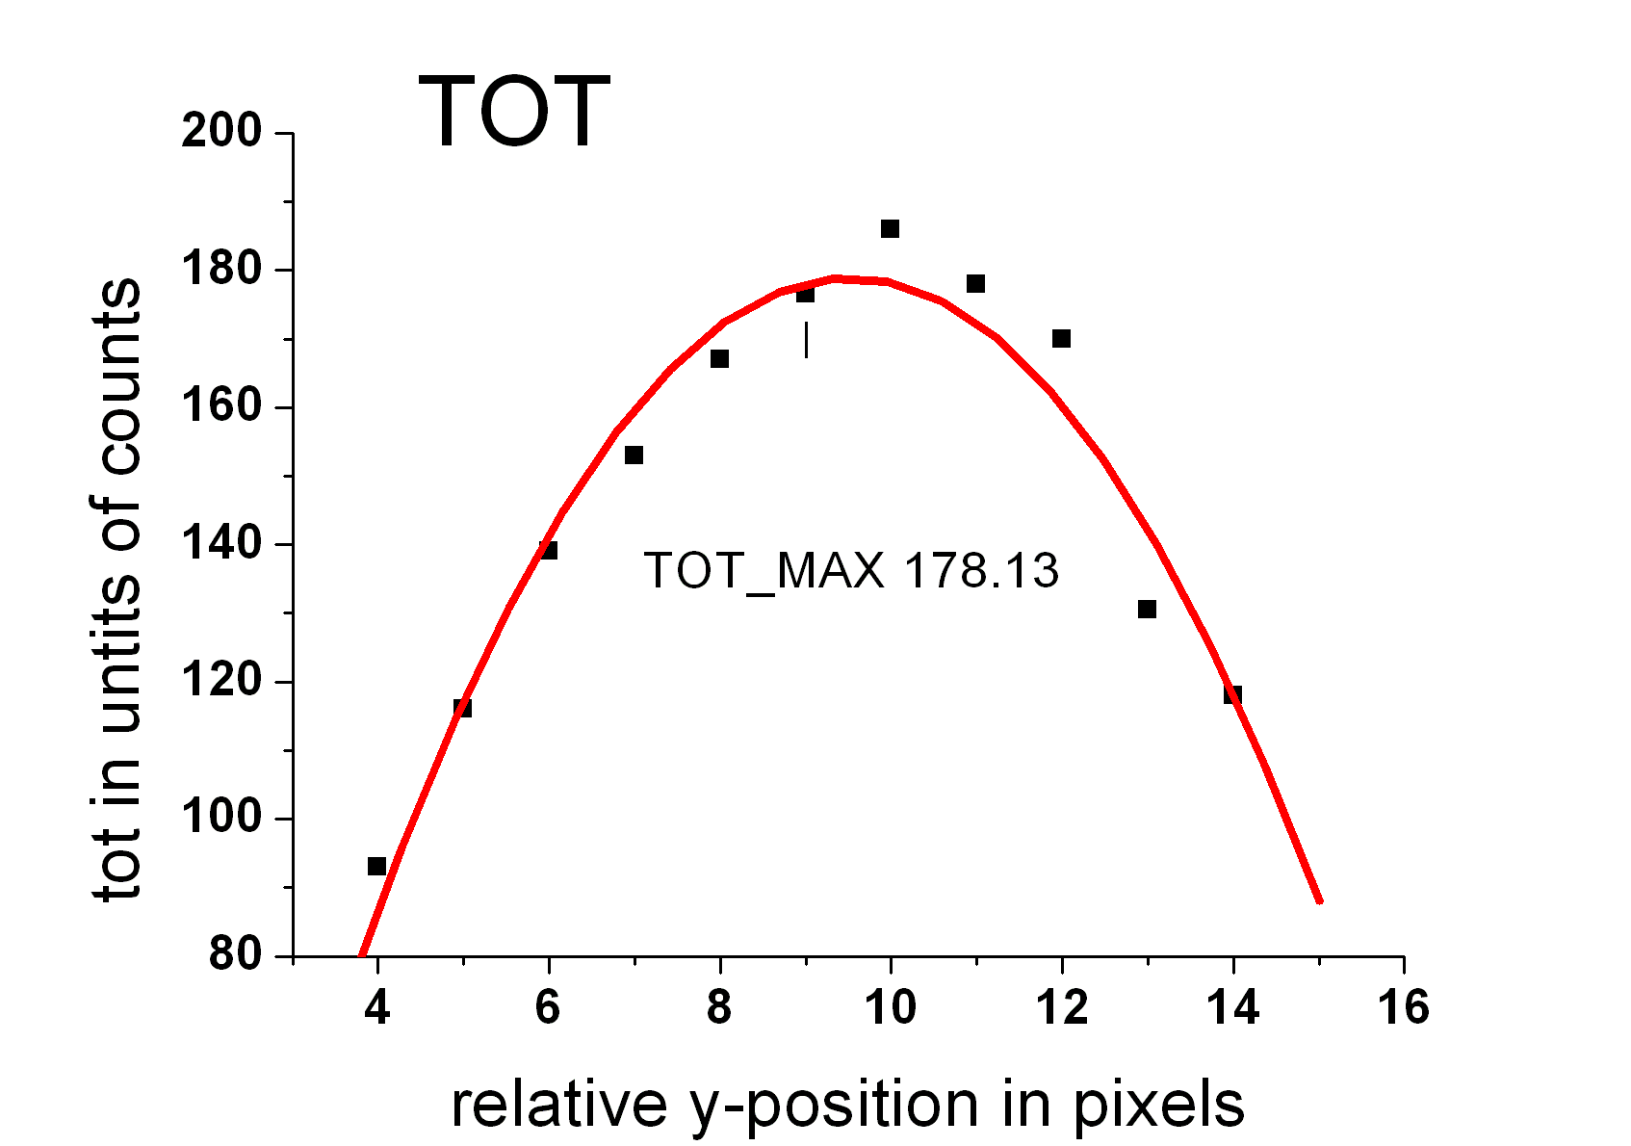
Treatment of time walk correction
Select a column near the centroid of the cluster
Fit 2nd order polynomials to the TIME and TOT distributions, look for maxima
Time walk correction done only by the maxima of fits
Time correction with an exponential function
for this run A = 24, B = 81

Slide 20
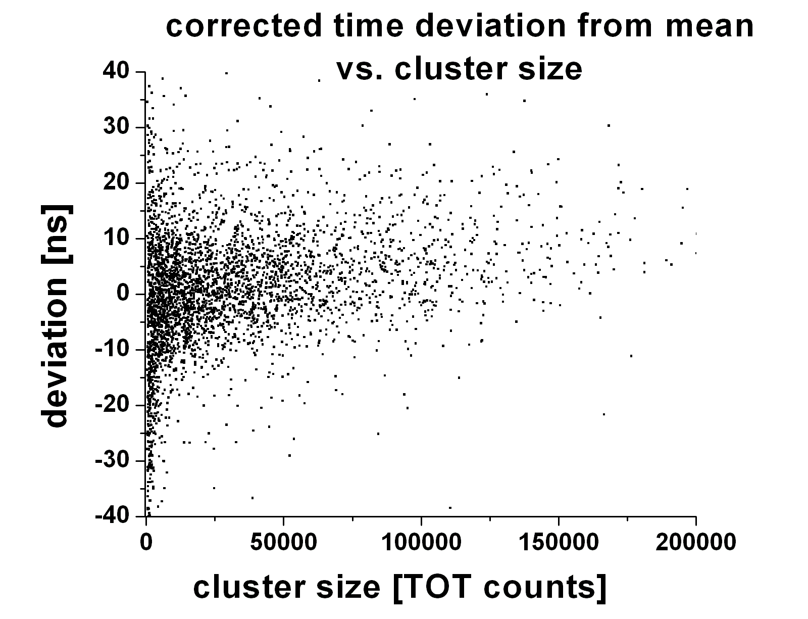
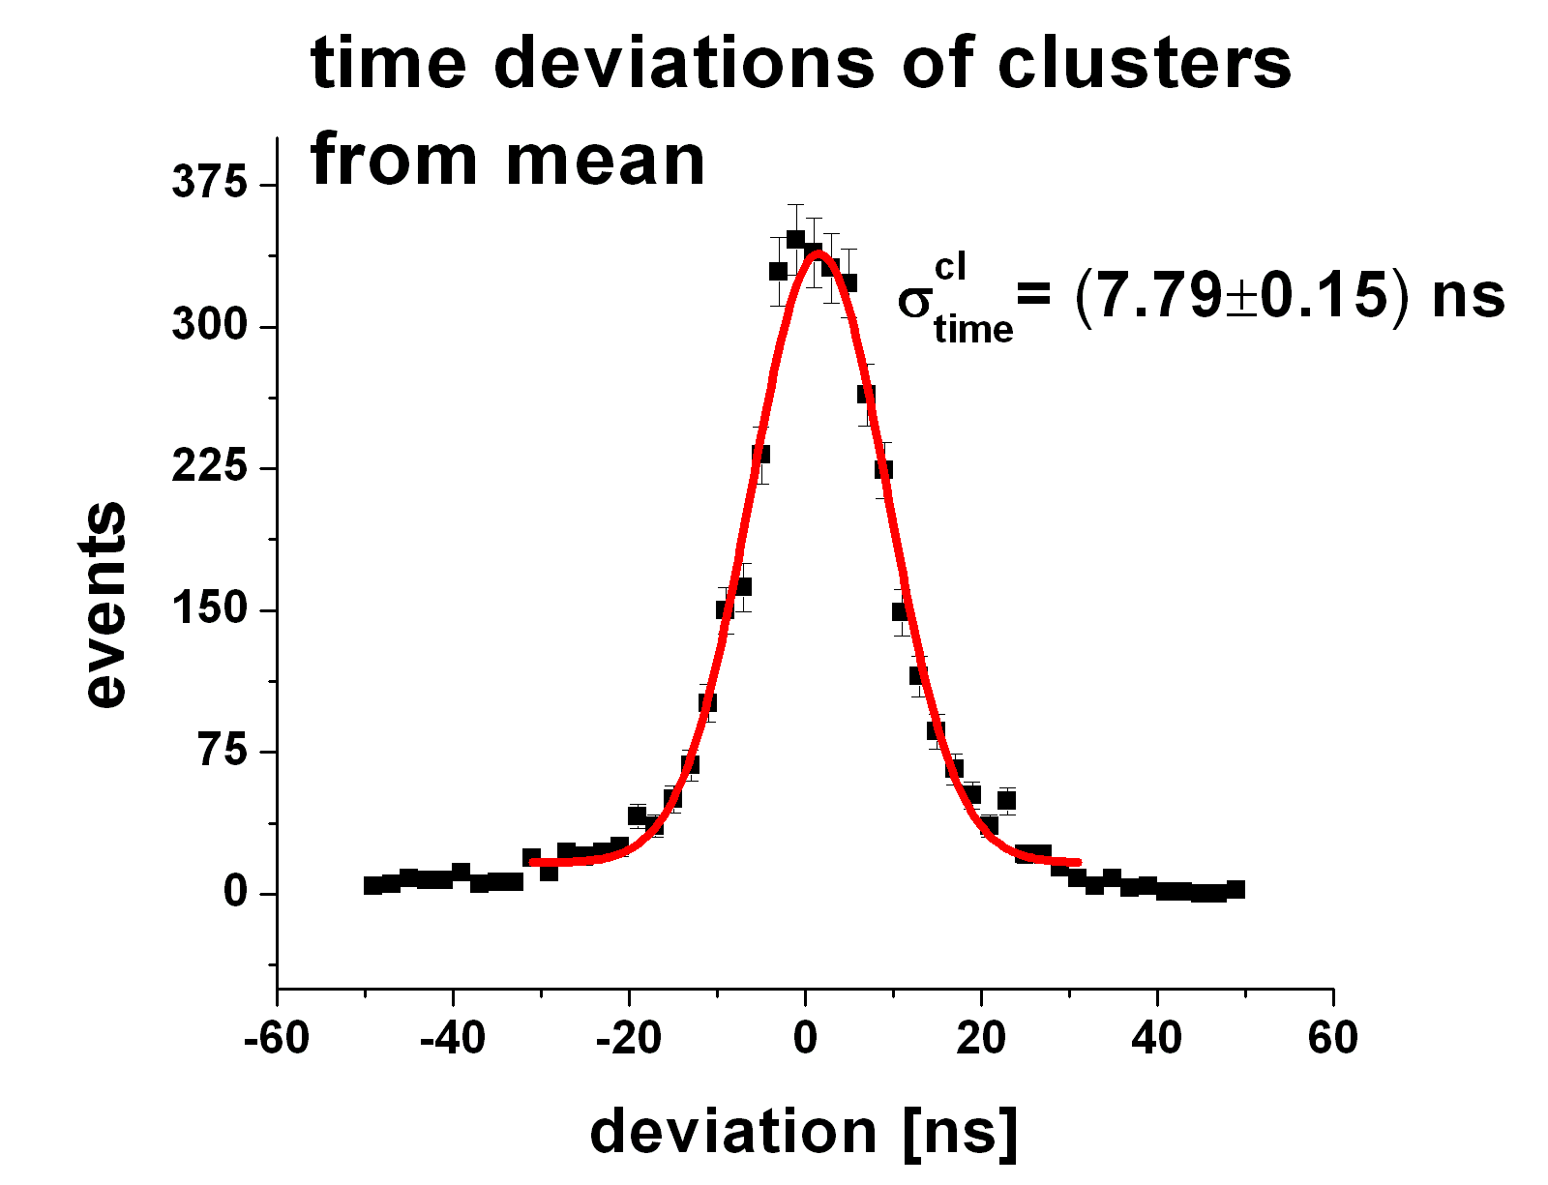
After correction of time walk for a 100 MHz clock
Similar results from the 48 MHz data (2006) operation: σ_{time} about 12 ns

Slide 21
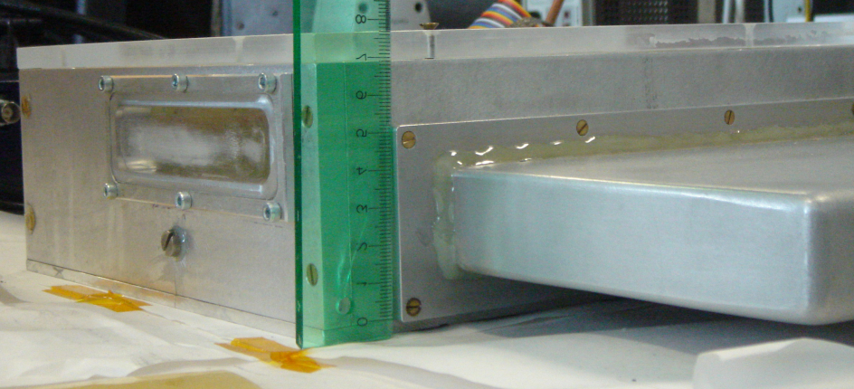
Measurements with laser
Detector with metallized drift cathode.
The laser releases single photo-electrons ⇒ creation of well defined and seperated clusters
Installation of a laser test bench for measurements with a small number of (primary) electrons.
8cm
8 cm
N₂-laser
Study single electron clusters
Investigate influence from number of primary electrons on single point resolution.
Possibly study ion backdrift proberties

Slide 22
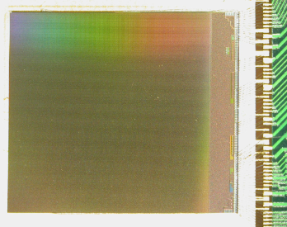
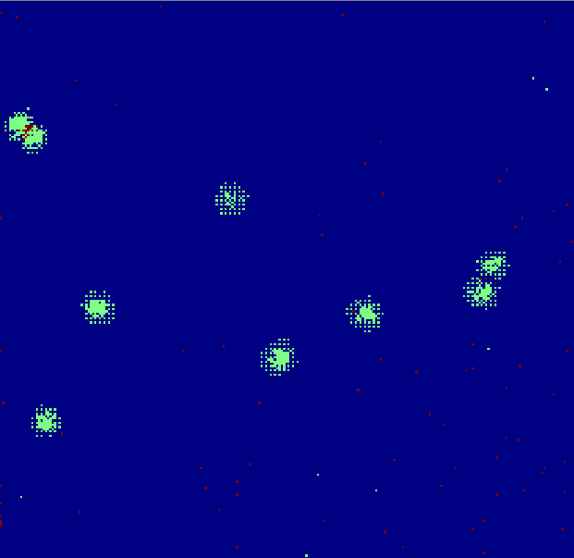
Chip Post-Processing
originally
processed
Fe⁵⁵-Cluster
Clusters are partly filled. Possible reason for this:
    Insufficient thickness of passivation
    Crosstalk on chip level
55x55µm²
110x110µm²
Pixel size 55x55µm²
Pixel size 110x110µm²
Pixel acitve
Pixel passivated
Work on technologies for post processing chips
Optimization of readout granularity

Slide 23
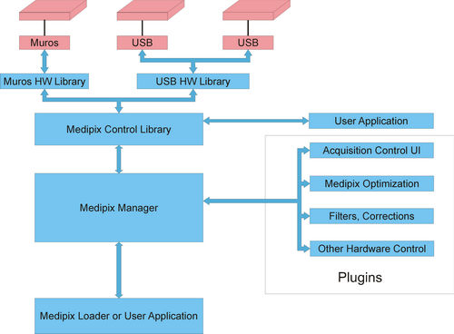
Pixelman Design
Pixelman architecture
All basic functions of the Pixelman Software are hardcoded and cannot be changed by the user. The source code is not available.
http://aladdin.utef.cvut.cz/ofat/others/Pixelman/img/arch.png
Interface Pixelman through a dynamically linked library (DLL)

Slide 24
Pixelman Interface DLL
Pixelman is Windows based
Pixelman is written in C++
→ one is obliged to use the Microsoft Foundation Classes (MFC) which wrap the Windows®Application Interface (API) into a more user- friendly class architecture
However today‘s Windows developer use the .NET framework (CLR). This is „incompatible“ with Pixelman.
→MFC is already a kind of old fashioned

Slide 25
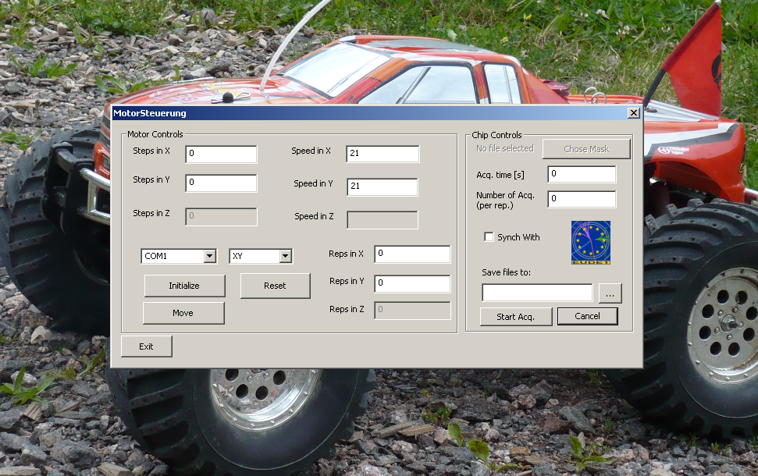
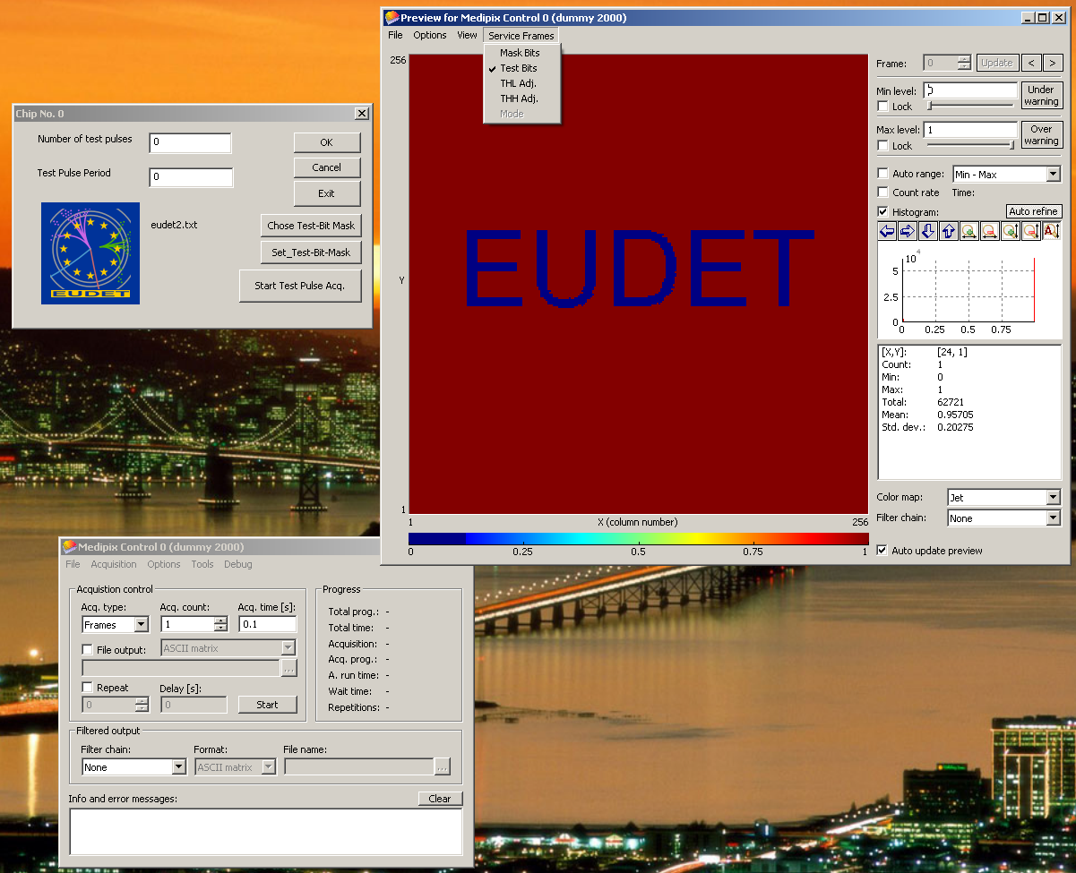
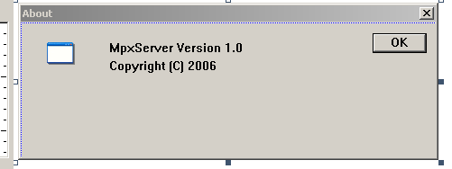
First Plugins
More „mature“ Plug-In for step motor control
Socket Server Plug-In, written by L. Tlustos
First plug-in was a kind of „toy“ plug-in to gain experience. But be warned - as it turns out it is not so straight forward to implement a Graphical User Interface (GUI) into a DLL. But the Prague people from IEAP were a great help, special thanks to M. Jakůbek.

Slide 26


Next steps...
Can Linux and Windows be „friends“?
...or the question how can we manage on a reasonable (short) time scale to have a Linux based DAQ steering at least basic Pixelman functions, e.g. Start/stop???

Slide 27



Next steps...
Solution → use network tools
Program a plug-in that uses standard network connections and TCP/IP, so that Pixelman software can be operated by a Linux DAQ-system, e.g. EUDAQ

Slide 28

Next steps...
A socket is a software interface between two programs for interprocess communication. The programs can be running on the same machine or on different machines connected via network.
EUDAQ
Producer
TCP/IP
software
socket
plugin
Pixelman
TimePix
interface
As an option Pixelman can also send commands to the DAQ via the socket plug-in
Details will be discussed this late afternoon
Room H331, 6 p.m.
6-Oct-08, Amsterdam

Slide 29
Summary
Superb spatial resolution of 20-24 µm
Time resolution of 8ns after corrections for time walk
-> z resolution of ~0.5mm in typical TPC gases
First successful test of pixel with enlarged pixels of 110x110µm²
Reliable operation of TimePix/GEM setup without any special „protective“ „add-ons“

Slide 30
Outlook
Finalizing setup of laser test-bench, which could be interesting also for other EUDET partners
Developing software tools for integration with other DAQ systems and slow control
BUT everybody is looking forward to a first test beam at DESY -> so focus man power and give a good show ☺

Slide 31
Rotated GEM structure (2007)
FFT
expected signal
signal spatial
after rotation by 90° the observed spatial signal from the GEM pitch vanishes
effect on the resolution is an improvement of ~ 2 μm

Slide 32

Simulation studies: Inverse TPC
Interaction region
-HV
-HV
Pixellated readout on central electrode
Investigate optimal pixel size as function of:
          Drift distance
          Magnetic field
          Studies on technical feasibility, e.g. cooling
                ⇒expertise on design integration in Freiburg available

Slide 33
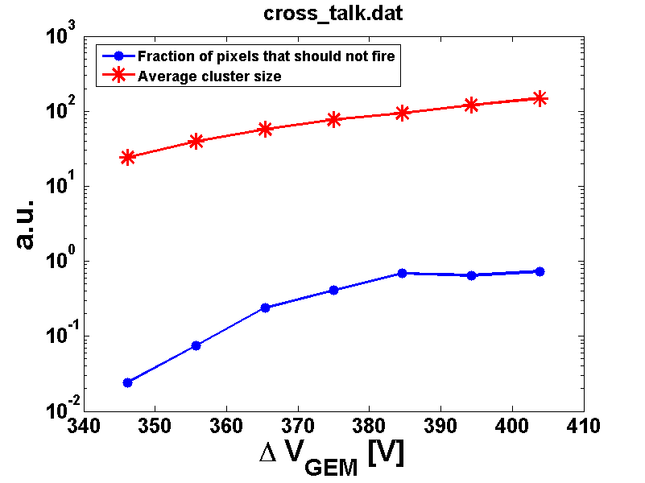
First results with pro-cessed chip
Clusters not filled
Clusters filled
≈27 V
100%
10%
≈27V correspond to a factor 5 in gain.
Ongoing investigation of the cross talk behavior

