Slide 1
Cryomodule
Norihito Ohuchi
S1-Global cryomodule design
Plug-compatible design

Slide 2
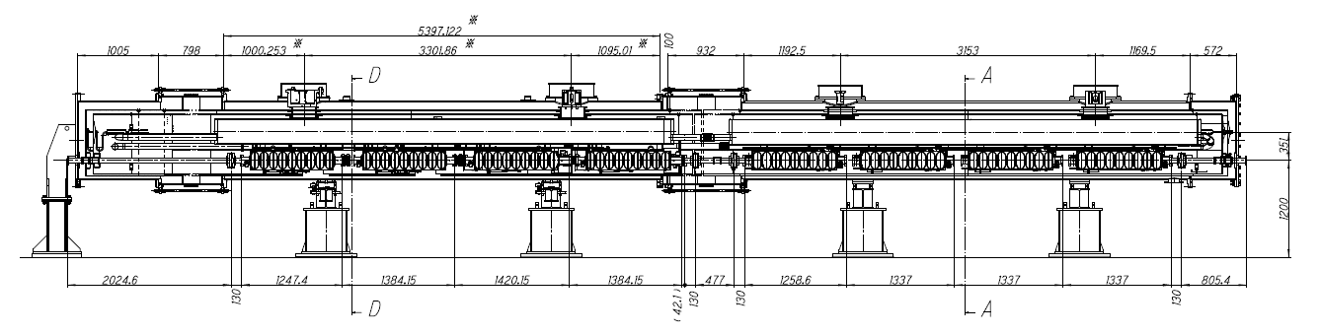
S1-Global cryomodule design (1)
Fixed support post
Fixed support post
Connection to cryogenic system
Input
coupler
Input
coupler
FNAL-DESY-cavities: Module C
KEK-BL-cavities: Module A
The configuration and the interface design of the S1-Global cryomodules were discussed between INFN and KEK.
  Because of the position of input couplers, Module-C locates at the upper stream position.
The flange design of vacuum vessel of Module-C is the same as the type-III cryomodule design (same as XFEL).
  KEK will use the present vacuum bellows, and the additional connection flanges and pipes are prepared by KEK.

Slide 3
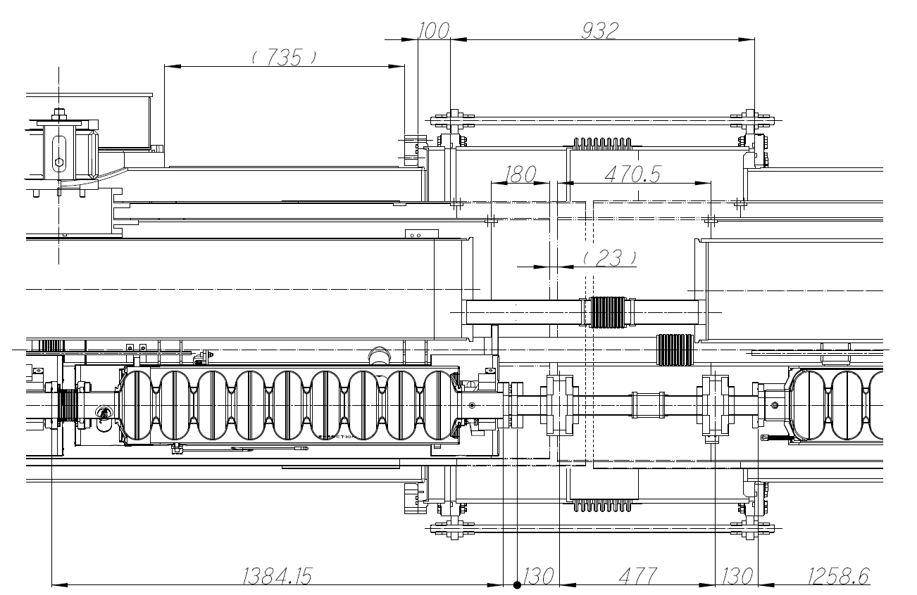
S1-Global cryomodule design (2)
DESY-cavity
STF-BL-cavity
Cooling pipes
  The end of gas return pipe has the plate and the reduced pipe at the transportation to KEK because of the pressure and leak tests in INFN.
  Al shield pipes of Module C are connected to the STF pipes with the additional Al pipes by welding.
The input coupler positions of FNAL and DESY cavities are different because the FNAL cavity has a short beam pipe on one side.
  It will be confirmed on the drawing.
KEK got the XFEL cryomodule drawing from Carlo, and the XFEL module design will be reflected in the S1-global cryomodule design.
KEK tries to complete the specific cryomodule design in August. The design should be reviewed by the concerned people.

Slide 4
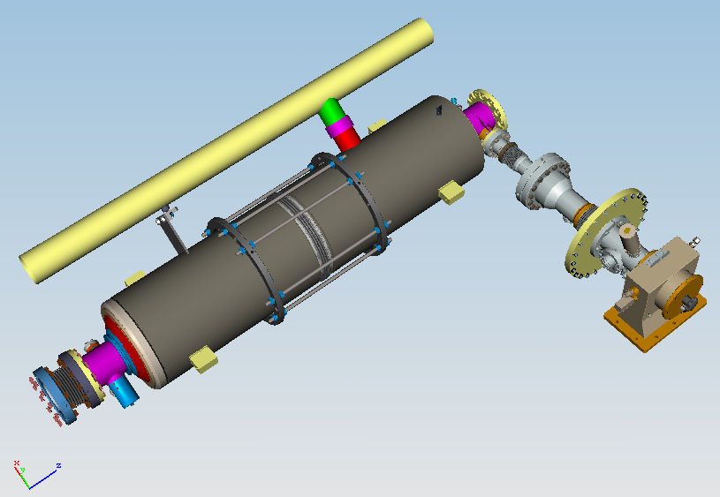
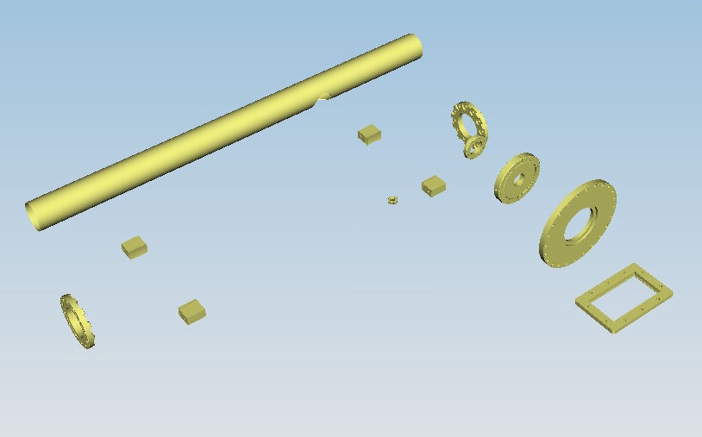
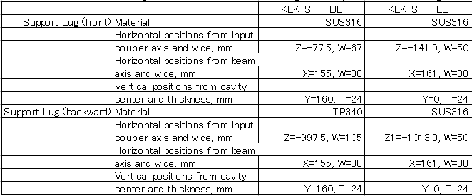
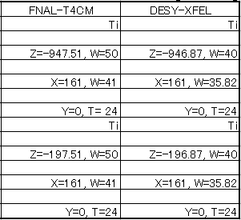
Plug Compatible Design
Cavity Package
Proposed in the specification

Slide 5
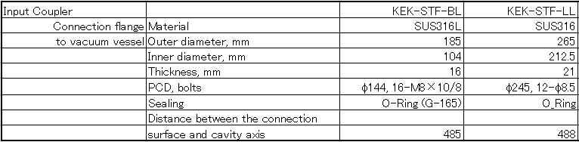
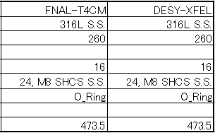
Cavity Package
We will study the new flange design of the STF input coupler in order to connect it to the FNAL and DESY flanges.
Locations of the cross connect pipe to the LHe supply pipe and the cool-down pipe will be decided after studying the tuner location on the helium jacket.
Interference between the cavity packages and the components in the cryostat should be studied with 3D-CAD drawings.

Slide 6
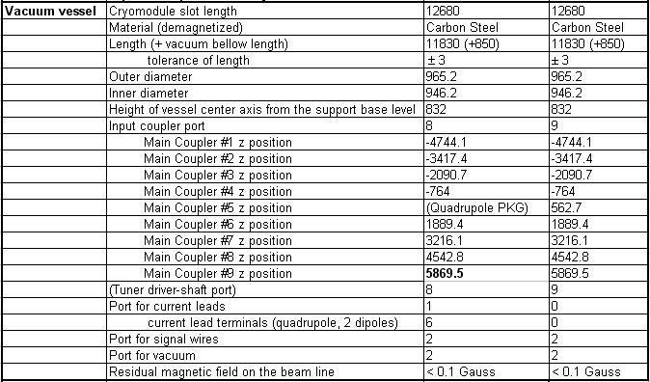
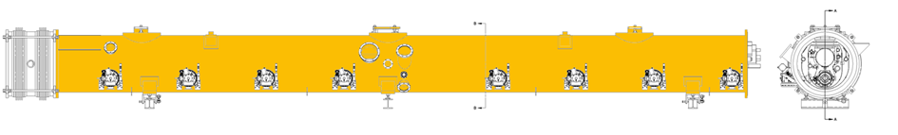
Interface
Connection flanges of vacuum vessel and vacuum bellow:
T3 (XFEL) and T4-CM design
Main coupler flanges on the vessel:
  Locations defined in Spec. Table
  Design need to be studied

Slide 7
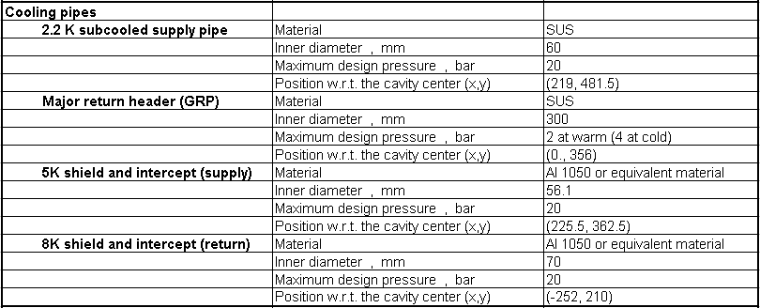
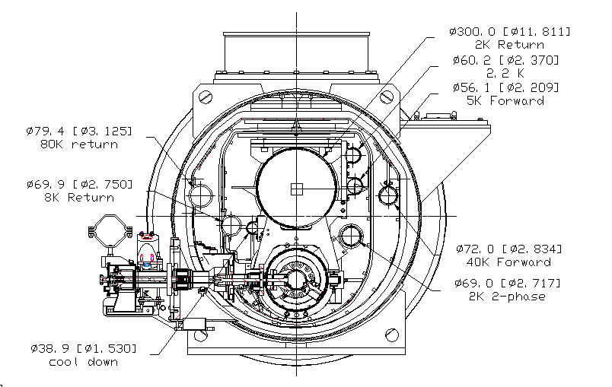
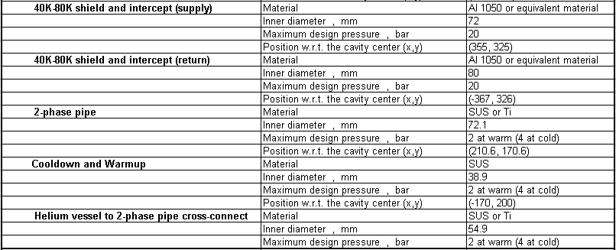
Cooling Pipes
The beam line (cavity axis) locates in the position of (0, -247) with respect to the center of vacuum vessel).
The thermal radiation shield design with or without 5K shield should be done in the condition of plug compatible design.

