Slide 1
Efficiency Distributions for Tan Lambda
Pelham Keahey

Slide 2
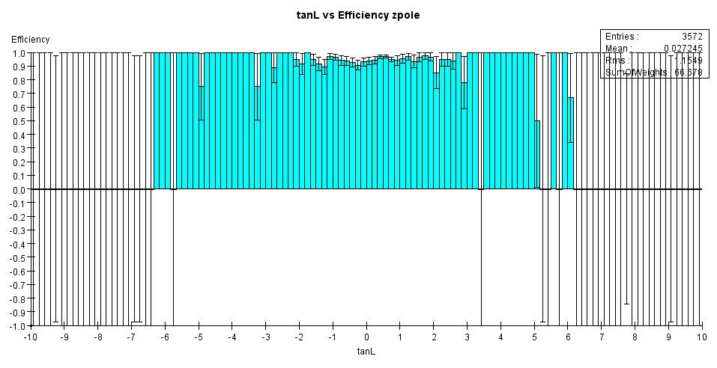
Zpole event

Slide 3
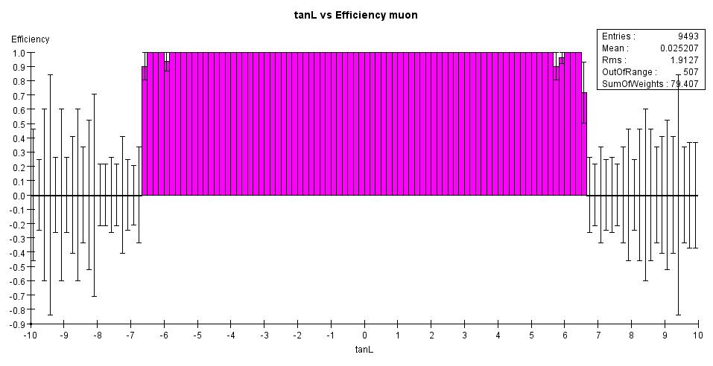
Muons 100 GeV

Slide 4
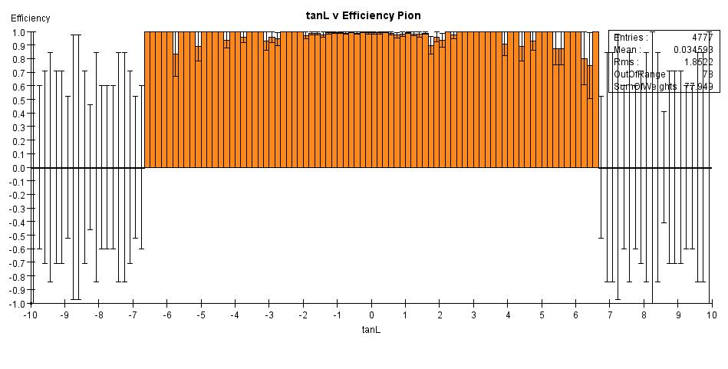
Pions 1-50 GeV

Slide 5
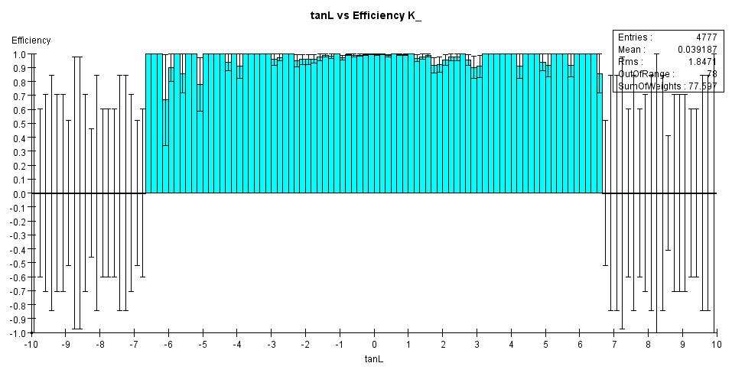
Kaons 1-50 GeV

