Slide 1
Efficiency Analysis
Pelham Keahey

Slide 2
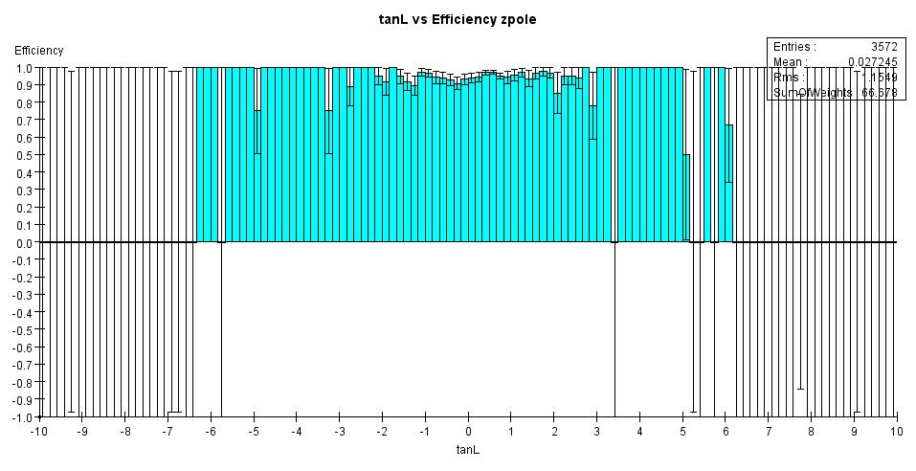
tanL efficiency

Slide 3
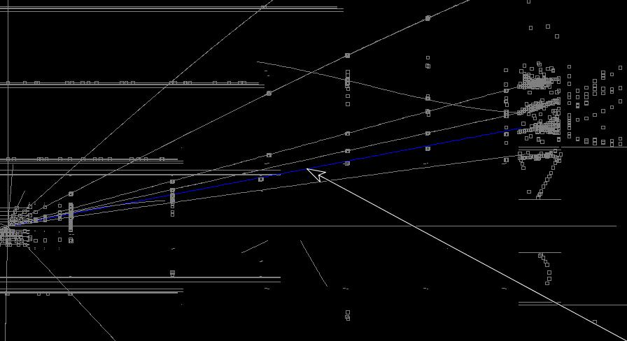
This Track
Zpole event, the highlighted “track” is the one of interest

Slide 4
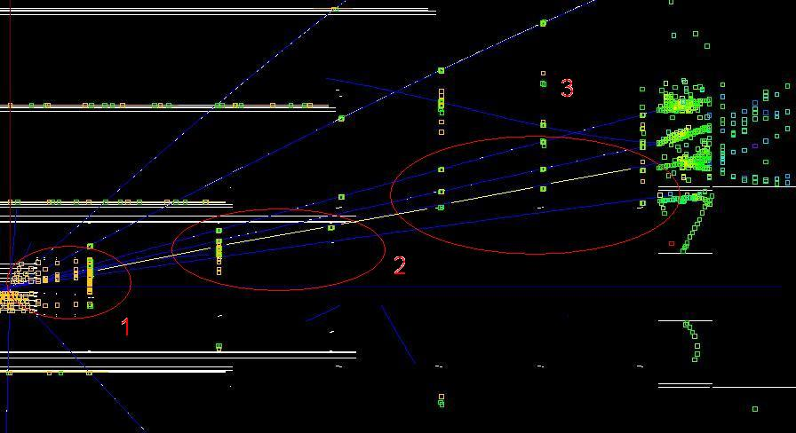
Areas of Interest
Zpole event

Slide 5
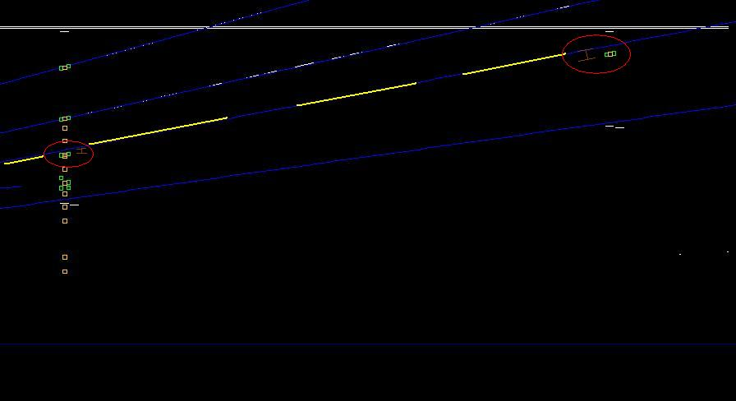
Area 2: Track Separates from Hits
Zpole event

Slide 6
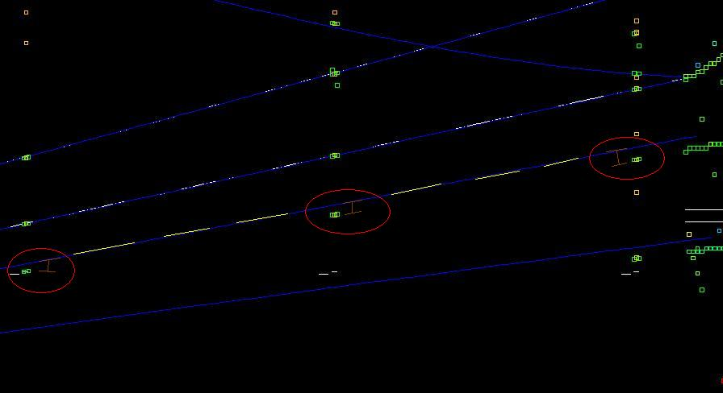
Area 3: Tracks further separates
Zpole event

Slide 7
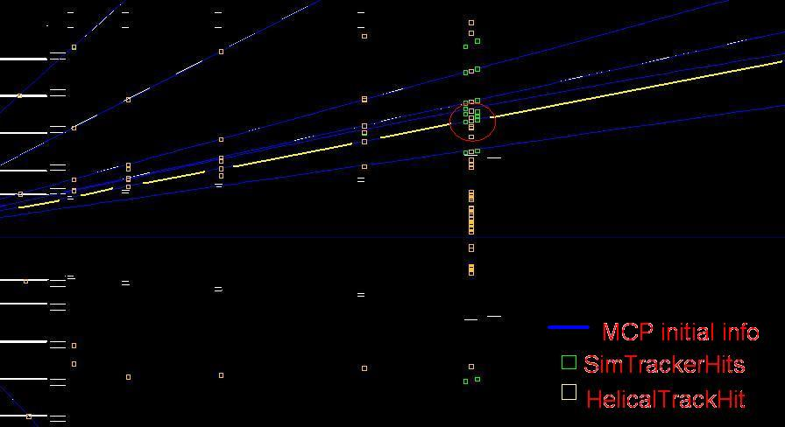
Area 1
Multiple Scatter occurred here resulting in a .363 degree shift.
.074 GeV change in pt

Slide 8
Just In Case

Slide 9
Hit info post merge
Fitted Successfully From Analysis Driver
P: [ -0.17834, 2.2226, 11.636]
VertexEndcap1ENDCAP_NORTH(-1.2874999999999943,17.23750000000001,90.21)
VertexEndcap2ENDCAP_NORTH(-1.7124999999999915,23.23750000000001,121.61)
VertexEndcap3ENDCAP_NORTH(-2.2874999999999943,32.48750000000001,170.01)
TrackerForward0ENDCAP_NORTH(-2.6864370646168565,39.336350932377684,206.14999999999998)
TrackerForward1ENDCAP_NORTH(-7.086286049940095,100.95339948624628,540.6500000000001)
TrackerForward2ENDCAP_NORTH(-8.716537965573066,154.57902214895475,831.6500000000001)
TrackerEndcap2ENDCAP_NORTH(-6.278401855804343,255.7350373705223,1380.1499999999999)
TrackerEndcap3ENDCAP_NORTH(-2.6093143157637644,303.20657815405724,1638.15)
chisq0: 10811.365373699291
chisq1: 4149.15079429791
chisqtot: 14960.5161679972

Slide 10
Pre-merge
From SeedTrackerDig Tool
P:[ -0.17834, 2.2226, 11.636]
Endpoint:[ -0.72164, 321.80, 1737.1]
SeedlayerHits:
TrackerForward2ENDCAP_NORTH(-8.716537965573066,154.57902214895475,831.6500000000001)
TrackerEndcap2ENDCAP_NORTH(-6.278401855804343,255.7350373705223,1380.1499999999999)
TrackerEndcap3ENDCAP_NORTH(-2.6093143157637644,303.20657815405724,1638.15)
chisq0: 93.07855637055766
chisq1: 28.004731172571265
chisqtotal: 121.08328754312893

