Slide 1
Status
Akiya Miyamoto, KEK
3-Dec-2008
ILD Asia Meeting

Slide 2
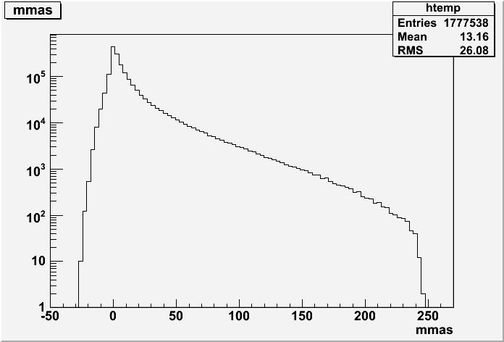
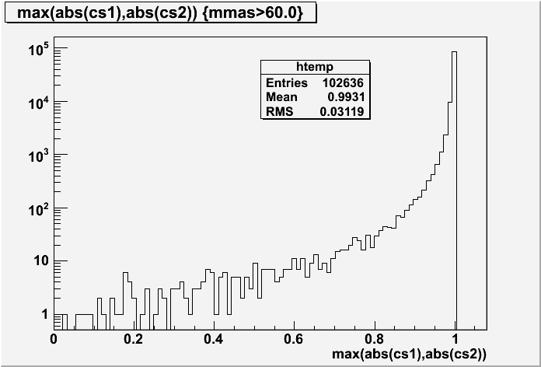
250 GeV Bhabha preselection for eeH
w21168_01 (1.78M events)
|cosθ|<0.95
MM> 60 GeV
250 GeV Bhabha samples: - σ=1.7x10⁷fb x 4 processes (w21168, 21169, 21170, 21171), 35.5M events, ( 2fb⁻¹ ( ab⁻¹ ?) ) - Cut: Recoil mass of e+e- > 60 GeV, |cosθ|<0.95 ➔ Red. rate=~0.6%.21.3M events left. Mokka production at jlccpuXX completed.

Slide 3
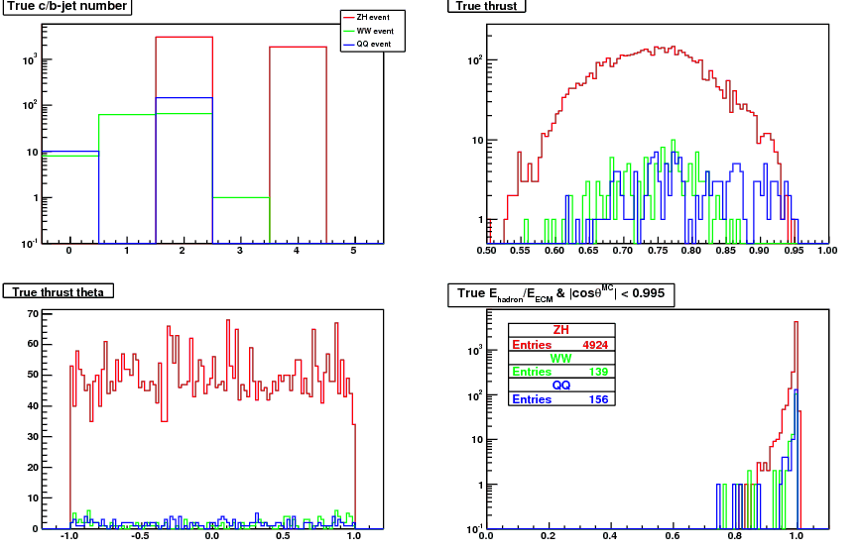
250 GeV qqbar for ZH
Request by Wenbiao
Evis ( |cosθ| < 0.995 ) > 150 GeV
Thrust < 0.95
Wenbiao’s plot

Slide 4
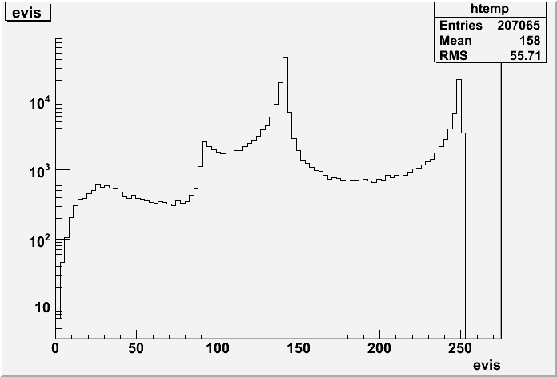
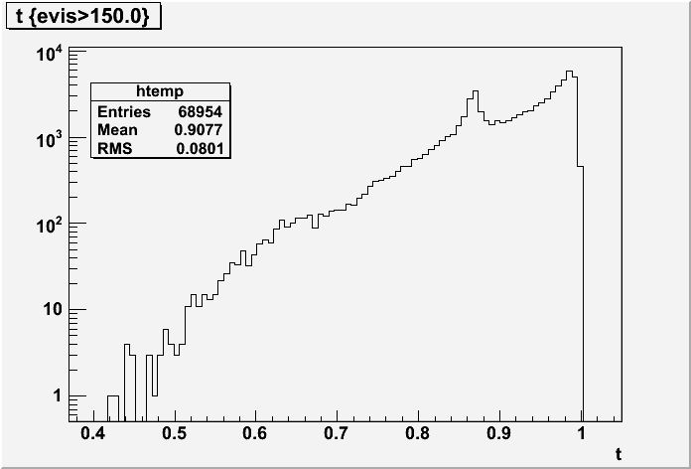
250 GeV qqbar for ZH
w21161_01 (uubar events)
Thursut<0.95
Evis>150 GeV
Expected reduction rate: (Evis > 150 GeV, Thrust<0.95) : 41163/207065 ~ 20%
-- Not siginificant reduction.
#events(~10M udscb pair events for 2(1?) ab-1. ) → 0.5M events for 250fb-1 with cut ?

Slide 5
Other samples in process in KEK
M.Thomson’s uds events at 90, 200, 360, 500 GeV : 10 k each done
250 GeV Bhabha without cut. producing 25 to 50 k events.
500 GeV Bhabha a la Taikan’s pre-selection
…
cross section table of 500 GeV sample → will be put on the web
Location of files produced in KEK → will be put on the web
New disk connected to jlccpuXX. → new simulation/dst files will be put on new disk
Copying DST files from DESY to KEK → Ikematsu-san

