Slide 1
BPM processor Update
10 December 2008
Robert Apsimon

Slide 2
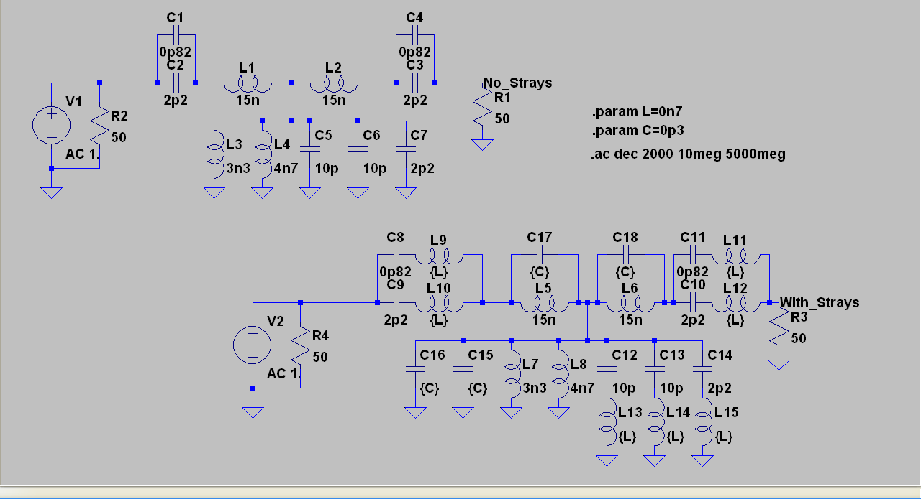
A schematic diagram of the band pass filter, both with and without the strays included. “.param” defines the values for the strays.

Slide 3
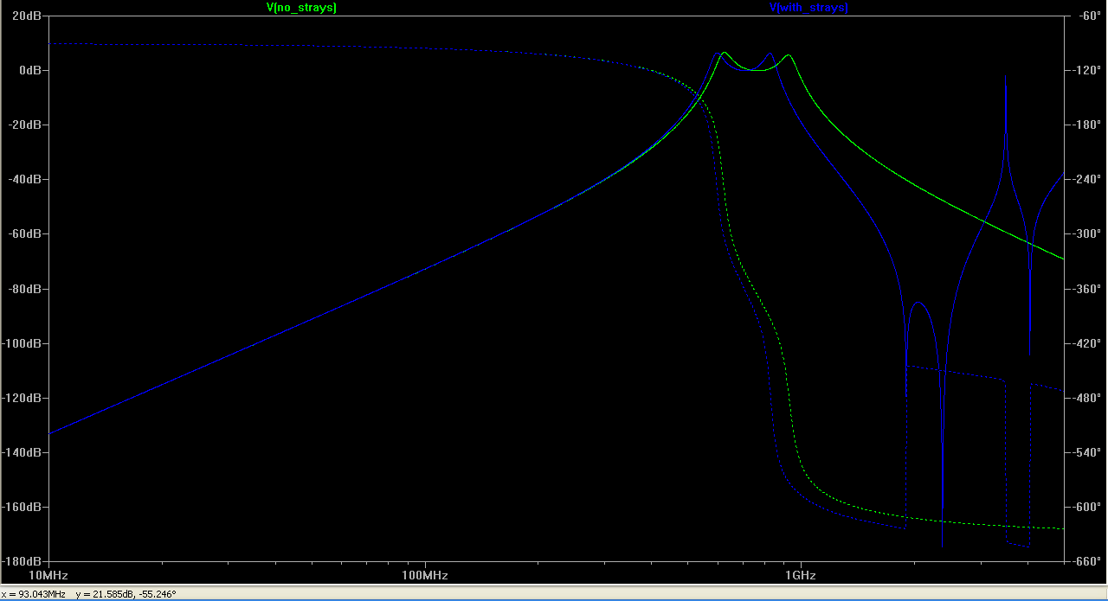
The frequency response of the BPF with and with strays. The solid line is the output of the BPM in dB and the dotted line is the phase delay of the output in degrees.

Slide 4
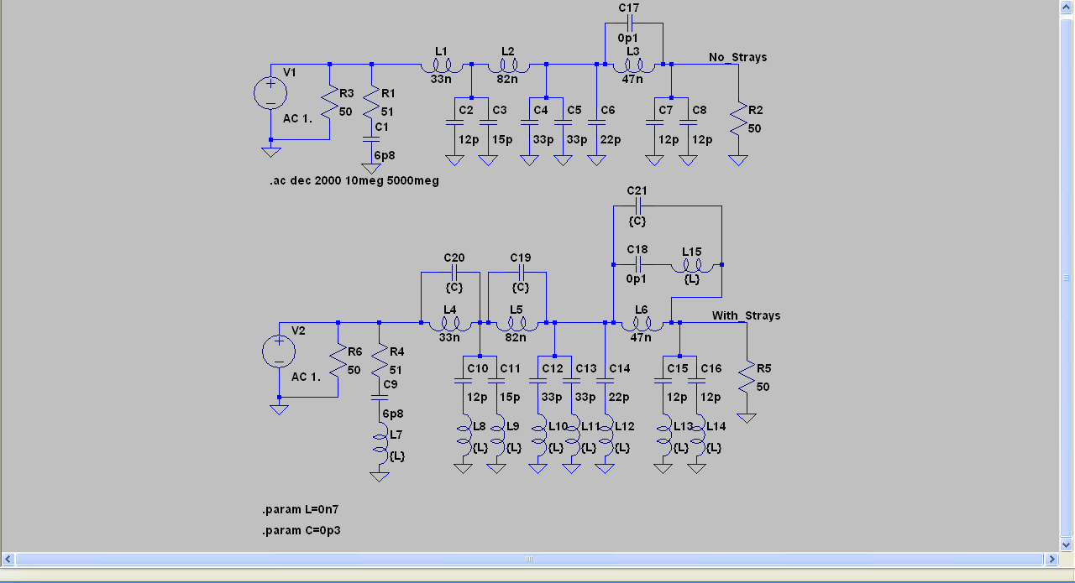
A schematic diagram of the low pass filter, both with and without strays. The same values of the strays have been used here as for the BPF.

Slide 5
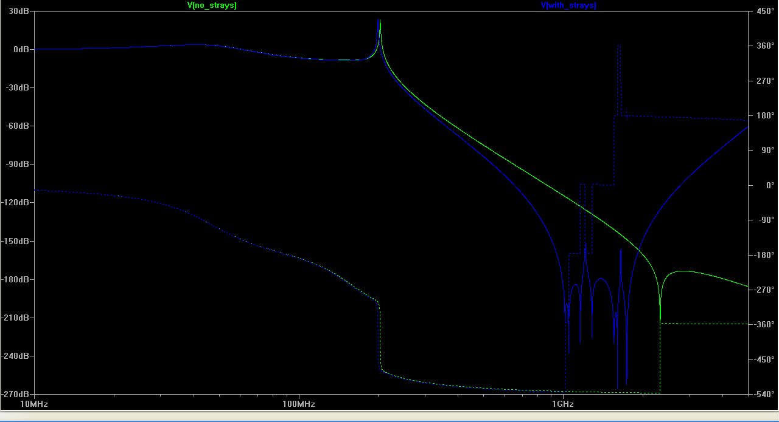
The frequency response of the LPF with and with strays. The solid line is the output of the BPM in dB and the dotted line is the phase delay of the output in degrees.

Slide 6
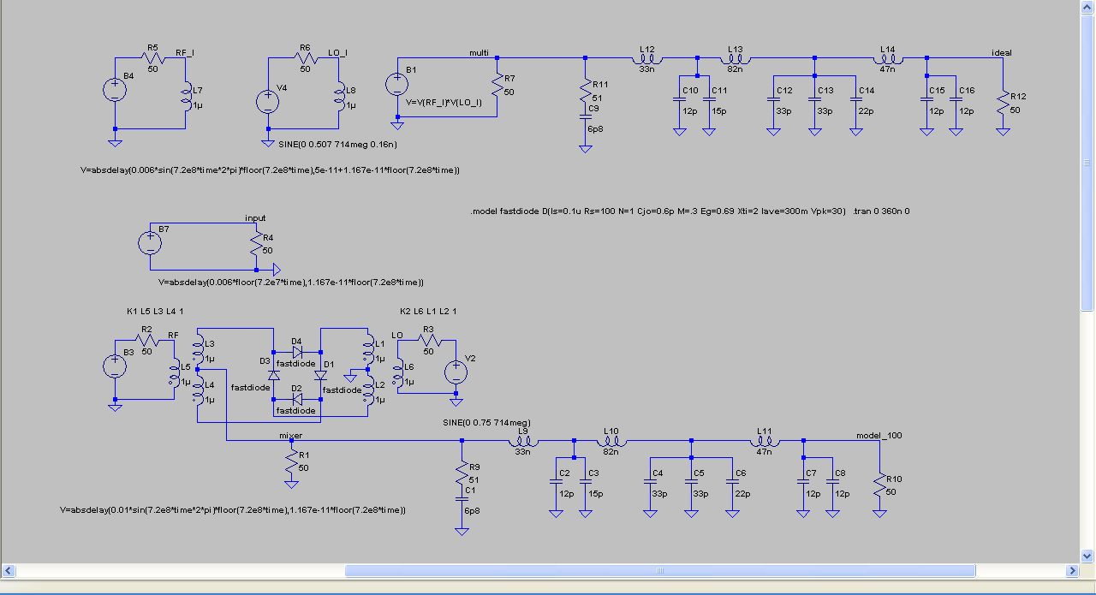
A schematic diagram of the mixer (bottom) and an ideal mixer (top). The ideal mixer takes the inputs and multiplies them together, the inputs have been kept separate so that there is no coupling between the RF and the LO. The mixer uses a model of the diodes created by Colin. Both outputs are passed through a low pass filter to remove the high frequency component.

Slide 7
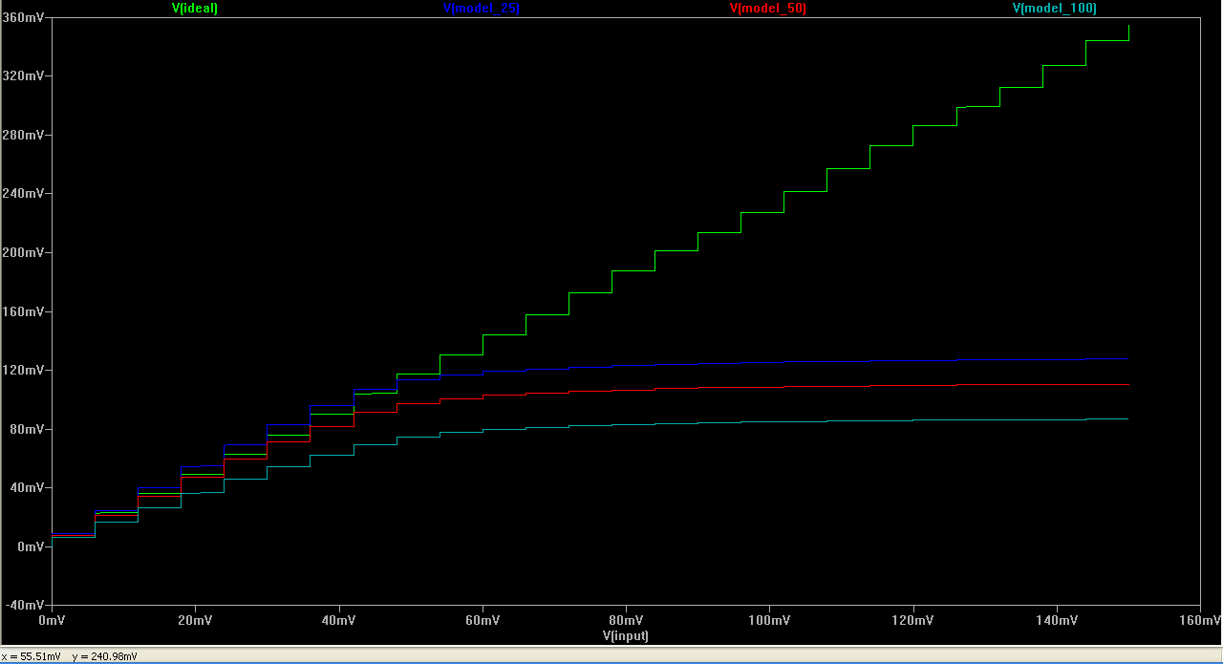
The output amplitude of the mixer as a function of the input RF. The diode model has had the zero-bias resistance of the diodes varied to show the effect on saturation voltage of the mixer. The resistances used were 25, 50 and 100 ohms.

