Slide 1
Hadron Shower Development in BGO
Adam Para
January 9, 2009

Slide 2
Goals and Purposes
Study the spatial (and temporal) distribution of energy deposition inside hadronic showers in BGO (and other crystals)
To optimize the dimensions of the test beam hadron calorimeter prototype
Test beam module must be ‘right-sized’ to serve its function as a proof of the high resolution calorimetry:
  If it is ‘too small’ than the leakage fluctuations will dominate the energy resolution
  If it is ‘too big’ it is too expensive to be constructed
Goal: demonstrate the resolution ~0.1/sqrt(E), hence need the leakage fluctuations to be well below that:
  0.7% @ 100 GeV, 1.5% at 25 G2V, 2% at 10 GeV ?

Slide 3
Tools
SLIC-framed Geant 4 (Hans Wenzel)
3 x 3 x 3 m cube of material, subdivided into 1 cm3 volumes
BGO, density of 7.13, n=2.21
Particles deposited at z=-100 cm in a positive z direction
Pions, protons and muons

Slide 4
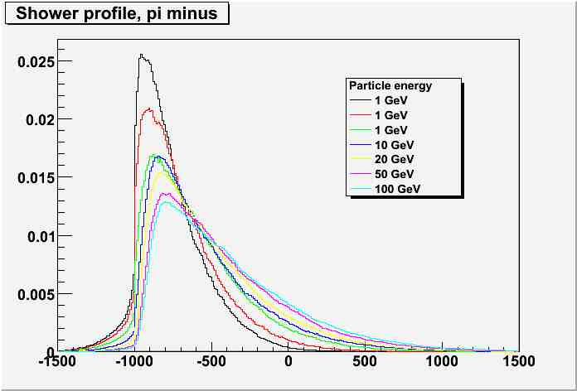
Longitudinal shower profiles as a function of pion energy
Shower penetrates deeper and deeper into the calorimeter as the energy of a hadron increases
A significant fraction of the hadron shower energy is deposited before the vertex position (albedo, backscattering), especially at low energies

Slide 5
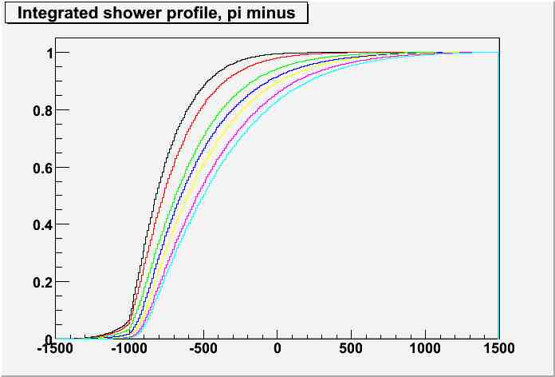
Cumulative shower profiles (Containment)
A1 meter long calorimeter contains only ~85% of energy of 100 GeV pion shower
Backscattered energy leads to additional fluctuations in a test beam configuration
Backscattered energy will be recorded predominantly in the early layers of the calorimeter in the collider geometry

Slide 6
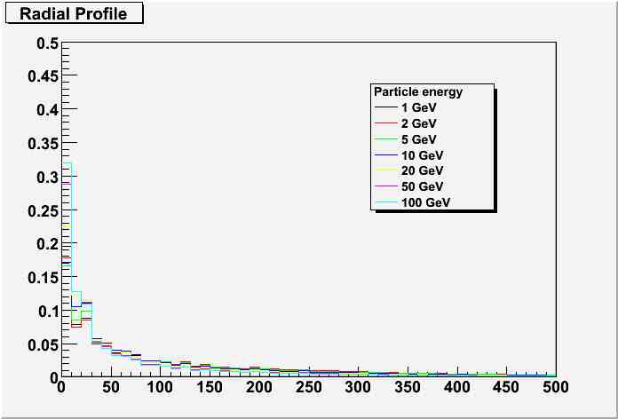
Radial Profile of Hadronic Showers
Hadron shower has a well collimated central core with a radius of few centimeters
And a long tail extending over several tens of cm
Radius, in mm

Slide 7
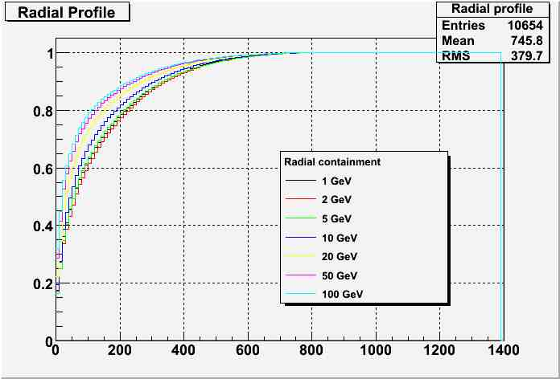
Cumulative Radial Profile
Normalized radial shower profile shrinks with the particle energy (collimation)
Radial extent of 40-50 cm is necessary to contain ~95% of hadron shower energy

Slide 8
Leakage Problem
For any size of the calorimeter some fraction of the hadron energy will leak out of the detector. So what?
This fraction will, on average, vary with the particle energy ➔ calibration and non-linearity of the response
The actual fraction of leaking energy will vary from event to event ➔ resolution
Need to optimize the size of the test beam module to keep both effects at reasonable level. Resolution is a primary concern.

Slide 9
Leakage Studies
The following figures:
  Fraction of the shower energy contained in a detector of certain length (different curves) as a function of the transverse size (cylindrical geometry assumed)
For different particle energies

Slide 10
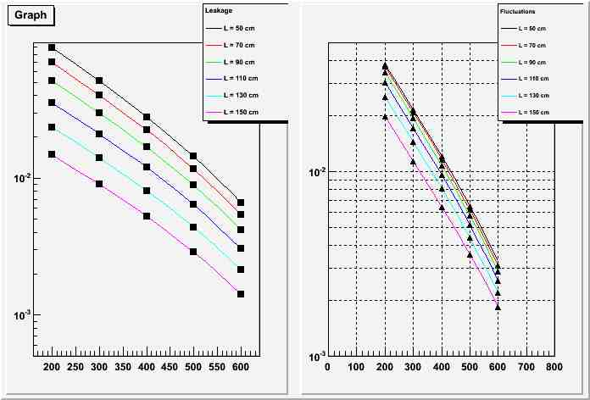
100 GeV π-
Fraction of leaking energy
Fluctuations of leaking energy

Slide 11
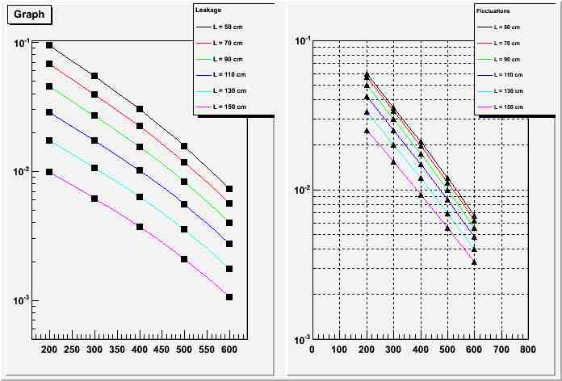
20 GeV π-
Fraction of leaking energy
Fluctuations of leaking energy

Slide 12
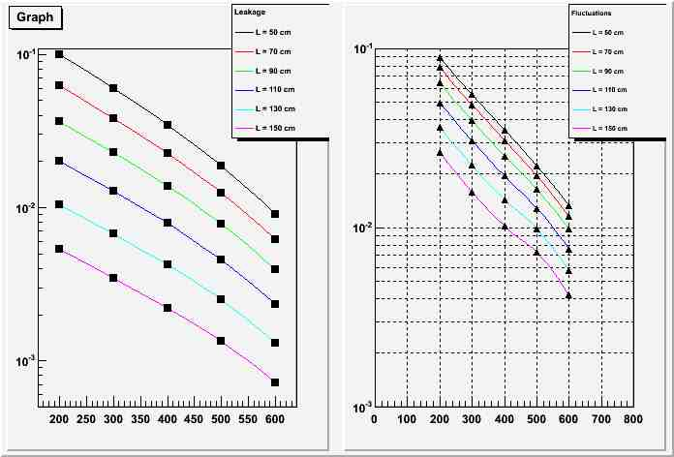
5 GeV π-
Fraction of leaking energy
Fluctuations of leaking energy

Slide 13
Initial Conclusions
Transverse dimensions more critical than longitudinal at high energies, at low energies the opposite is true
Fractional containment and induced resolution problems more serious at low energies
More work necessary to quantify and optimize, but a ball-park size of L~ 1m and R~40 cm seems likely
To be continued…

