Slide 1
Noise Study of the GRPC Detector
1- Time Correlation and Efficiency of GRPC
2- Study of Noise Distribution for Different Runs

Slide 2
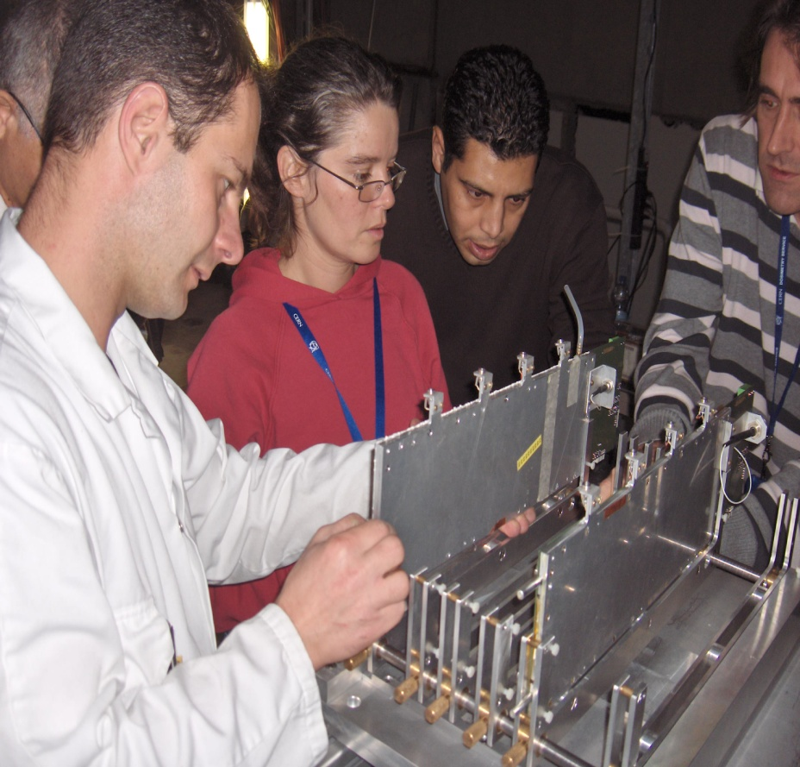
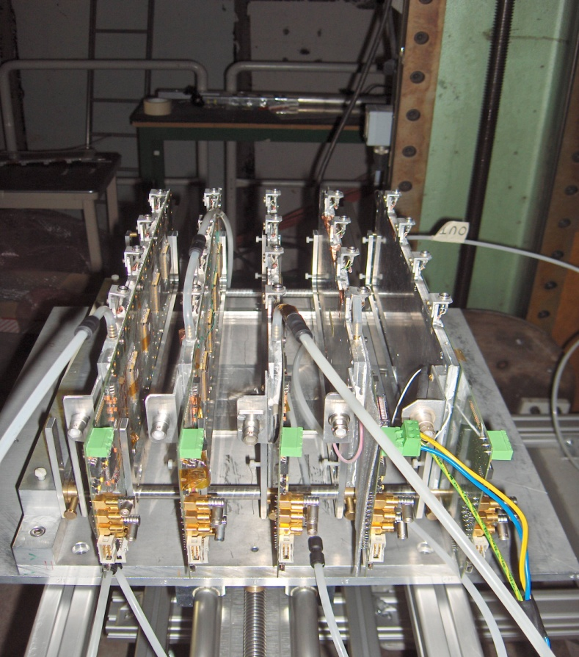
The TestBeam
  July-August 2008: 4 RPC 32×8 cm2
  November 2008: 5 RPC 32×8 cm2 (with one multi-gap RPC)

Slide 3
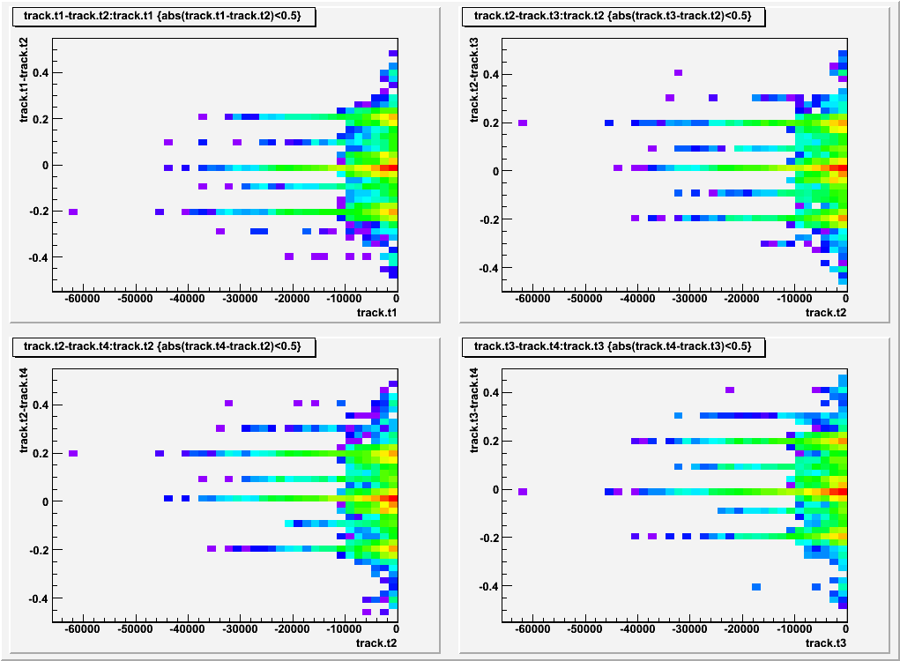
Time difference between hits in Asics
Peaks at 0 & ±200 ns

Slide 4
Study of the efficiency
Time selection & position selection
Time difference between hits < 300 ns
Reconstruction of tracks with projection on the next layer
Two Methods used to calculate the efficiency
Select tracks with 3 hits and search the fourth in the other layers
Select tracks with at least hits and search the fourth in the other layers
?

Slide 5
Efficiency vs HV

Slide 6
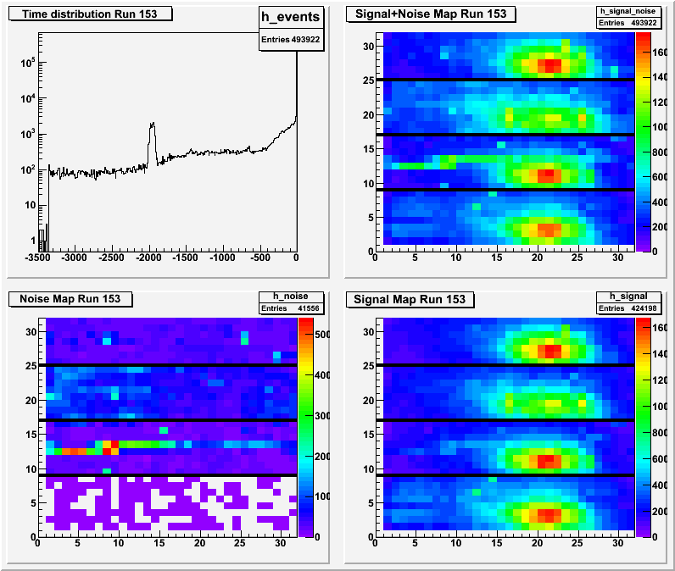
RUN 153: cut at -400 ms
First spill
Second spill
Number of all hits ~ 493000
Noise (between the two spills) ~ 41000
Signal >-400 ms ~ 424000 → 86%

Slide 7
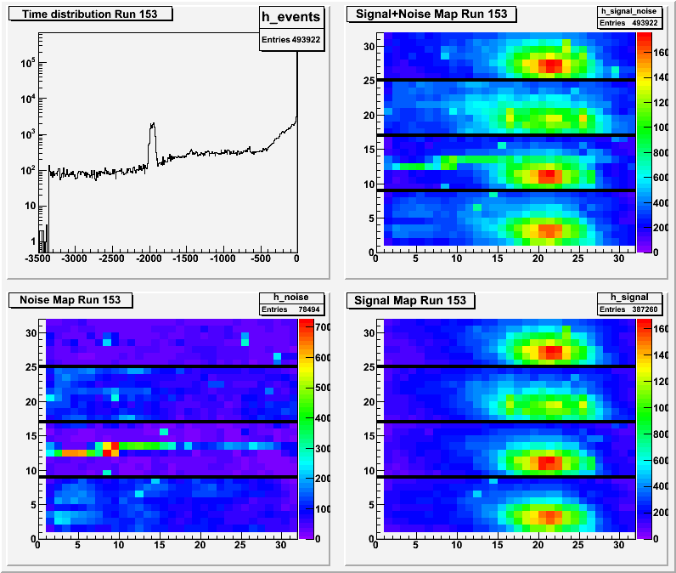
What about a cut at -50 ms?!

Slide 8
What’s the difference????
Number of all hits ~ 493000
Noise (between the two spills) ~ 41000
Signal >-400 ms ~ 424000 → 85%
Number of all hits ~ 493000
Noise (between the two spills) ~ 78000
Signal >-50ms ~ 387000 → 78%

Slide 9
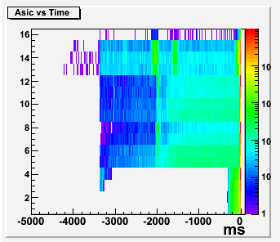

But there is a problem !

Slide 10
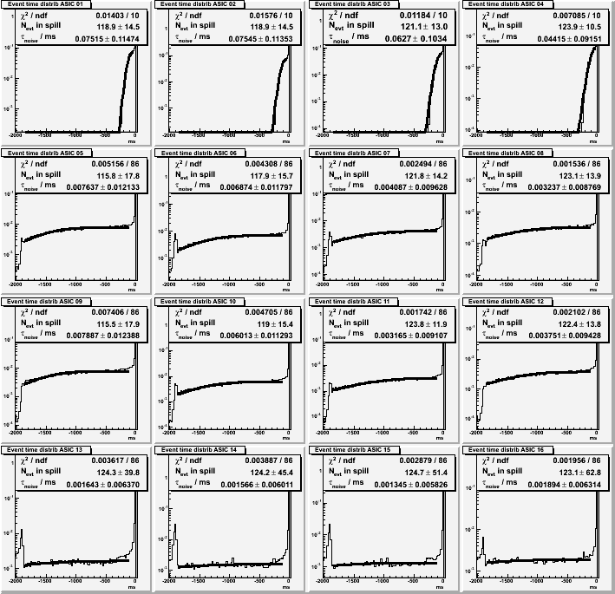

Slide 11
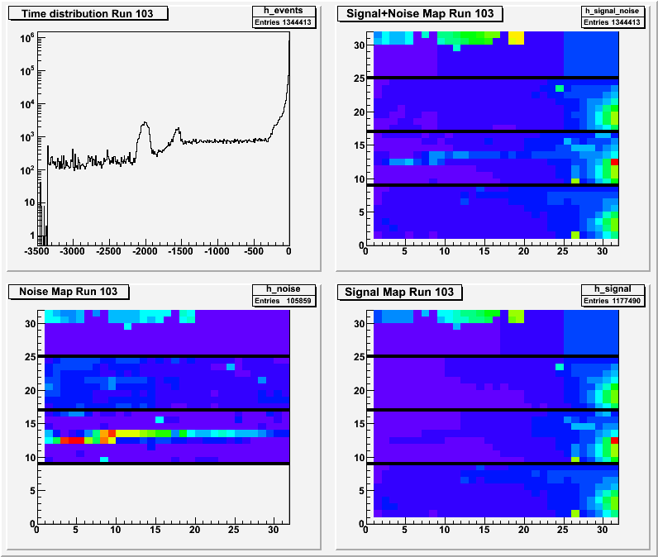

Slide 12
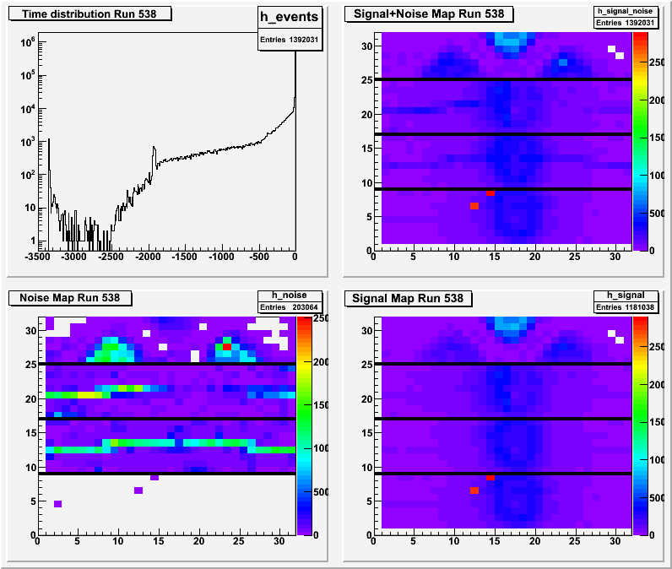
The multi-gap chamber
Cut at -50 ms

Slide 13
Conclusion
Noise distribution shows some problems
with fishing line
Cut at -50 ms gives 78% of events
Next steps:
Making a map of efficiency
Reconstruction of tracks and study of multiplicity and alignement problems

Slide 14
Merci pour votre attention
and sorry for my bad english

