Slide 1

IP Tuning Task Updates
Glen White, SLAC
January 28 2009

Slide 2
IP Tuning Task Update
Further studies of QF1 12-pole effects.
Effect of more realistic mover parameters on tuning simulation time.
Speed of tuning convergence for ~100nm IP beam spot sizes with different IP beta-y.
Shintake Monitor simulations.
Task list.

Slide 3
Multipole Measurements
Magnet Name
Sextupole/quad
Octupole/quad
10pole/quad
12pole/quad
20pole/quad
Tolerance
(tightest)*
<0.03
<0.025
<~0.01
<0.05
<0.12
QD0 at
132.2 amps
0.0255
0.0052
0.007
0.036
0.0027
QF1 at
77.5 amps
0.0274
0.0058
0.0128
0.036
0.0027
Measured multipoles exist for final focus bends, sextupoles and final doublet quads.
All have minimal effect on beam size and tuning process other than those highlighted above.

Slide 4
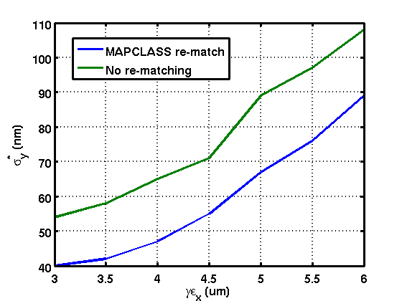
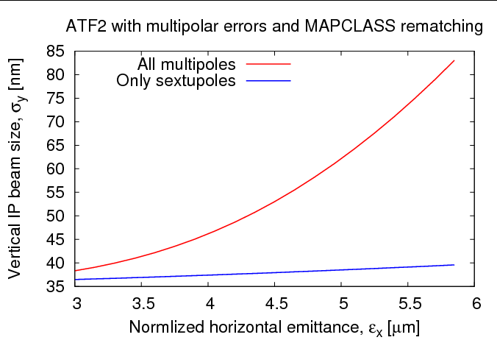
QF1 12-pole
MADX (left) Lucretia (right)
IP vertical beamsize scales strongly with horizontal emittance

Slide 5
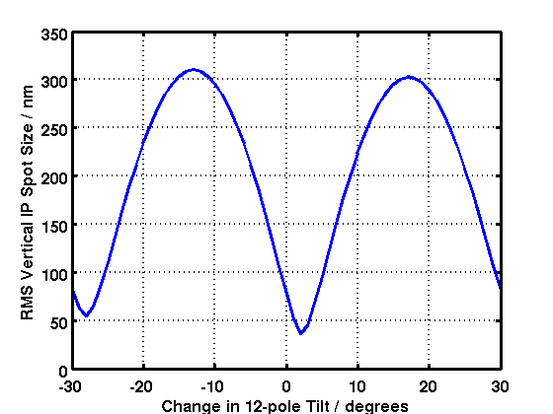
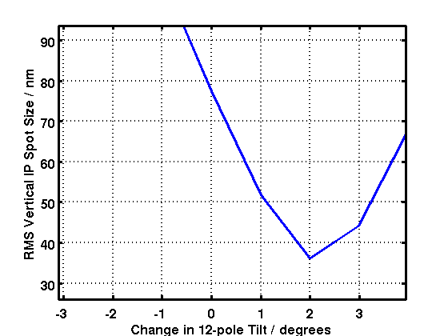
QF1 12-pole Tilt
6 um Horizontal
Emittance
Effect of 12-pole changes dramatically with tilt angle.
Around measured value- effect ~875urad/nm
Magnetic measurement error ~0.01% (~40urad).

Slide 6
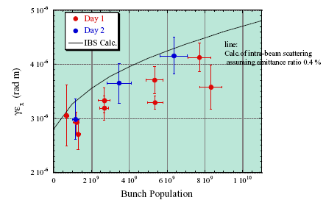
Horizontal Emittance at ATF
Only get simulated 3e-6 emittance at low charge. 1E10 charge implies min RMS y size of ~60nm.
Get large RMS sigma_y due to high tail-population (will be measured by shintake monitor?).

Slide 7
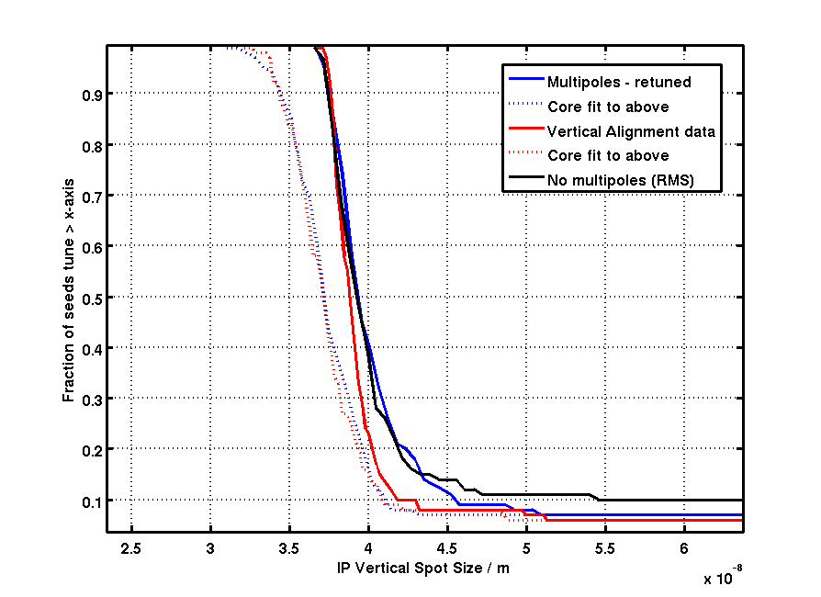
Tuning Results (6um x emit and no QF1FF 12-pole)
MAPCLASS rematching improves performance even over case where no multipoles were added.
Better vertical alignment has noticable effects in tail of tuning distribution
90% seeds tune < 41-42nm
50% seeds tune <37-39nm
No QF1 12 pole

Slide 8
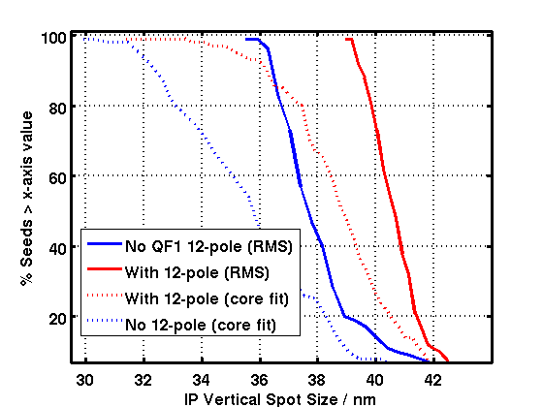
Tuning Results with QF1 12-pole and 3um x emit
Tuning results including QF1 12-pole component, with horizontal emittance = 3um.

Slide 9
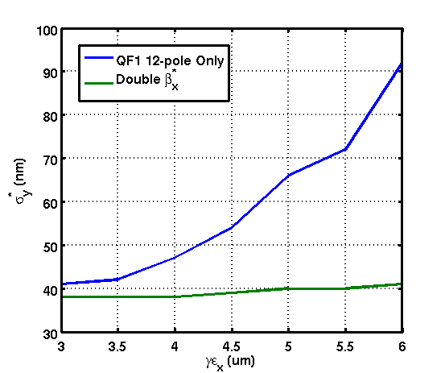
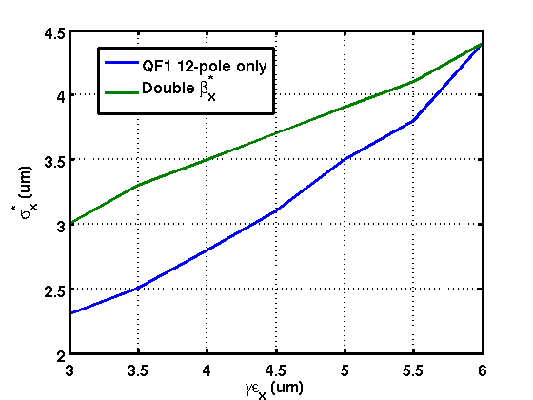
Increase Horizontal IP Beta
Horizontal (right) and vertical (left) beam size at IP with increasing horizontal emittance with normal and 2* normal IP horizontal beta function.

Slide 10
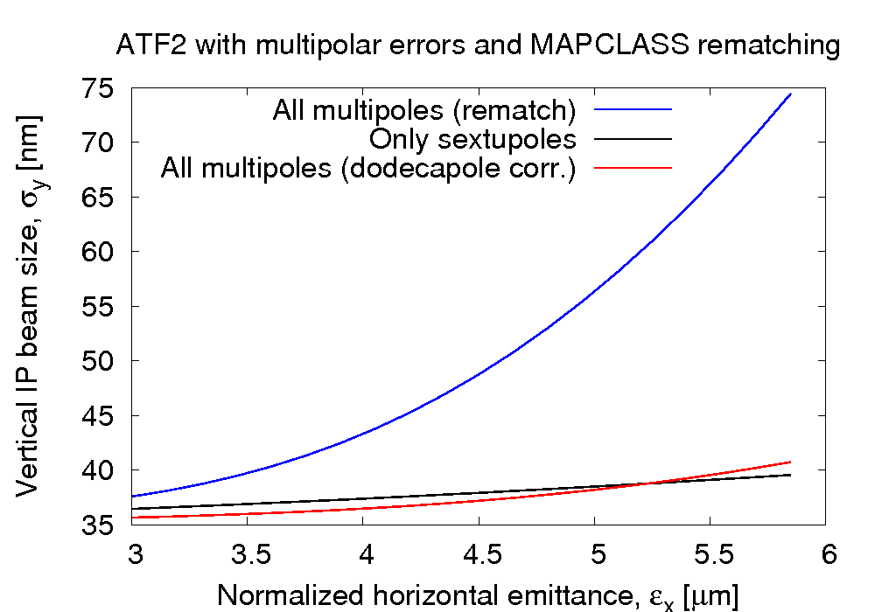
Introduce Skew Dodecapole Magnet
Skew dodecapole 0.7456m from QF1 front face, strength: K5Ls=1424122.25 m^{-5}

Slide 11
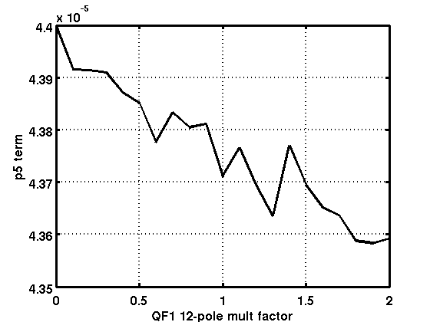
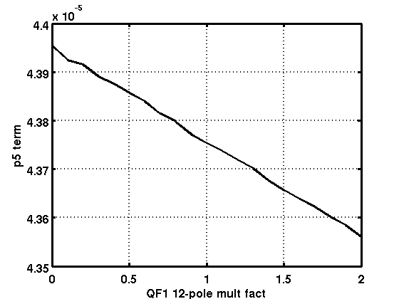
Beam measurement of 12-pole?
Scan beam past QF1 (need ~ +/- 15mm) (Possible with +/- 60urad kick from ZV11X)
Plots show how p5 term of polynomial fit to curve at IP assuming 100nm resolution measurement (left) and 10nm (right)
Only possible with IP y position measurement with <100nm accuracy over dynamic range of ~15mm – not feasible.
Maybe can experimentally deduce 12-pole magnitude by tilting QF1 and measuring effect on vertical IP size if can de-tangle additional dispersion and coupling effects?

Slide 12
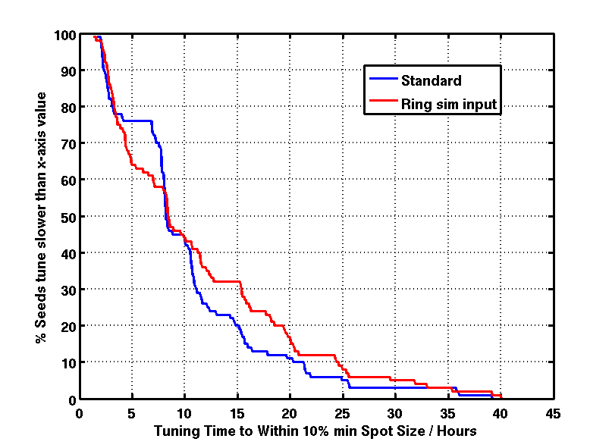
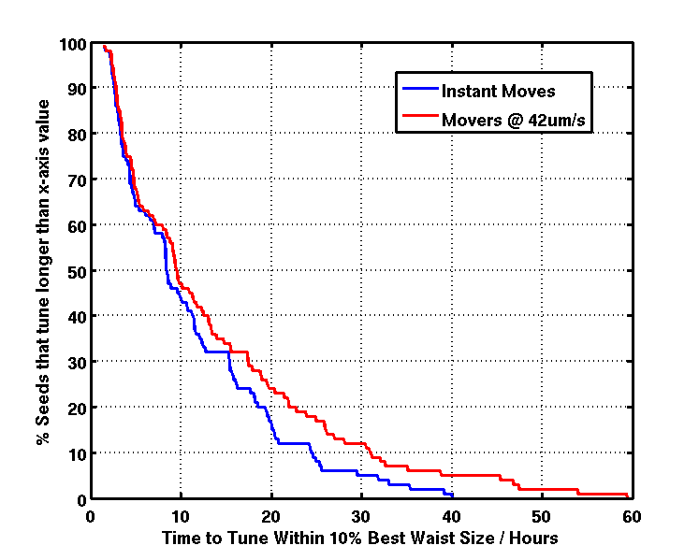
Tuning Time With Realistic Current Mover Speeds (no trim)
Comparison of tuning time with previous simulation (left) (adds ~4 hours tuning time in slowest 10% of seeds)
Effect of adding finite mover speed (right) (adds ~6 hours of tuning time in slowest 10% of seeds)

Slide 13
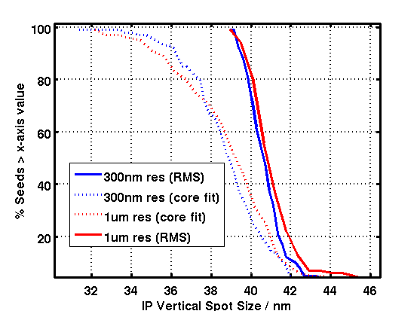
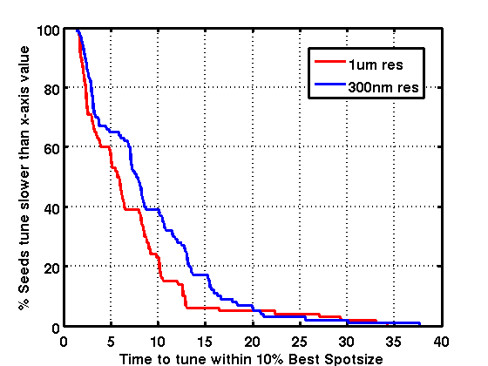
Relaxed Mover Precision
Effect of reducing mover precision to 1um
Tunes faster due to relaxed tolerance on where sextupoles move to during multi-knob moves.

Slide 14
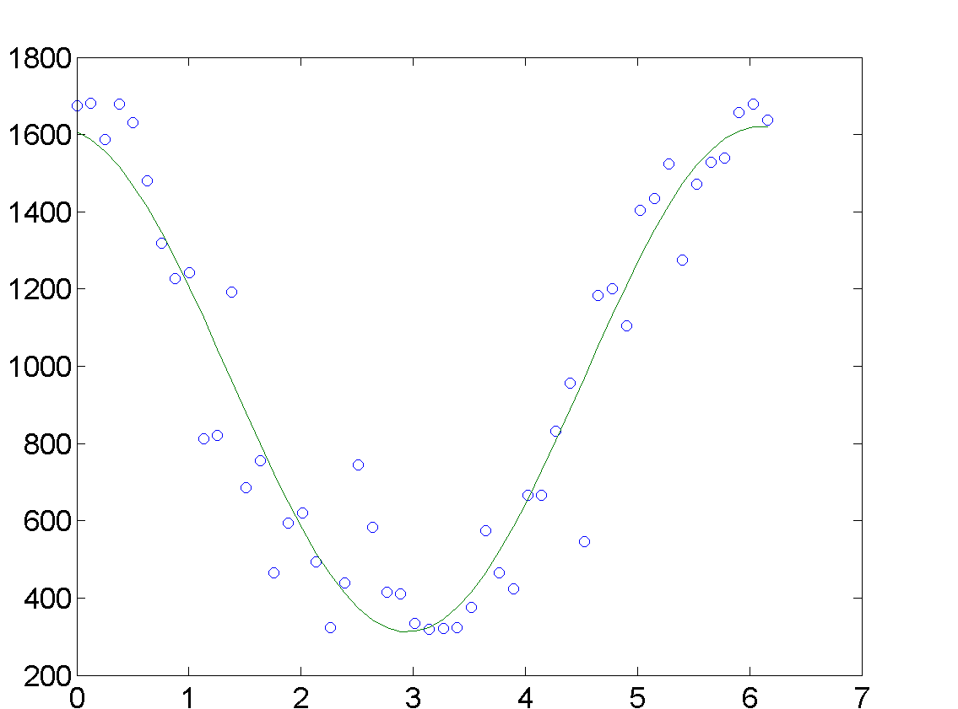
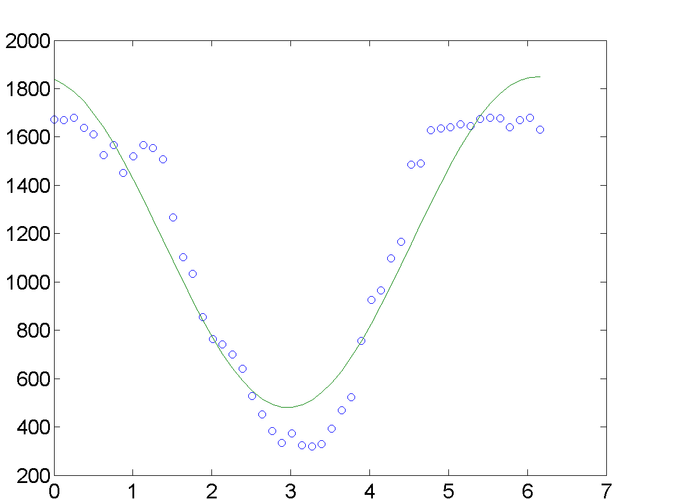
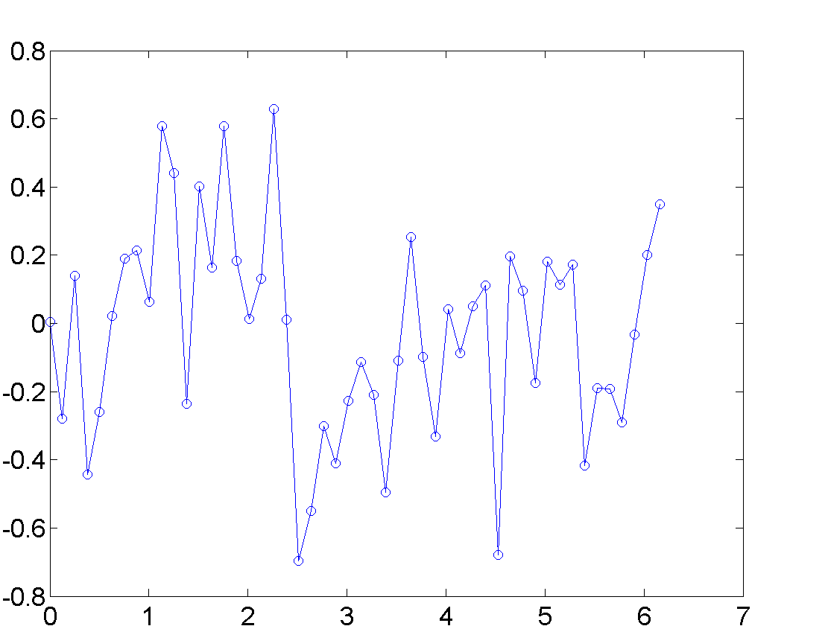
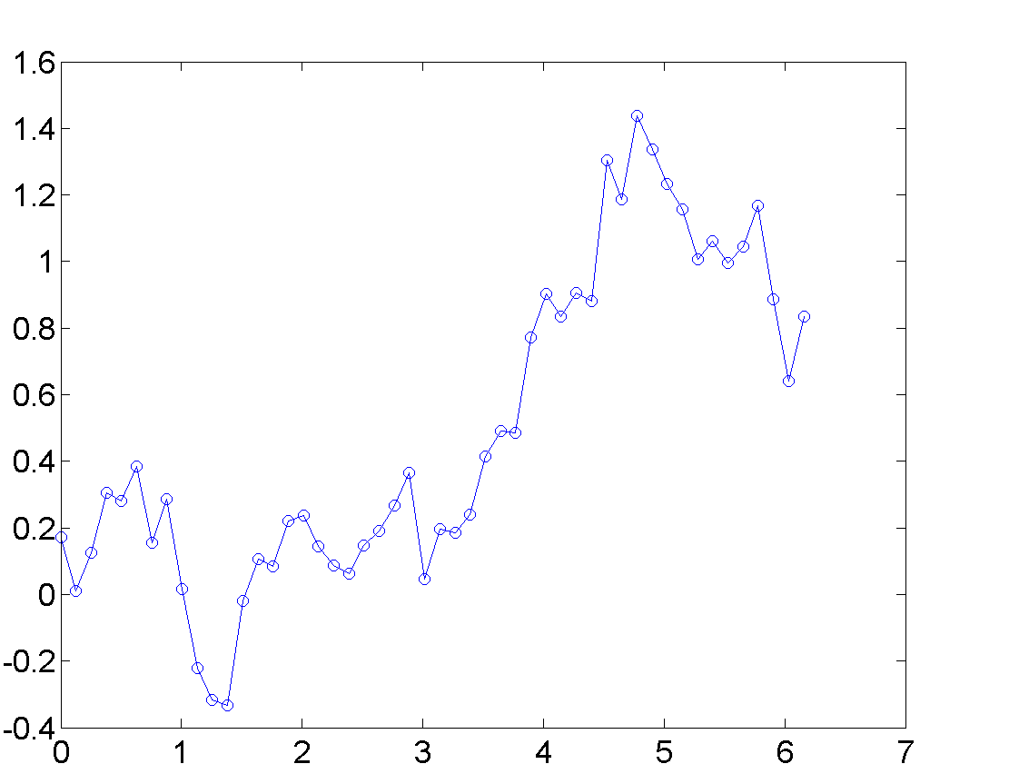
SM Simulation (Matt Warden) – investigate alternate
phase error model
Independent, Gaussian
distributed phase errors
Alternative error model
(1/f noise: has slow variations)
gama ray intensity / a.u.
fringe phase error / radians
fringe phase / radians
fringe phase / radians

Slide 15
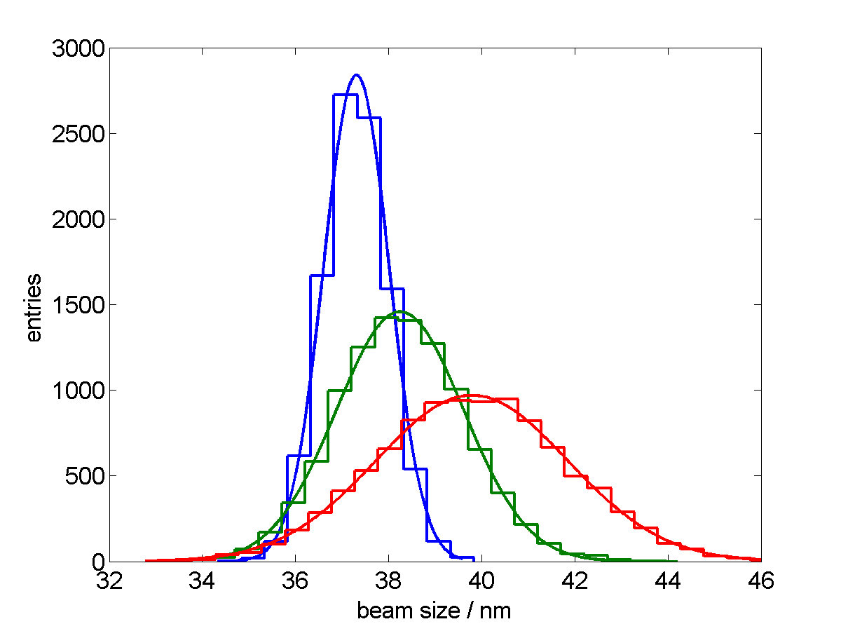
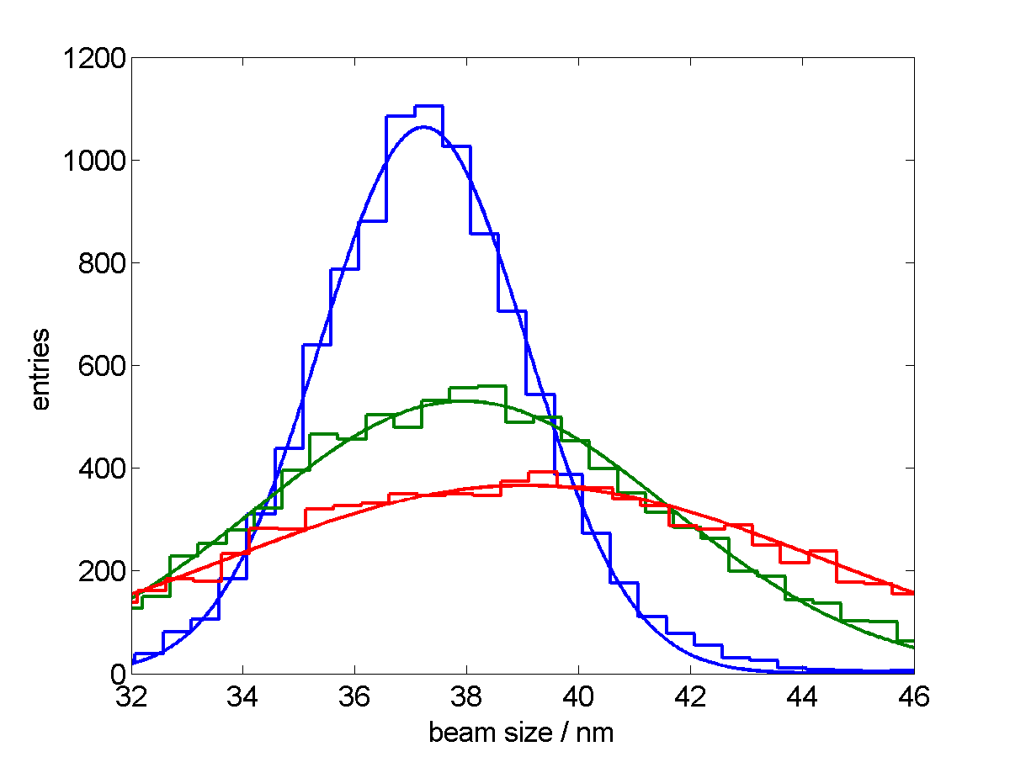
SM Sim Results: Comparison of error models
(Matt Warden)
Parameters:
Number of bunches (measurement points) = 50
Scan range = 1 fringe (2π)
Gamma ray intensity error = 0%
“jitter” = standard deviation of phase error
Different measurement resolution predicted with 1/f noise model
Fringe position error model:
independent Gaussian distributed errors
Fringe position error model:
1/f noise
5 nm jitter
5 nm jitter
10 nm jitter
10 nm jitter
15 nm jitter
15 nm jitter

Slide 16
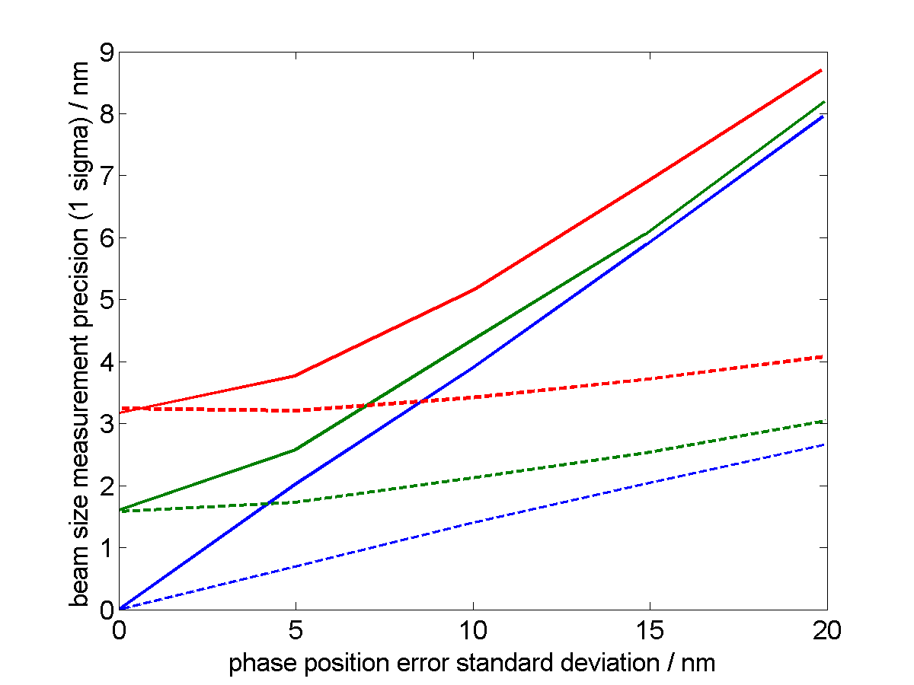
Results: Comparison of error models
Measurement resolution summary plot
(including gamma ray intensity errors)
Gamma ray intensity error
0% 10% 20%
Phase error model:
1/f noise
Phase error model:
Independent, Gaussian distributed
This plot shows again that there is a significant difference in the predicted measurement resolution depending upon which error model is used.

Slide 17
SM Sim Conclusions
Beam size measurement precision depends upon what model is used for the phase errors
Worse for 1/f noise than for independent Gaussian errors
Actual beam size measurement precision will depend on which model is closer to reality
May well be somewhere in between the precisions predicted by the two models used here
Possible points for further study:
Could investigate which fringe position model is more realistic by, for e.g, looking at the power spectrum of phase variations on fringe phase monitor
Investigate varying other simulation parameters

Slide 18
Tasks to do
Full tuning sim with 12-pole and mitigation techniques.
Lucretia/PLACET cross-checks
Performance vs. IP beta_y and beta_x
Write tool to keep track of magnet mover in/out of range for FS (being implemented now in EPICS by JN)
Develop SM sim for use in main simulation.
Dynamic simulations with tuned lattice.
Faster Sext mover system project.
Start writing FS tuning tools now.

