Slide 1
H -> mu mu
Marcel Stanitzki
Jan Strube
Rutheford Appleton Laboratory

Slide 2
Motivation
Clean sample for benchmarking
  Fully reconstructed event w/ recoil
  Or empty detector w/ two muons
Ideal channel for testing the Yukawa coupling to the second generation
Tracking algorithms, Muon ID, Tracking hardware can be benchmarked

Slide 3
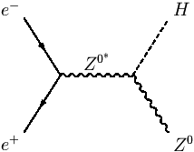
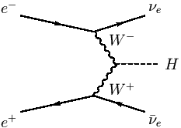
Samples
Signal
  Inclusive H -> mu mu
  Recoil + WBF channel
Background
  2, 4, 6 fermion channels (+ n photons)
  (after requiring two identified muons)

Slide 4
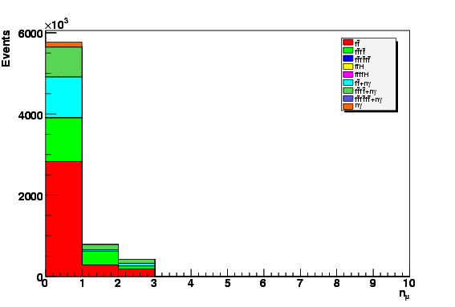
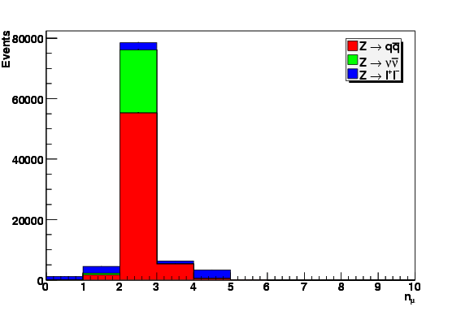
Muon selection

Slide 5
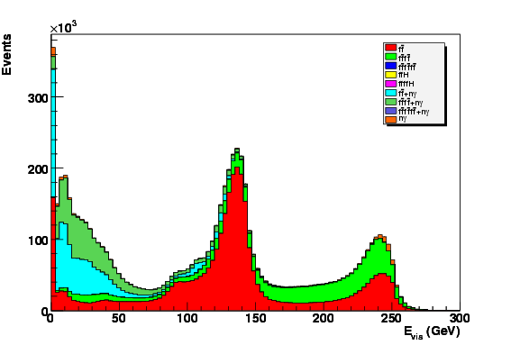
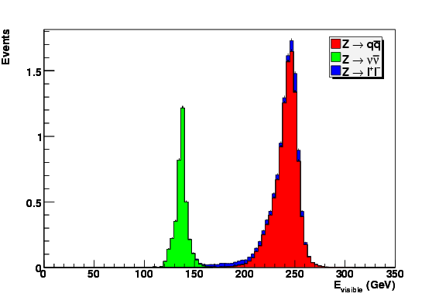
Visible energy

Slide 6
H -> mu mu + hadronic Z
Prototypical recoil measurement
  Fully reconstruct the Z, muon pair comes from the SM higgs
  Model-independent Higgs mass measurement

Slide 7
EventShape
q
Back-to Back events
Minimum opening angle between the jets and the muons
Exploit acoplanarity
q
Z
H
μ
μ

Slide 8
Backgrounds
For the hadronic channel:
  4f -> qqμμ is the biggest background
  Mainly from ZZ production
  Irreducible at some level
Just a number game
  ZZ vs HZ ~ 10:1
  ZZ-> qqμμ vs HZ-> μμqq ~ 2500:1

Slide 9
Event Selection
N_{tracks}>5
E_{vis}> 190 GeV
Jet Selection
  Leading Jet 30<E_{jet1}<105 GeV
  Second Jet 10 <E_{jet2} 70 GeV
  Jet1 P_{T}< 90 & Jet2 P_{T}< 60
  Y_{cut} >0.05 (forcing two jets)

Slide 10
Cont’d
Dimuon Mass 100< M_{μμ} < 140 GeV
Angular cuts (Events are back to back)
cos θ _{μμ} <-0.5
cos θ _{BB} <-0.8 Reconstructed Bosons tend to be really back to back
Distance of muon to any jet (rad)
  > >0.1
Boson Acoplanarity > 2.8 (rad)

Slide 11
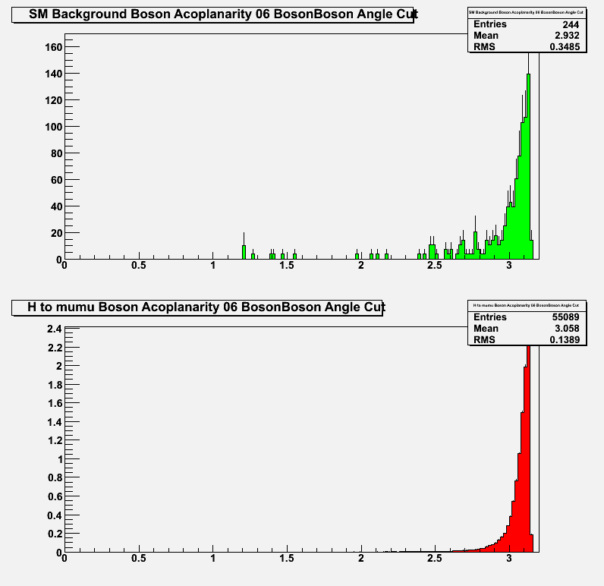
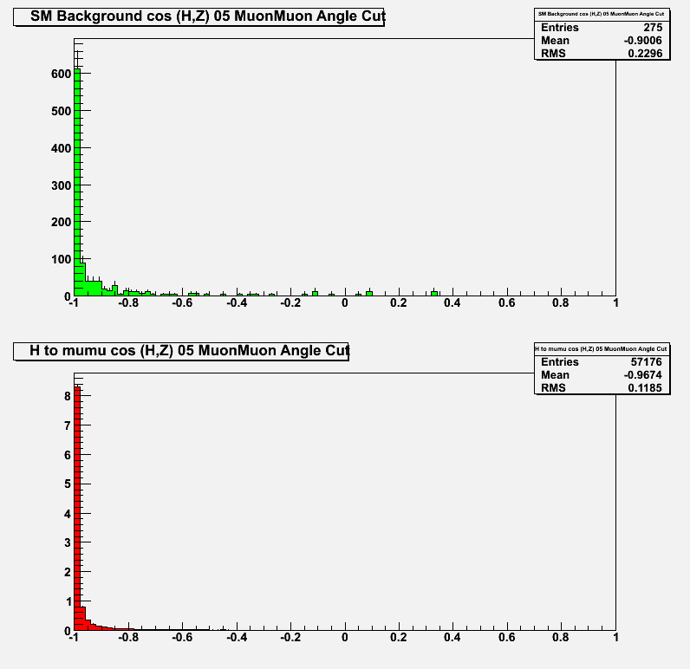
Event Shapes

Slide 12
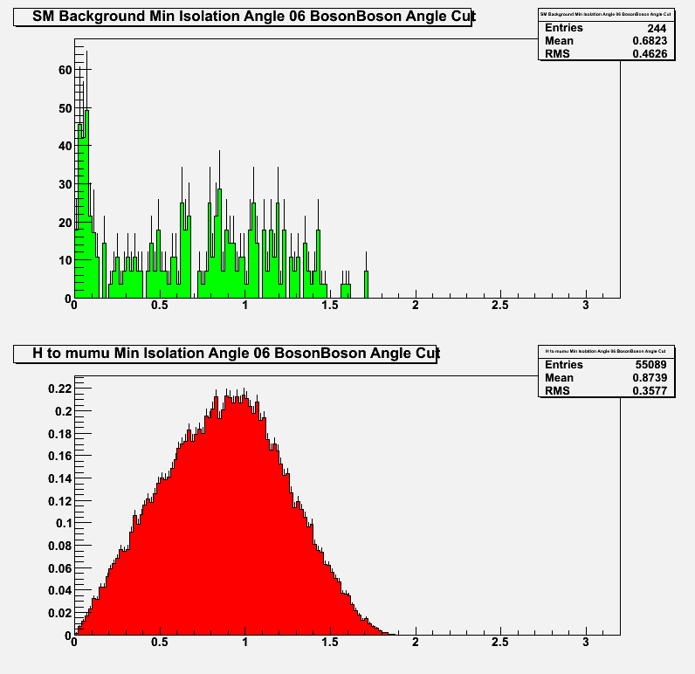
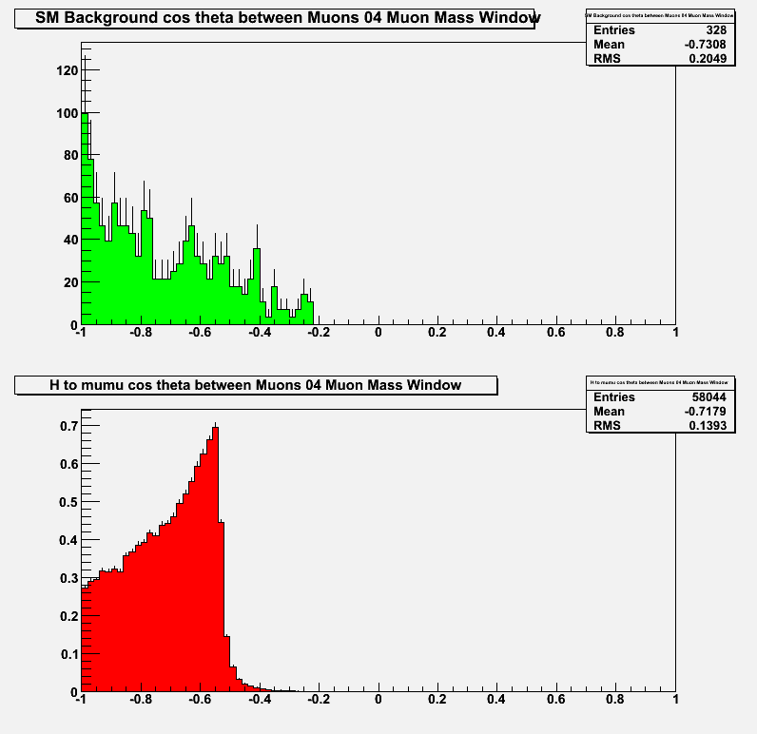
Muon Properties

Slide 13
Event chisquare
Testing the compatibility the event with either hypothesis !

Slide 14
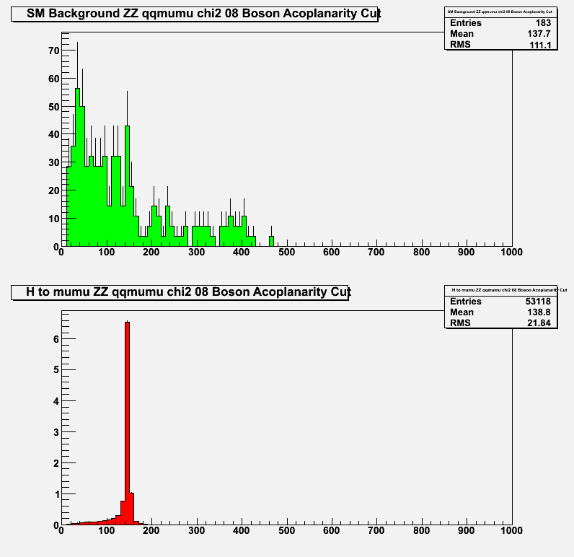
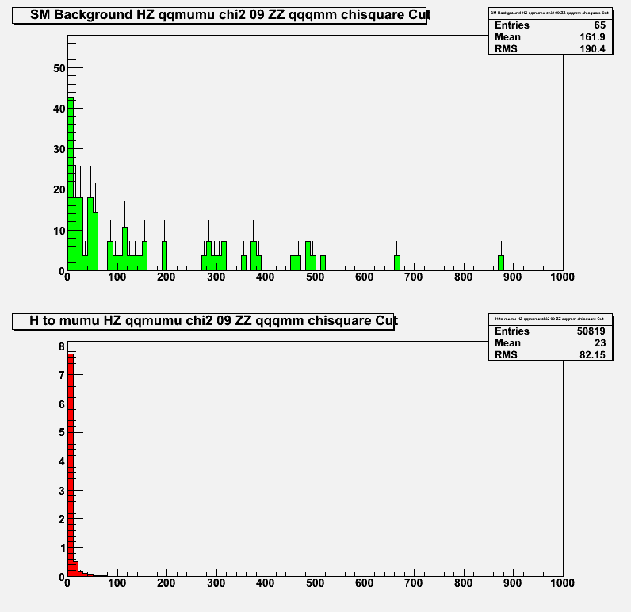

Slide 15
Selection Efficiencies (hadronic)
Cut | H to mumu |  | SM Background
 | Events | Efficiency | Events | Efficiency
00 two muons required | 15.8 | 91.50% | 2034509.3 | 2.2000%
01 Charged Tracks hadronic | 11.0 | 64.00% | 17455.1 | 0.0000%
02 Evis hadronic Cut | 11.0 | 63.70% | 11891.4 | 0.0000%
03 Jet Selection Cut | 10.9 | 63.10% | 10257.1 | 0.0000%
04 Muon Mass Window | 10.7 | 62.00% | 1216.4 | 0.0000%
05 MuonMuon Angle Cut | 10.5 | 61.10% | 1027.1 | 0.0000%
06 BosonBoson Angle Cut | 10.1 | 58.80% | 897.1 | 0.0000%
07 Min Isolation Angle Cut | 10.1 | 58.50% | 720.7 | 0.0000%
08 Boson Acoplanarity Cut | 9.8 | 56.70% | 660.0 | 0.0000%
09 ZZ qqqmm chisquare Cut | 9.4 | 54.30% | 232.1 | 0.0000%
10 HZ qqqmm chisquare Cut | 8.2 | 47.90% | 60.7 | 0.0000%

Slide 16
Signal Sample composition
Cut | Z to qq |  |  | Z to nunu |  |  | Z to ll
 | Events | Total Efficency | channel efficiency | Events | Total Efficency | channel efficiency | Events | Total Efficency | channel efficiency
00 two muons required | 10.9 | 63.30% | 94.60% | 3.7 | 21.70% | 94.70% | 1.1 | 6.50% | 63.80%
01 Charged Tracks hadronic | 10.9 | 63.20% | 94.50% | 0 | 0.00% | 0.00% | 0.1 | 0.80% | 7.70%
02 Evis hadronic Cut | 10.9 | 63.10% | 94.40% | 0 | 0.00% | 0.00% | 0.1 | 0.60% | 6.00%
03 Jet Selection Cut | 10.8 | 62.60% | 93.50% | 0 | 0.00% | 0.00% | 0.1 | 0.60% | 5.60%
04 Muon Mass Window | 10.6 | 61.40% | 91.80% | 0 | 0.00% | 0.00% | 0.1 | 0.60% | 5.50%
05 MuonMuon Angle Cut | 10.4 | 60.50% | 90.40% | 0 | 0.00% | 0.00% | 0.1 | 0.50% | 5.30%
06 BosonBoson Angle Cut | 10.1 | 58.30% | 87.20% | 0 | 0.00% | 0.00% | 0.1 | 0.50% | 4.90%
07 Min Isolation Angle Cut | 10 | 58.00% | 86.70% | 0 | 0.00% | 0.00% | 0.1 | 0.50% | 4.90%
08 Boson Acoplanarity Cut | 9.7 | 56.30% | 84.20% | 0 | 0.00% | 0.00% | 0.1 | 0.40% | 4.10%
09 ZZ qqqmm chisquare Cut | 9.3 | 53.90% | 80.50% | 0 | 0.00% | 0.00% | 0.1 | 0.40% | 3.80%
10 HZ qqqmm chisquare Cut | 8.2 | 47.60% | 71.10% | 0 | 0.00% | 0.00% | 0 | 0.30% | 2.60%

Slide 17
Background Sample Composition
Cut | ff | ffff | ff+ng | ffff+g
00 two muons required | 1313710 | 64664.3 | 545000 | 111133
01 Charged Tracks hadronic | 170 | 12282.1 | 5000 | 2
02 Evis hadronic Cut | 120 | 11771.4 | 0 | 0
03 Jet Selection Cut | 100 | 10157.1 | 0 | 0
04 Muon Mass Window | 70 | 1146.4 | 0 | 0
05 MuonMuon Angle Cut | 70 | 957.1 | 0 | 0
06 BosonBoson Angle Cut | 40 | 857.1 | 0 | 0
07 Min Isolation Angle Cut | 10 | 710.7 | 0 | 0
08 Boson Acoplanarity Cut | 10 | 650 | 0 | 0
09 ZZ qqqmm chisquare Cut | 0 | 232.1 | 0 | 0
10 HZ qqqmm chisquare Cut | 0 | 60.7 | 0 | 0

Slide 18
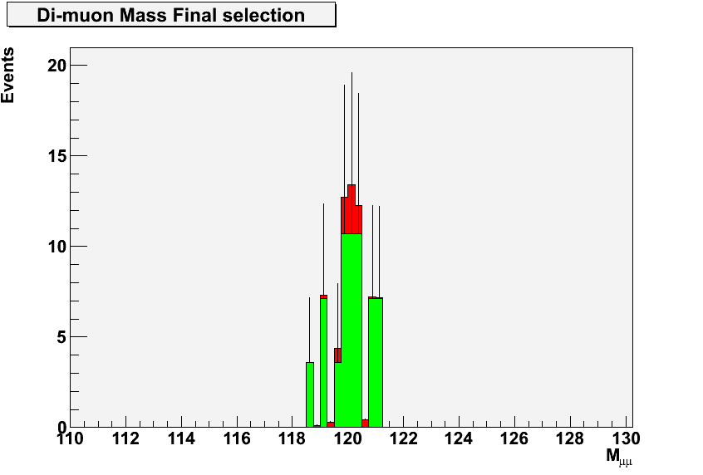
Final mass plot

Slide 19
H + invisible
‘Empty’ detector allows for precision measurement
  No confusion for tracking, no pfa
Signal sample is swamped by SM background

Slide 20
Selection Efficiencies (invisible)
Cut | H to mumu |  | SM Background
 | Events | Efficiency | Events | Efficiency
00 two muons required | 15.8 | 91.5% | 2034509.3 | 2.20%
01 Charged tracks | 3.7 | 21.6% | 1922742.3 | 2.10%
02 missing mass | 3.5 | 20.1% | 548163.4 | 0.03%
03 missing momentum | 3.3 | 19.4% | 100542.9 | 0.02%
04 muon opening angle | 3.3 | 19.0% | 35024.3 | 0.01%
05 leading photon energy | 2.9 | 16.8% | 30017.1 | 0.01%
06 visible Energy | 2.6 | 14.9% | 14475.7 | 0.00%

Slide 21
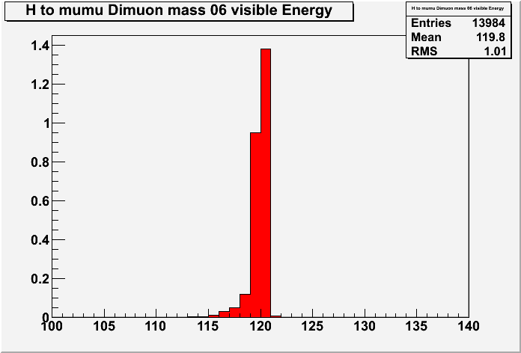
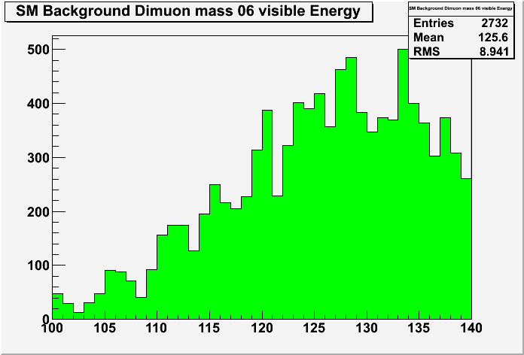
Muon Mass (not final…)

Slide 22
H mu mu note
In preparation
  Hadronic channel 70 % complete
  Invisible channel remains to be done
First draft next week

Slide 23
Summary
Higgs + hadronic Z is shaping up quite nicely
Higgs + invisible has just started and needs work
H -> mu mu is a great channel for detector benchmarking
  Given the large (not really statistical) uncertainties on the background sample, we need to determine a sensible benchmark quantity.

Slide 24
What could be improved ?
Improved Track reconstruction
  I think we can do better than 300 MeV
  Something for post LoI
Bremsstrahlung recovery …
Muon ID
  Could use some work post LoI
Multivariate techniques
  We could if we had enough events to train

