Slide 1
Characterization of MPPC/SiPM/GMAPD’s
Adam Para
February 17, 2009

Slide 2
‘Silicon Photomultipliers’ a.k.a. Pixelized Photon Detectors (PPD)
Novel, very attractive photodetectors:
Compact
Inexpensive
Insensitive to magnetic field
Low operating voltage
But.. They have very little to do with photomultpliers. They are, in fact, solid state versions of RPC’s.
There are several variants of these devices with different operational characteristics
There is very limited body of experience with their operation, optimization of the operating point, calibration and monitoring

Slide 3
Standard Model of the PPD
There are at least two parameters strongly affecting the response of the PPD to a light signal: temperature and bias voltage
The principal effect is the variation of the breakdown voltage with temperature. At the fixed overvoltage the dependence of the response with temperature is greatly reduced
Given an incoming photon:
P_{av}(T,V) = probability that an incoming photon will start an avalanche. Amplitude of the single avalanche signal is well defined, but depends on V and T.
A random avalanche due to a thermal electron may accompany the photon induced signal at a random time, with probability dependent on temperature and voltage R_{dark}(T,V)

Slide 4
Standard Model of the PPD II
For every produced avalanche (independent of its origin ➔ beware of non-linearities)
P_{ap}(T,V,t-t₀) = probability that an avalanche at time t₀ will lead to another avalanche at time t. The amplitude of this avalanche is suppressed by a factor F_{sup}(t-t₀)
P_{xtalk}(T,V) = probability that an avalanche in a pixel will induce an avalanche in a neighboring pixel (optical cross-talk). This additional avalanche occurs at ‘the same’ time as the parent avalanche
In an application where the precise measurement of the light intensity is necessary all these factors: P_{av}(T,V), R_{dark}(T,V), P_{ap}(T,V,t-t₀), F_{sup}(t-t₀), P_{xtalk}(T,V) must be known to model the response of the detector and to interpret the measured signal in terms of the number of photons.
Goals of the R&D project: develop the methodology to identify and measure the parameters affecting the response as a function of relevant variables.

Slide 5
PPD Testing Setup
Real estate: SiDet
Equipment:
Temperature chamber (acquired)
Fast laser 635 nm (acquired)
4 Keithley 2400 source-meters (SiDet infrastructure/borrowed)
Two Tektronix 3054 scopes (borrowed/SiDet infrastructure)
HP53131A counter (borrowed)
MITEQ amplifiers (500/1000 MHz, 30/60 dB)
4 PC computers (SiDet infrastructure/recovered from surplus)
Several dark boxes allowing for simultaneous measurements, as allowed by the measuring infrastructure
Labview data acquisition infrastructure allowing for simultaneous, but independent measurement
All results show in the following were obtained with Hamamatsu detectors (mostly 25 μ devices)

Slide 6
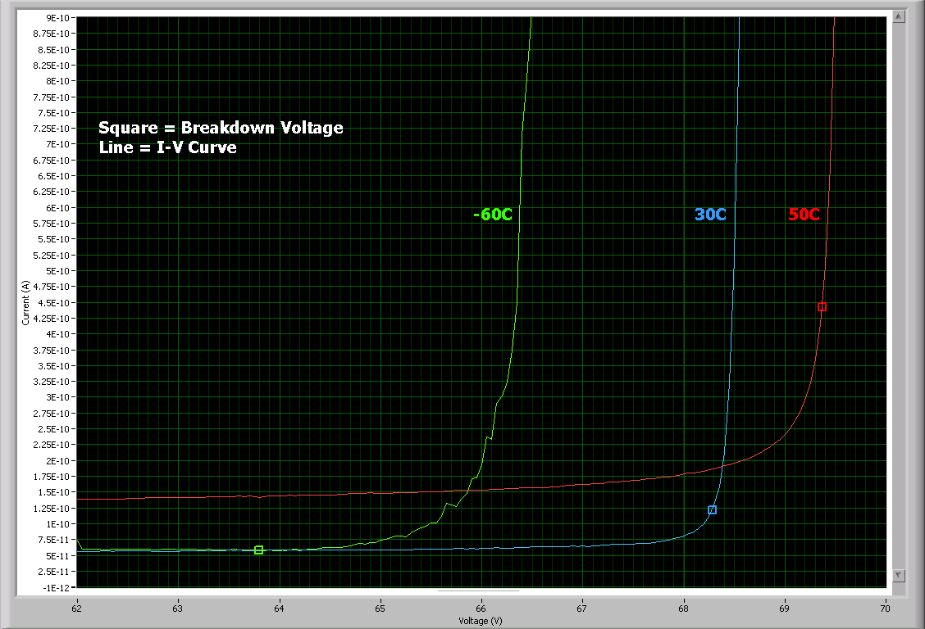
Static Characteristics: I-V Curves
Provide an important cross check on the understanding of the behavior of he detector.
Their role in determination of the breakdown voltage appears to be limited
Studies of temperature dependence of the I-V curves and the dark current is limited, in the case of Hamamatsu detectors, by the sensitivity of the Keithley source meters (~20 nA).
More sensitive (~pA range) source-meters exist, but they are fairly expensive (~$8K)

Slide 7
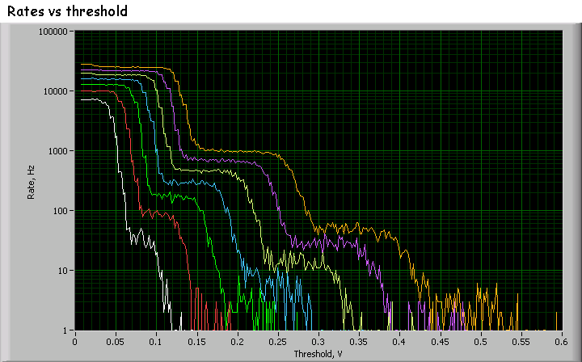
Dark Rate as a Function of Threshold
Rates of pulses as a function the threshold is measured at different bias voltages and temperatures
Staircase patter is a reflection of the pulses pattern: single, double, tripple pulses, no pulses of intermediate height

Slide 8
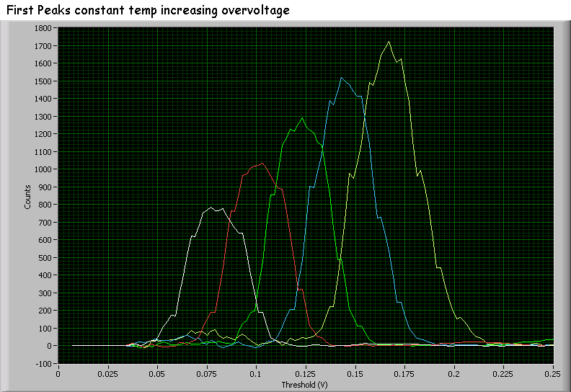
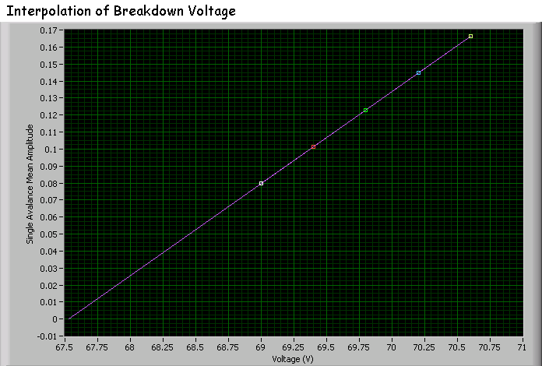
Rate Studies II
Rates dependence on the threshold allows reconstruction of the pulse height spectrum. Here: the single avalanche spectra at different bias voltages
Height of the single avalanche pulses, at a given temperature, is proportional to the overvoltage. Linear fit yields the V_{br} = breakdown voltage

Slide 9
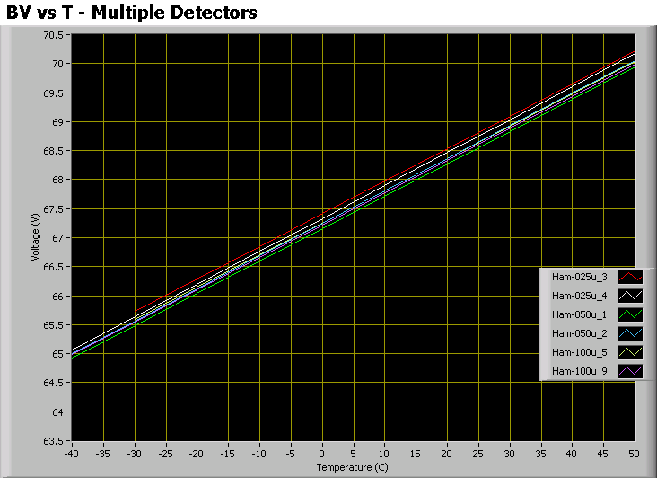
Breakdown Voltage Variation with Temperature
Breakdown voltage varies linearly with the detector temperature in the range -60C to +50C.
dV_{b}/dT = 0.056 V/degC for all 25U, 50U and 100U detectors.
Different batches, even of the same type, may have somewhat different values of the breakdown voltage

Slide 10
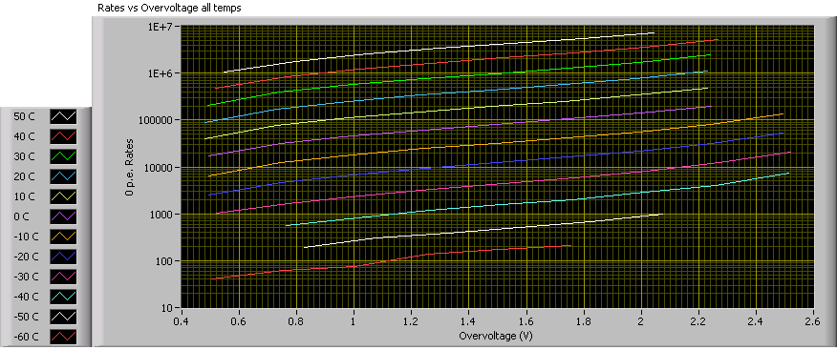
Dark Counts Rates
Dark count rates vary by many orders of magnitude in an approximately exponential fashion as a function of bias voltage and temperature.

Slide 11
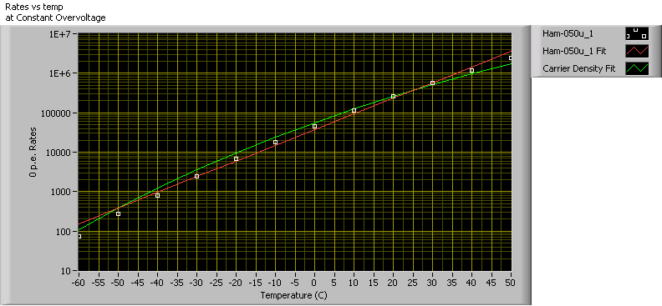
Temperature Dependence of Dark Count Rate
Dark rate is due to free carriers present in the conduction band.
It is proportional to the carrier density:
Temperature dependence of the dark current rate (at fixed overvoltage) yield the information on the effective band gap width: ΔE_{g} = 0.6 eV (d for silicon 1.11 eV)

Slide 12
Cross Talk Measurement
Given the dark current rates, the rate of accidental coincidences of two thermally-induced avalanches is very low
The primary source of pulses with double (tripple) height is the optical cross talk from the primary avalanche
The ratio of rates of double-to-single avalanche pulses is a direct measurement of cross-talk probability at a given bias voltage and temperature.

Slide 13
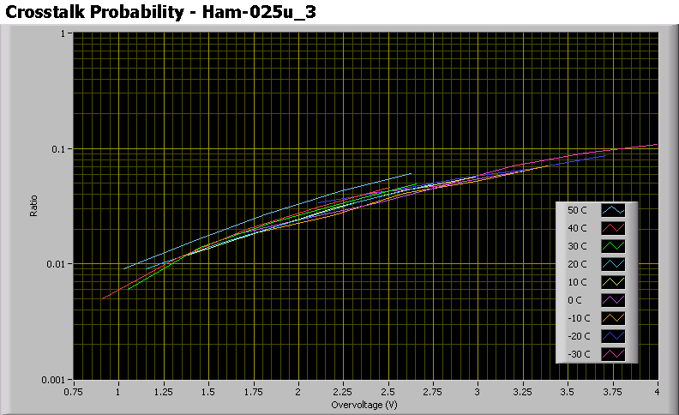
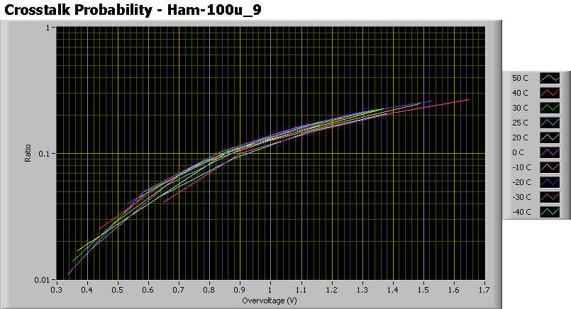
Cross-talk Probabilities
25 μ devices: cross talk in the range of few percent, at typical operating conditions
100 μ devices: cross talk at the level of 10-20% for ~ 1 V overvoltage.
Cross-talk probability does not depend on operating temperature of the device.

Slide 14
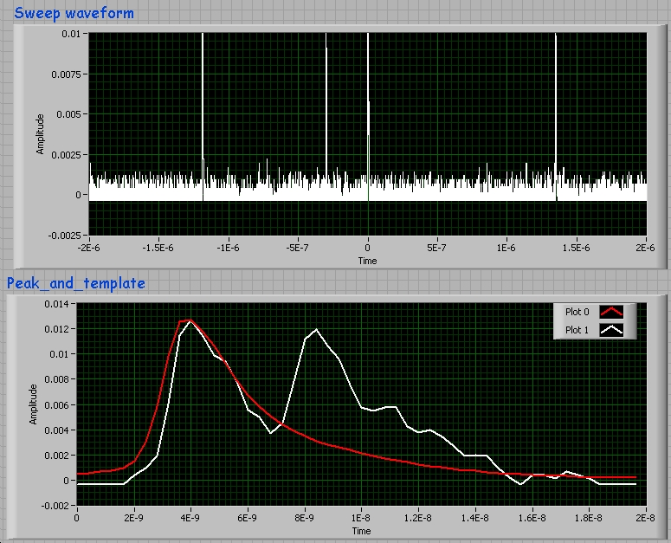
Waveform Analysis
Acquire the complete waveform (triggered by external laser trigger or by a dark pulse) with ~ 2μsec pre-trigger gate
Store waveform for off-line analysis
Decompose the waveform in terms of the sequence of the ‘standard pulses: WF = {N_{pulses}, A_{i}, t_{i}}

Slide 15
Bias Voltage Dependence of the Response
Response of the detector at T=20C to the laser light with the bias voltage increasing within the range of 1.75 V
Huge variation of the response
The same laser light intensity!
Need a calibration prescription to yield the same measurement in all cases

Slide 16
Temperature Dependence of the Response at Fixed Overvoltage
Response of the detector at -50C, -20C, 20C and 50C to the laser pulse. Detector biased at the same nominal overvoltage.
Some increase of the response with temperature is observed
Need to verify if the overvoltage values were truly identical
Need self-calibration procedure

Slide 17
Breakdown Voltage Self-Calibration: Method 1
Acquire responses to low intensity light.
Separate 1,2,3 etc avalanches peaks, fit the response.
Fit ‘pe’ as a function of bias voltage
Fit 1/2/3/4/5 avalanches responses, determine ‘pe’ at this bias voltage

Slide 18
Breakdown Voltage Self-Calibration: Methods 2 and 3
Common fit to the amplitude spectrum, allow width to vary: ‘pe’ is the peaks spacing
Fit the ‘pe’ as a function of the bias voltage. The intercept with x-axis defines the breakdown voltage
Common fit to the amplitude spectrum, common width

Slide 19
Breakdown Voltage Self-Calibration
Several methods of in-situ calibration investigated.
They all provide consistent estimates of the breakdown voltage in the actual running conditions
They also provide a ‘single pe’ calibration. i.e. a value of a signal caused by a single avalanche (NOT a single photon or photoelectron). Significance of this value depends strongly on the details readout system, and in general is not relevant to the actual calibration of the measurement.

Slide 20
‘Single pe’ as a Function of Temperature
‘Single pe’ is often used todefine ‘gain’ of the device.
‘single pe’ defined for a measurement related to a total charge of a single avalanche signal is nearly independent on the temperature
‘single pe’ defined via the amplitude of the signal depends strongly on the temperature
the difference between these two measures presumably reflects the variation of the actual shape of the signal, presumably due to the variation of the value of quenching resistance.

Slide 21
Dark Pulses as a Function of Temperature
Record traces triggered on dark pulses (0.3 pe level) at different temperatures and bias voltages
Shown here: -50C, -20C, 20C and 50C at 3V overvoltage
Evidence for significant afterpulsing, increasing with temperature

Slide 22
Afterpulses within 100 nsec gate
Studies limited by statistics (DAQ rate of the scope)
Data at different bias voltages summed at fixed temperature
Decay time fit at different temperatures: gives the time constant and the overall rate
Examples shown here: -50C, -20C, 20C, 50C

Slide 23
Afterpulsing Probability as a Function of Voltage and Temperature
Total rate of afterpulses may be converted to a multiplicity of afterpulses per a parent avalanche
Measurements and different temperatures and bias voltages (statistically challenged at low temperatures and low bias voltages)
Afterpulsing probability increases very strongly with the bias voltage and with temperature

Slide 24
Afterpulsing time constant
Afterpulsing has a characteristic time constant of 5-8 nsec (for Hamamatsu 25 μ devices)
Temperature dependence needs more studies, but it may indicate an increase of the the lifetime at low temperatures, whereas the apparent increase of the time constant at high temperatures may be result of multiple afterpulses
Need a lot more data to improve statistical accuracy

Slide 25
Amplitude of Afterpulses
Amplitude of a pulse is shown as a function of time since the previous pulse
Examples of data shown at different temperatures
Clear evidence of the reduction of the pulse height during the pixel recovery time
Recovery time varies with temperature (as the result of the variation of the value of quenching resistor)

Slide 26
Temperature dependence of the Afterpulses
Examples show the afterpulse amplitude as a function of the time since the parent pulse at -60C and 50C
Significant variation of the time constant with temperature is evident
More data and more refined analysis is necessary to investigate the details of temperature and voltage dependence

Slide 27
More Data and Analysis
Data analysis barely started. More to come, more refined analysis methods may improve the reliability of the results and conclusions.
Many measurements statistically limited due to poor rate capabilities of the present system (scope+offline analysis)
Significant improvement possible if the analysis could be performed inside the scope (like 9000 class Agilent scopes)
Once the methodology is established the analysis of various classes of devices can be performed.

Slide 28
Broadening the Scope ?
The study presented represent only a limited set of the operational parameters of the devices. More complete characterization may include:
Absolute detection efficiency measurement
Spectral dependence of the detection efficiency
Spatial variation inter-pixel and intra-pixel variation of the detection efficiency
Long term stability of the characteristics
Radiation hardness studies and the mechanism for the radiation damage/annealing

