Slide 1



DHCAL Test Beam Results using Full Train Reconstruction
Khaled Belkadhi

Slide 2
The Test Beam
Efficiency study
Time cuts for tracks reconstruction
Tracks reconstruction without position cuts
Tracks reconstruction with position cuts
Efficiency map
Conclusion

Slide 3
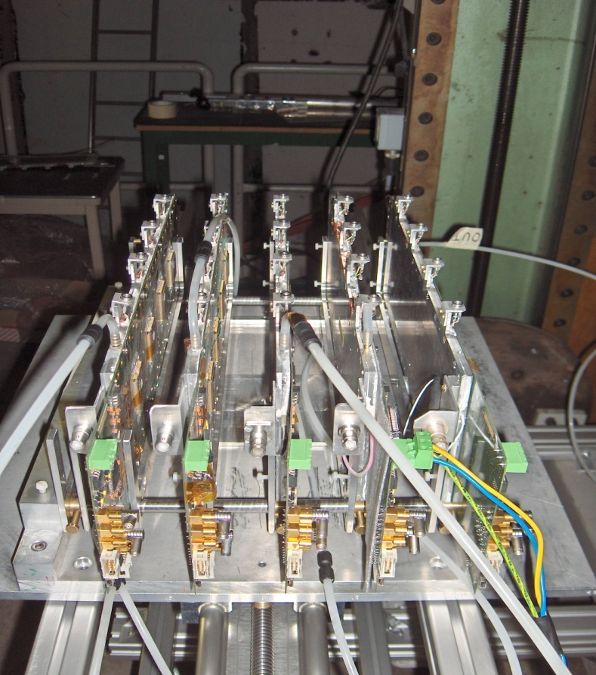
The TestBeam
  TestBeam at CERN (PS)
  July-August 2008: 4 RPC 32×8 cm2
  November 2008: 5 RPC 32×8 cm2 (with one multi-gap RPC)
RPC: 4 Asics
Asic: 64 Channels
1 | 2 | 3 | 4
2 Scintillators: Trigger
→ Read recorded events
Khaled Belkadhi (LLR-Ecole Polytechnique)
3

Slide 4
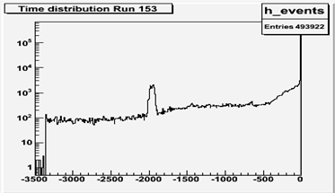
The TestBeam
Full Train Time Distribution (all events)
Time (ms)

Slide 5
Efficiency Study
Efficiency = Probability to find a track reconstructed on 3 layers in the 4th layer
?

Slide 6
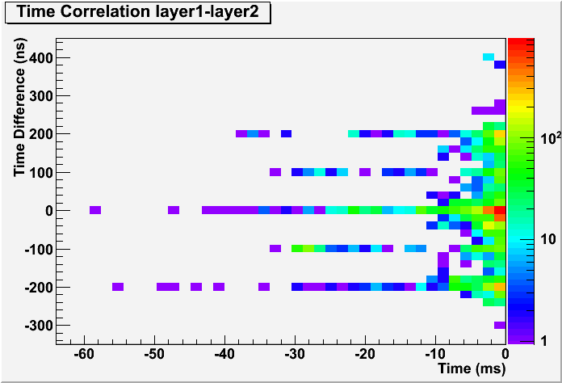
Time Cuts
Time Correlation between hits in Asics
6

Slide 7
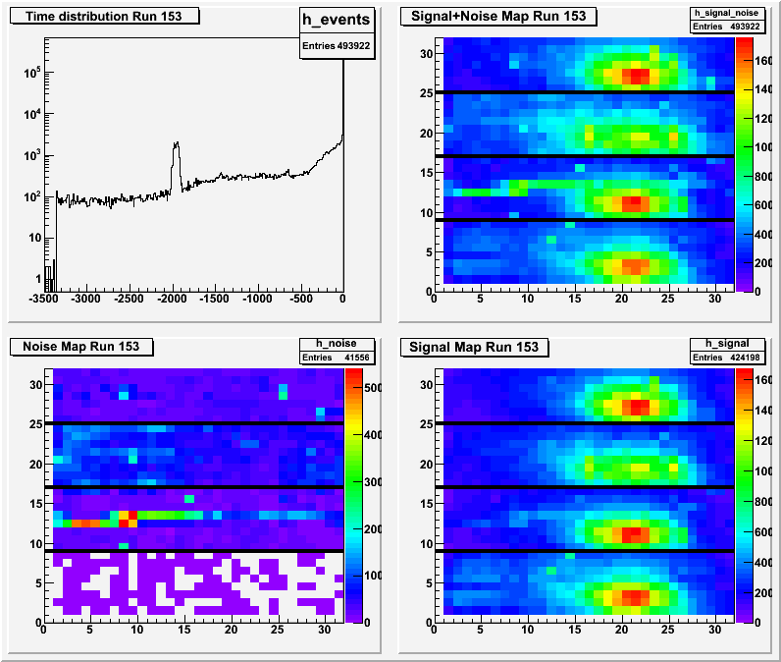
Time Cuts
RUN 153: cut at -400 ms (spill length)
All Events
Layer 4
First spill
Second spill
Layer 3
Layer 2
Layer 1
Noise
Signal

Slide 8
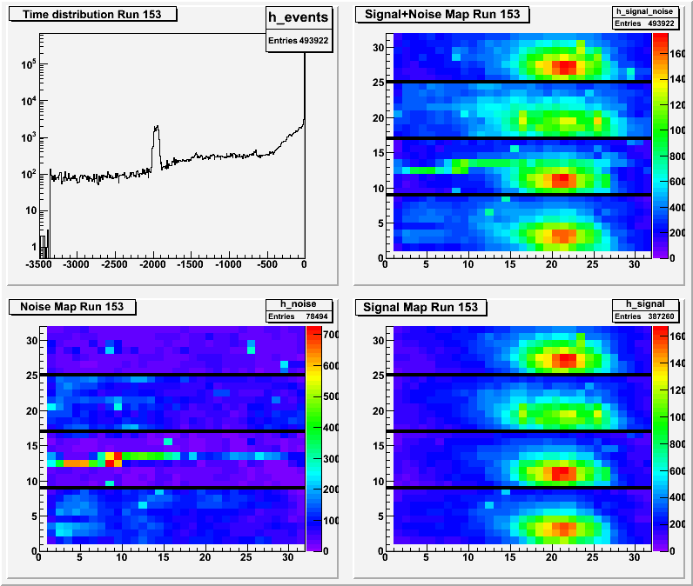
Time Cuts
Cut at -50 ms
Layer 4
Layer 3
Layer 2
Layer 1

Slide 9
Time Cuts
cut at -400 ms
cut at -50 ms
Khaled Belkadhi (LLR-Ecole Polytechnique)
9

Slide 10
Time Cuts
Δ t < 300 ns.
t > -50 ms.

Slide 11
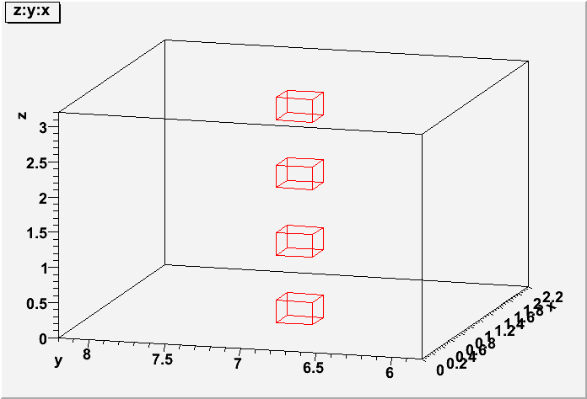
Tracks Reconstruction without position cuts
Select Hits with time cuts to separate
events in the train

Slide 12
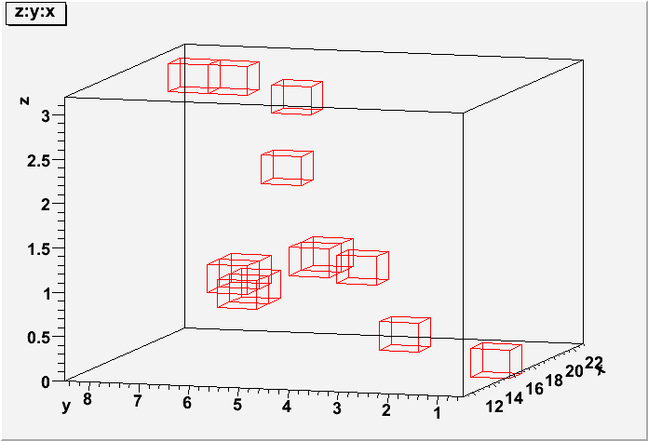
Tracks Reconstruction without position cuts
Problem:
1- Inclined Tracks

Slide 13
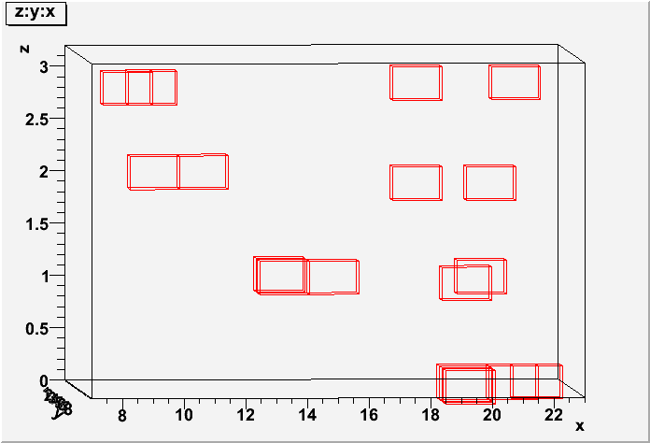
Tracks Reconstruction without position cuts
2- Interaction

Slide 14
Tracks Reconstruction with position cuts
Solution:
Take a first Hit in the first layer.
Select hits with time cuts.
Select hits with position
cuts : ± 1 cm (1 pad) in X
and Y.
→ Remove Inclined Tracks and Interaction Events

Slide 15
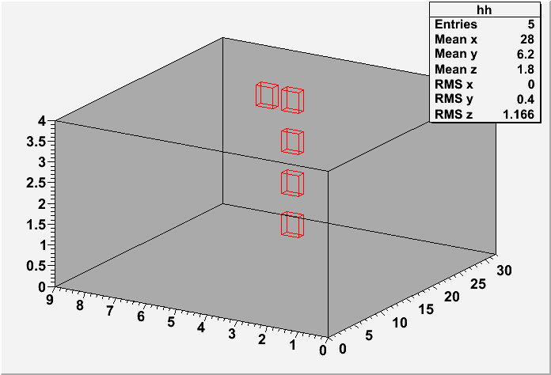
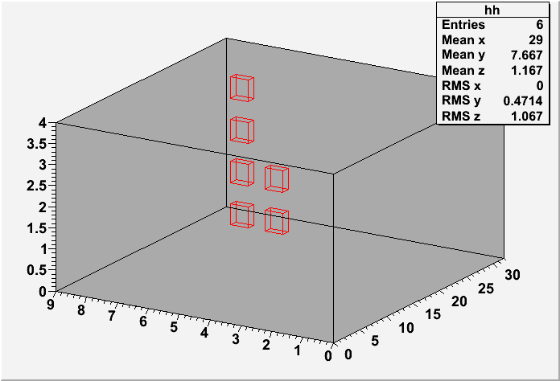
Tracks Reconstruction with position cuts
Result:

Slide 16
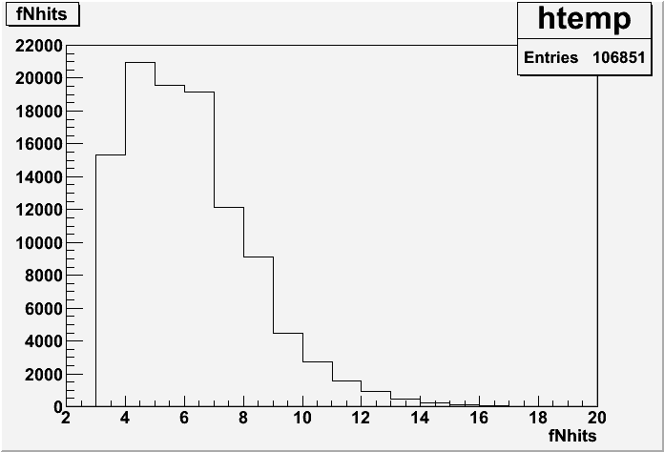
Quality Plots
Number of Hits:

Slide 17
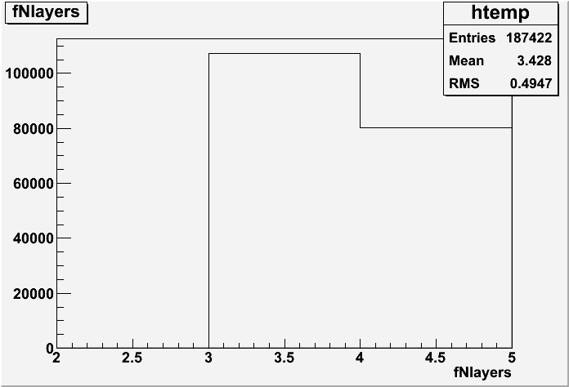
Quality Plots
Number of Track Layers:

Slide 18
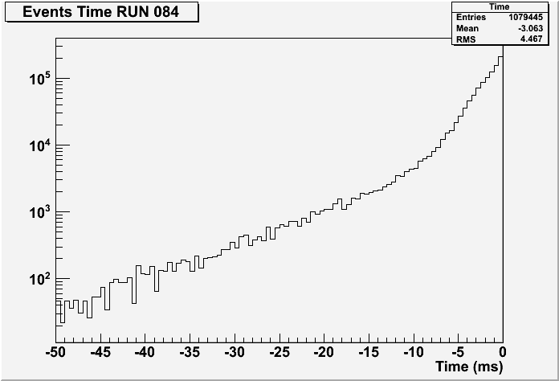
Quality Plots
Hits Time

Slide 19
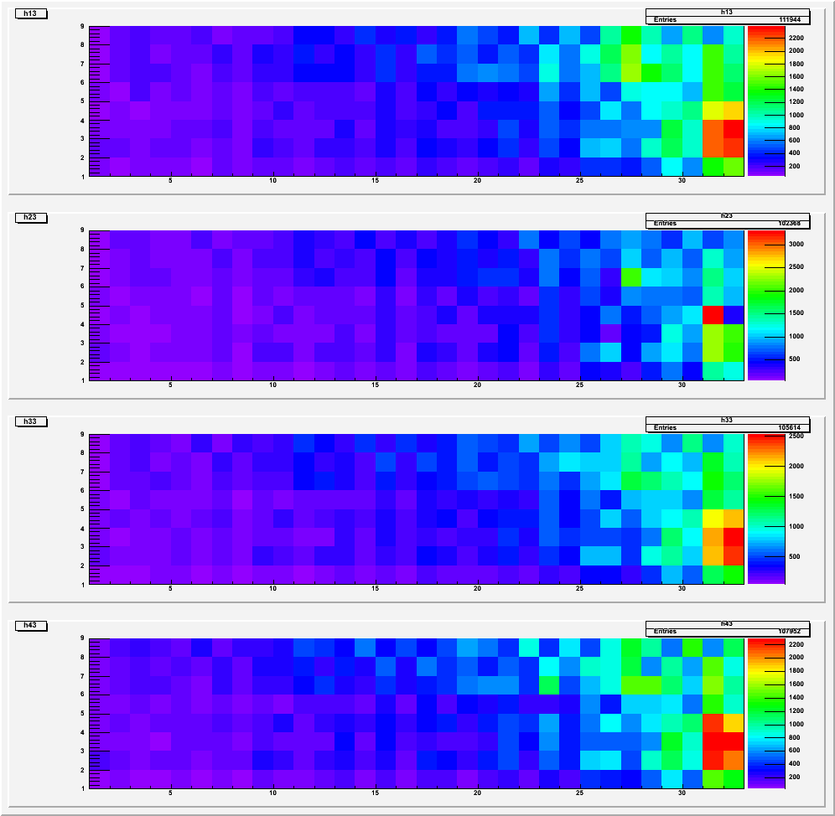
Efficiency Map
RUN084 Beam Profile:
4
3
2
1

Slide 20
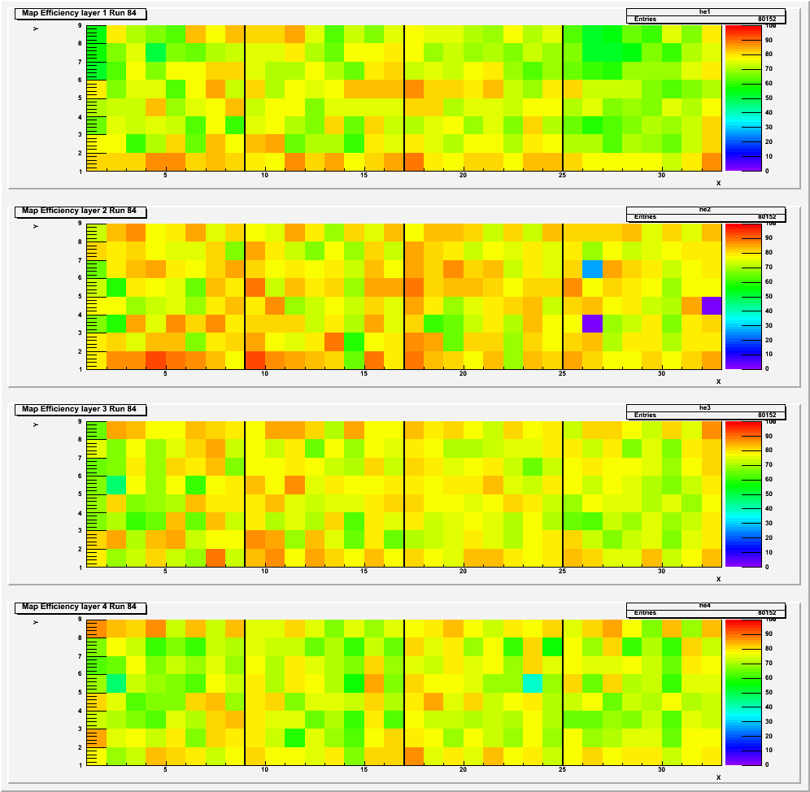
Efficiency Map
RUN084 Efficiency Map:
100 %
0 %
4
3
2
1
100 %
0 %
100 %
0 %
100 %
0 %

Slide 21
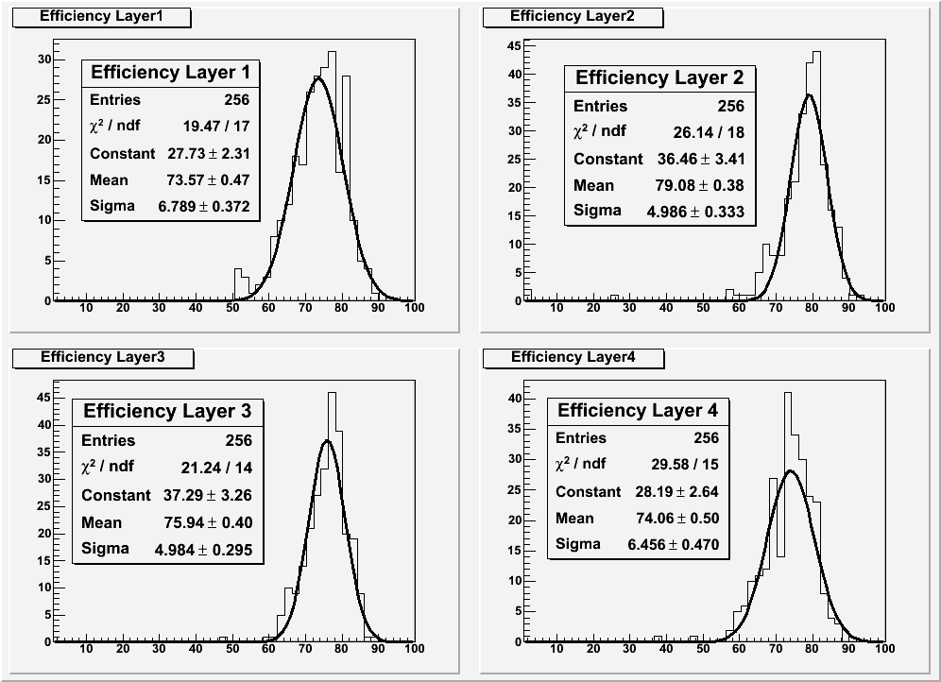
Efficiency Map

Slide 22
Conclusion
All tools for time reconstruct ion of events
Access to full detector history
Study of different parameters
(Gaz, HV, Type of particles ..): Full efficiency study

