Slide 1
Physics PriNciples of High Resolution Jet Calorimetry
Adam Para, Krzysztof Genser, Hans Wenzel,Fermilab
ALCPG, Albuquerque
September 30, 2009

Slide 2
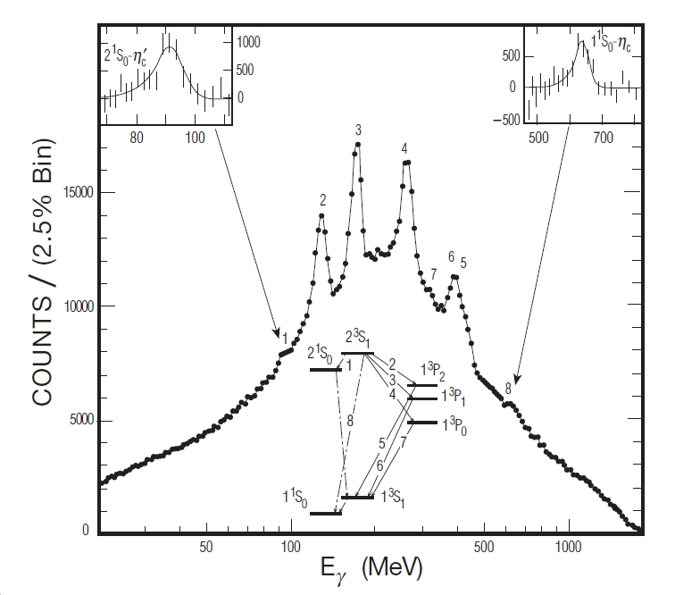
Historical Perspective: Crystal Calorimetry: a Powerful Tool for Particles Spectroscopy
35 years ago two narrow states J/Ψ(3100) and Ψ’(3700) discovered. What were they???
Radiative decays/Photon spectroscopy the key: these are the radial excitation of the ccbar states
Excellent energy resolution of NaI crystals an enabling technology.
Note: One particle Ψ’(3700) and precisely measured inclusive photon spectrum sufficient to uncover several intermediate states and prove their physics interpretation

Slide 3
Future of High Energy Physics: a Possible? a Likely? Scenario
The Standard Model is a huge milestone in our quest to understand the Nature
Discovery of the Higgs boson will be the spectacular coronation, but… we are not done, yet..
Several indications of a possible new layer of particles with masses at the hundreds of GeV- few TeV scale (related to dark matter?): new world to be explored
LHC is the discovery tool: expect many new heavy particles, complicated decay chains… Will know more in ~5 years.
These new particles will sequentially decay with emission of W/Z bosons and jets
Clean environment of the lepton collider and a very high resolution jet calorimetry may be the critical tools in the exploration of the new particles. The necessary energy resolution set by the mass splitting and the decay rates. Natural width of W/Z irrelevant (they may be virtual anyway)

Slide 4
The Target Energy Resolution
Will know it once we know the physics (== too late)
We will not get a second chance
Given the magnitude (time, resources, manpower) of the project ➔ try the best we can realistically achieve
Past (modest) goal: try to achieve 30%/sqrt(E)
Mark Thomson: beyond any doubt, PFA cannot do that. The resolution is limited by a ‘constant term’ and it takes heroic efforts to keep the constant term from growing too much.
In Bangalore I have offered a prize for achieving 30%/sqrt(E) with the PFA. No takers, so far. In recognition of outstanding efforts by Mark Thomson I offer him a consolation prize: a bottle of wine of his choice (with my approval).
Let’s not be desperate: we have more time than we ever wanted
How about 10%/sqrt(E) ??
Is it possible? What would it take to achieve it?

Slide 5
Not a Sampling Calorimeter
even a very large sampling fraction (30-50%) with sampling frequency of 1-2 cm induces a significant stochastic term in energy resolution
and it is a tip of the iceberg only. “Sampling fraction” is a function of particle type and particle energy. “Neutron problem” is a complete artifact of a sampling calorimeter with scintillator as an active medium, for example.

Slide 6
TAHCAL: Totally Active Hadron Calorimeter
To a first order: total observed energy is equal (up to an overall calibration factor) to the total energy deposited in a calorimeter. This is ensured by the energy conservation and it does not require any simulation studies. In particular, it does not depend on any specific model of hadron interactions.
Two second order corrections. In hadronic showers some of the deposited energy may escape detection or do not produce the detectable signal:
  Every charged pion stopped and decayed in the calorimeter induces a loss of 100/140 MeV (depending on the integration time)
  Hadron-nucleus interactions may result in nuclear breakup, evaporation of nucleons (neutrons and protons): ~ 8 MeV per liberated nucleon
These energy losses fluctuate from event to event. These fluctuations limit the energy resolution. The actual size of this term depends on the modeling of the hadron interactions (pi-zero fraction)

Slide 7
Dual Readout Calorimeter
Detect separately scintillation and Cherenkov light
Scintillation light is a precise measure of the total energy released in the calorimeter (~total path length of the charged particles in a shower)
Cherenkov light is a precise measure of a total path length of the relativistic particles (β>1/n) in the shower
Calibrate C=S for electron showers (spread of both signals very small)
Hadron showers with large C/S – large electromagnetic component, small missing energy
Hadron showers with low C/S – purely charged hadrons, large amount of missing energy

Slide 8
TAHCAL Simulation and Analysis
Optical calorimeter option in SLIC (GEANT4) (H. Wenzel, Fermilab)
  “Test beam” calorimeter: 1 x 1 x 3 m³ volume subdivided into 1 cm³ ‘crystals’
  SiD detector, version 1 (‘thin’)
Crystals composed of various materials (elements or isotopes) at fixed density of 8 g/cm³
Optical properties characterized by the refractive index n (relevant for Cherenkov)
All scintillation (==ionization) and Cherenkov light summed up from the entire volume. Total information about an event reduced to two variables : S and C.
Completely automatic reconstruction, no tuning/optimization. No use of the spatial distribution information (yet).
“Test beam” analysis (K. Genser/Fermilab): physics principles, linearity and resolution
“SiD” analysis (A. Driutti, G. Pauletta/Udine): containment, leakage fluctuations and their mitigation
Very early stages, much room for refinements and improvements.

Slide 9
Can You Trust the Simulation ?
Yes, if you know the result a priori.
Homework: work out a crude estimate of the maximal energy lost to nuclear binding energy losses:
  Take 100 GeV charged pion.
  With density of 8 g/cc of , dE/dx ~ 16 MeV/cm.
  Total path length in purely charged pion shower is 60 m.
  With 20 cm absorption length there will be ~300 hadron-nucleus interactions (mostly at low energies)
  Make a guess of an average number of liberated nucleons and calculate the corresponding ‘missing energy’. Ask your nuclear physicist friend if in doubts.
  Compare with the GEANT simulation
Notice: for a given category of showers the missing energy is a result of a large number of small losses ➔ small fluctuations

Slide 10
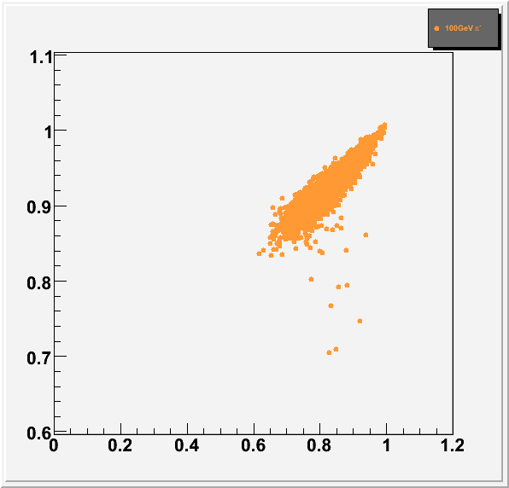
Mechanics of Dual Readout Correction (Example of 100 GeV pion)
πº-rich showers: almost all energy detected
S(cintillation)/B(eam Energy)
= fraction of energy detected
πº-poor showers: ~85% of the energy detected
Use the observed C/S to correct every shower
The resulting resolution limited by the local width of the scatter plot
Much better resolution can be achieved by using the C(herenkov) light rather than C/S, but it requires an a priori knowledge of the shower energy
Cherenkov/Scintillation

Slide 11
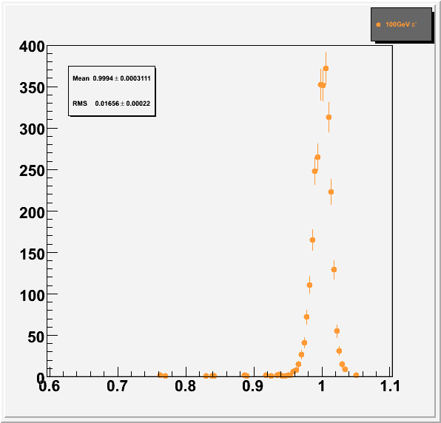
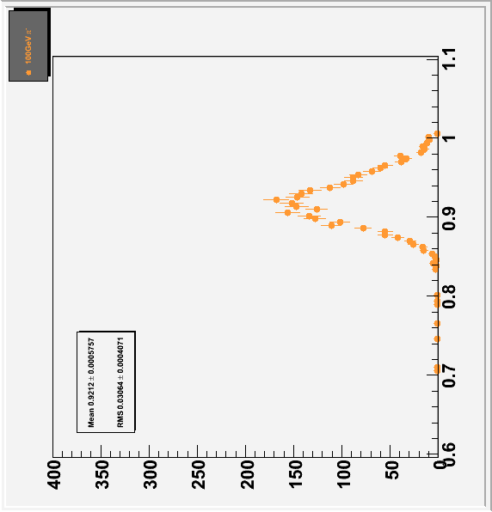
TAHCAL at Work: Single Particle Measurement
100 GeV π⁻
Full Geant4 simulation
Raw (uncorrected)
ΔE/E ~ 3.3%
but significant non-linearity, E~ 92 GeV
After dual readout correction, correction function (C/S) determined at the appropriate energy:
Linear response: S/B=1 for all energies
energy resolution scales as ΔE/E~α/√E (no constant term)
stochastic term α~12-15%
Gaussian response function, no tails.
S/B
S/B
S/B
C/S

Slide 12
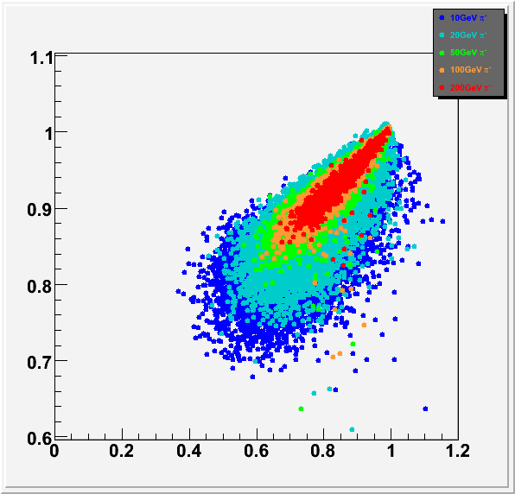
Dual Readout Correction at Different Energies
Correlation of the fraction of ‘missing energy’ and Cherenkov-to-scintillation ratio for showers of different energies: 10 – 200 GeV:
High energy showers contain more EM energy (range of C/S confined to higher and higher values)
Width of the correlation shrinks like ~1/√E (hence the ΔE/E~ 1/√E)
Overall shape quite similar, but significant (compared to the width of the correlation) differences present. They will lead to:
  non-optimal energy resolution
  non-linearity of the response
  contribution to the jet energy resolution
S/B
C/S

Slide 13
From Single Particles to Jets
Single particles provide an over-optimistic estimate of the calorimeter performance. Jets contain many particles of different kinds and various energies. And the jet fragmentation function fluctuates from jet-to-jet.
In a segmented calorimeter jet energy measurement can be decomposed into several separated regions with the correction function optimized for the particles in this region
The pessimistic limit of the detector performance can be evaluated by applying the average corretion function (derived from the global fit to data at different beam energies) to the total amount of scintillation and Cherenkov light measured for a jet.

Slide 14
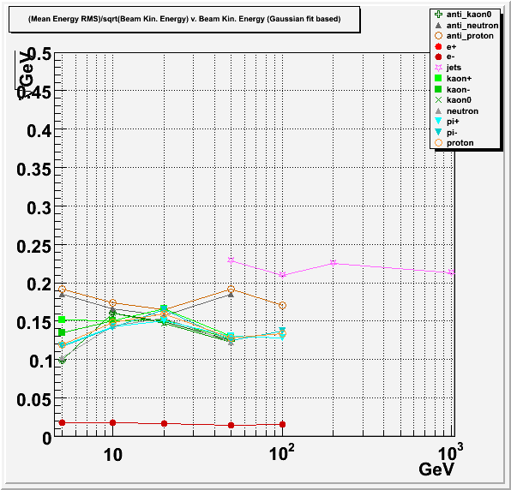
TAHCAL: The Energy Resolution with the Global Correction (TILC09)
With very crude reconstruction and non-optimal global correction function:
energy resolution shows no constant term and scales ΔE/E~1/ √E
stochastic term in the energy resolution is ~15% for single hadrons, 2% for electrons and ~22-23% for jets
gaussian response function, no long tails
there are several obvious ways to improve the energy resolution. At least in the simulated calorimeter .
Why is jet resolution so poor?
Jets

Slide 15
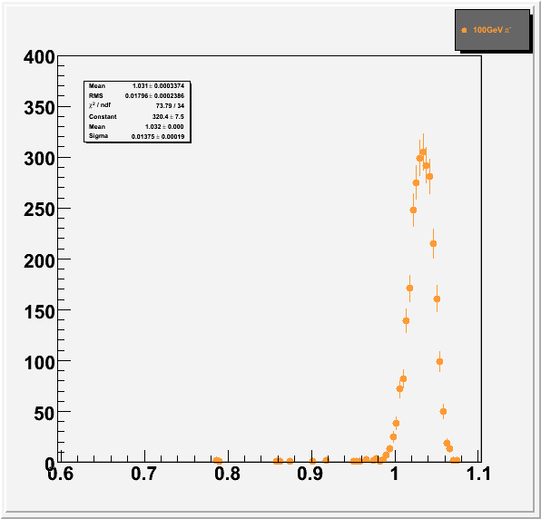

Impact of Using the Average Correction: Example of 100 GeV pion
Use of the average correction degrades (slightly) the resolution: 1.38% instead of 1.22% and shifts the average response by 3.3%. The latter will induce significant degradation of jet energy resolution.

Slide 16
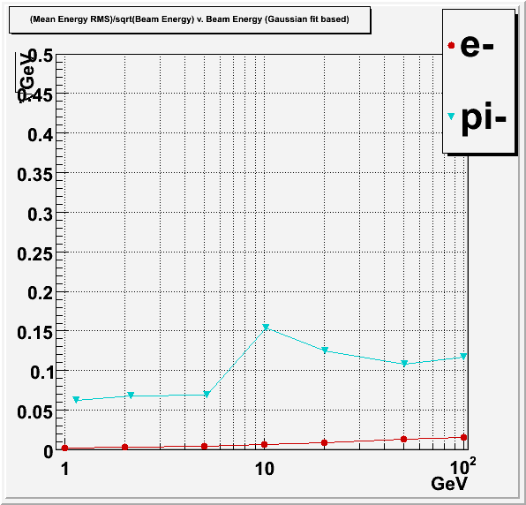
Further Studies of GEANT4 (with QGSP-BERT)
Dramatic degradation of the energy resolution in the energy regime 5-20 GeV. (Critical range for the typical QCD jets).
This is an artifact of GEANT4 implementation of different models

Slide 17
’10 GeV’ Problem in GEANT
Fraction of the missing energy is modeled using a mixture of different models, with very different nuclear binding energy losses.
The corrected energy resolution would be very good with either of the models

Slide 18
10 GeV Problem, Further studies
The problem is not present for a hypothetical calorimeter built from ‘heavy hydrogen’
It is NOT a problem of modeling hadron interactions per se, but rather a problem with modeling the nuclear effects
Current estimates of the energy resolution for jets are limited by the implementation of the transition between physics models in GEANT4 and NOT by the knowledge of hadron interactions or nuclear effects

Slide 19
Physics Modeling in GEANT: Examples
We tend to focus on deficiencies (obviously), but there is a lot of physics incorporated into GEANT
Energy observed in nuclei smaller than in hydrogen (nuclear binding energy losses)
Energy in BGO larger than in iron (fission?)

Slide 20
Challenges of High Resolution Jet Calorimetry
Are numerous. Everyone has his/her own list. We need to concatenate/prioritize these lists to address the issues in a logical fashion. Contributions are welcome.. (to the list, and especially to the search for solutions)
Frequently asked question: is there enough light to maintain the excellent energy resolution?
  Scintillation: need much more than 100 photons detected per GeV to maintain 10%/sqrt(E). Scintillating crystals produce hundreds (or thousands, or tens of thousands) photons per MeV, but..
  How much Cherenkov light one needs to maintain good dual readout correction? Typical light yield in Cherenkov calorimeters (with very good photodetectors coverage) is ~ 2 photoelectrons/GeV

Slide 21
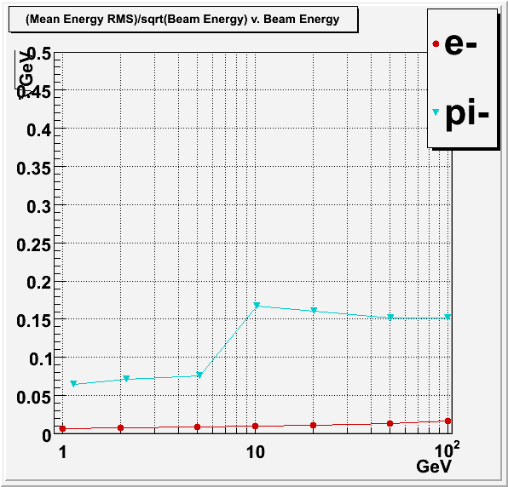
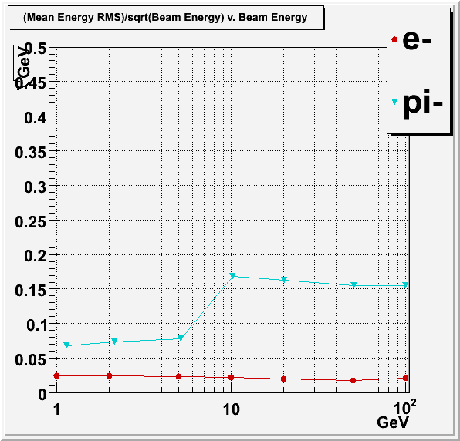
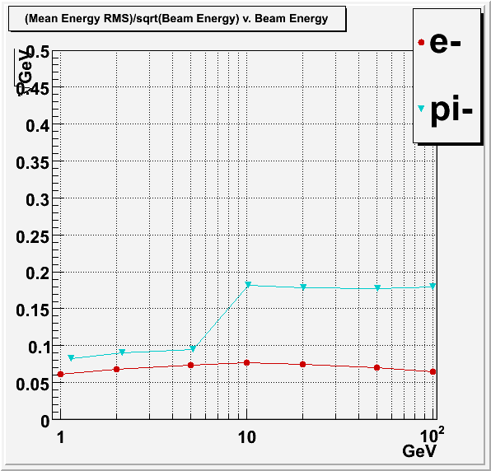
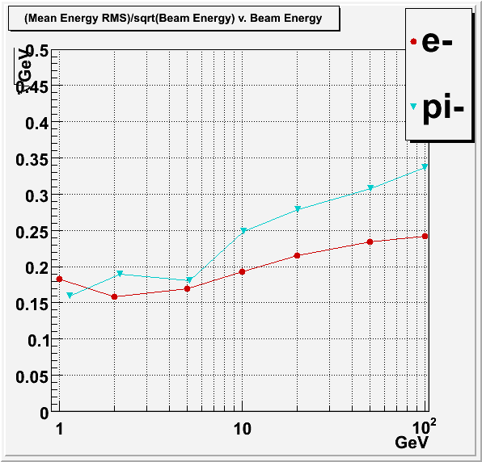
Impact of the Cherenkov Photon Statistics on Energy Resolution
Full RMS (not gaussian fit or other suspect measure
Left-to-right : infinite statistics, 200, 20 and 2 photons detected per GeV of deposited energy.
Red: electrons, blue: hadrons
No visible degradation of energy resolution down to 20 photons/GeV
Degradation at 2 photons/GeV, and in the case of electrons primarily an artifact of the implementation of the correction procedure and can be significantly improved

Slide 22
Some Further Studies Presented Here
Detailed comparison of various physics lists in GEANT (Hans Wenzel, simulation session)
Energy resolution in too thin (i.e. practical) calorimeters, importance of the longitudinal sampling (Giovanni Pauletta, Thursday)
PFA approach with crystal calorimeters (Steve Magill, Friday)
Dijet mass reconstruction, WW/ZZ separation (Adam Para, Friday)

Slide 23
Summary
Theoretical and experimental foundations of high resolution hadron calorimetry established more than 20 years ago
Progress with development of dense scintillating materials and compact photodectors enables construction of hadron/jet calorimeters with energy resolution better than 20%/√E
Past and present generations of experiments limited by physics and not the hadron calorimeter performance, experiments at the future lepton collider may be the first ones requiring high resolution hadron calorimetry
Practical construction of very high resolution calorimetry is technically possible, but it requires further development of inexpensive scintillating crystals/glasses and economical large area photodetectors
In any realistic detector the ultimate energy resolution is likely to be limited by the leakage fluctuations and calibration accuracy. At high energies it is the constant term, what counts!

