Slide 1
TE-Mode Microwave e-Cloud Measurements in the Fermilab Main Injector
Jim Crisp
Nathan Eddy
Manfred Wendt
October 1, 2009

Slide 2
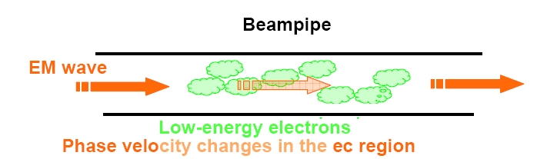
Microwave Transmission Theory
From plasma physics, expect a microwave travelling down a waveguide
to experience a phase shift due to a homogeneous plasma
From the microwave dispersion relation
For an electron cloud is proportional to e density

Slide 3
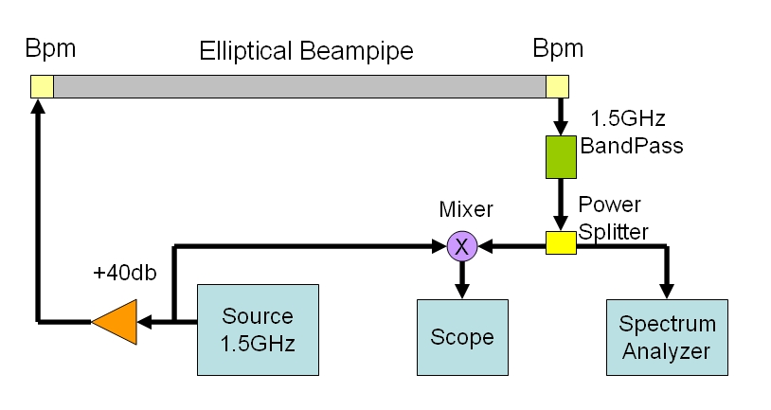
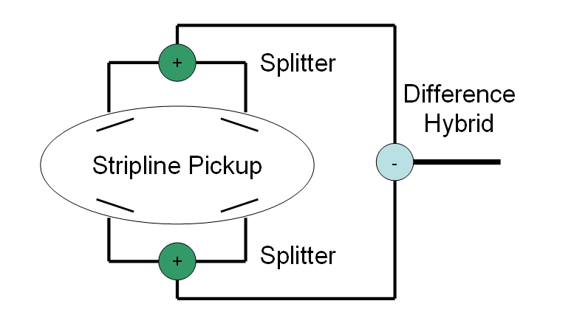
Measurement Setup
Made three different measurements of the phase shift
  Measure sideband spectrum of 1.5GHz carrier with SA
  For phase modulation of amplitude β, sideband dbc = 20log(β /2)
  Measure 1st sideband over a full MI ramp (800ms) in zero span mode with SA
  Mix down to baseband and record IF with deep memory scope (10MHz BW)
Pickup connections to optimize coupling to TE₁₁ mode
  Measure -20db transmission for two pickups and 15m of beam pipe
  Cutoff for beam pipe is just below 1.5GHz

Slide 4
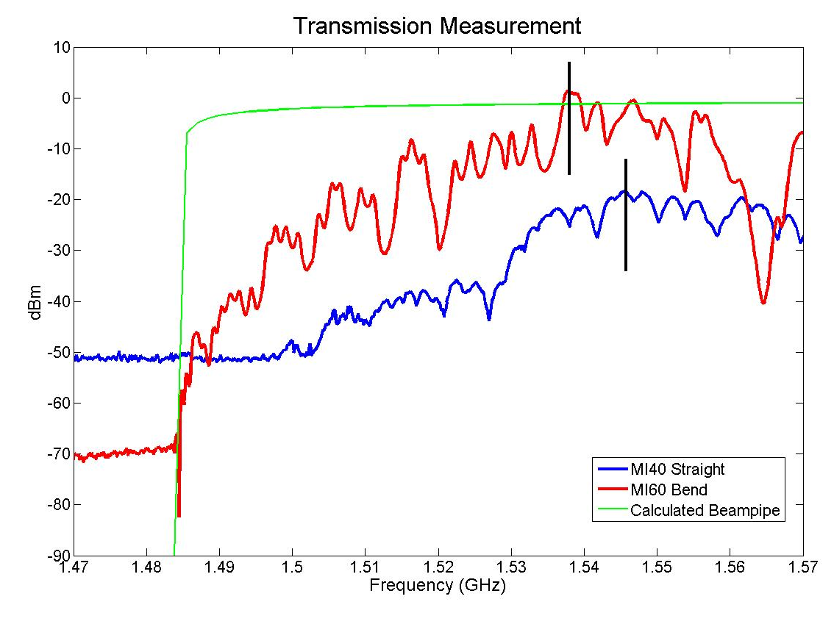
Previous Measurement Locations
MI60 Bend Region
12.6m
Quad
2.5m
Dipole
4m
Dipole
4m
Quad
2.5m
MI40 Straight Region
17.6m
Quad
2.5m
Quad
2.5m
At MI60 Bend Region able to use spare Heliax cable
At MI40 Straight Region have to use RG8 bpm cable
  See an addition 20db of attenuation on transmitted signal
  Appear to get coupling between the cables
  Put the 40db drive amplifier in the tunnel at this location

Slide 5
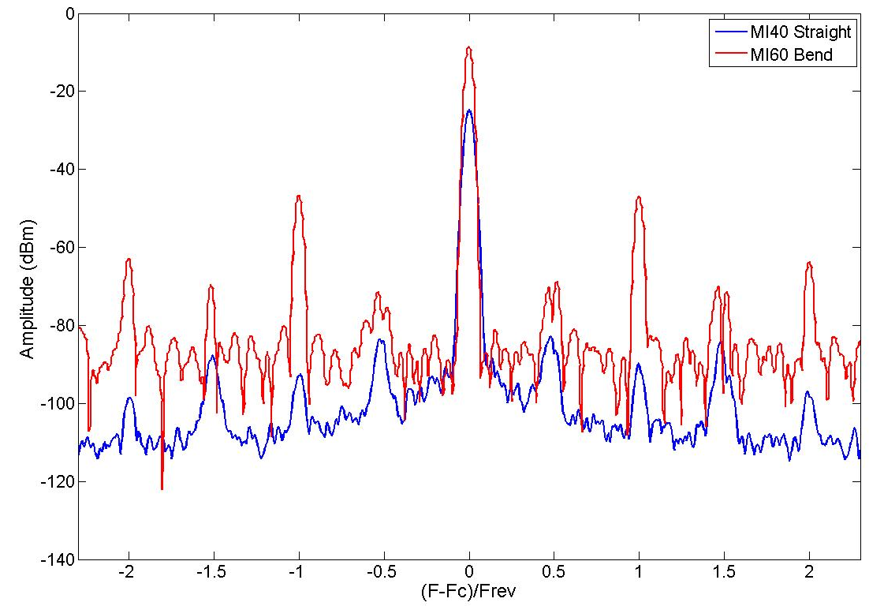
Sideband Spectrum Measurement
Microwave
Carrier
Beam Harmonics
-40dBc
-65dBc
39mRad PM
2.2mRad PM

Slide 6
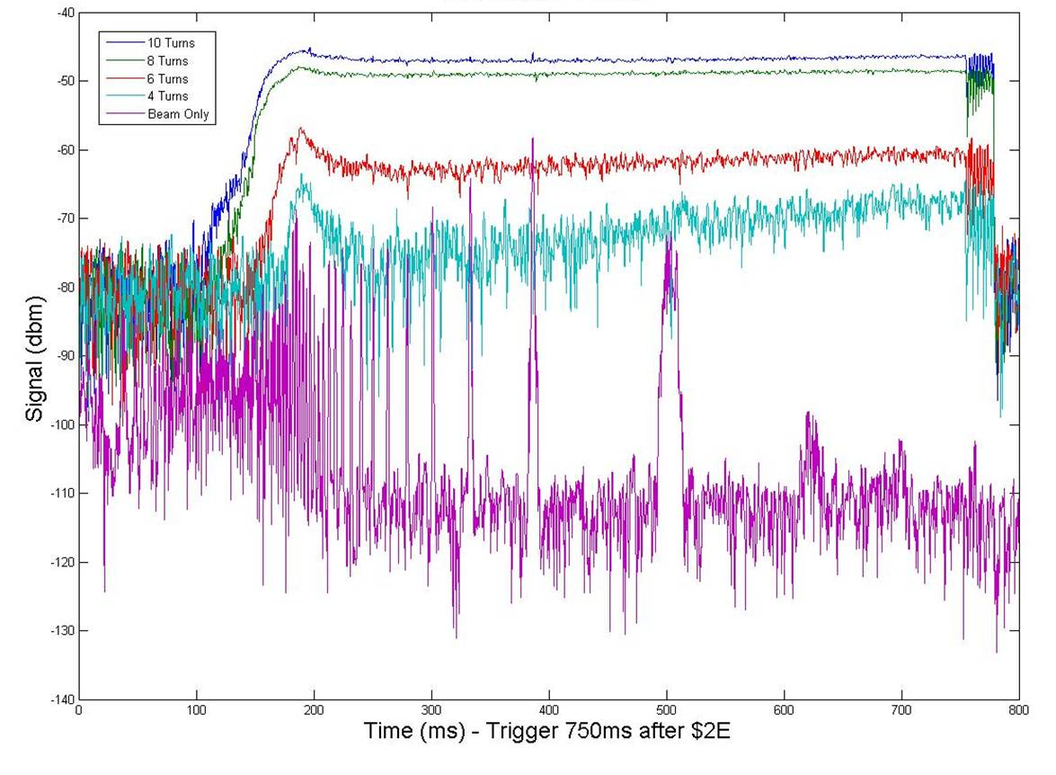
Zero Span Sideband Measurement
MI60 Bend
Transition
Bunch Rotation
Ramp Start

Slide 7
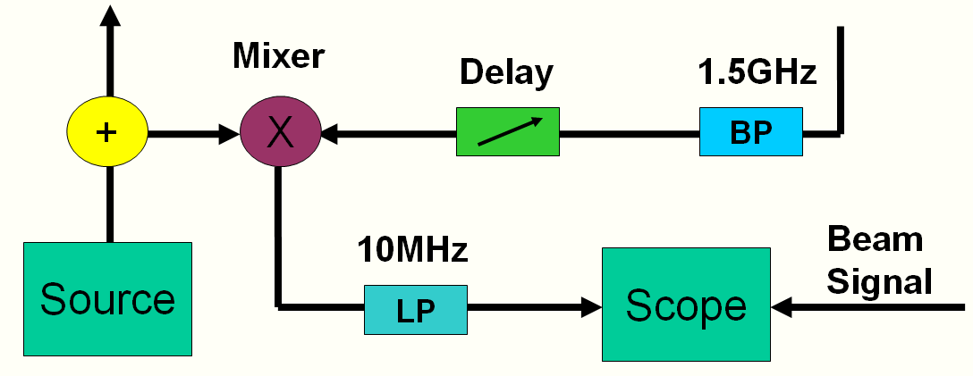
Direct Phase Shift Measurement
Mix the transmitted microwave signal to baseband
  Use the delay to effect 90° phase shift (zero DC offset)
  Theoritically, should only see PM modulation as AM cancels
Scope aquires from 2ms to 20ms sampling at either 500MS/s or 100MS/s respectively
  Expect eCloud induced phase shift to be the same each turn
  The beam harmonics behave as noise which averages away
    Use 100 turn average at MI60 and 1700 turns at MI40
  Size of the beam harmonics impacts the dynamic range

Slide 8
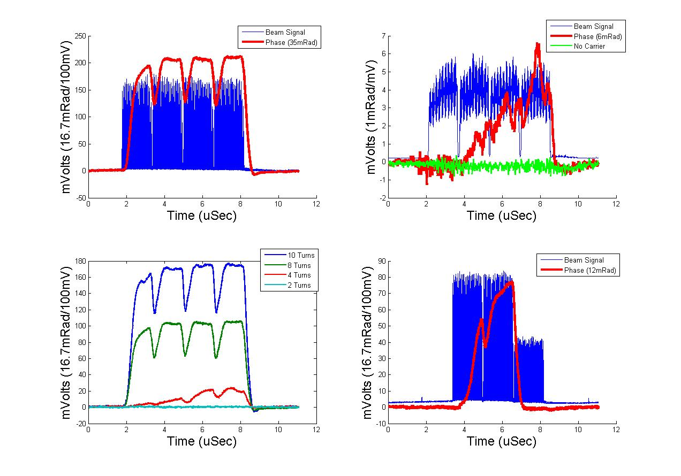
Direct Phase Shift Results
MI60
MI40
MI60
MI60

Slide 9
New Dedicated Pickups
MI52 Bend Region
12.9m
Quad
2.5m
Dipole
4m
Dipole
4m
Quad
2.5m
MI40 Straight Region
15.1m
Quad
2.5m
Quad
2.5m
Dedicated BPMs installed at MI52 Bend and MI40 Straight
  Standard elliptical beam pipe and pickups
  Completely field free at MI40 straight
Good quality heliax cable pulled for each BPM
  Expect improved sensitivity for MI40 Straight

Slide 10
Coated Pipe/RFA Comparison
Setup at MI-521
1m
1m
B
A
C
RFAs
RFAs
Absorber
Absorber
6” Round Pipe
Three Large Aperture BPMs have been installed around 1m long test pipes at MI-521
  Cutoff for the 6” round pipe is just below 1.2GHz
  As measured phase shift is proportional to length -23db sensitivity
Will provide direct comparison with RFA
  Expect to be very useful in understanding Δφ e density

Slide 11
Summary and Plans
Crosscheck Measurements and Sensitivity at New Locations
  Can now make measurements at each location under similar conditions rather than weeks or months apart
  Expect stronger signals before conditioning
Demodulate transmitted signal to separate PM & AM
  Verify we are observing Phase Modulation
  Verify expectation of no Amplitude Modulation
Calibrate phase shift to electron density
  Comparison with RFA measurements
  Comparison with simulation results
We welcome anyone interested in helping!

