Slide 1
Top and Tau Measurements
Tim Barklow (SLAC)
Oct 02, 2009

Slide 2

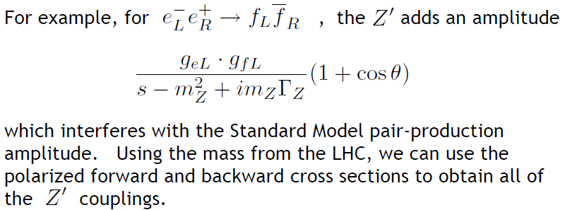
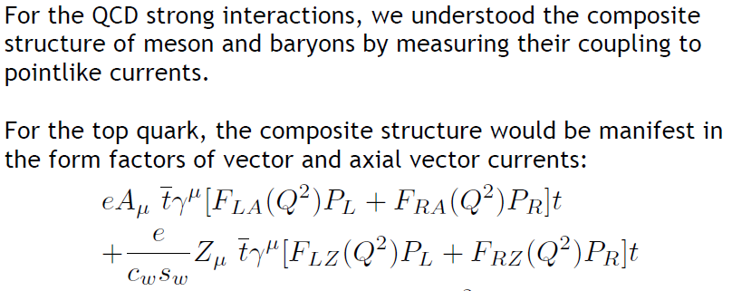
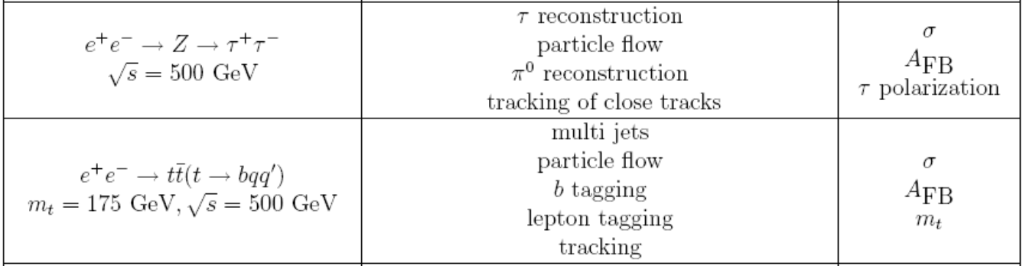
Examples of early LHC discoveries from M. Peskin, Rethinking the LHC-ILC Connection:

Slide 3
The top and tau analyses of ILD and SiD are very similar.
For each topic I will discuss the analysis of just one detector
concept in detail while noting differences. At the end of the
talk I will present the results from all concepts.
Top Mass and σ_{tot}: ILD
Top A_{FB}: SiD
Tau σ_{tot}, A_{FB} and Decay Mode ID: SiD
Tau Polarization: ILD

Slide 4
Top Mass & σ Measurement

Slide 5
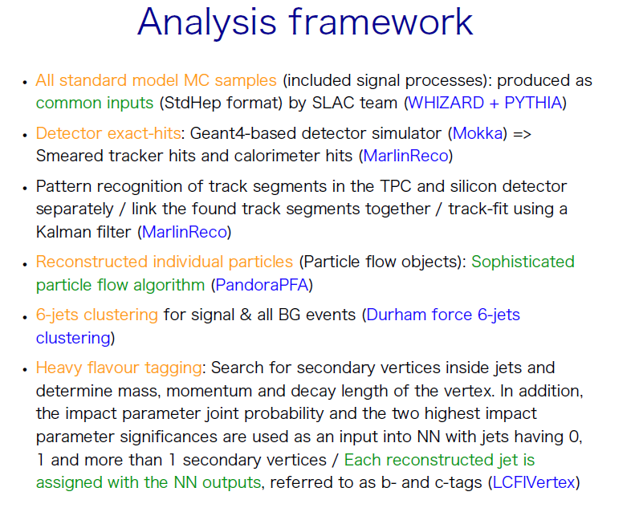

Slide 6
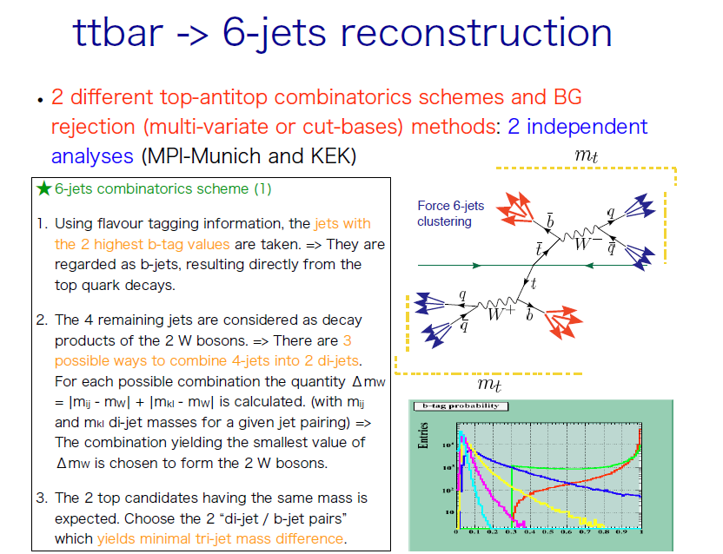

Slide 7
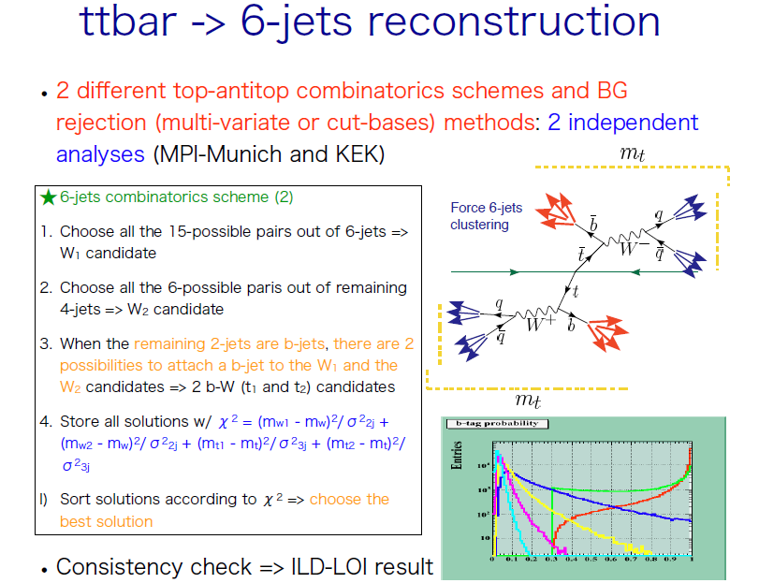

Slide 8
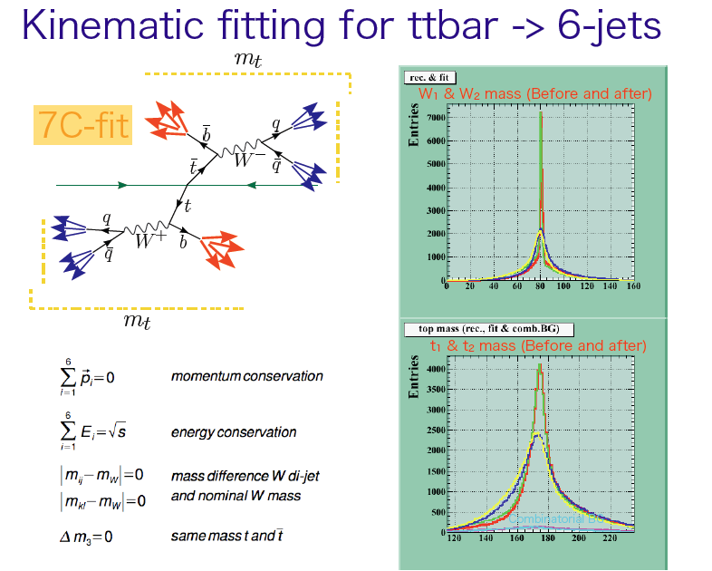

Slide 9
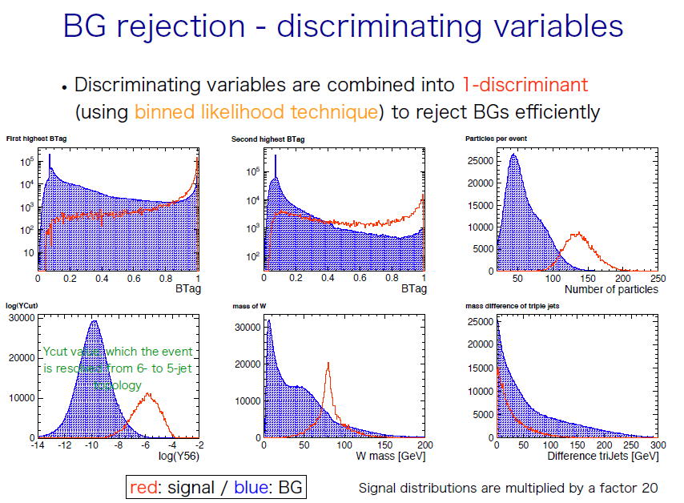

Slide 10
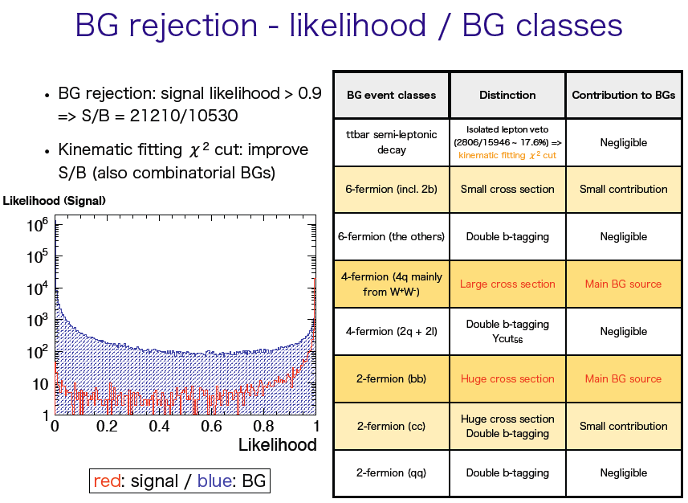

Slide 11
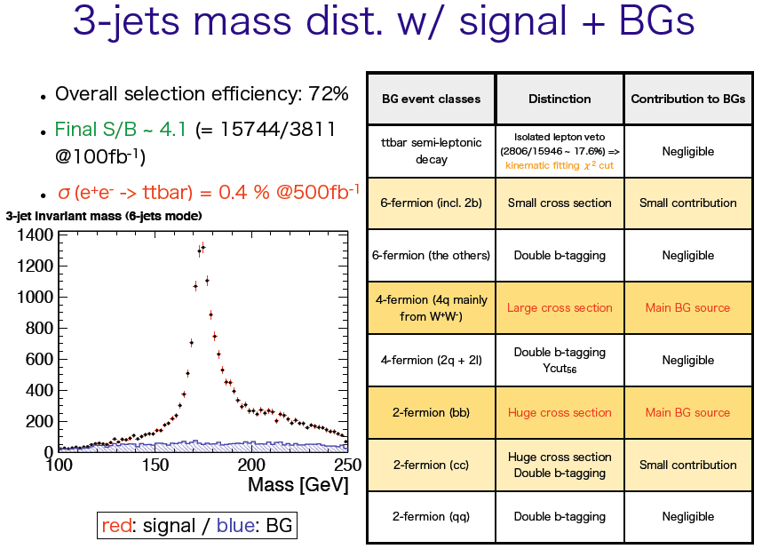

Slide 12
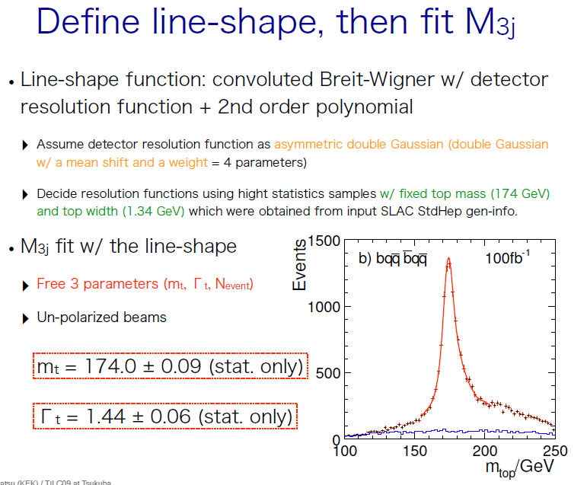
(100 fb⁻¹)
SiD uses both line-shape and template mass fitting techniques

Slide 13
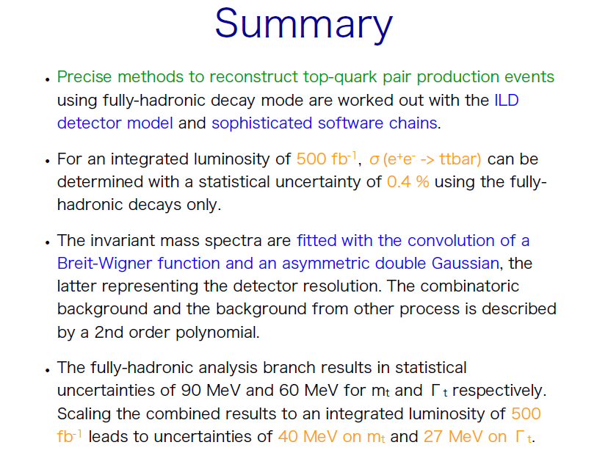
ILD M_{t} & σ_{tt}

Slide 14
Top A_{FB} Measurement

Slide 15
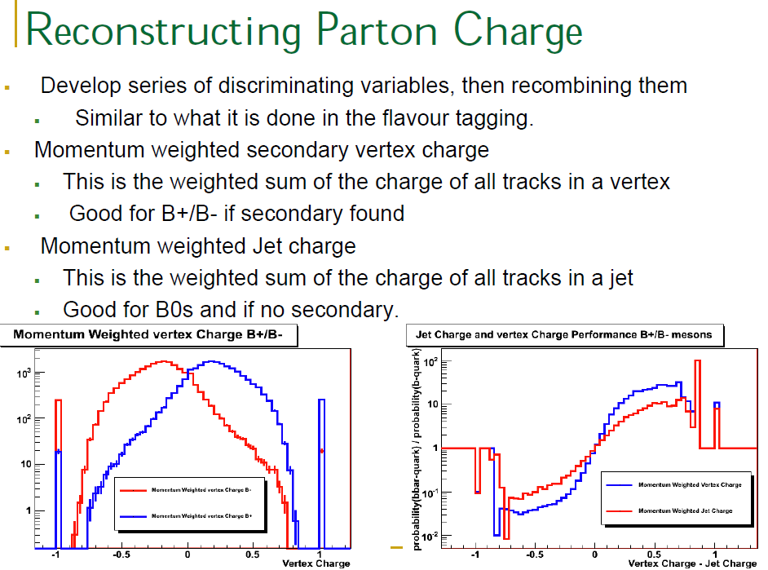

Slide 16
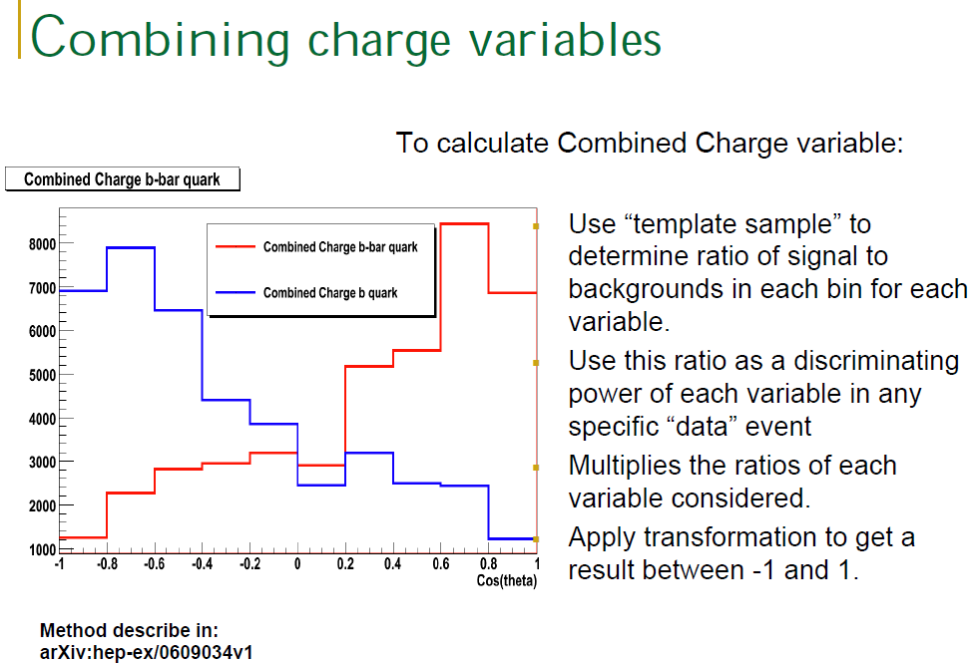

Slide 17
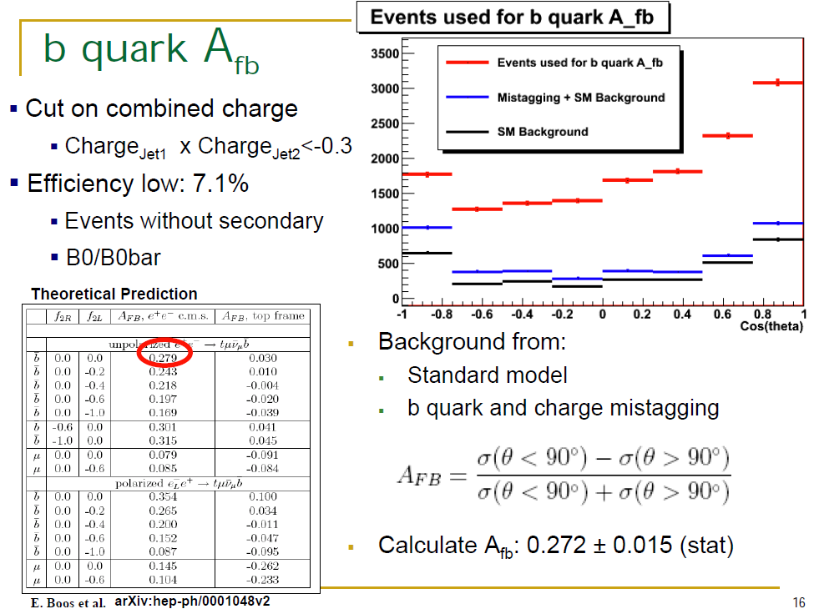

Slide 18
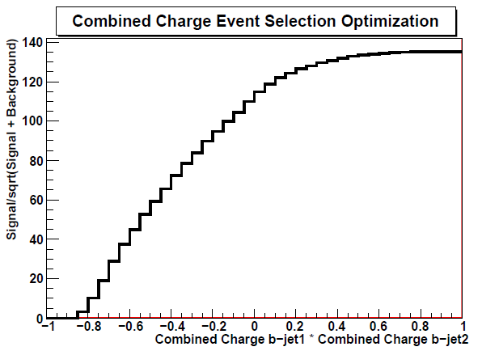
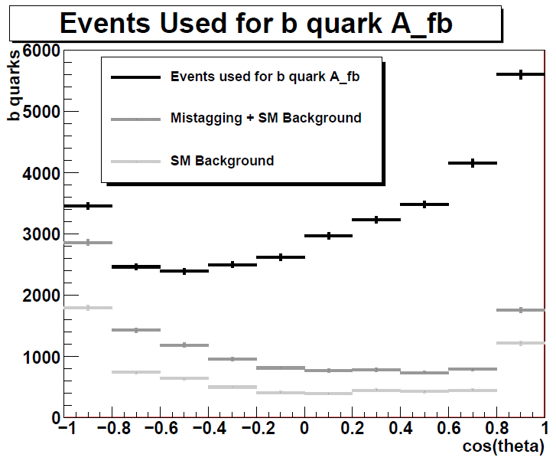
b quark A_{fb}
post LOI update
No cut on combined charged:
Charge_{Jet1} x Charge_{Jet2}<1
Efficiency = 22.7%
Purity=58.1%
Impurity composition:
  SM bkgd 45.9%
  ttbar with wrong b-jet charge 45%
  ttbar with wrong b-jet id 9.1%
A_{fb}(b)=0.293+0.008

Slide 19
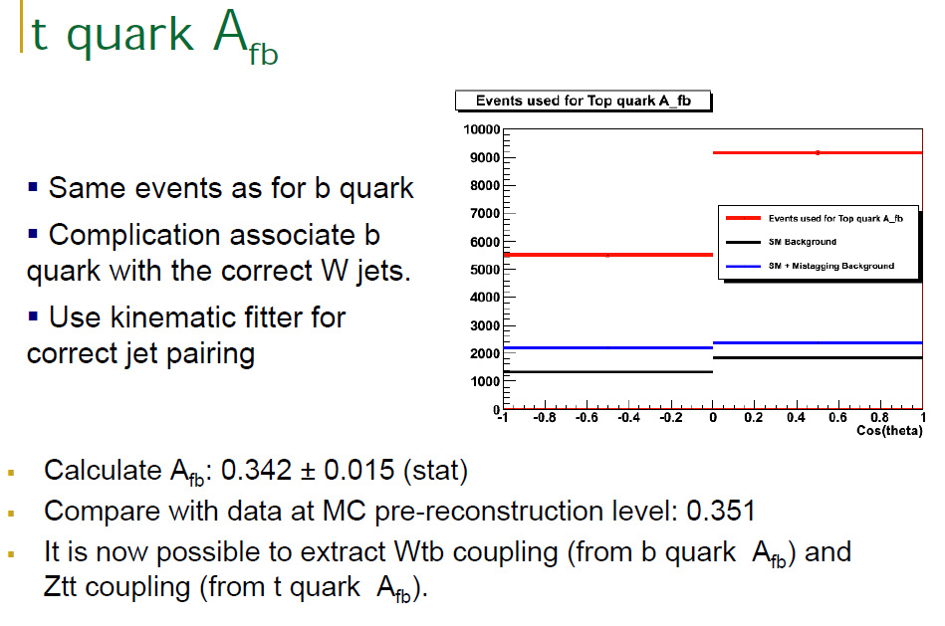
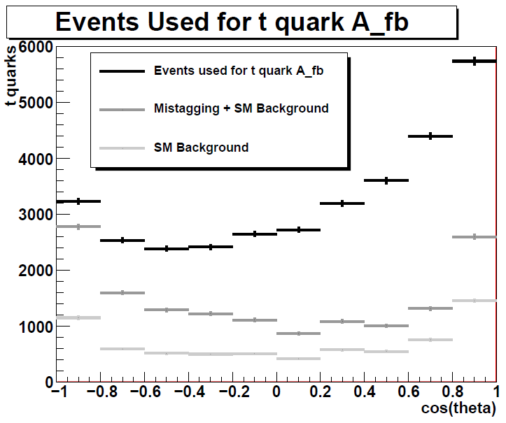
0.356+0.008

Slide 20
Tau σ_{tot}, A_{FB} and Decay Mode ID

Slide 21
Tau selection and background
Event cuts: 2-6 tracks, 40<Evis<450 GeV
Event cuts: 2-6 tracks, 100<Evis<450 GeV
Tau jet clustering, 2 jets, each cosθ < .95
Opening angle > 178 degrees
Eliminate events with both mu or both e
Selects 17.4% of all tau pairs, 72% of minE > 240
Background from other SM 2.4%

Slide 22
Tau pair cross section and A_{FB}

Slide 24
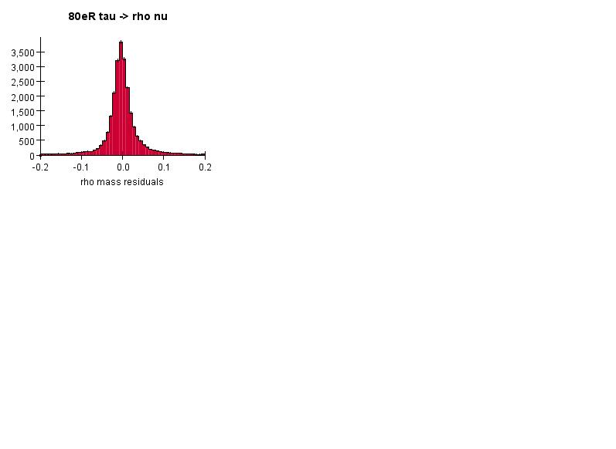
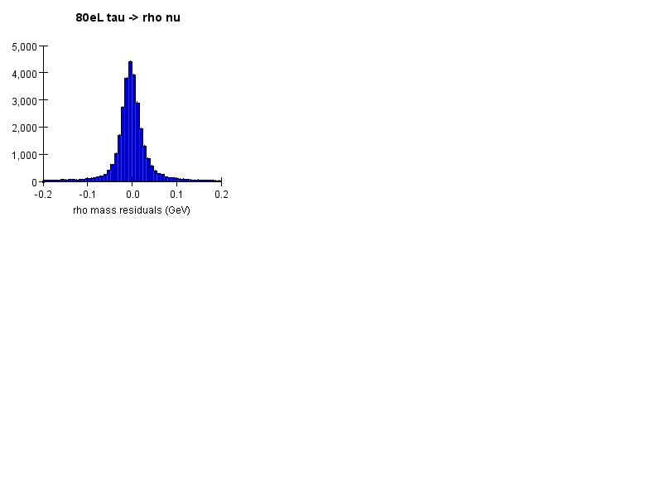
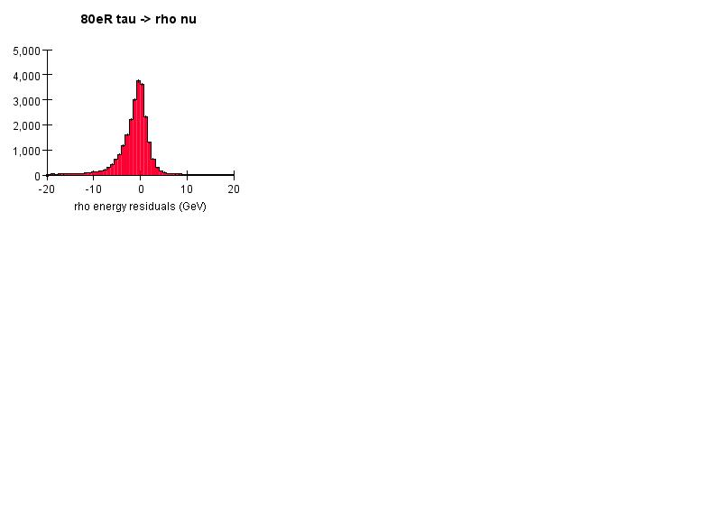
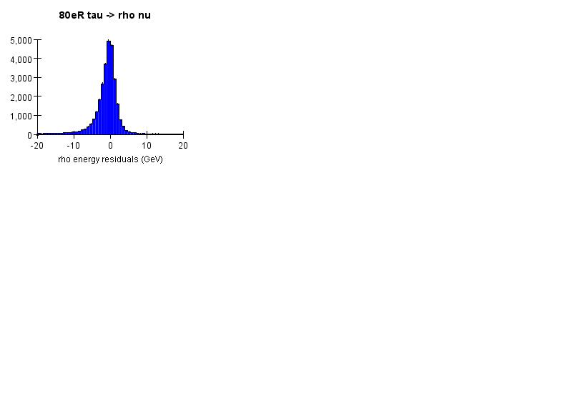
Rho reconstruction

Slide 25
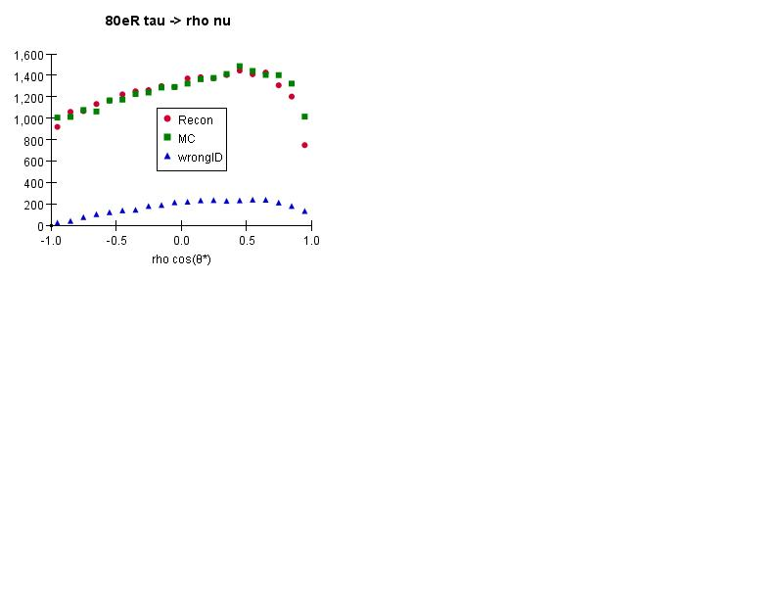
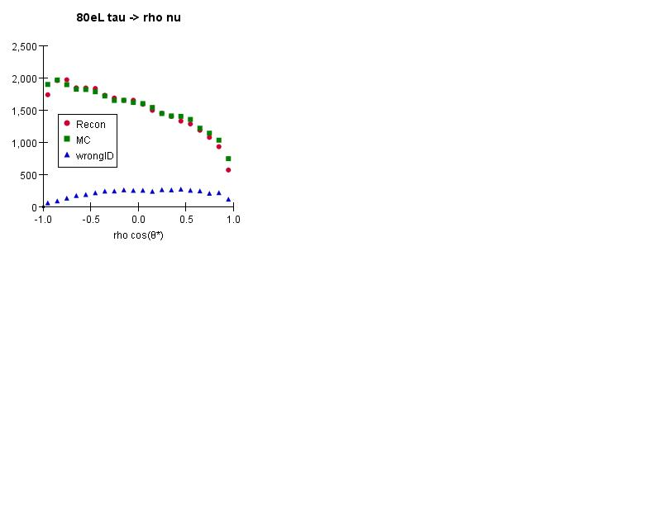
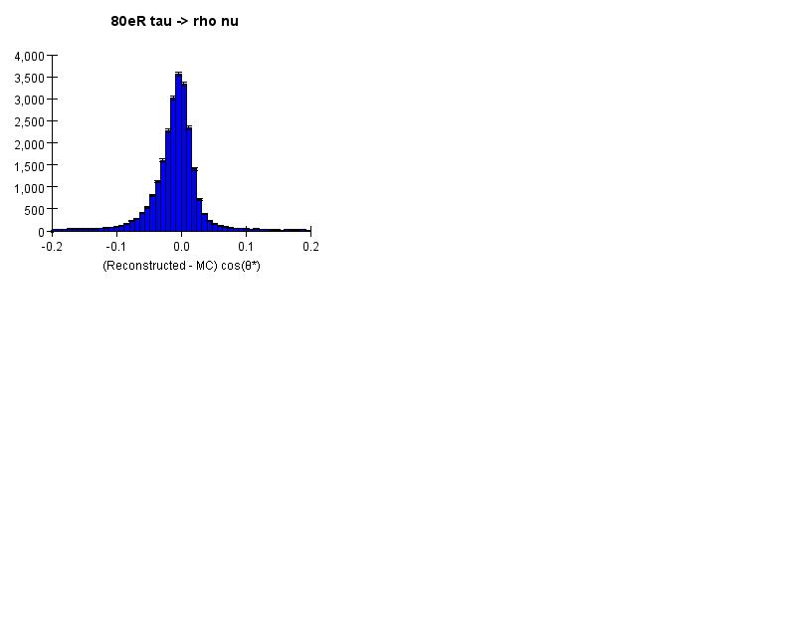
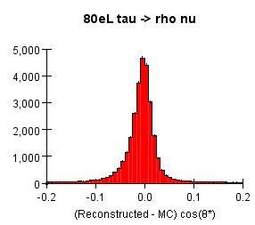
Θ* = angle between rho and tau in tau rest frame

Slide 26
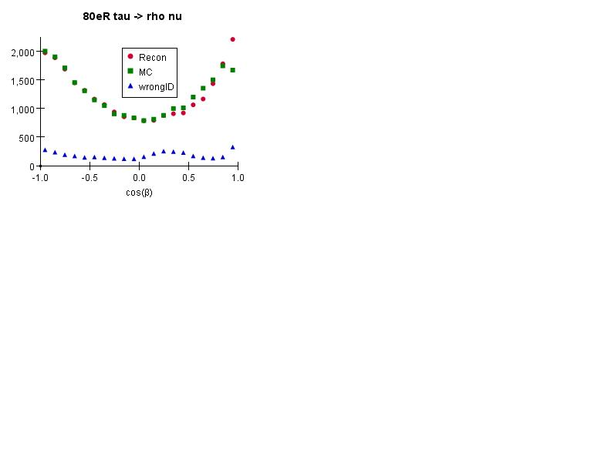
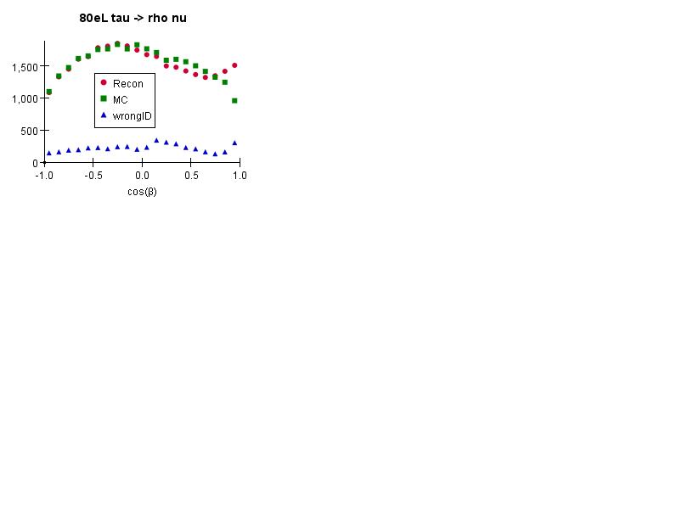
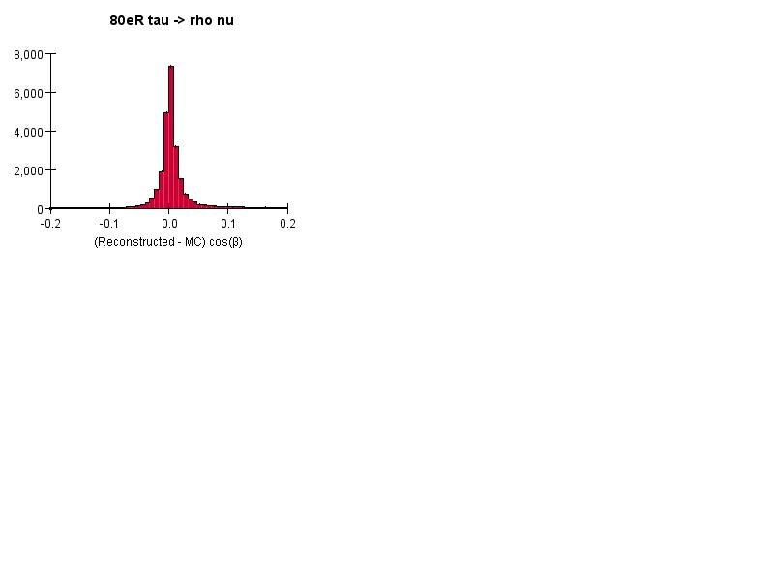
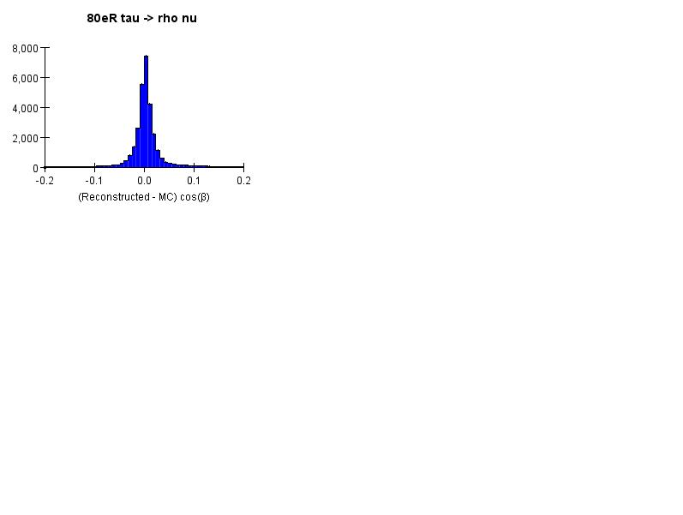
β = angle between pi+- in rho rest frame

Slide 27
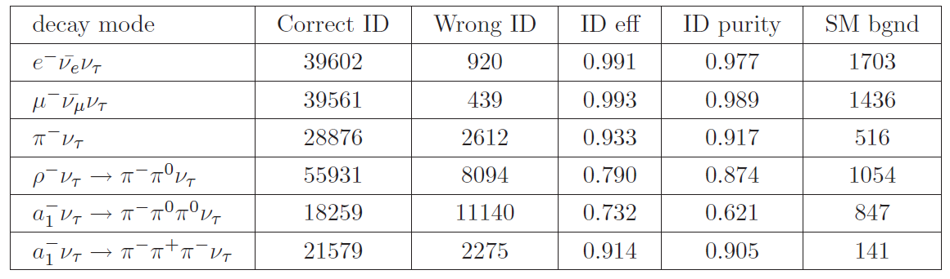

Slide 28
Tau Polarization Measurement

Slide 29



Decay modes in A_{pol} analysis
4 decay modes:
  Separated by lepton-ID (high eff.)
  Polarization information is lost by two missing neutrinos
  1 charged π, moderate BR, good for pol. derivation
  1 charged π+2 γ photon separation (detector)
ρ (770 MeV mass, 150 MeV width)
Minimize stat. error by combining decay modes

Slide 30
Optimal observable
Polarization calculation varies by decay modes.
  Energies and angles of/between daughters
  Better if single criterion can be used in all decay modes.
→ optimal observable ω
  expression of ω differs by decay modes, but ω can
  be summed up through all decay modes.
  (multi-dimensional fit in each decay mode is not needed)
  Developed in LEP.

Slide 31
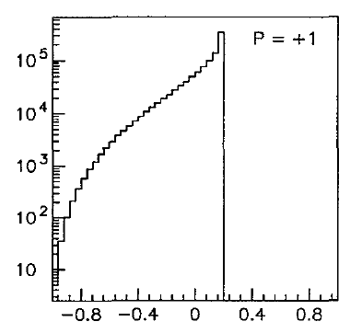
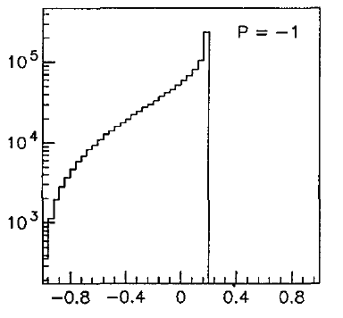

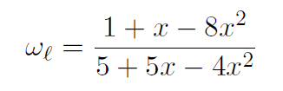
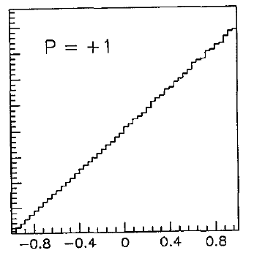
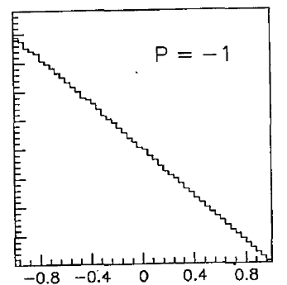



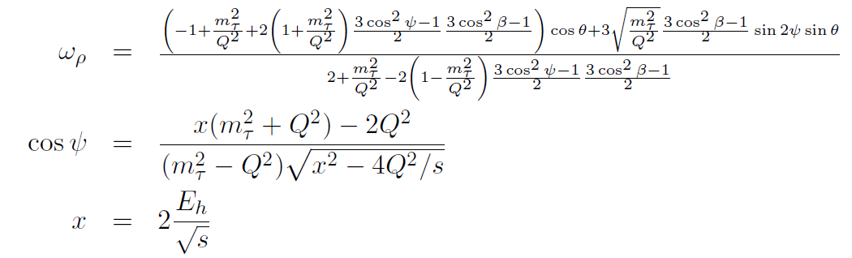
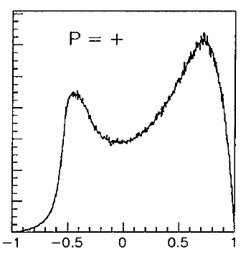
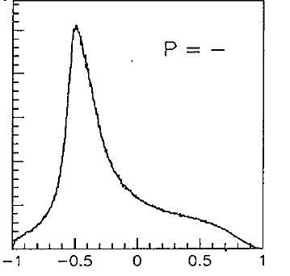
Optimal observable
(x: lepton energy / tau energy)
(2 energies and 3 angles, 5 parameters)
(4. a₁ : almost ready…)

Slide 32
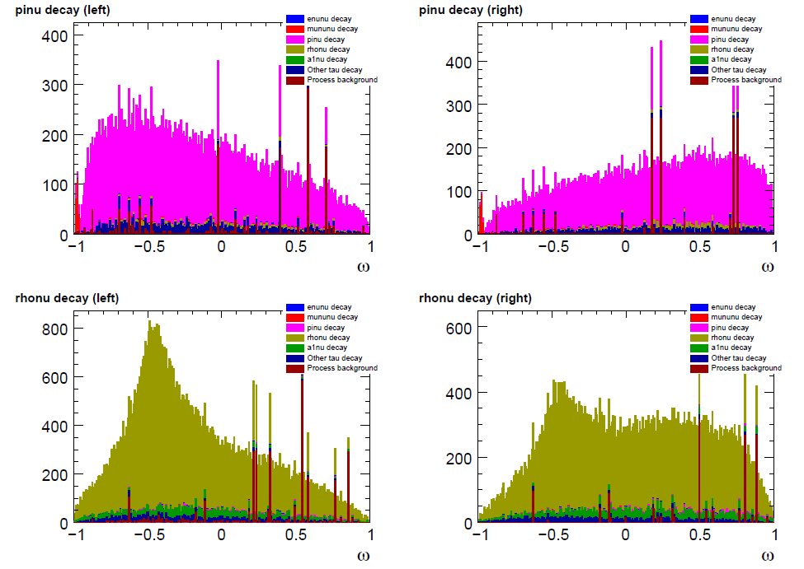
Optimal observable distribution
Apply ω formula on sample of
initial polarization P(e⁺, e⁻) = (30%, 80%)

Slide 33
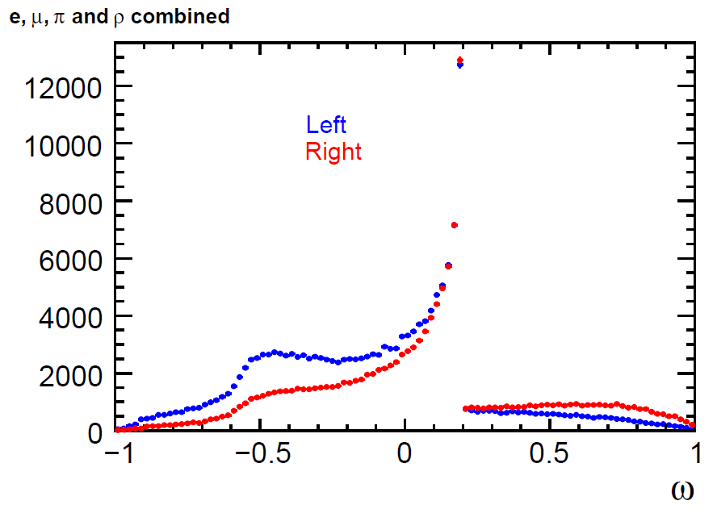
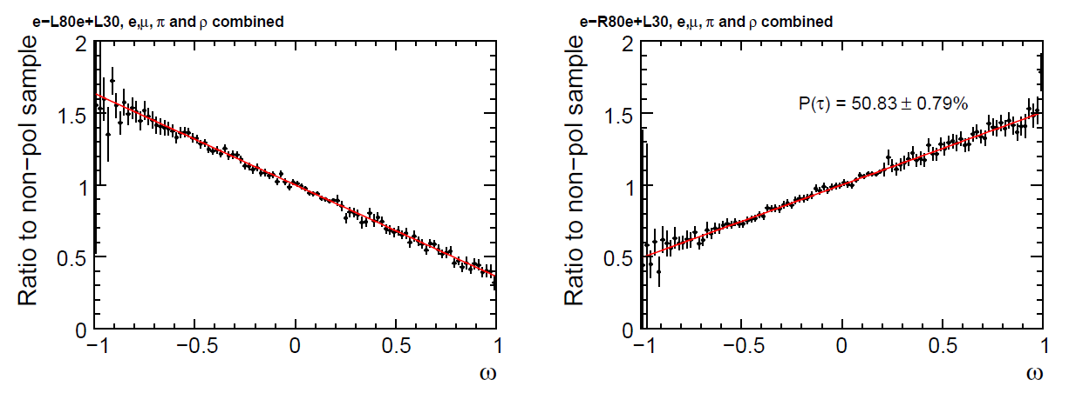
Polarization of tau
Summed up 4 ω distributions
  Process background is excluded (short statistics)
Obtain P(τ)
Obtain P(τ) stat. error with 500 fb⁻¹
P(τ) = -63.82 ± 0.66% (e⁻_{L}e⁺_{R})
P(τ) = +50.83 ± 0.79% (e⁻_{L}e⁺_{R})

Slide 34
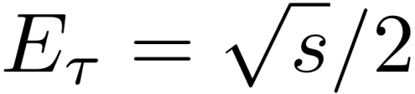
Tau flight direction
should help with polarization measurement
  3 degrees of freedom of tau four-vector
  3 constraints:
    tau/hadron angle from two-body decay kinematics
    tau track must meet the hadron track at a point (1-prong) or the vertex (3-prong)
  can be solved for tau direction analytically
hadron
a sneak preview of this concept will be shown for 1-prong events
using first-order approximation for tracks (using line segment instead of helix)
tau
θ
IP
neutrino

Slide 35
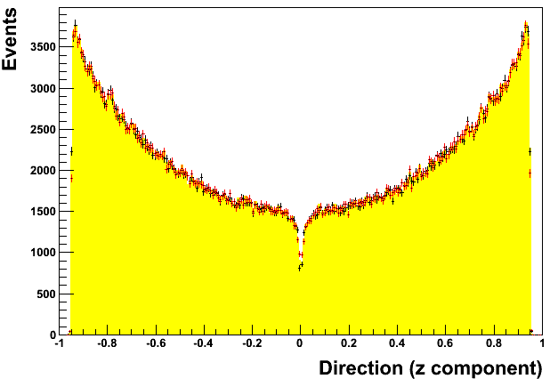
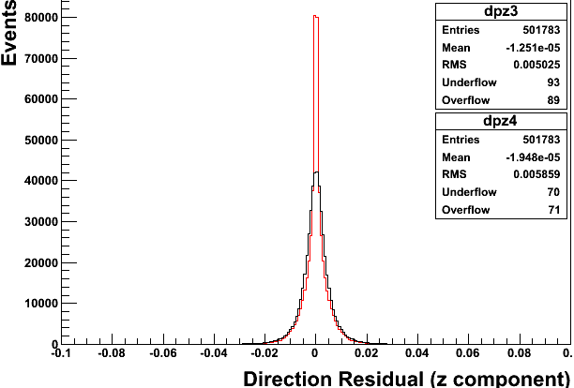
Tau flight direction (1-prong events)
tau direction in lab frame
tau direction residual (reco – mc)
tau
(tau reco – tau mc)
hadron
(hadron reco – tau mc)
hadron dir (reco)
tau dir (reco)
tau dir (mc)
x,y residuals look similar
tau direction successfully reconstructed (3-prong work next)
better than assuming tau dir = hadron dir (rms: 0.0059 > 0.0050)

Slide 36
Summary of Results from the
Detector Concept Groups

Slide 40
Conclusion
ILD (SiD) have demonstrated that they can measure the mass of the top quark in the fully hadronic channel at Ecm=500 GeV with 40 (45) MeV statistical precision. They have also shown that the vector and axial-vector couplings of the top quark can be measured through the forward-backward asymmetry in the challenging fully hadronic mode with a precision of 0.008
ILD and SiD can identify the decay modes of 250 GeV tau leptons with purities and efficiencies in the 90% range. They both measure the tau polarization with an accuracy of 0.7%.
ILD and SiD are well positioned to take the next steps in studies of top and tau couplings:
Future studies of top quark coupling measurements would involve top polarization studies with optimal observables.
Future studies of tau coupling measurements are already underway in ILD with the addition of the a₁ decay mode and the incorporation of vertex detector information to further constrain the tau direction.

