Slide 1
FNAL Cavities for S1 Global
Jim Kerby
ALCPG 09

Slide 2
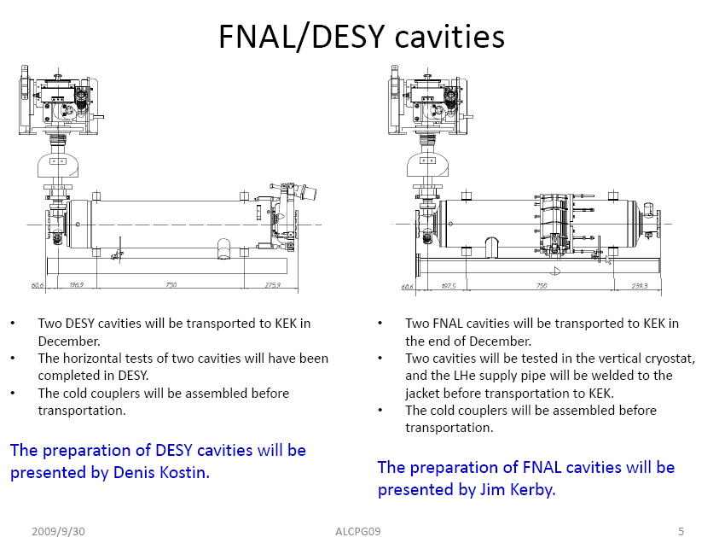
FNAL Deliverables
Discussed in meetings 15/16 July and 10/11 Sept, and Webex and emails

Slide 3
FNAL Cavities for S1 Global
Major components well understood
Working to complete cavity testing and assembly
Working to identify ‘incremental’ pieces that can be supplied most efficient manner
Assisting where possible to understand tooling requirements

Slide 4
Cavity Processing
As discussed elsewhere is has been a difficult few months
  processing cavities
  dressing cavities
  testing due to civil construction at the test facility
A working plan has been developed, agreed to by the Americas team and is in use

Slide 5
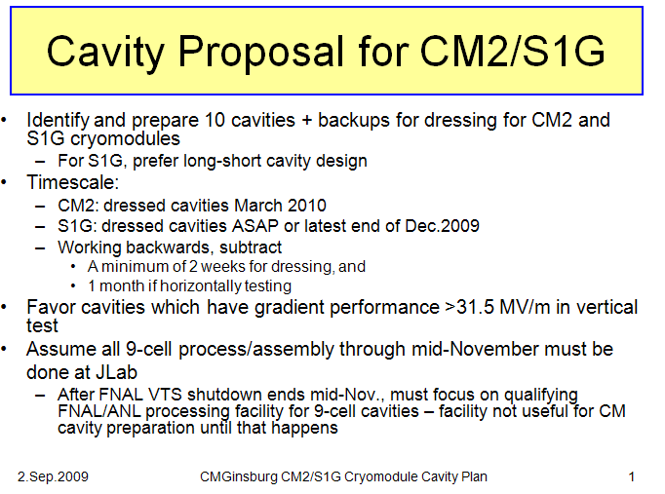
Cavity Plan
(slides from C. Ginsburg after discussion among cavity group / subset of M. Champion talk tomorrow)

Slide 6
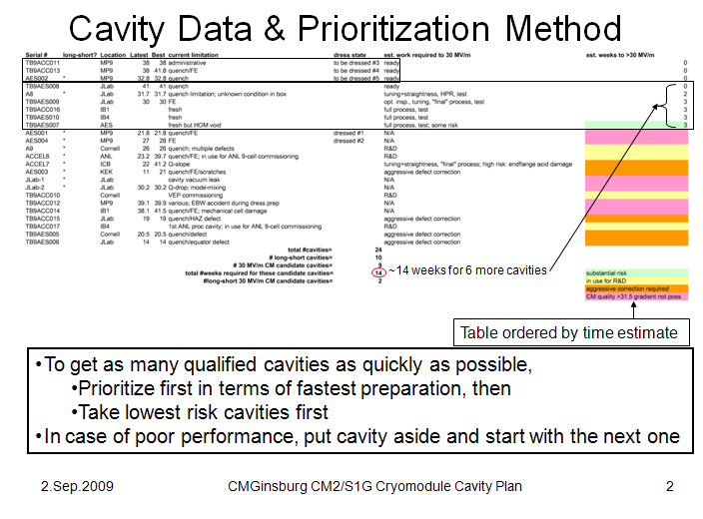
Cavity Plan

Slide 7
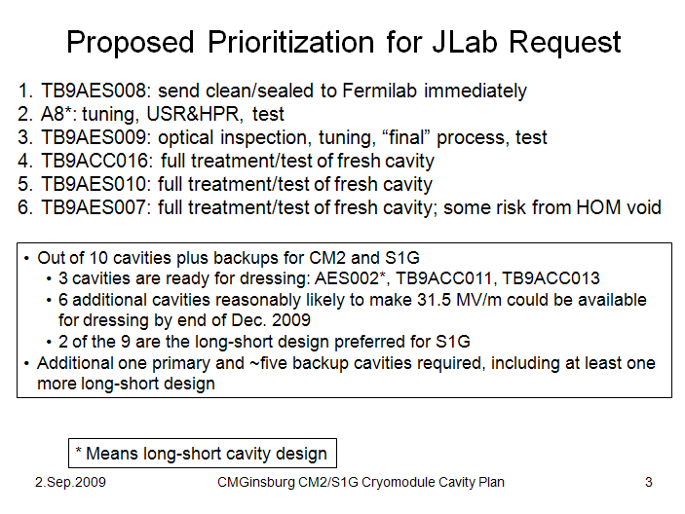
Cavity Plan

Slide 8
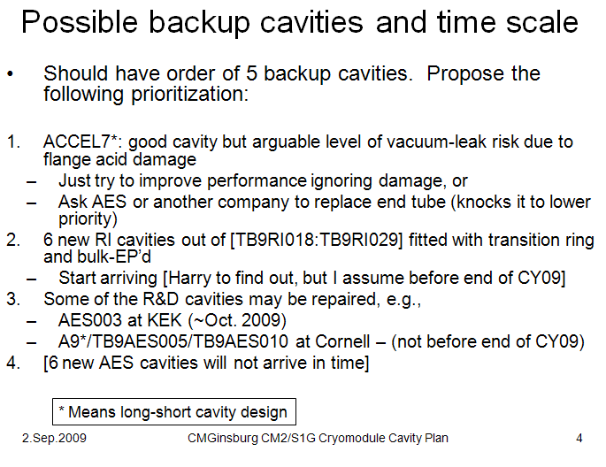
Cavity Plan

Slide 9
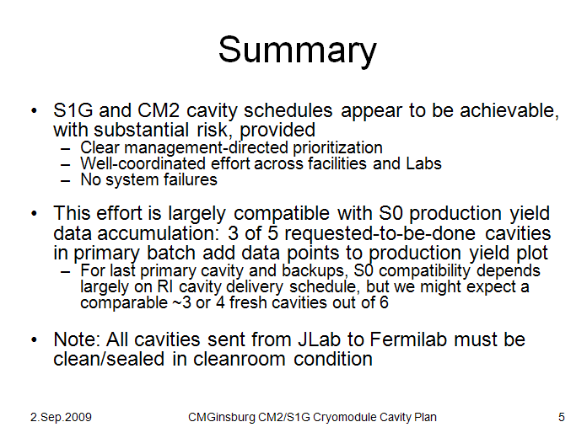
Cavity Plan

Slide 10
Cavity Shipment (thanks to T. Arkan)
The cavities will be shipped to KEK with the configuration as below:
  Outfitted with helium tank, w/ the bellows in the middle of the tank supported with 4 spanner rods. (These rods should not be removed until the blade tuner assembly task).
  All flanges are blanked-off with peripheral components, cavity ready to be assembled into the string. Cavity will be under vacuum during transportation.
  2-phase pipe welded to the helium tank, cold end of the coupler is supported with an arm support fixture through the 2-phase pipe. (Do not remove this support until string is ready to be assembled to the GRHP.)
  Blade tuner and magnetic shielding pieces (will be assembled at KEK.)
Cavities will be shipped with these fixtures to KEK

Slide 11
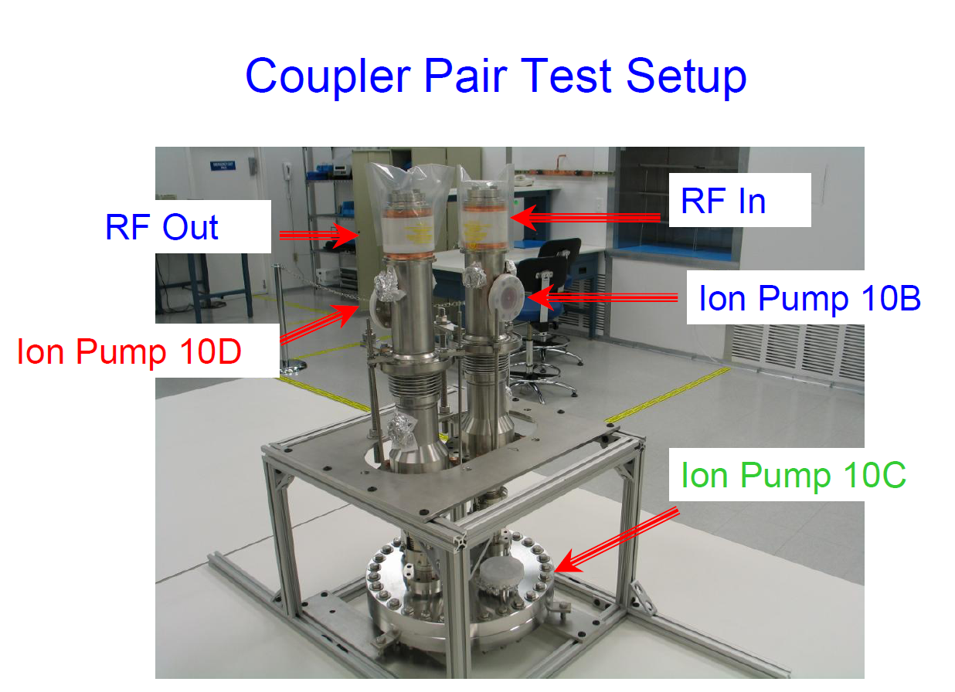
Power Couplers-I
Power Couplers are high power cleaned, assembled and high power processed at SLAC

Slide 12
Power Couplers-II
Cold End of the couplers will be assembled to the cavities that we will send for S1 Global

Slide 13
Power Couplers-III

Slide 14
Power Couplers-IV
Cold Parts will be installed at FNAL, we will not send Case A to KEK
Case B, C and D will be sent to KEK as they are shipped from SLAC to FNAL. FNAL will not send any assembly fixtures to KEK.

Slide 15
Cold Mass Assembly Procedures
Procedures will be provided for:
  Ti 2-phase pipe & Ti bellows welding
  Blade Tuner & motor assembly
  Magnetic shielding assembly
  Needle bearings assembly
  Cavity Final Alignment
  Instrumentation Flanges (A, B) wiring diagrams

Slide 16
Instrumentation Flanges / Additional Parts
FNAL will provide 2 sets of T-configuration flanges with Flange A and B.
Wiring diagrams will be provided along with all the coax cables and instrumentation wires. FNAL will provide components such that cavity instrumentation and RF connectors can be attached to the vacuum side of the Flange A and B.
Bellows and transitions (piping and magnetic shielding) have been identified in Norihito’s list
The bracket on the coupler external to the vacuum vessel (discussed 10/11 Sept) will be sent.
The transition to the Gate Valve region still must be clarified

Slide 17
Summary
FNAL is working to supply two cavities and associated parts to S1 Global by December
FNAL is willing to participate in assembly processes to the extent practical and as local needs allow
Instrumentation List is in preparation for ‘CM2’ like cavities. Upon completion this should be reviewed for S1.
FNAL Tooling is under review to accommodate design changes in the dressed cavities. Changes / lessons learned will be communicated to KEK

