Slide 1
Pulse Shapes of MPPC’s
Adam Para
March 20, 2009

Slide 2
‘Single pe’ as a Function of Temperature
‘Single pe’ is often used to define ‘gain’ of the device.
‘single pe’ defined for a measurement related to a total charge of a single avalanche signal is nearly independent on the temperature
‘single pe’ defined via the amplitude of the signal depends strongly on the temperature
the difference between these two measures presumably reflects the variation of the actual shape of the signal, presumably due to the variation of the value of quenching resistance.

Slide 3
Determination of the Pulse Shape
Sooo… How does the MPPC pulse shape change with the operating conditions (temperature, voltage). Simple, in principle: just average some number of pulses…
In practice, though:
  How to trigger?
  Which pulse use to average (avoid pulses ‘contaminated’ by afterpulses, which may vary with voltage/temperature)
  How to overlay/align pulses (peak position? Fixed threshold? Constant fraction?)

Slide 4
The Procedure
Using the analysis of the data triggered on laser (hence: unbiased) determine the approximate height of a ‘single pe’ for any operating condition
Trigger on 1/3 of a ‘single pe’ and collect the data at different V, T
Select pulses ‘consistent’ with the approximate pulse shape at a given temperature (loose cuts)
At any operating conditions:
  Cut out pulses higher than 1.2 of the most probable amplitude
  Cut out pulses longer that 1.2 of the most probable width
  Align the resulting pulses at the peaks
  And the result is..

Slide 5
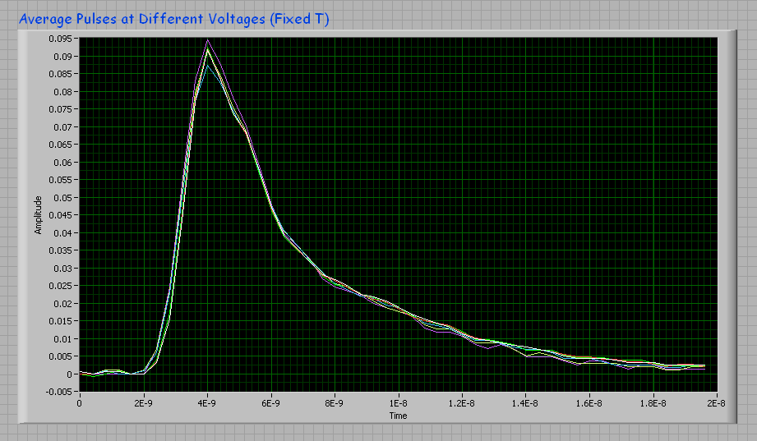
Pulses at different V

Slide 6
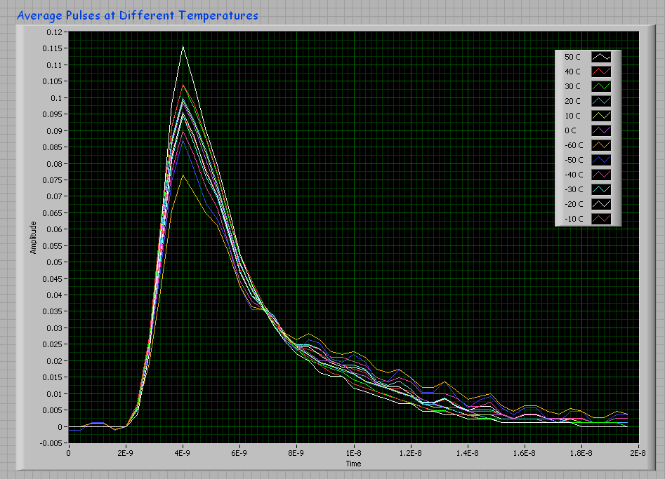
Pulses at Different Temperatures

Slide 7
Conclusions
At fixed temperature the pulse shape is nearly independent of the bias voltage
With the decreasing temperature the pulse are getting longer and longer
More studies to come..

