Slide 1
Superconducting Cavity
& Infrastructure Development at RRCAT
Satish Chandra Joshi
Raja Ramanna Centre for Advanced Technology, Indore, India
Presentation in Web Meeting with Fermilab April 20, 2009

Slide 2
Outline
Motivation for SCRF cavity R&D Activities
Major Objective under the Plan Project
Cavity development
Infrastructure Facilities planed
Collaborative Activities under MOU between Indian Institutions & Fermi lab

Slide 3
Motivation: Link to Major Programs
(Domestic and International)
Development of SCRF Science and Technology, including setting up of infrastructure facilities for SCRF Cavity for High Energy & High Power Accelerator Applications
Indian participation in ILC/XFEL/Proton Driver
Superconducting Materials R & D for SCRF cavity related research.
Application of SCRF in development of an infrared source, High Power Proton Accelerator for Spallation Neutron Source etc.

Slide 4
Project Objective
Technology development and setting up of an infrastructure for the SCRF cavity fabrication, chemical processing, cleaning, assembly and testing at required accelerating gradient for accelerator applications like SNS, XFEL, ILC etc.
Establish Cryogenic Infrastructure to operate large systems
Experimental research in bulk and thin film superconducting materials for SCRF cavities of high gradient and quality factor.

Slide 5
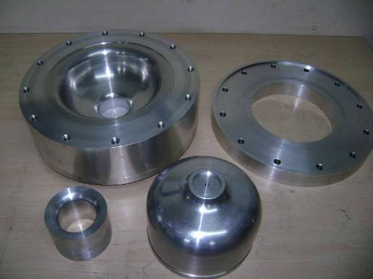
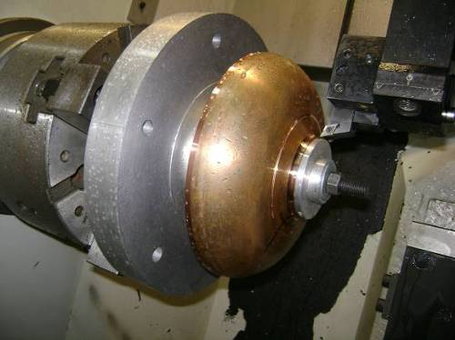
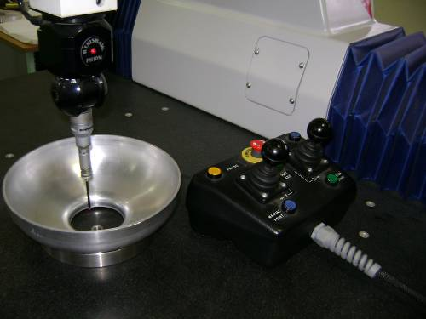
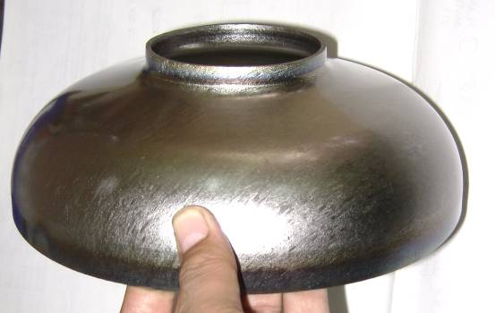
Development of 1.3 GHz TTF Cavity
Forming and Machining Tooling
Manufactured and qualified one complete set of forming and machining tooling (Mid half cell, Long end half cell, Short end half cell) for TTF cavity.
One complete set of forming tooling transported to Fermilab.
Developed Niobium grade RRR 300 half cells for 1.3 GHz SC Cavity.
Forming tooling
Half cell machining
CMM inspection
Formed half cell
20 April 2009

Slide 6
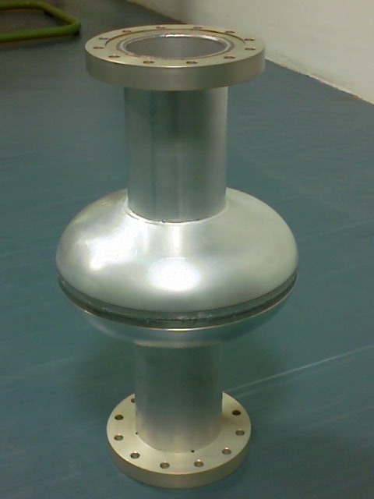
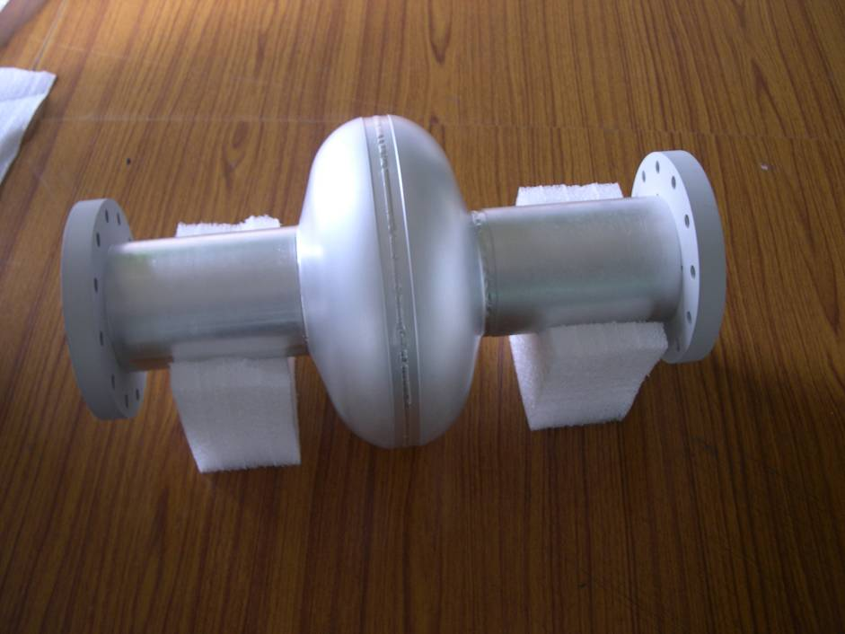
First EB welding trial
1.3 GHz Single cell Aluminum Prototype
Cleaned
As received
Made in collaboration of –
RRCAT, Indore – Indian Industry , LTE, Coimbtour
EBW Machine : 06 kW, 60 kV; Chamber size 0.5 m x 0.45 m x 0.45 m
M/s Techmeta, France

Slide 7
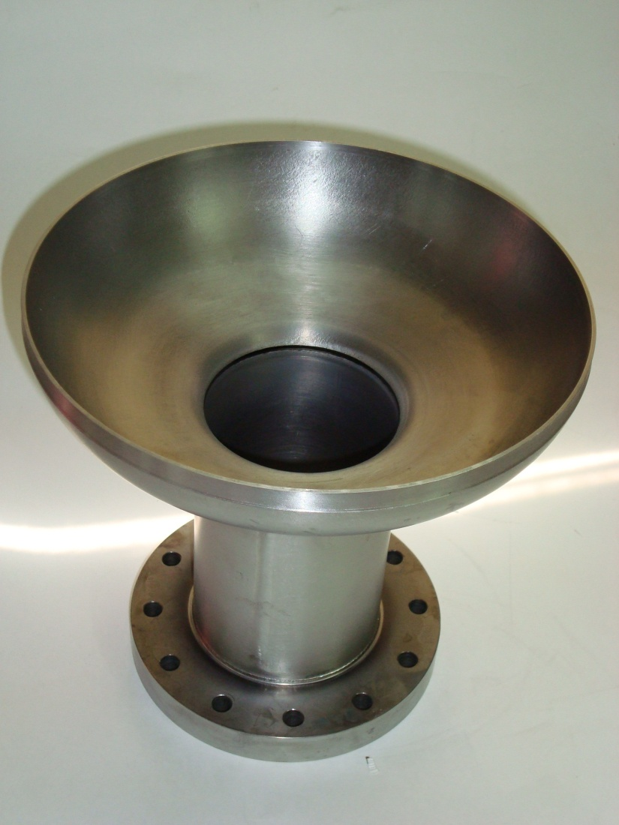
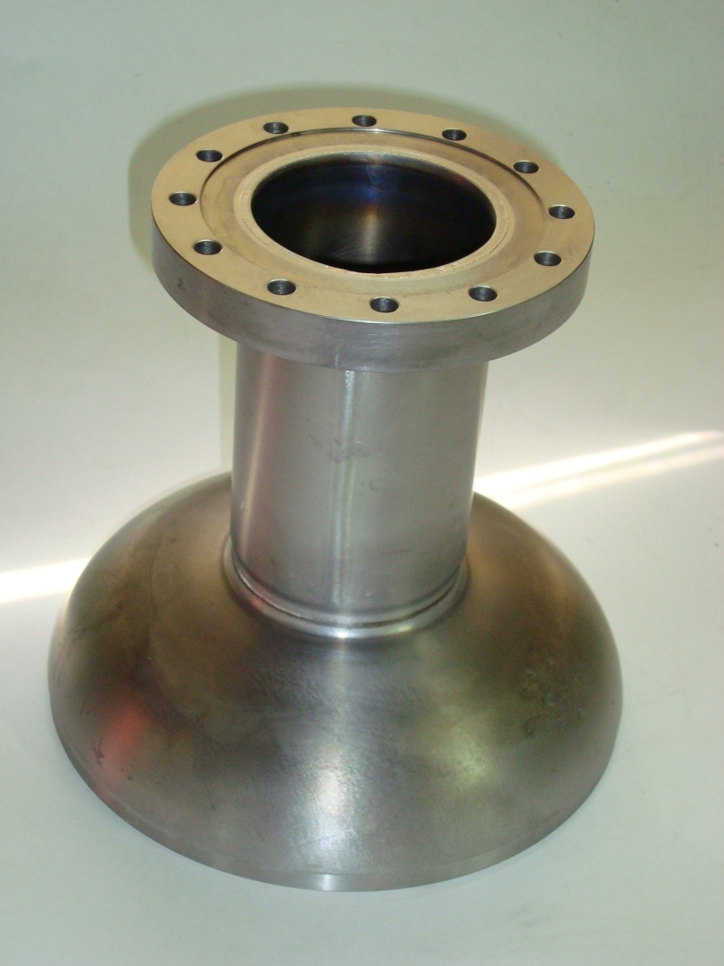
Half Cell with Beam Pipe of 1.3 GHz Single cell Cavity in Niobium
Made in collaboration – RRCAT, Indore – IUAC, New Delhi
EBW Machine : 15kW, 60 kV; Chamber size 2.5 m x 1.0 m x 1.0 m
M/s Techmeta, France

Slide 8
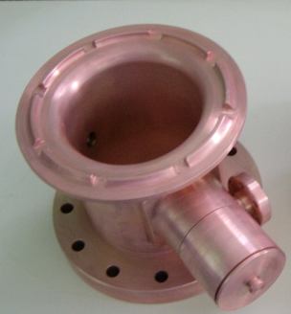
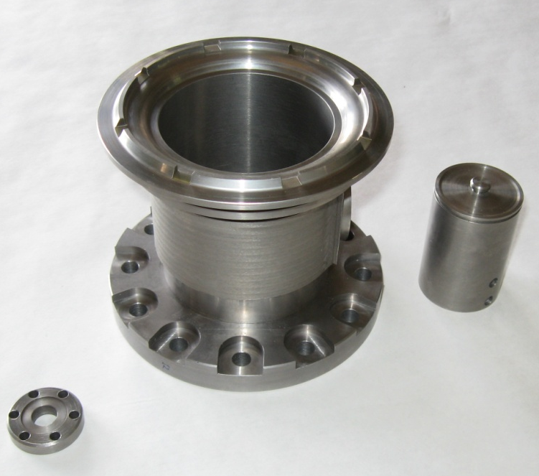
End Group- Design for Manufacturing
Objectives:
Easy manufacturing
Economy
Concurrently address the issue of reference alignment
(HOM coupler head or extended bracket.)
Approach
Machining of entire end group from a single cylindrical block.
Extensive prototyping and testing planned.
A solid cylinder will be removed from inside by EDM wire cut process.
This solid part will be used to make other components like form teil housing.
Status
Prototypes in Copper and Low RRR niobium block completed.
Prototype in Copper
Prototype in Low RRR Nb

Slide 9
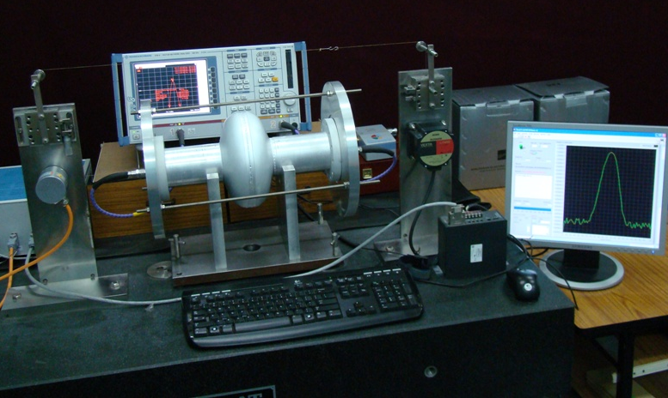
Bead Pull Measurement Setup with Single Cell Cavity

Slide 10
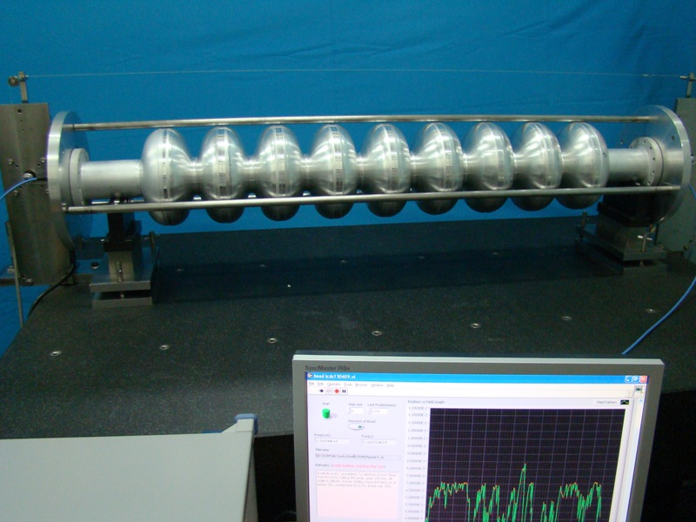
Assembled 9 Cell Cavity (Al) on Bead Pull Measurement Setup

Slide 11
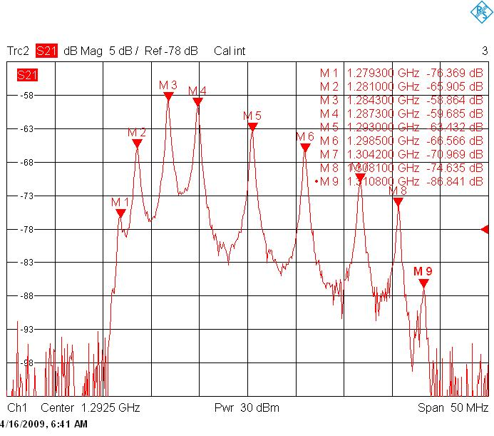
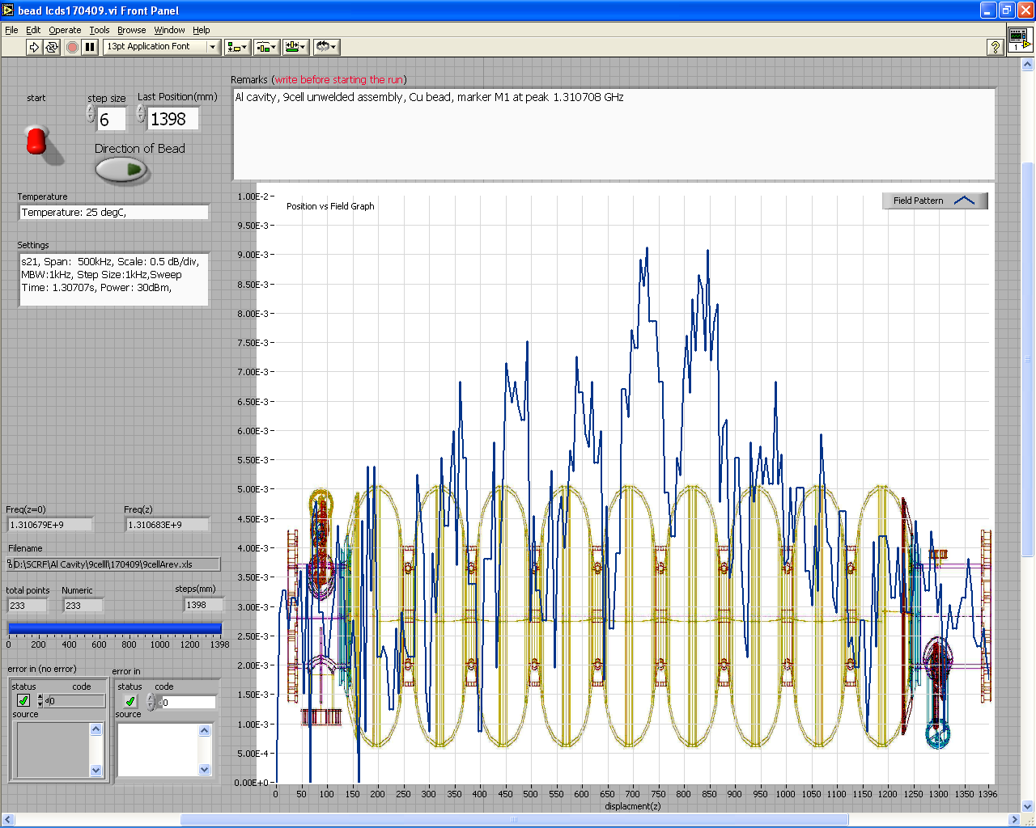
Frequency & Bead Pull Measurement of 9 Cell Assembled Al Cavity
Bead Pull Measurement
(screen shot)
Frequency Measurement

Slide 12
New Facilities Planned at RRCAT
Setting up of SCRF cavity fabrication (120 Ton Hydraulic Press, Facility for Nb machining, EBW Machine etc.),
Chemical & thermal processing facilities (EP/BCP/CBP, HPR & Annealing Furnaces etc.),
Assembly & testing set up. (Clean-room, Test cryostats, RF sources etc.)
Cryogenic infrastructure, (Bigger Liquid He Plant, Liquid N2 Plant and Accessories for Larger Cryogen & Gas Handling Systems etc.)
Experimental facilities for superconducting materials research. Add to presently available (magnetic, electrical & thermal conductivity measurements)
Facility to support cavity design, fabrication & processing (UTM, CMM, SIMS, Eddy Current Scanner etc.)

Slide 13
Building Plan for SCRF Cavity R&D

Slide 14
Proposed Clean Rooms
A set of 4 clean rooms are planed as a part of Superconducting cavity processing and assembly facility.
Clean rooms will be as per FS-209E/ISO standard
  Class 10000 General assembly area,
  Class 1000 Ante Clean room and
  Assembly clean room divided in Class 100 and Class 10.
  The division between class 100 and class 10 area will be with plexiglas panel divider from ceiling, as short as possible to permit easy access between the adjoining areas of class 100 and class 10.
The sizes indicated for the clean rooms are tentative.
Federal Standard FS-209E/ ISO classification system or equivalent will be used for the clean room class specifications.

Slide 15
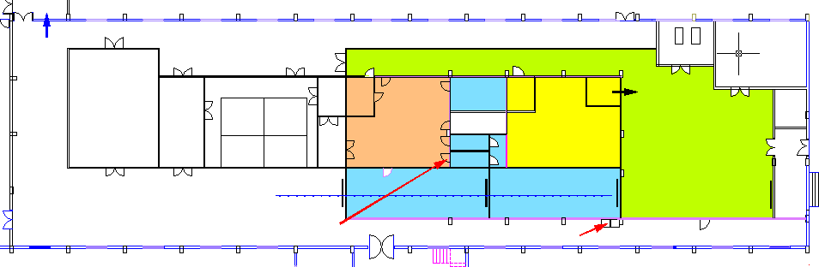

CLEAN ROOM FACILITY
TO DRYING, VACUUM TESTING & VACUUM SEALING
(CLASS 10)
TO CAVITY CHEMICAL PROCESSING :
CBP→ EP → BCP → WATER RINSING
EBW OF DUMB-BELLS TO FORM
SINGLE CELL/ MULTICELL
CHEMICAL ETCHING OF HALF CELLS, BEAM PIPE & FLANGES
TO HOT WATER ULTRASONIC CLEANING
(CLASS 1000)
TO HIGH PRESSURE RINSING
(CLASS 100)
CAVITY MOVEMENT IN BUILDING
BEAD PULL MEASUREMENT & TUNING FOR FIELD FLATNESS
TO VTS FOR CAVITY TESTING
EBW TO FORM DUMB-BELLS
RF FREQUENCY MEASUREMENT
RF LAB
OVENS
CHEM. LAB
PASS
THRU
E.B. WELDING
EP BCP
EP CBP
PURE GASES
CLASS 1000
CLASS 10
CLASS 10000
STRING ASSY
RF MEASUREMENT LAB
(CLASS 1000)
RAIL
CLASS 100
HPR
UHV PUMP
EBW WELDING STATION
CAVITY PROCESSING AREA
Proposed Clean Room Facility
Class-10 | 80 sq m
Class-100 | 120 sq m
Class-1000 | 130 sq m
Class-10,000 | 230 sq m

Slide 16
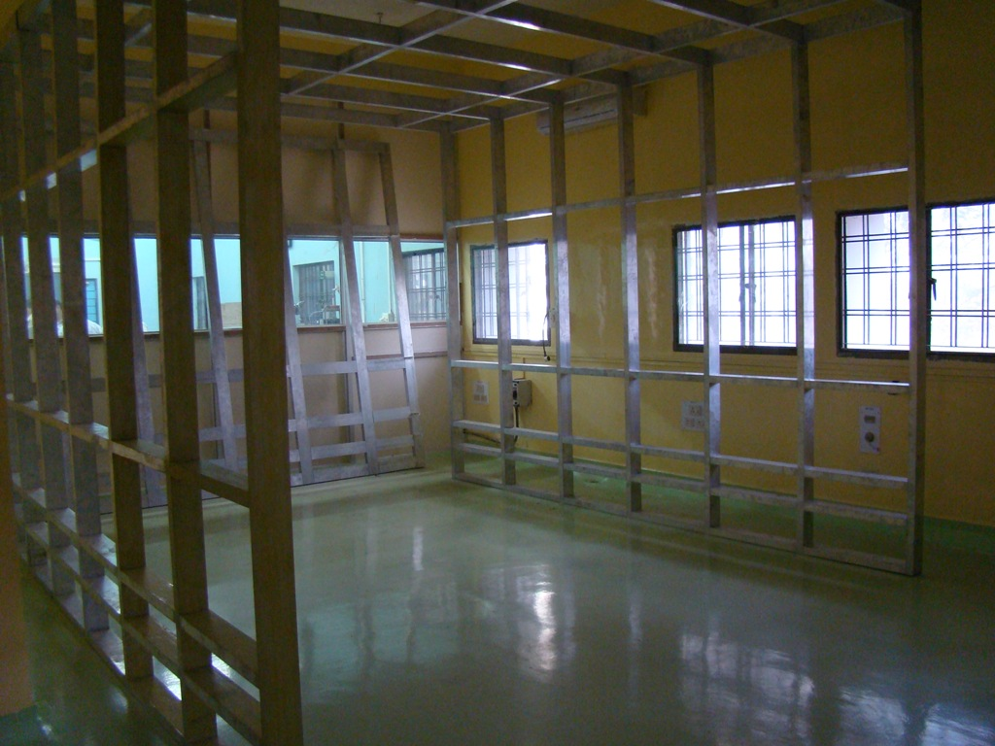
Clean Room Area
Modular Clean Area
Size = 6 m x 4 m
HEPA & ULPA FFU = 12
Assembly and measurement Area

Slide 17
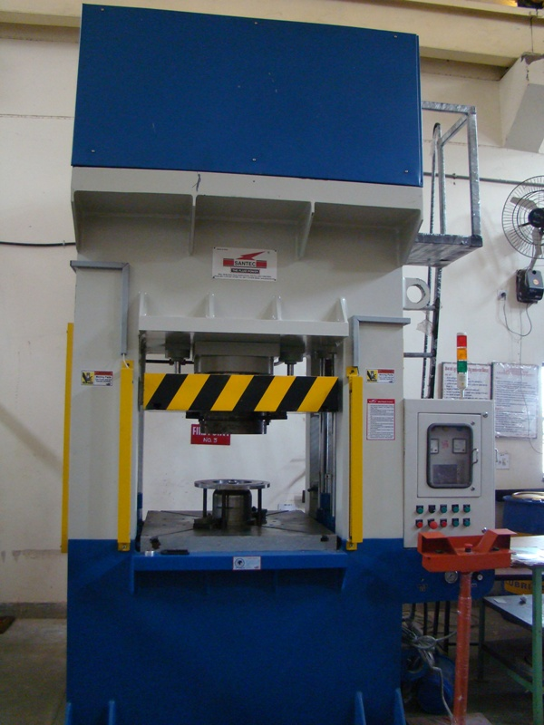
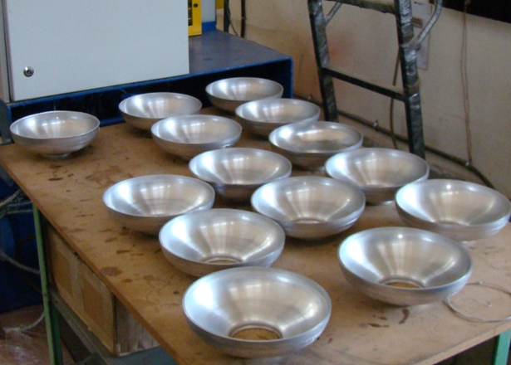
120 T - HYDRAULIC PRESS
CAPACITY
MAIN RAM : 120 TONS
MAIN RAM STROKE : 400 MM
DIE CUSHIONING: 40 TONS
DIE CUSHINING STROKE: 200 MM
CLAMPING : 20 TONS
DAYLIGHT : 600 MM
BOLSTER PLATE SIZE : 900MM X 900 MM
Machine Installed:
March 2009
17
Forming of Al Half Cells

Slide 18
Proposed EBW Machine
Major Specifications
Electron Gun– 15 kW – 70 kV,
Welding chamber Suitable for a job size: 1300 mm (L) x 1000 mm (W) x 1000 mm (H) with two suitable pumps for vacuum ~1x10⁻⁷ mbar and run out platform.
Y axis, by the Electron Gun, 200 mm travel, CNC controlled.
X axis, by the worktable, 1300 mm travel, CNC controlled.
CNC Rotary Manipulator with tail stock
Motorized Tilting system, 0° to 90°
General Control System with CNC

Slide 19
Plan for EP Setup
Electro polishing Bench (Single cell / Multi cell)
Acid Storage, refrigerator and handling system
Heat Exchanger for EP solution
Scrubber Unit (Acid fumes from EP)
Chemistry Lab support for EP,BCP
Used Acid and affluent Collection & neutralization
PLC Control Power supply ( 0-25 V, 1000 A)

Slide 20
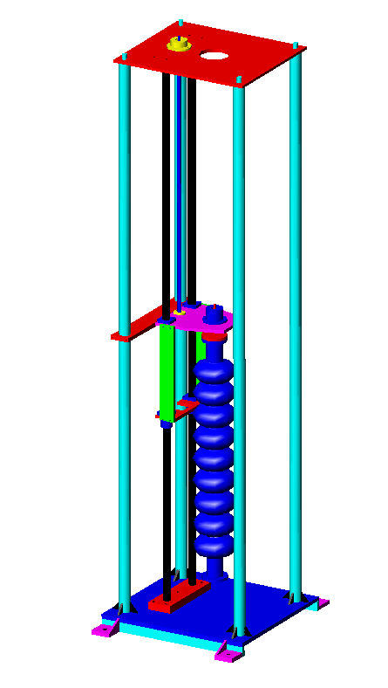
High Pressure Rinsing Stand
Features:
Cavity Rotational speed:
10-100 RPM
Vertical Stroke: 1300 mm
Vertical movement speed: 300 mm/min
Ultra-pure water jet pressure: 80 – 100 bar
Structure made of SS304
Installed in Class 100 clean room

Slide 21
Plans for Enhancement of Cryogenics Infrastructure
Development of infrastructure required for
  Saturated bath type vertical Test Cryostats: 2 K
  (For Sensor calibrations, RRR measurements etc.)
  Vertical Cryostat for testing SCRF Cavities: 2 K
Development of Horizontal Test stand for high power testing of SCRF Cavities at 2K.
Development of Cryomodules
Augmentation of present facility of liquid Helium and Liquid Nitrogen production to
Approx. 200 lit/hr LHe with 10,000 L storage capacity
Approx. 400 lit/hr of Liquid Nitrogen.

Slide 22
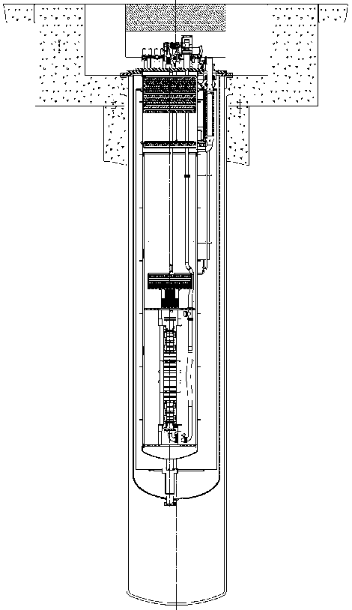
Development of VTS-2 in collaboration with FNAL
Single & 9-cell Tesla-style cavities (2 – 6 cavities)
Single Spoke Resonator cavity 325 MHz
Triple Spoke Resonator Cavity 325 MHz
  Measure Q vs. T (T_{min}~1.5 K)
  Measure Q vs. E_{acc} at 2 K
cryogenic capacity ~250 W at 2 K
Magnetically shielded cryostat
  External (room-temperature) Amumetal® (80% Ni alloy) and internal Cryoperm 10® magnetic shield, designed to attenuate field to <0.01 G at cavity
Radiation shielding to maintain “Controlled Area” status
  < 5 mrem in an hour immediately outside the shielding
vacuum vessel φ=54”
radiation shielding
cavity
helium vessel 32”
Notes:
22

Slide 23
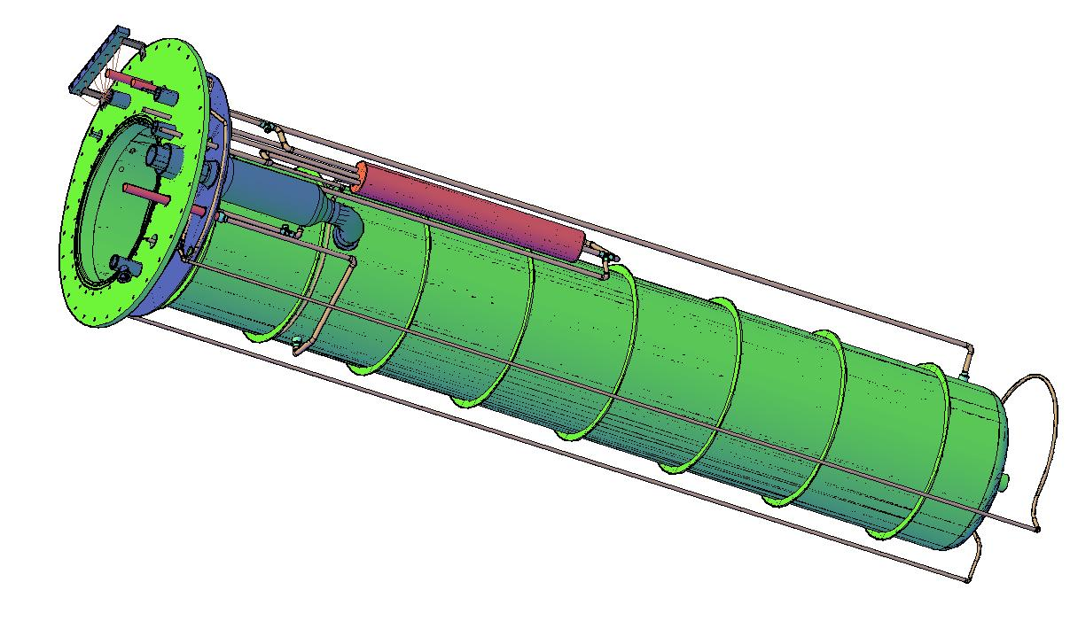
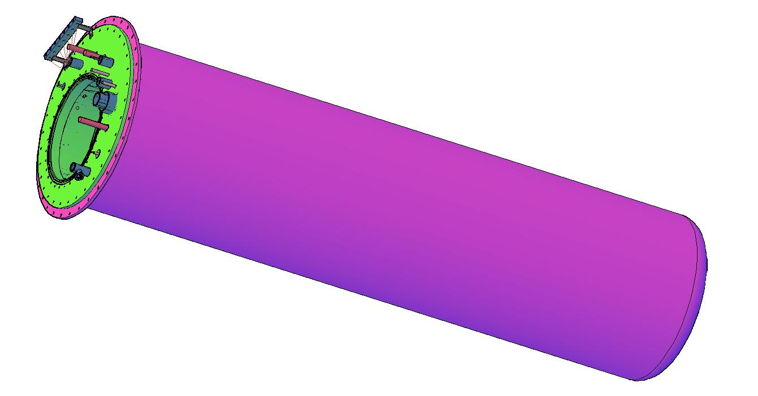
VTS-2 Development
Design study of 32” bore VTS-2
  Engineering design of
    LHe, Vessel, 80 K shield, Top Flange,
    internal & external magnetic shield
    Vacuum Vessel (54” OD)
    JT Heat Exchanger
Design & Fabrication of VTS-2 at Indian Industry
Evaluation of VTS-2 at RRCAT
LHe Vessel of VTS-2
Assembly of VTS-2
Thank You

