Slide 1
Commissioning of the Crystal evaluation setup
Adam Para,
Fermilab, May 19, 2009

Slide 2
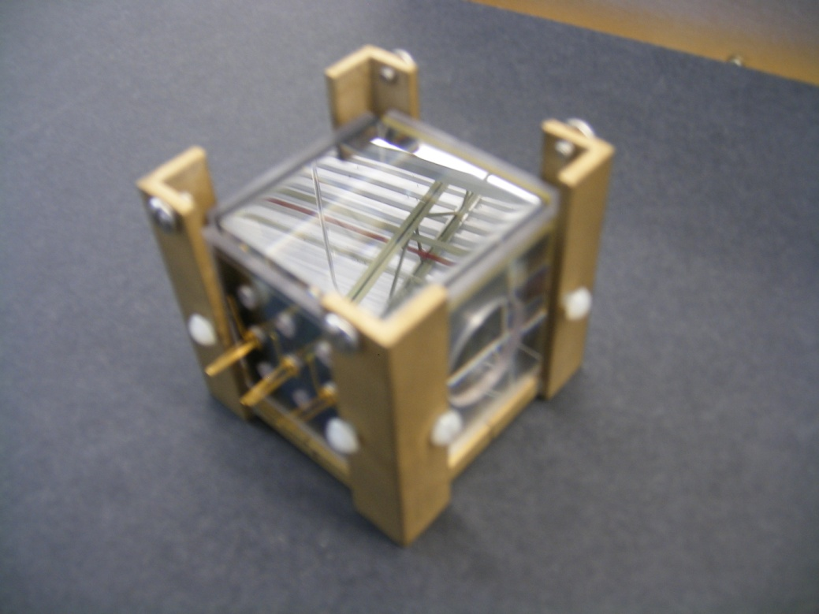
The Crystal
5 x 5 x 5 cm BGO crystal (SIC Shanghai)
All six sides equipped with filters:
‘UV’ (UG11, low pass filter, 370 nm)
‘Vis’ high pass filter, 400 nm
Photodetector mounting fixtures:
Phototube centered
Hamamatsu MPPC, 9 positions
SensL array

Slide 3
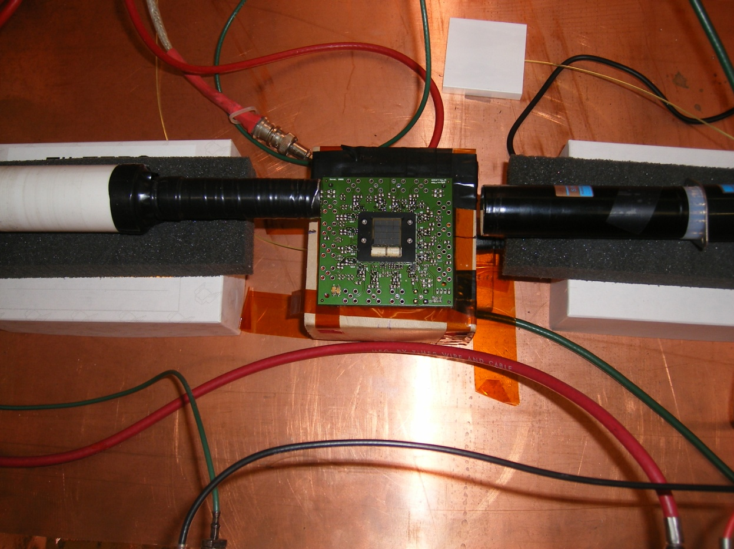
The SensL Array of SiPM’s
The SensL array was placed under the crystal. It should detect the Cherenkov light produce by the cosmic muon. This detecting system is not fully comissioned yet, and we have no useful information. Stay tuned..

Slide 4
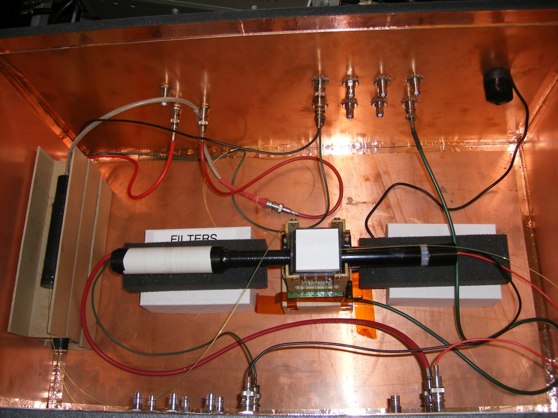
Test Setup
Black box with signal/HV feed-throughs
two 5 x 5 cm trigger counters
read out with the waveshifting fibers (shown)
later replaced by scintillators with waveguides
Comment on triggering: waveshifter fiber readout reduces the light yield and spreads the photons in time, leading to low amplitude of triggering signals. Coiccidental PMT pulses dominate the trigger rate.

Slide 5
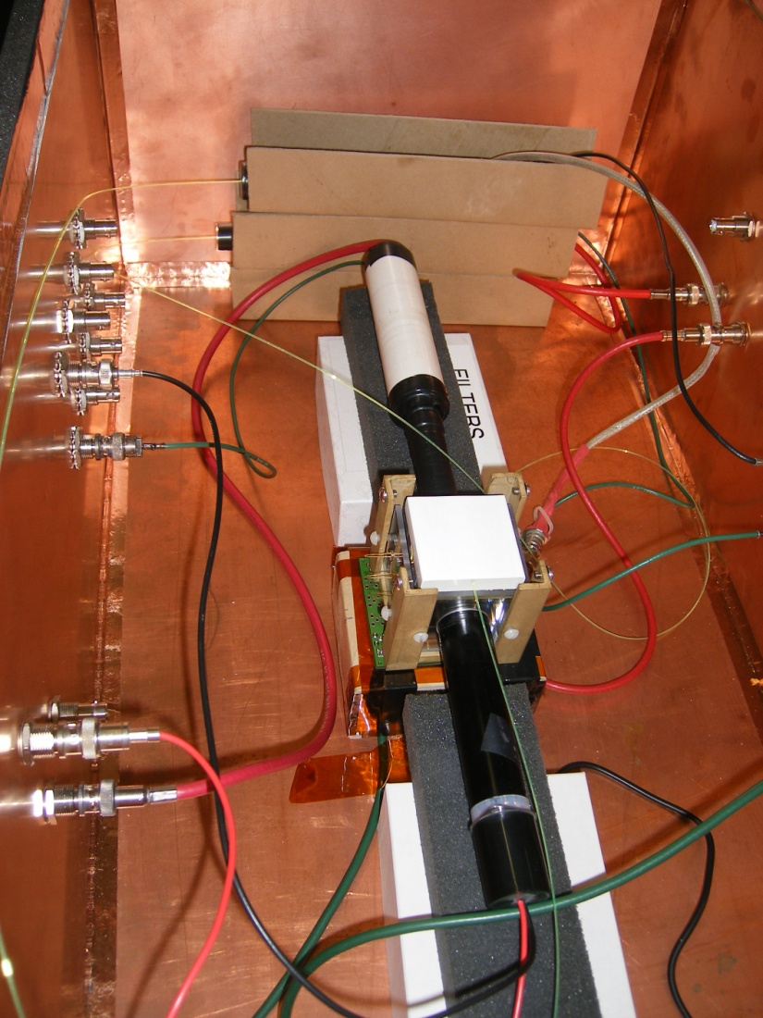
The Setup
Trigger counter
PMTs
Crystal PMT
(scint)
MPPC
(scint)
Trigger counter
SensL
array
Crystal PMT
(Cher)

Slide 6
Readout/data acquisition
Readout with the Paul Rubinov’s 4-channel SiPM ‘data acquisition card’. It is a multichannel high speed digitizer. It provides the detector bias and samples the output signal with 141 MHz rate (at the moment, 250 MHz possible)
Two channels modified to remove the bias voltage and used to digitize and acquire the signals from the PMT’s
Card used in the ‘external trigger mode’
USB interface to the PC
C# data acquisition program written by Paul
Scope used to monitor the signals from the trigger counters and to produce the trigger signal for the card

Slide 7
Run 0001
Digitize and record:
One of the trigger counters
Crystal PMT (scintillation)
Crystal MPPC (scintillation) 50 micron pixel, center
Crystal MPPC (Cherenkov) 50 micron pixel, center
No quantitative analysis, yet, but rather exploratory look at the setup

Slide 8
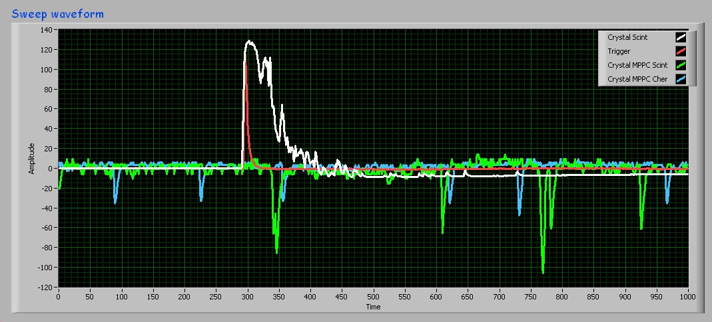
Examples of waveforms
It works !
Scintillation (PMT) well in time with the trigger
MPPC dark pulses rate consistent with the specs
but they will provide a challenge in the measuring the light output
Scintillation process not ‘smooth’, but rather clumpy (time-wise)

Slide 9
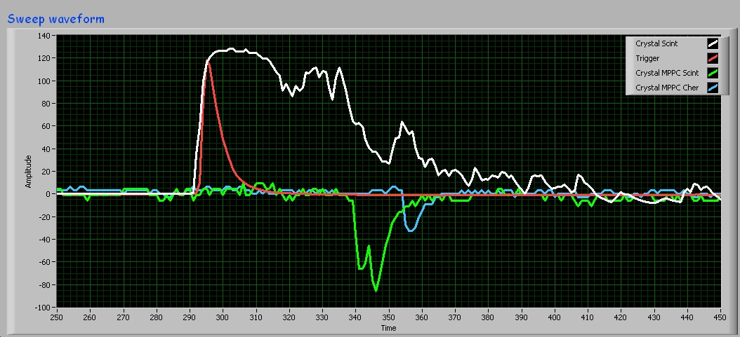
Fluctuations in Scintillation (Zoomed)

Slide 10
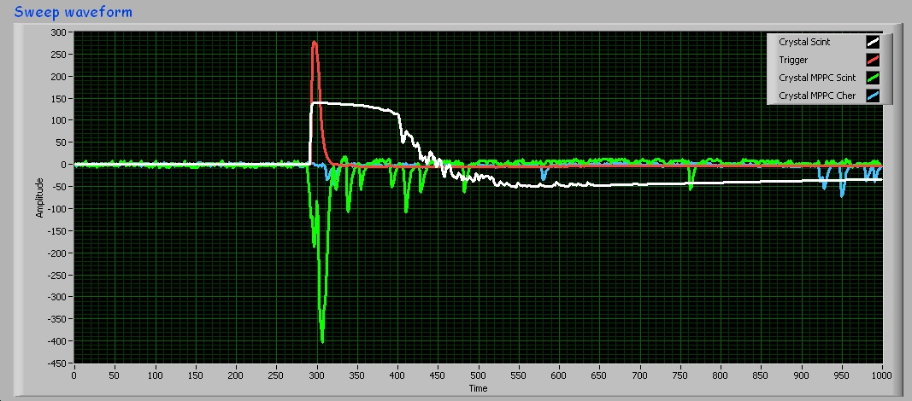
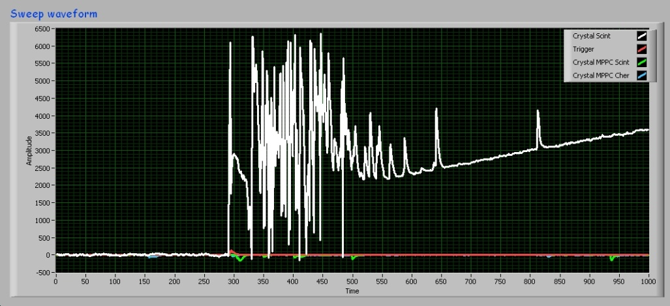
Some Patologies/ Things to Improve
Saturation of the PMT (scintillation)?
Need bigger attenuator?
Occasional breakdowns. Related to the large size of the input signals?

Slide 11
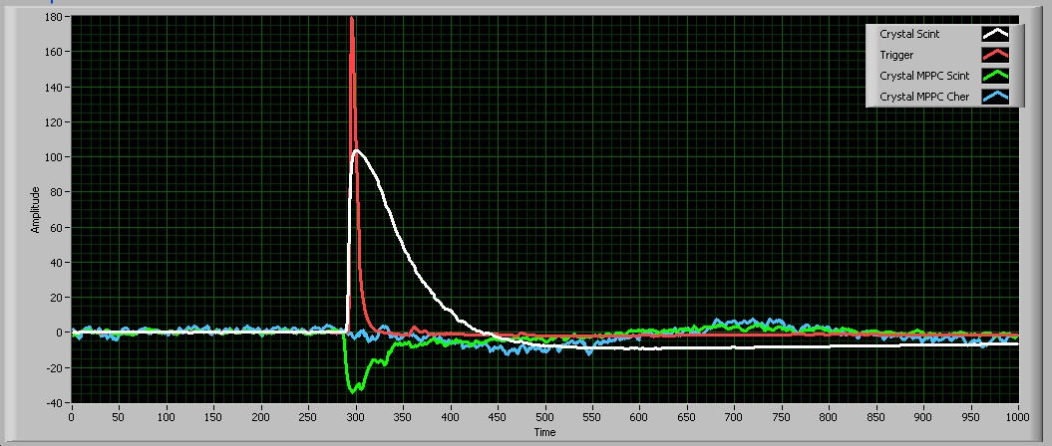
Run 00001: Summary (Averages)
Scintillation decay time consistent with the BGO (PMT)
Clear signal of the scintillation observed with the MPPC (1 mm²!)
No visible signal in MPPC Cherenkov, yet.. Some evidence for .. ??? Some kind of coupling/cross talk to other channels??

Slide 12
Run 0002
Digitize and record:
Crystal PMT (Cherenkov)
Crystal PMT (scintillation)
Crystal MPPC (scintillation) 50 micron pixel, center
Crystal MPPC (Cherenkov) 50 micron pixel, center
No quantitative analysis, yet, but rather exploratory look at the setup

Slide 13
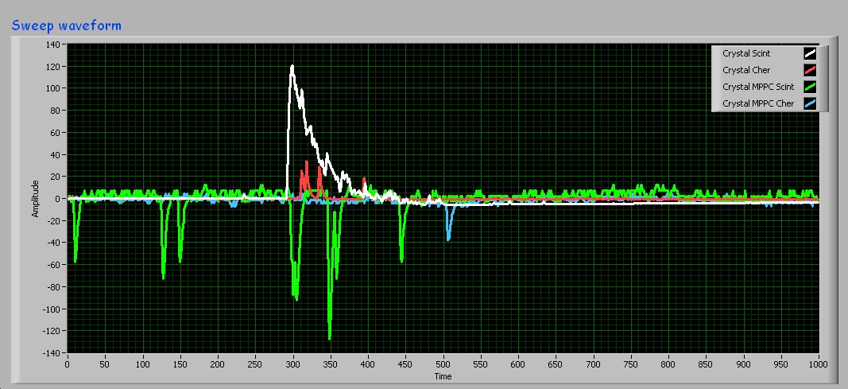
Example of Waveform
Scintillation clearly visible (both PMT and MPPC)
‘Cherenkov’ PMT signal visible, but probably detecting some short wavelegth component of scintillation (timing!)
Cherenkov PMT at 90 degrees to the muon track. How much signal can one expects??

Slide 14
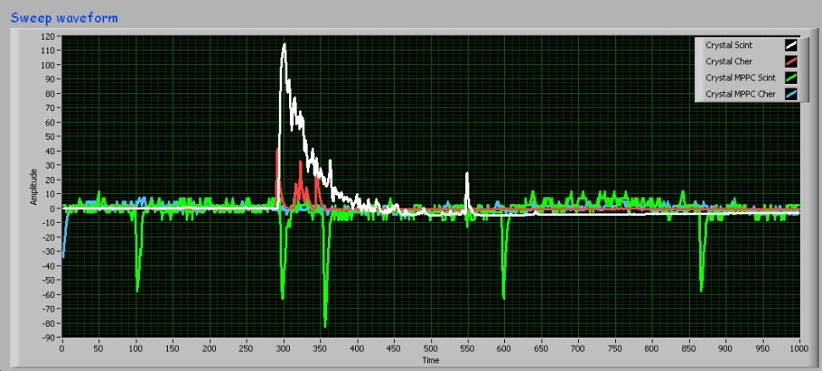
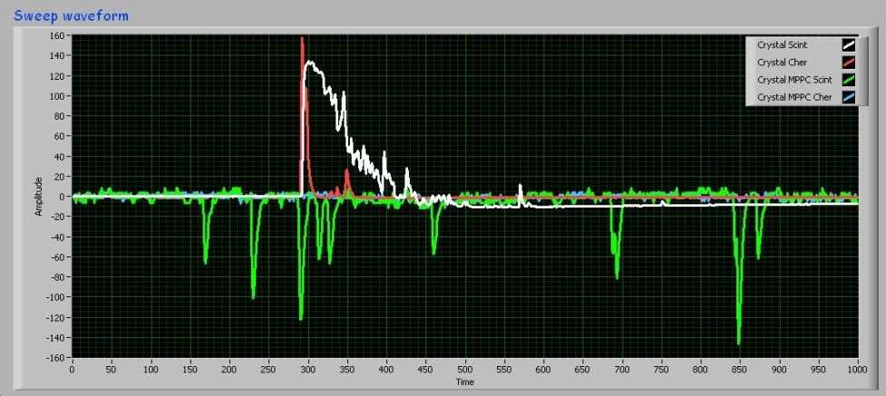
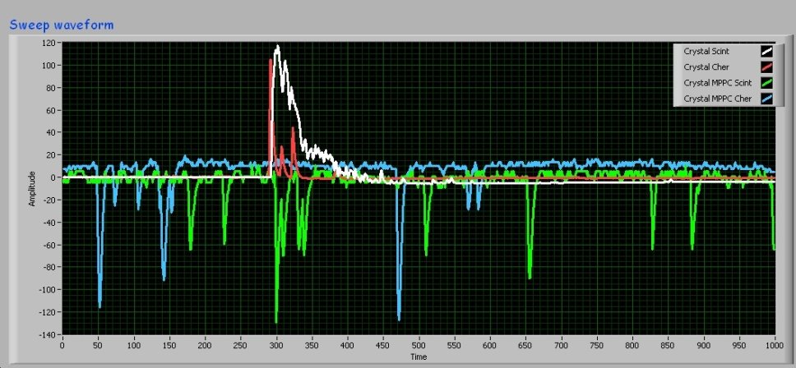
Cherenkov Signals are There!
Even at 90 degrees
Cherenkov light trapped inside the crystal making it to the detector?
or muons traversing the crystal near the PMT and the Cherenkov cone intersecting the face of the crystal?
Need to start comparing with the single crystal simulation
and need the muon track information

Slide 15
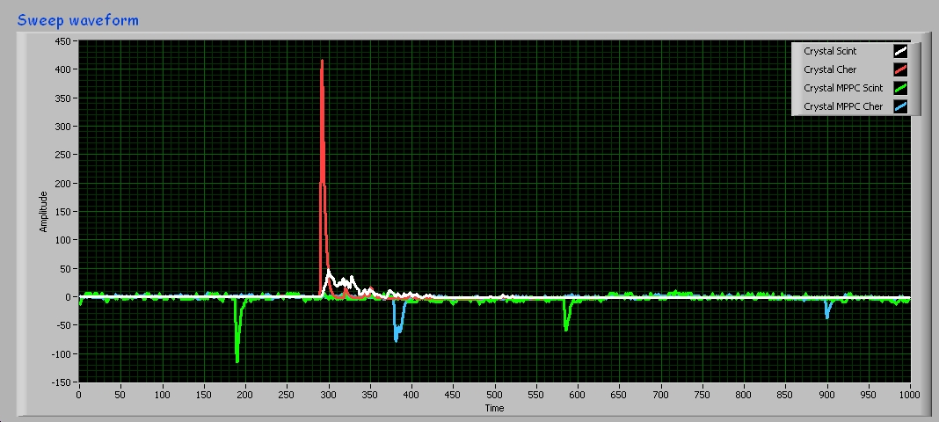
Occasionall Huge Cherenkov Signal

Slide 16
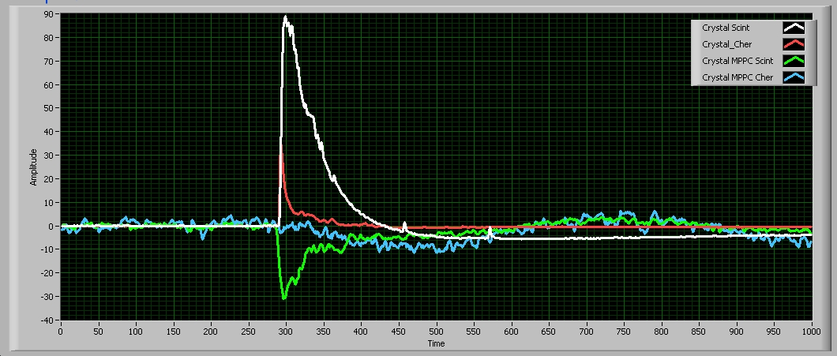
Run 00002 Symmary (averages)
Scintillation (PMT and MPPC) signals consistent with Run 00001
Clear evidence for Cherenkov signal (at 90 degrees to the muon track!)
What is the signal from the Cherenkov PMT at later times? Long tail of trapped Cherenkov? Short wavelength scintilation?

Slide 17
Next steps
More detectors (correlations between them, spatial distribution of the signal)
Larger SiPM/MPPC’s (Hamamatsu, IRST)
Tracking hodoscope
Calibration and quantitative analysis

