Slide 1
Commissioning of the Crystal evaluation setup part II
Adam Para,
Fermilab, May 26, 2009

Slide 2
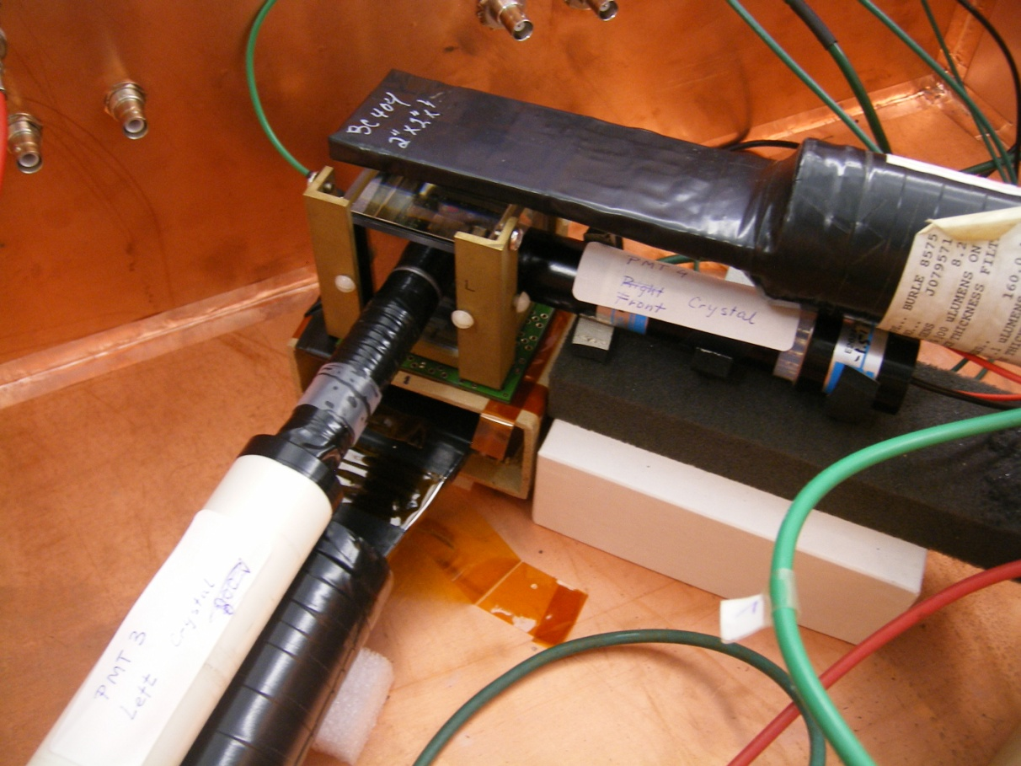
Setup Version 2
modified trigger counters: scintillator + waveguide replacing the waveshifter-based trigger
because of space limitations the PMT’s and the SiPM’s viewing the crystal mounted on the neighbouring sides of the crystal
as before, one side with PMT’s/SiPM’s is equipped with the UV filer, the other one with the ‘visible’ filter

Slide 3
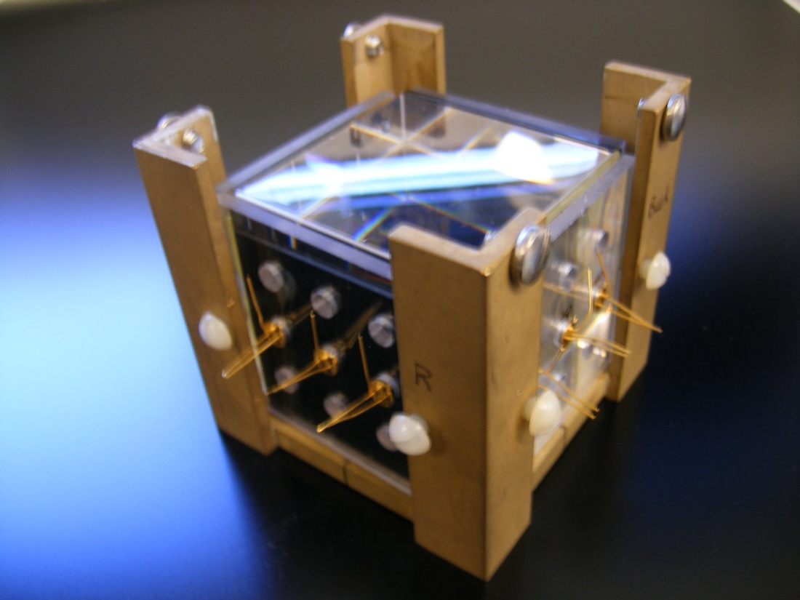
The Crystal
5 x 5 x 5 cm BGO crystal (SIC Shanghai)
All six sides equipped with filters:
  ‘UV’ (UG11, low pass filter, 370 nm)
  ‘Vis’ high pass filter, 400 nm
Photodetector mounting fixtures:
  Phototube centered
  Hamamatsu MPPC, 9 positions
  SensL array

Slide 4
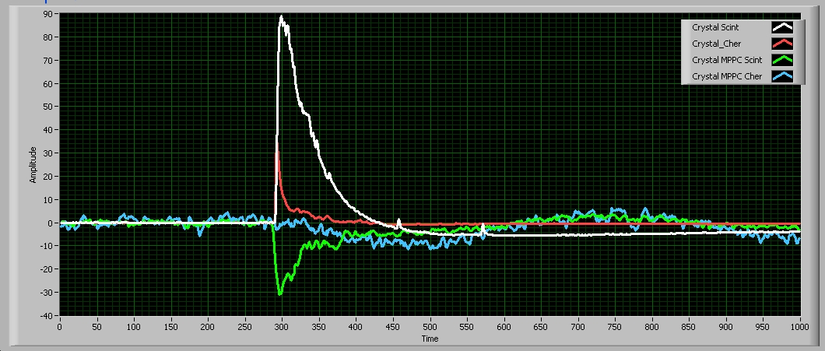
Reminder 1: Run 00002 Summary
What is the signal from the Cherenkov PMT at later times? Long tail of trapped Cherenkov??? Short wavelength scintilation?
Answer: it is a reflection of a large PMT signal. All cables from the photodetectors are coupled to the same ground at the interior of the black box.
This is not a reflection of a higher frequency of avalanches, but rather a baseline shift. It is clearly visible even when the SiPM is operated below the breakdown voltage .

Slide 5
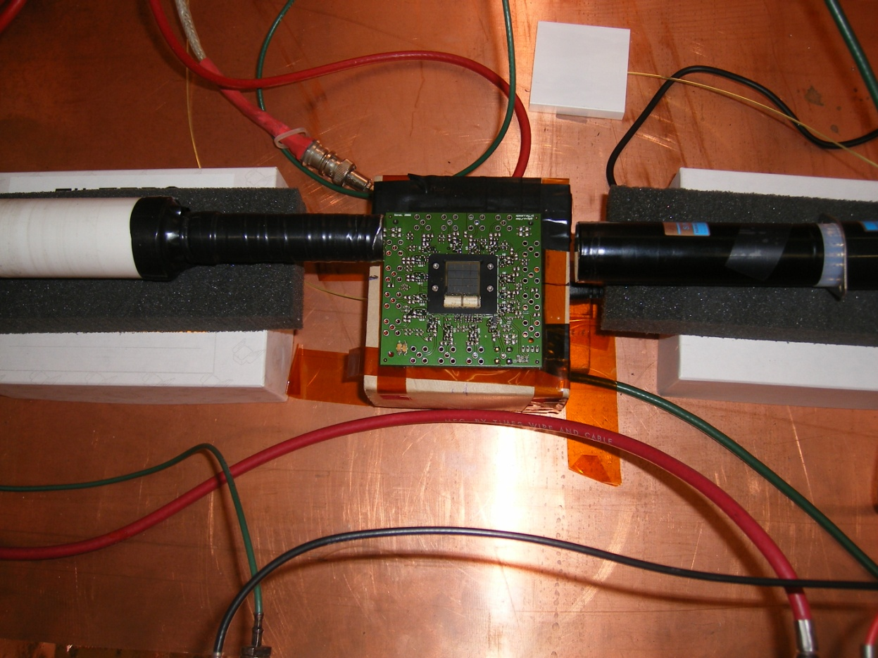
Reminder 2: The SensL Array of SiPM’s
The SensL 4x4 array was placed under the crystal. It should detect the Cherenkov light produce by the cosmic muon. This detecting system is not fully comissioned yet, and we have no useful information. Stay tuned..
This array was placed behind the UV filter. Change of the filter to the ‘visible’ one produces clearly visible signals. The interesting questions:
  the amount of Cherenkov light is so low, that even the large area detector cannot detect it? Or..
  The SensL photodetectors have poor or no sonsitivity to the short wavelength light

Slide 6
Run 0003
Digitize and record:
  SensL array (6dB attenuation)
  Crystal PMT (scintillation) (12 dB attenuation)
  Crystal MPPC (scintillation) 50 micron pixel, center
  Crystal MPPC (Cherenkov) 50 micron pixel, center
No quantitative analysis, yet, but rather exploratory look at the setup

Slide 7
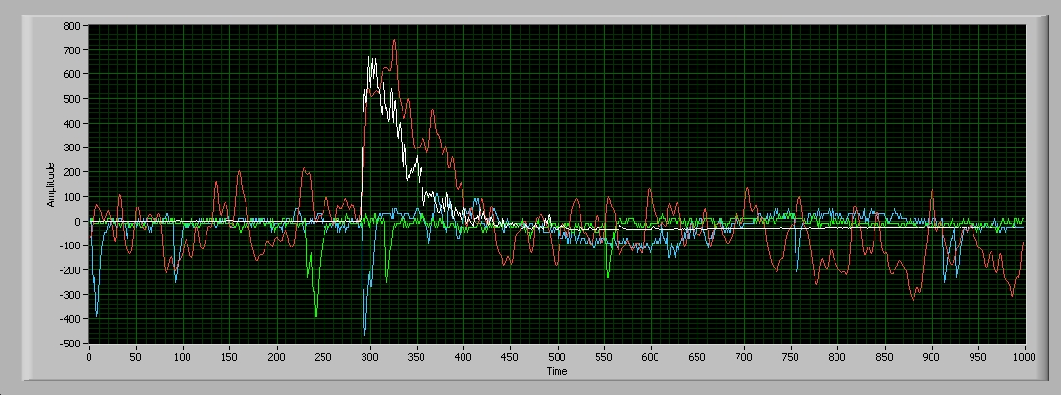
Run 3: Example of Traces (6 μsec)
White: PMT, visible. Quiet PMT, large scintillation signal. Undershoot from the amplifier
Red: SensL, visible. Clear scintillation signal. Relatively noisy
Green: SiPM, visible
Blue: SiPM, UV filter. Visible distortion of the baseline due to coupling via the ground plane. (Why not the other SiPM??)

Slide 8
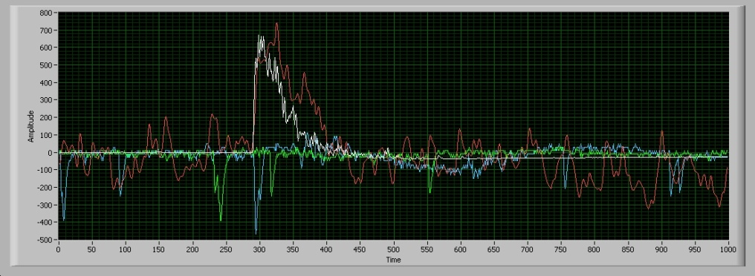
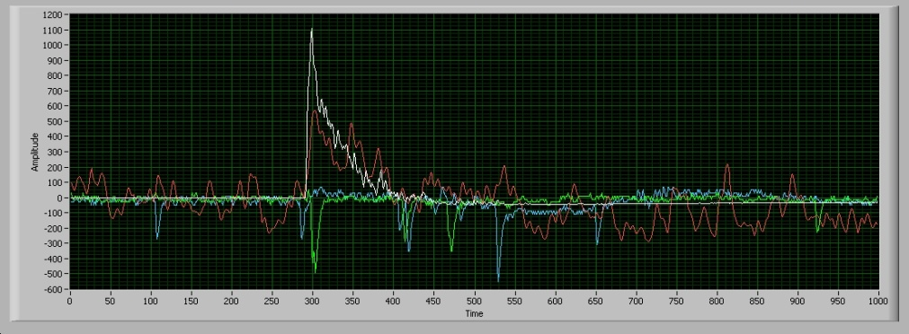
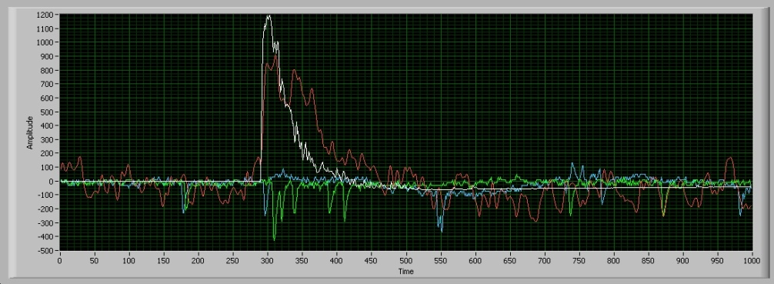
Run 3: Cherenkov Signals in SiPM?
Examples of prompt signals produced by the SiPM viewing the crystal through the UV filter.
But they can be just random coincidences
Need more quantitative measurement.

Slide 9
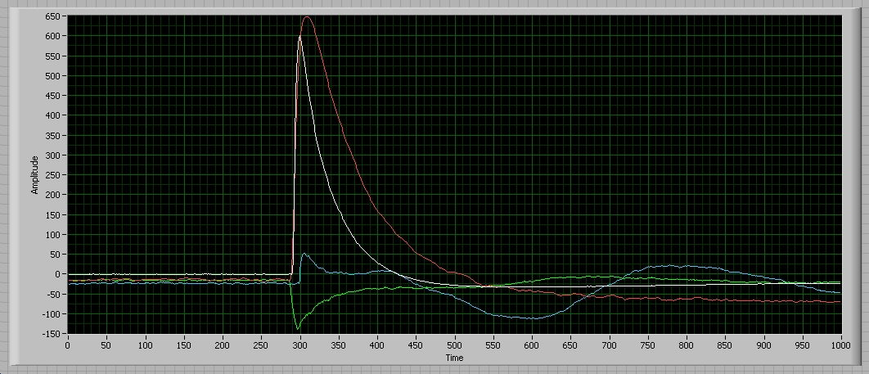
Run 3: Summary
White: PMT/visible scintillation. As expected
Red: SensL/visible scintillation. Much slower signal. Presumably effect of afterpulsing?
Green: SiPM/scintilation. OK
Blue: SiPM/Cherenkov. No signal visible (on average) Large baseline shifts.

Slide 10
First Attempt at Statistical Analysis
Pedestal (for PMT, Hamamatsu SiPM) == 1.2*integral from bin 1 to bin 250
Pedestal (for SensL) == average value for bins 1-250
Signal == integral, after the corresponding pedestal subtraction) from bin 250 to 550

Slide 11
PMT Signals (Visible, Scintillation)
Quiet tube, very narrow pedestal
Healthy scintillation signal
Relatively large fraction of ‘no scintillation’ events:
  random coincidences of trigger phototubes?
  misaligned trigger counters? (muon missing the crystal?)

Slide 12
SensL (Scintillation, Visible)
Quite noisy detector/electronics (reminder: 16 pixels, 9 mm² each)
but the scintillation signal clearly visible

Slide 13
PMT vs SensL: Correlation?
Good correlation between two different measurements of the scintillation light (PMT at the side of the crystal, SensL at the bottom of the crystal)
good linearity (or similar saturation in both channels)
‘no signal’ events coincident in both photodetectors => very likely that the trigger purity is the principal reason

Slide 14
SiPM: Scintillation
‘signal’ larger than pedestal, large signals with higher frequency in the ‘signal’ gate ➔ an evidence that the scintillation is detected.
but the resolution would be very poor, if signal integrated over a very long gate (~1.5 μsec)
probably need a smarter analysis: peak finding, peak counting or integration of peaks
some contribution (?) from the baseline shifts due to ground plane coupling?

Slide 15
SiPM, Cherenkov?
Pedestal broader than signal
Signal dominated by the baseline shifts (from the inspection of the waveforms)

Slide 16
Next steps
Eliminate coupling to the large PMT signals
Try larger area SiPM’s (larger thermal noise too)
Try light concentrators (larger signal, the same thermal noise?)
Try more photodetectors

