Slide 1


Introduction: Joint GDE, ILC-HiGrade and JINR CFS Meeting
presented by Marc Ross - for the ILC Project Managers:
Marc Ross - (Fermilab),
Nick Walker - (DESY),
Akira Yamamoto – (KEK)
ILC-GDE / ОИЯИ-ГCПI, (DESY) 25-26.06.2009
Notes:
PAC
Coordination and Management - pac presentation.
Mission of gde - pm organization
The three goals from Brian Foster
Develop the design
Do the risk - mitigating R&D
Develop the community
Goals for tdp
As written in the rd plan
Basis for our activity
- institutional and regional support for science ilc will provide.
- regional-ly provided resources
- common fund
- in-kind R&D
Summary of the resource table; defined by ' basis' 4 basis - ilc project prep specific, other project. specific, generic rd, combined
Return on investment for in kind contribution
Technology - based component; linac paper count
The role of gradient rd within regions - development of the technology - transfer
Challenge of a distributed organization - diversity vs centralized control
Organization - key roles and responsibilities (regional directors, pm and group leaders, and assoc. Pm)
- regional balance with cost/risk driven organization
- the org chart and its description
- examples of management of specific programs
Day to day, month-month operating practice
- meetings, notes
- planning
- reporting
Management Issues and challenges
- balancing R&D with fixed focus in time against longer term 'alternate' R&D.
- role of alternates in the rdr
- value engineering
- the replan
- mimimum machine effort
- capturing and maximizing work done primarily for unrelated projects
- technical and political process - comments from Loew panel
- balancing institutional and project driven priorities
+ example institutional issues one from each region:
+ Cern
+ SLAC
+ Kek
- developing links with emergent teams
+ India
- development of the pip and related involvement with falc.
+ connections with R&D
+ brian's talk
- promoting growth and exuding confidence in unstable climate
Technical design and project development strategy
- key elements of leading activities, per R&D plan, with schedule (intro to akira, nick, etc)
- summary of involved resources
- summary of regional / institutional participation, including activities supported through common fund, and including commentary about spefic regional / institutional roles
S0 graphic - showing institutional / regional developments
Test facilities - intro to Nick/Akira
Oversight process
The resource tables – summarize these with respect to what is needed for key goals. Give examples showing how the resources are controlled in S0 S2 ATF2 and CFS.
Give examples showing the political acceptance of the project – use th eRD plan and the discussion of plug compatibility. Talk about the review process. – our side of the picture.
Management challenges – rebounding from the budget difficulties of 2008. Developing healthy relationships with cern fermilab and kek. Each of which has its own near term goals that do not focus on ILC. the warm amchine
for 2009 – what we will do – to come back to at the next PAC review. TheS0 goals and the S2 tests at DESY. the initial ATF2 results. , the min mach process and the single tunnel design.
Talk about the total price tag and what is to be done about it. mention the consensus basis sused for the RDR and the top-down nature of the TDP. The political process in 2009 – FALC?

Slide 2
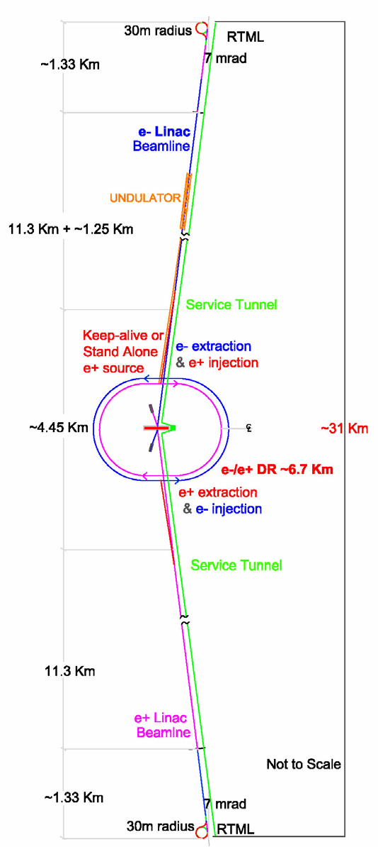
Introduction
ICFA statement (based on input from the community):
  the highest priority for a new machine for particle physics is a linear electron-positron collider with an initial energy of 500 GeV, extendible up to about 1 TeV, with a significant period of concurrent running with the LHC.
This is the International Linear Collider.
Notes:
Two 11 km linacs (3.5x SLAC) + end adapters (Compressor / collimation & focus) and positron with a Tevatron- sized central source

Slide 3
Physics:
a continuous center-of-mass energy range between 200 and 500 GeV
a peak luminosity of 2e34 and availability (75%) consistent with 500 fb-1 in the first four years
> 80% electron polarization at the IP
energy stability and precision < 0.1%
option for 60% positron polarization
options for e- e- and γγ collisions

Slide 4
ILC – Background:
traced back to:
  1965 article by Maury Tigner in Nuovo Cimento …
  1972 meeting in Switzerland in which G. I. Budker…
e+/e- collider labs –
  where the linear collider was born:
  BINP, SLAC, KEK, Cornell, DESY, …
    where cold SRF linac technology started
Technology Reviewed (TRC);
Recommendation made (ITRP):
  1995, 2002 and 2004
  0.5-1 TeV ILC: → Superconducting Linacs
Pief Panofsky and Gersh Budker

Slide 5
ILC R & D – Global effort
ILC Reference Design (RD)
  based on R & D in support of: TESLA, SBLC, JLC/NLC, VLEPP, CLIC
  strongly linked to TESLA Design; with work done by Russian institutions:
    BINP, Efremov, IHEP, INR, IRE-RAS, MEPhI, …
RD Report authored by 325 institutions (including physics/detectors)
  9 Russian institutions including:
    BINP, Efremov, ITEP, JINR, Lebedev, and Universities
EU-XFEL → a large scale demonstration
  ~ 5 Russian institutions involved:
    BINP, Efremov, IHEP, INR, JINR

Slide 6
RDR Author List
Asia 476
Americas 544
Europe 777
--------
TOTAL 1797

Slide 7
CLIC / ILC
Collaboration
Working Groups with
joint leadership
Accelerator Tech Areas
Physics / Detectors
Costing
First progress reported
last fall
LOI Follow-on: Study extrapolation to multi-TeV

Slide 8
Collaboration Working Groups
 | CLIC | ILC
Physics & Detectors | L.Linssen, D.Schlatter | F.Richard, S.Yamada
Beam Delivery System (BDS) & Machine Detector Interface (MDI) | D.Schulte, R.Tomas Garcia E.Tsesmelis | B.Parker, A.Seryi
Civil Engineering & Conventional Facilities | C.Hauviller, J.Osborne. | J.Osborne, V.Kuchler
Positron Generation (new 11/08) | L.Rinolfi | J.Clarke
Damping Rings (new 11/08) | Y.Papaphilipou | M.Palmer
Beam Dynamics | D.Schulte | A.Latina, K.Kubo, N.Walker
Cost & Schedule | H.Braun, K.Foraz, P. LeBrun | J.Carwardine, P.Garbincius, T.Shidara

Slide 9
Technical Design Phase and Beyond
TDR
RDR Baseline
TDP Baseline Technical Design
TDP-1
TDP-2
Change
Request
New baseline inputs
RDR ACD concepts
R&D Demonstrations
MM studies
2009
2010
2011
2012
2013
Notes:
9

Slide 10
ILC - Technical

Slide 11
Priorities for ILC
(value estimate metrics:)
Cost risk
  Linac: 60%
    main linac and its conventional
  CFS: 38%
    all conventional
  Linac + CFS: 79%
    main linac and all conventional
Technical risk (e.g.):
  SCRF “process”
  damping ring, esp electron cloud instability
Planning
What are the issues?
cost of going to the energy frontier: beam power

Slide 12
RDR civil “footprint”
72.5 km tunnels ~ 100-150 meters underground
  93% overhead v/v actual tunnel needed for ‘beam pipe’
  Tevatron/MI? … ~0.
  LEP/LHC ? 5%? PEP 5%
13 major shafts > 9 meter diameter
  1.6 km of large shafts
  roughly ½ of LHC/LEP
443 K cu. m. underground excavation: caverns, alcoves, halls
  77 m cube
10 Cryogenic plants, 20 KW @ 4.5o K each
plus smaller cryo plants for e-/e+ (1 each), DR (2), BDS (1)
92 surface “buildings” (for Americas’ site), 52.7 K sq. meters
230 M Watts connected power, 345 MW installed capacity
Notes:
80% of a football field

Slide 13
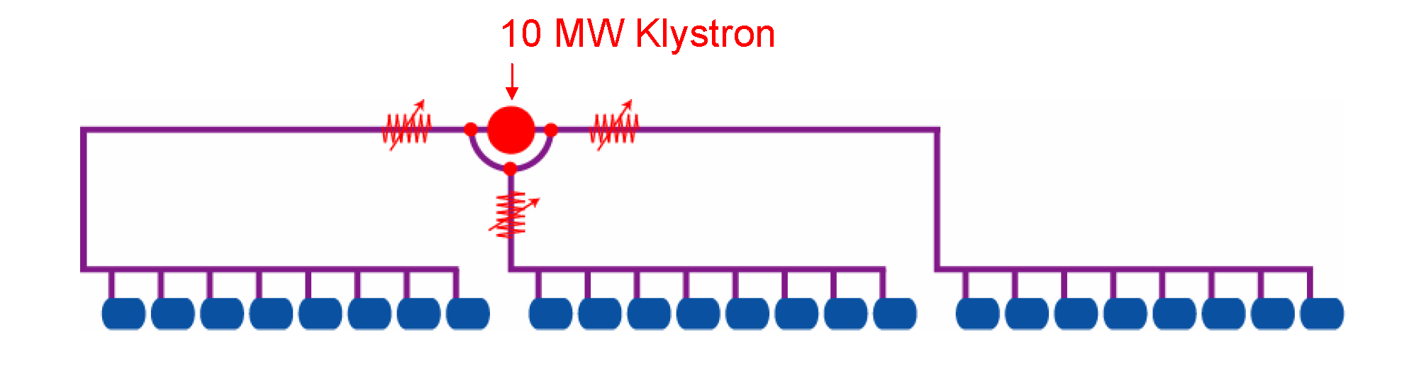
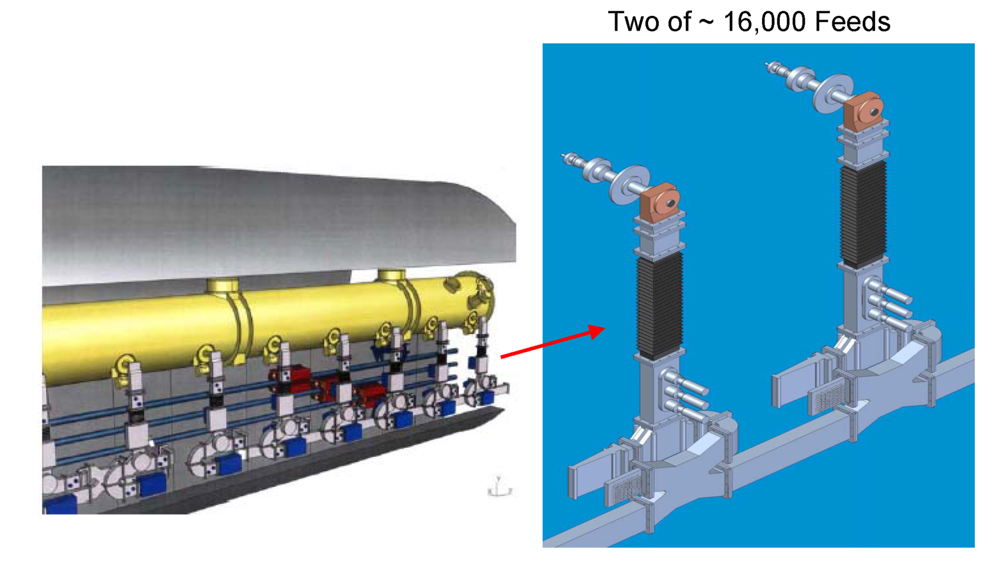
Tunnel function: RF power

Slide 14
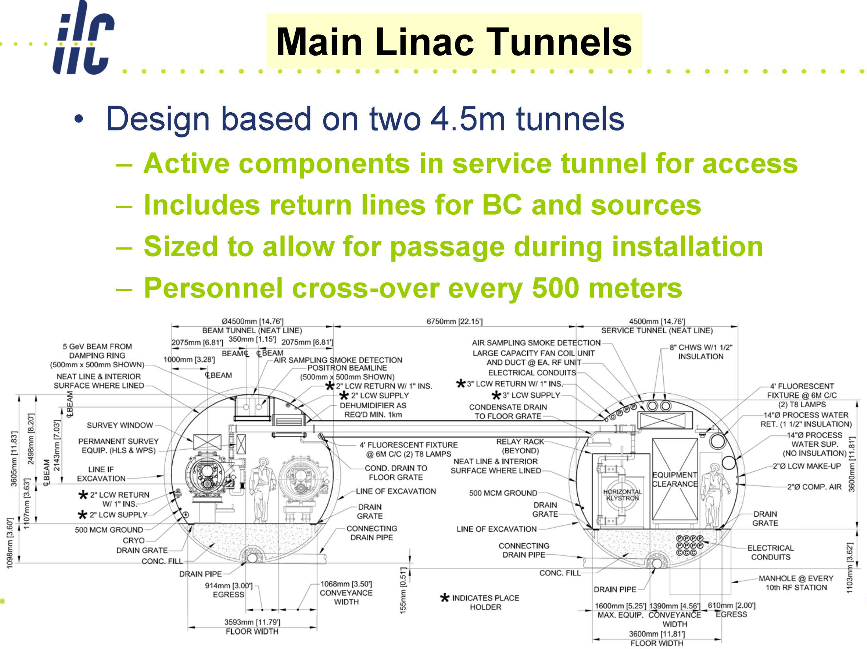

Slide 15
Value – CF&S + AS (non-CF&S)
site-specific
shared CF&S

Slide 17
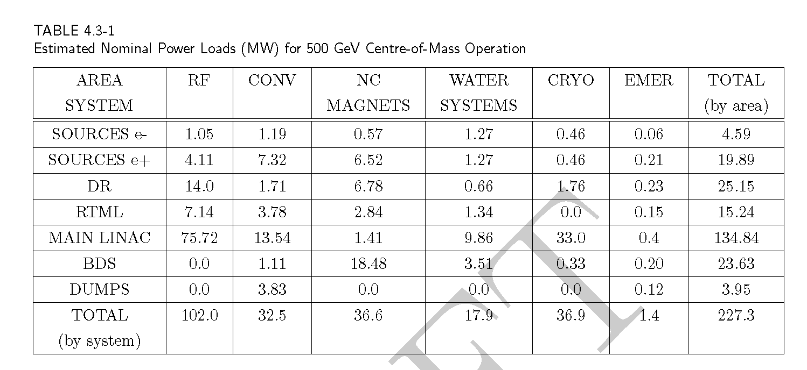
Rdr power parameters / water
power / water handling scheme is an indicator of design maturity
Beam power at IP → 10.8 + 10.8 MW
  15 % efficient
  10% cooling overhead (100W to remove heat from 1 KW load)
Good performance figures – but more to do
  TESLA design (2001): ~ 80 MW lower for same luminosity

Slide 18
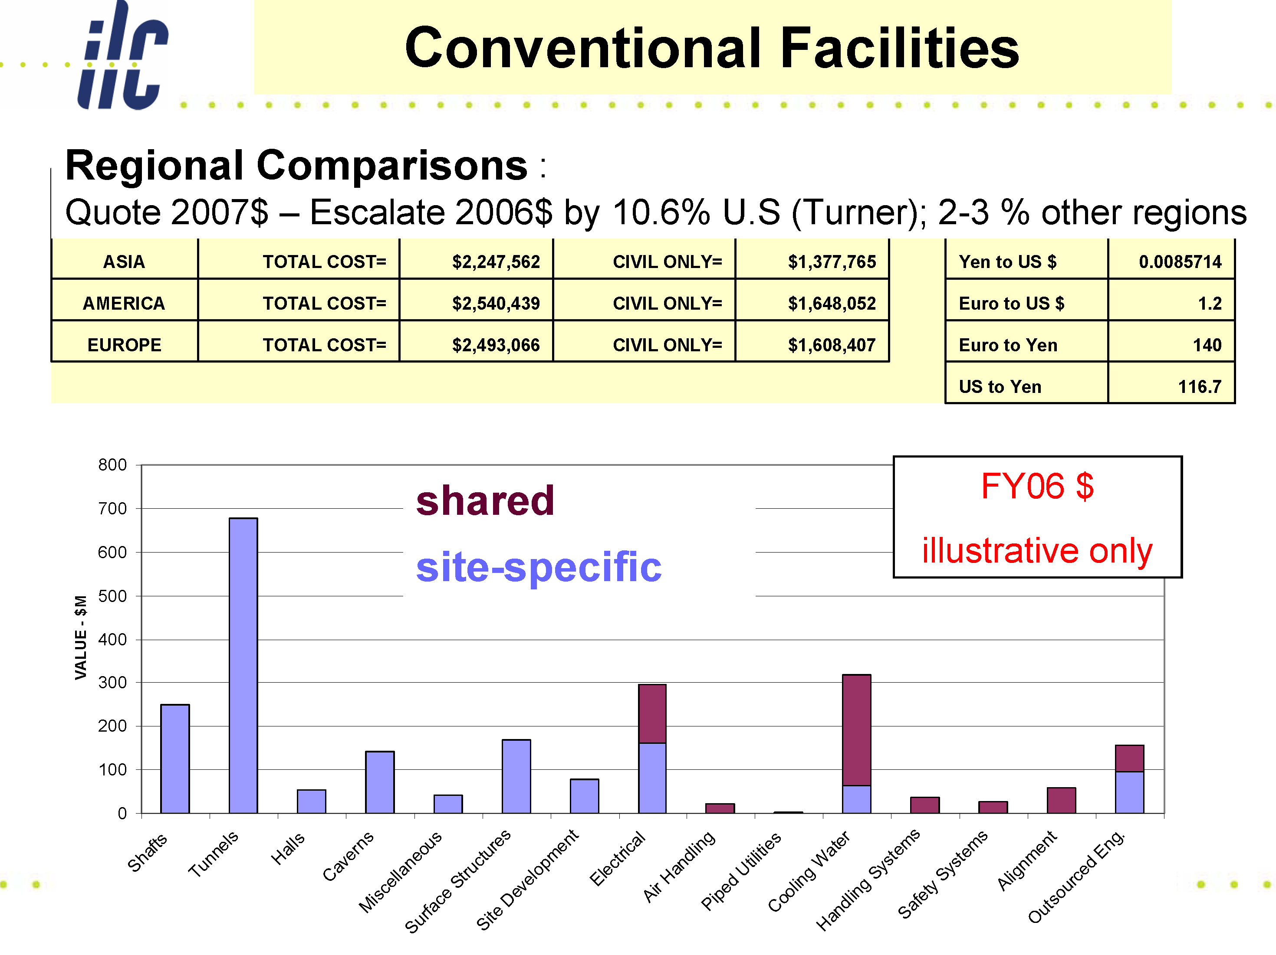

Slide 19
Cost cutting by increasing the temperature difference
Fixed costs: chillers, pressed air, water treatment, auxiliary pipes, etc
recooler: constant temperature difference for the heat flow at the cold side (e.g. the air temperature)
insulation: always the same heat flow
The outlet temperature should be less than 70°C:
Otherwise the water will be to hot for some equipments

Slide 20
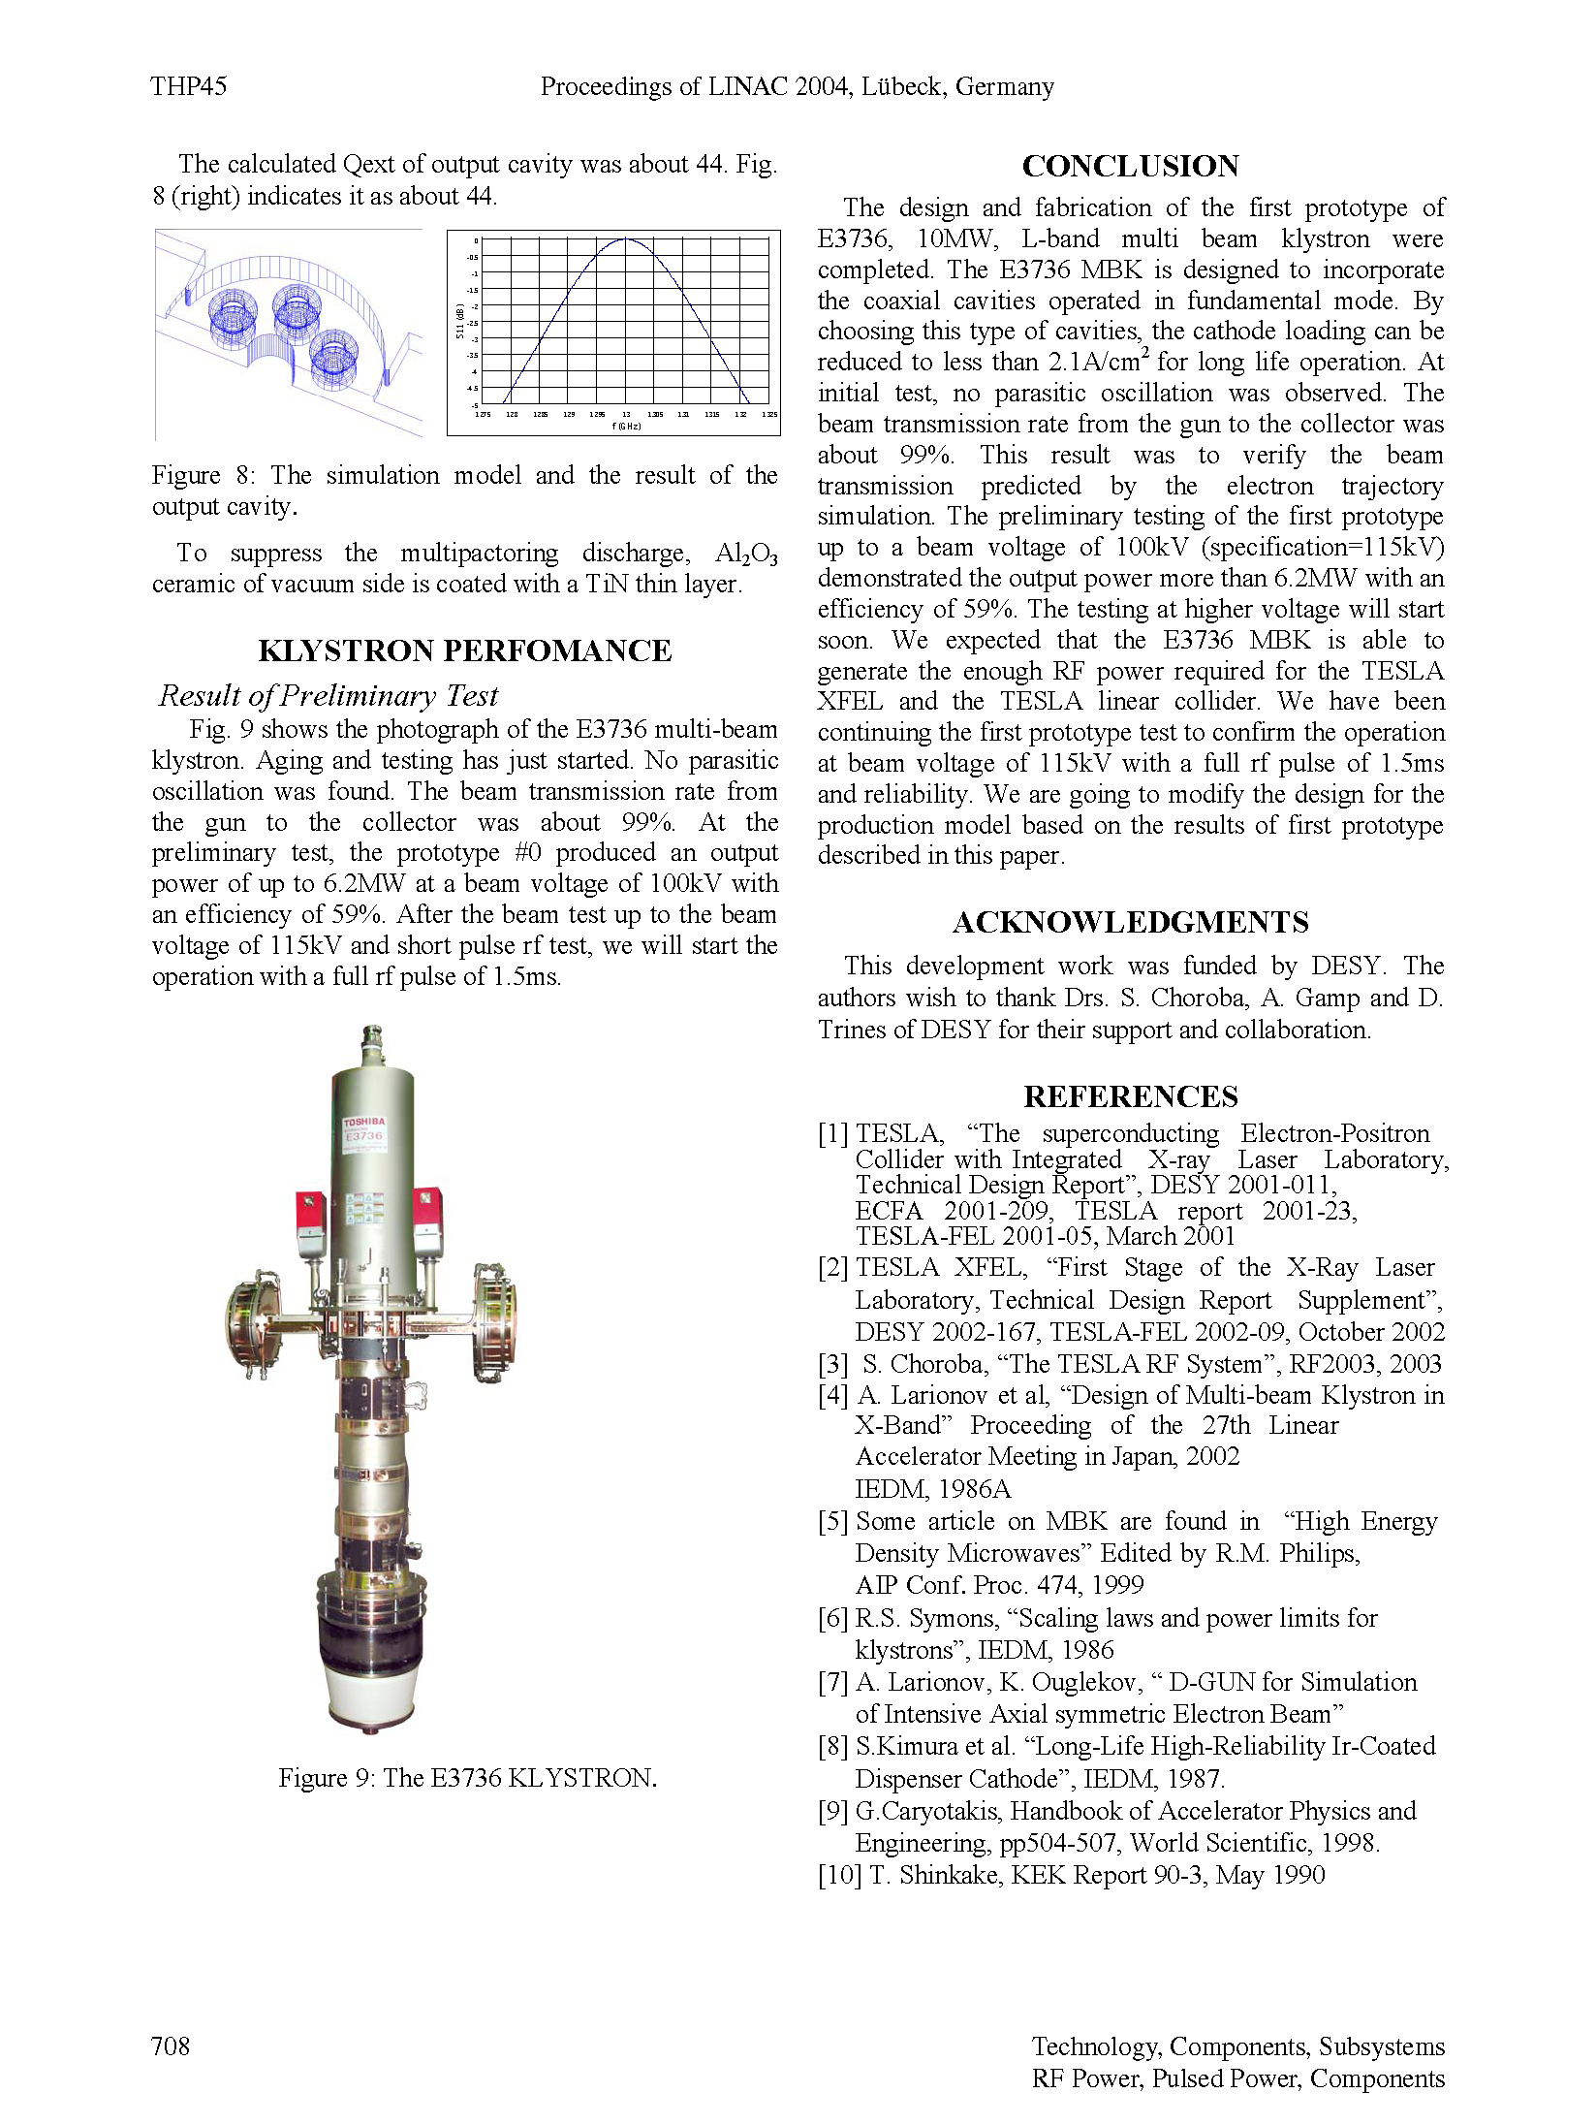
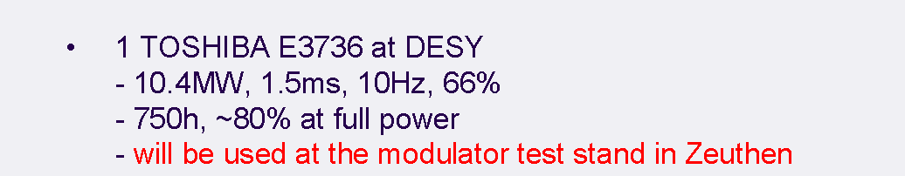
Klystron RF Power Source
S. Kazakov, A. Larionov, V. Teriaev, BINP, Branch of Institute of Nuclear Physics, Russia, et. al
  Russian Design team; fabricated in Japan
Most successful 10 MW multi-beam klystron → BASELINE

Slide 21
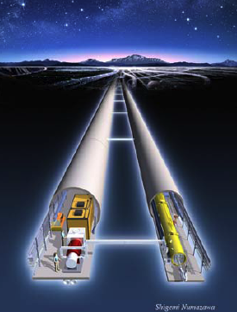
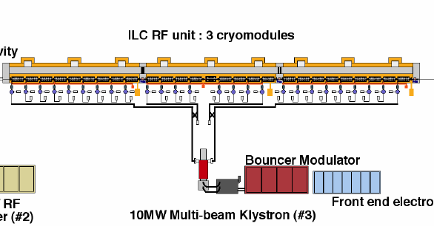
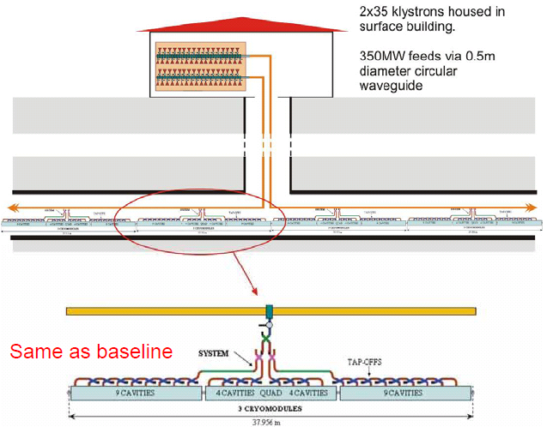
Cost Reduced RF Concepts
Basis: 2 tunnels
Surface Klystron Cluster
(Adolphsen, Nantista, SLAC; Kazakov, KEK)
Both options aimed at single-tunnel solutions
Also: Distributed RF Source Concept
(Fukuda, KEK; Kazakov, KEK)

Slide 22
CFS Value Engineering
The purpose of Dubna 06.2008 workshop
The Dubna shallow site:
  subsurface ‘communication building’ cost 1/10 bored tunnel
  RDR WBS input from GSPI (ГСПИ)
Next step:
  Joint Development of Dubna site:
    To be discussed and reported
  How to take best advantage of special features…

Slide 23
Civil works: RDR strategy
‘Sample sites’ – key aspect
  Allow detailed design development
Sample sites restricted to deep rock sites
  Only very preliminary investigation of shallow sites
Deep sites are less affected by surface conditions
Surface details make understanding of shallow site more complex
  More complex, but also more accessible
  Promise of substantially reduced cost

Slide 24
Role of JINR – GSPI Study:
The most advanced shallow site study underway
  All other site studies involve deep rock
  A kind of ‘neutral’ process
Comparison between deep and shallow sites will indicate substantial cost savings
  By evaluating a specific shallow sample site we are able make effective comparisons
  Allows us to prioritize and define further studies

Slide 25
Goal for ILC-GDE / JINR-GSPI meeting
Review GSPI Preliminary Report
Discuss geo-technical aspects of TALDOM area
Summarize in a jointly authored report
  Sponsored by:
  ILC – GDE
  JINR
  GSPI
  EC ‘ILC Hi-Grade’ FP7 programme
  DESY

Slide 26
Summary
Shallow site studies are very important for the ILC – GDE Conventional Facilities Technical Design Phase
  Cost.
  Comparison and evaluation will lead to cost savings and design improvements
JINR – GSPI is the most extensive shallow site study undertaken in support of the ILC – GDE Reference Design
  No other specific shallow site study is presently planned

Slide 27
Summary
Site studies will facilitate the site selection process
JINR effort is unique and will prove very useful in this complex task
  Preparation of joint report comes at a critical time: 2009 will see a recommendation to update the GDE Reference Design
On behalf of the ILC Project Managers, We thank you very much and strongly encourage further collaborative efforts

