Slide 1
Installation status of the
HLS system
Aug. 12, 2009
G. Gassner, M. Masuzawa, R. Ruland, M. Satoh and
R. Sugahara

Slide 2
SLAC agreed to give us 5 sensors
Mid July Preparation
(pipes, pipe supports, etc.)
Aug. 3~Aug.7 HLS sensor installation with Georg.
No major problem, a small modification needed.
Aug.6~Aug.10 Test run
Aug.10~Aug.11 Modification of the vessel,
re-wiring of the cables
Aug.11 ~ Long run
(with a few day interruption due to the "lab-wide planned power outage” next week.

Slide 3
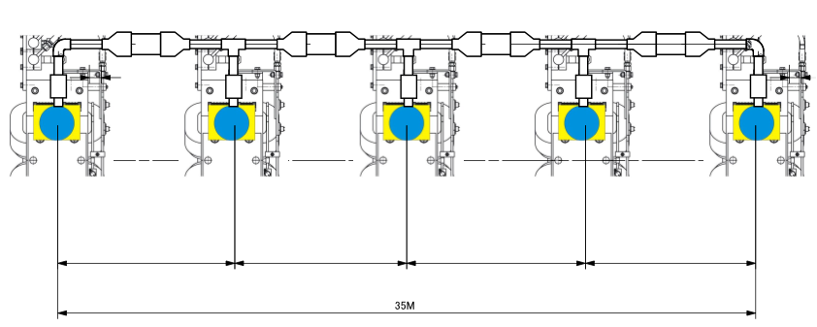
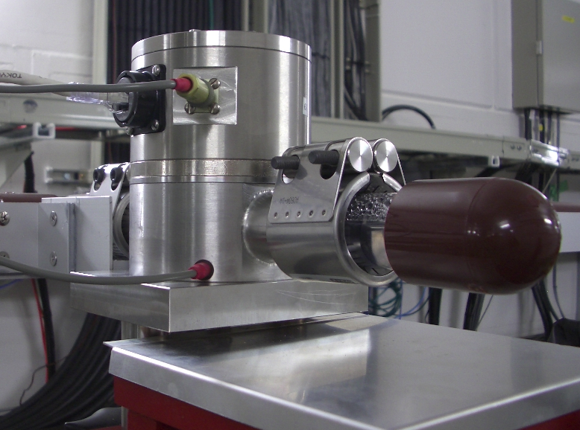
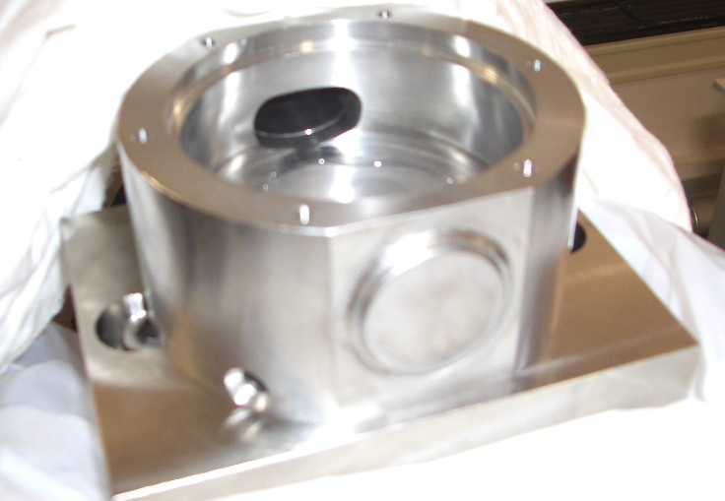
Small modification
Cut the second (extra) outlet and sealed it yesterday.

Slide 4
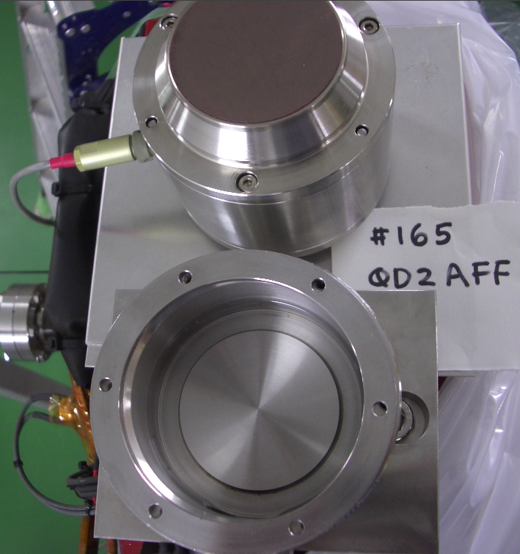
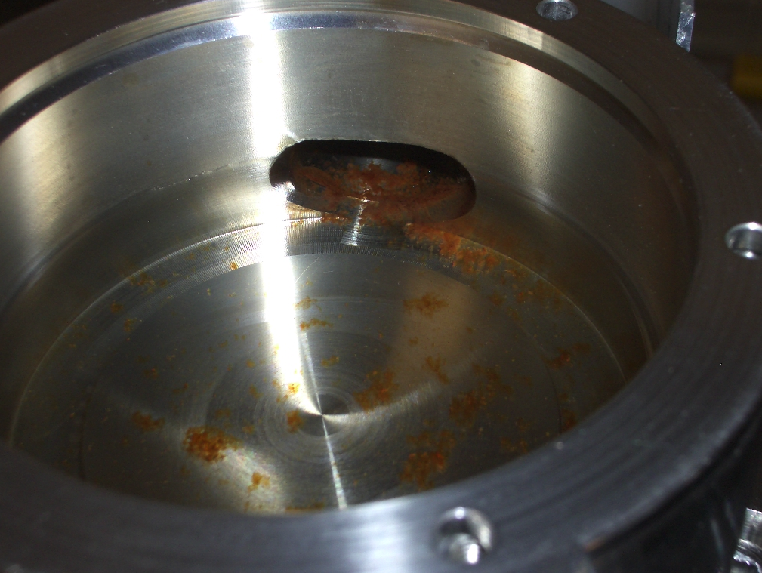
Small problem
One vessel ( out of 5 ) has some
brown deposition. Corrosion??
No problem with 4 vessels.

Slide 5
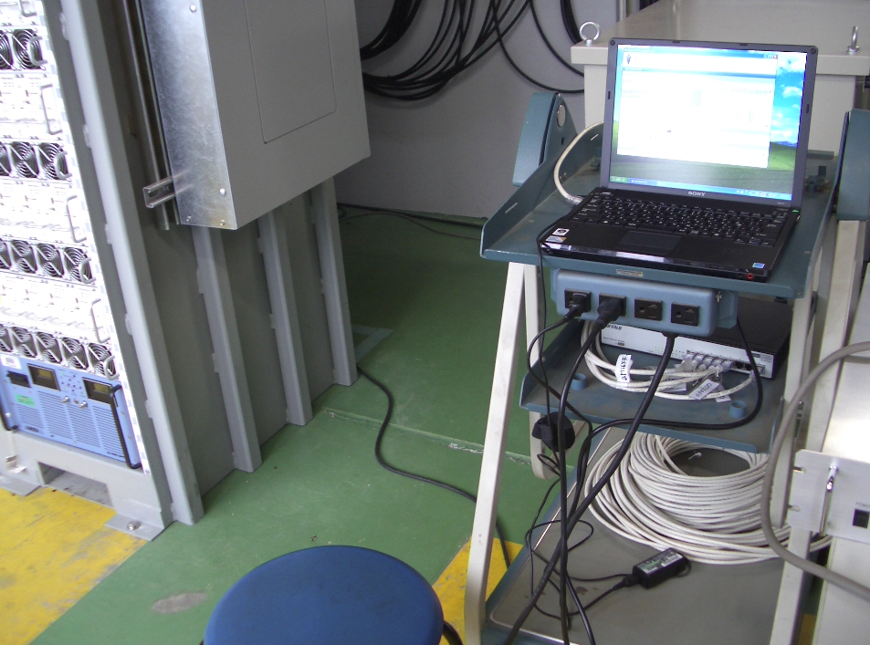
Data acquisition
HLS PC in the “FF power supply room” outside of the ATF2 beam line

Slide 6
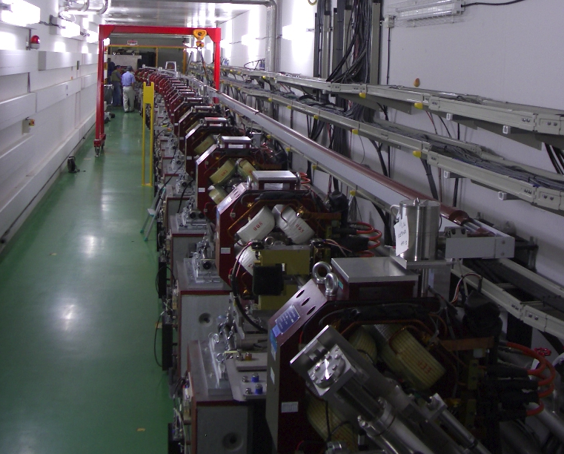
QD2AFF
QD4AFF
QF7FF
QM11FF
QF16FF
5 HLS capacitive sensors
(made by BINP) from SLAC
Each sensor 6~9 m apart
Covering ~ 35 m span

Slide 7
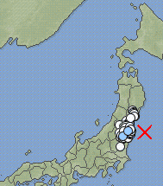
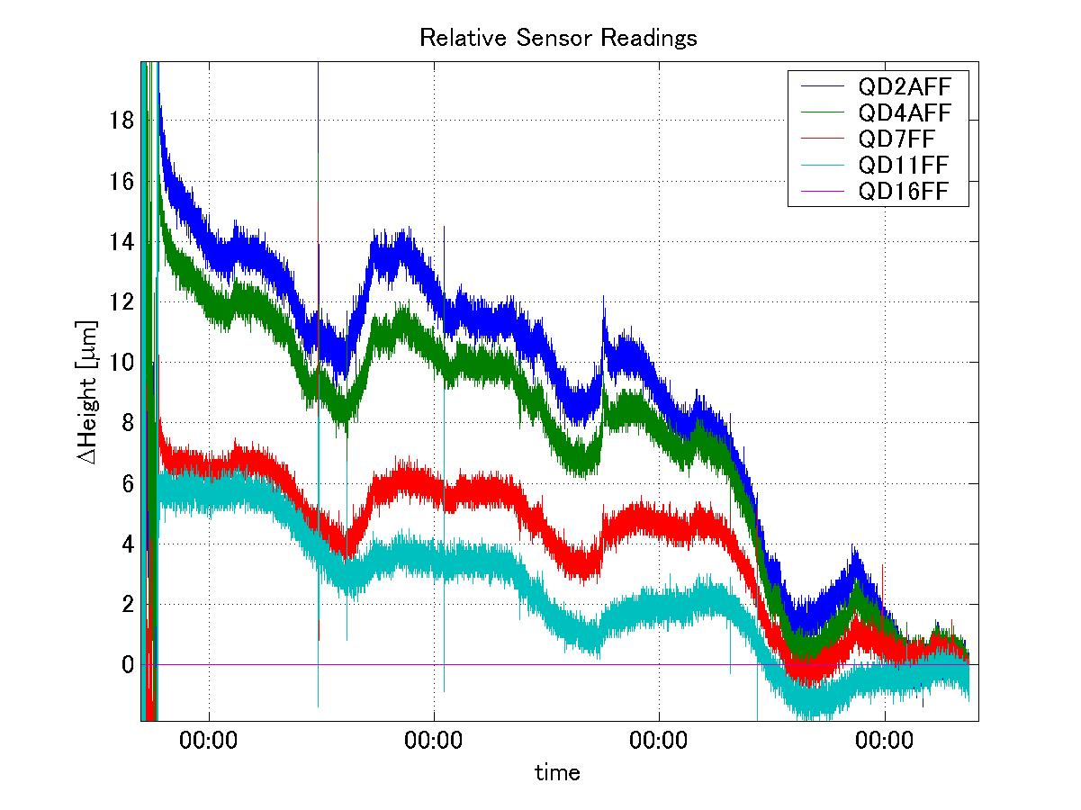
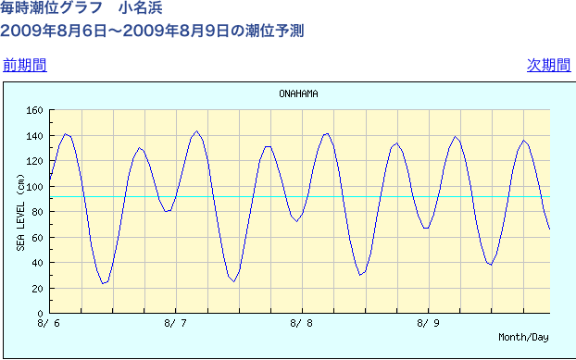
with respect to QD16FF
QD2AFF
QD4AFF
QF7FF
QM11FF
QF16FF
24 hours
?
QD16FF
Aug.6 (Thurs) Aug.7 (Fri) Aug.8 (Sat) Aug.9 (Sun)
Tidal motion + pitch

Slide 8
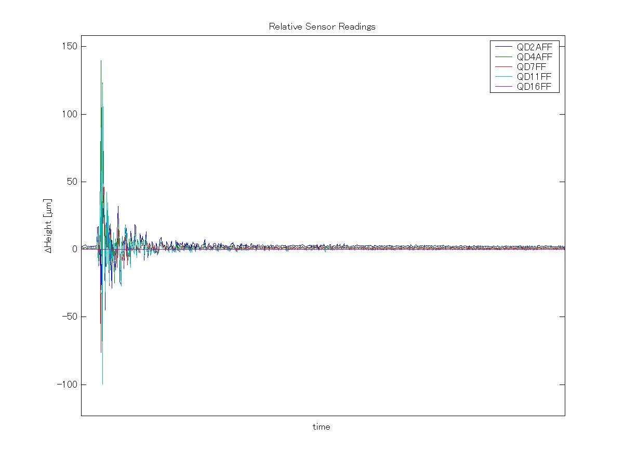
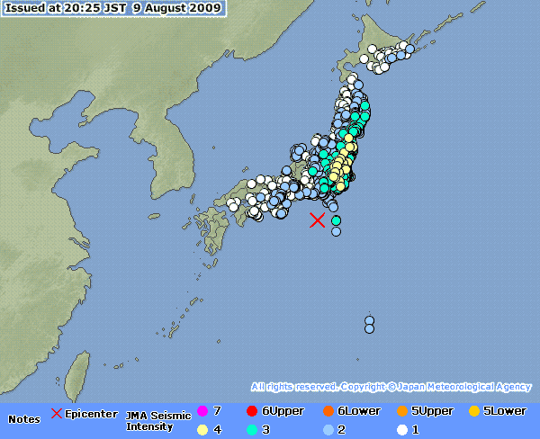
Aug. 9 (Sun) 20:25
3 on the Japanese seven‐stage seismic scale at Tsukuba
Data acquisition
at every 2 seconds

Slide 9
Summary
HLS installation went well.
Many thanks to Georg Gassner and the SLAC alignment group.
Small problems
  A modification needed to three vessels, from two outlets to one.
    Cut the second outlet and sealed it.
  One vessel got corroded ? ( Chemical analysis is underway) .
    We cleaned the surface and painted with epoxy.
Data are collected using a PC in the “FF power supply room”
outside of the beam line.

Slide 10
Future plan
  Collect more data
    Will report them periodically.
  Integrate the HLS system with the ATF2 EPICS database so that we can use the mover position data.
  More sensors?

