Slide 1



LCLS Digital BPM Processor for ATF2 Extraction Line BPMs
Steve Smith
26 August 2009

Slide 2
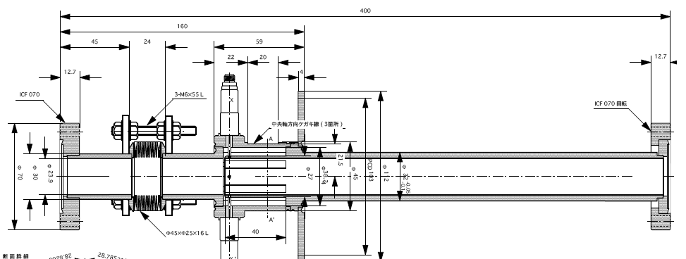
ATF2 Extraction Line BPMs
12 Stripline BPMs in ATF2 extraction line
3 types:
3 each with L= 40 mm, d=27mm
5 each with L= 40 mm, d=37mm
4 each with L= 120 mm, d=27mm
Angular coverage 70 degree/ strip
Charge range 1-10 x 10⁹ e⁻ / bunch
Single bunch or 3 – 20 bunches at 357 MHz separation
Requirements:
Several-micron resolution
Good stability over
bunch charge

Slide 3
LCLS Stripline BPMs
~ 200 BPMs
Most common type has L= 100 mm, d=24mm
Angular coverage 26 degree/ strip
Charge range 1.2 - 16 x 10⁹ e⁻ / bunch
Single bunch
Requirements:
< 5 micron resolution at 200 pC
Good stability over bunch charge
Similar signal, similar requirements

Slide 4
Estimate Resolution by Comparison
Resolution:
Proportional to diameter
Inversely to length, coverage:
ATF2
LCLS
Length ≥ 40 mm
Angular coverage 70 deg
Diameter 27 - 37 mm
Greater coverage, less length ➔ comparable resolution
Larger diameter BPMs will have slightly worse resolution
Length = 100 mm
Angular coverage 26 deg
Diameter 24 mm

Slide 5
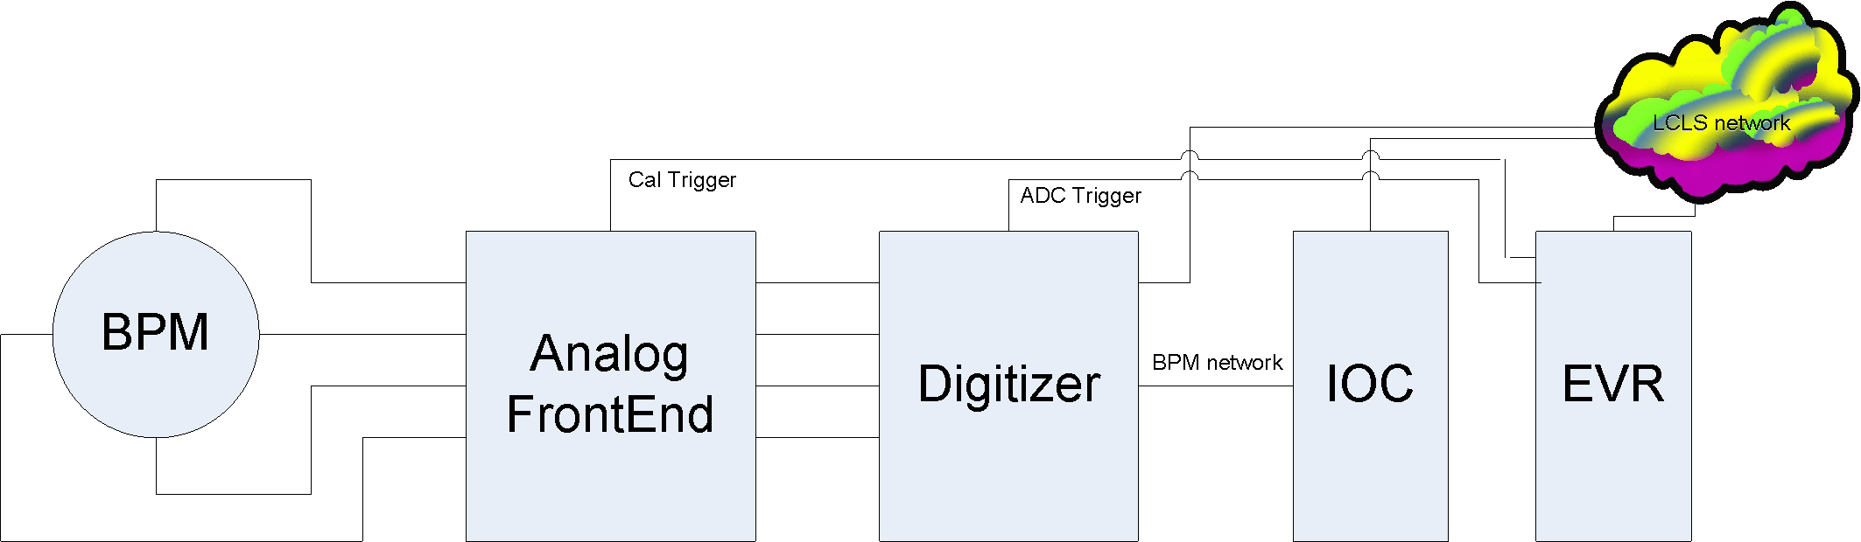
LCLS Stripline Beam Position Monitors
Analog Frontend
Signal is ~8 MHz band centered at 140 MHz

Slide 6
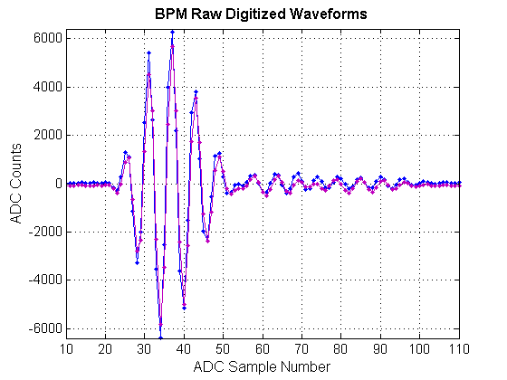
Algorithm
IOC (VME processor) calculates position and beam charge from ADC waveforms
Position:
Estimate amplitude from each strip
V_{i} = rms(ADC_{i})
Correct for calibrated gain ratio
X = R/2 Δ/Σ
BPM raw digitized waveforms. Sampling frequency 120 MHz.

Slide 7
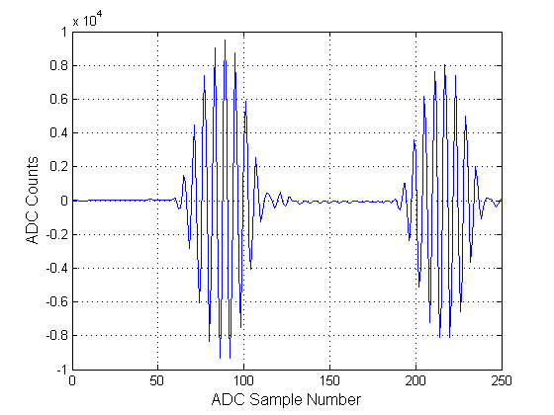
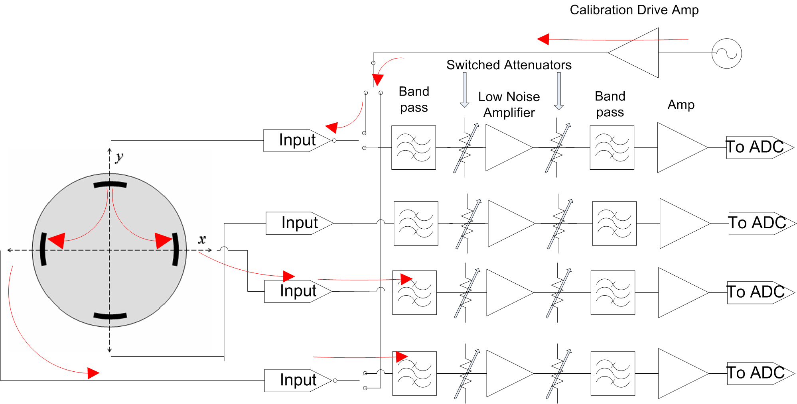
Online Calibration
Launch tone burst into one strip
Receive on adjacent strips
Estimate amplitudes as above
Calculate gain ratio
Correct raw beam amplitudes
Repeat between pulses
Calibrator tone burst detected on adjacent strips

Slide 8
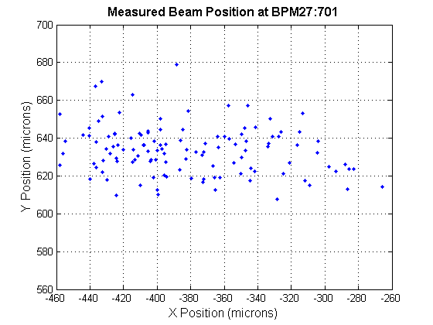
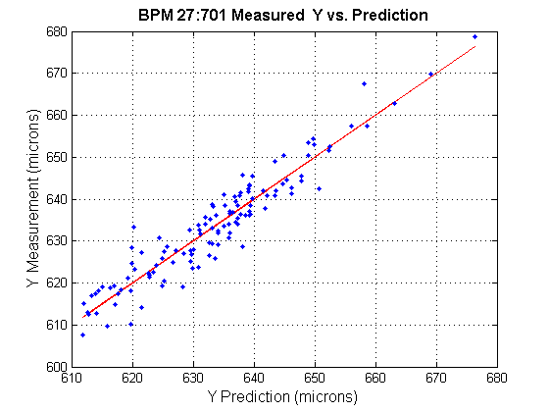
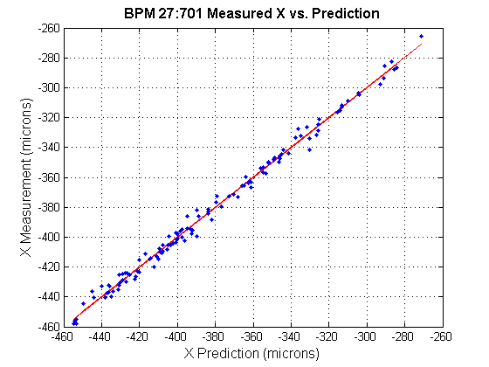
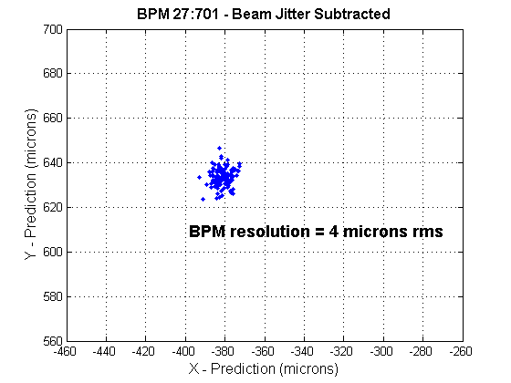
Resolution at 200 pC
a.
b.
c.
d.

Slide 9
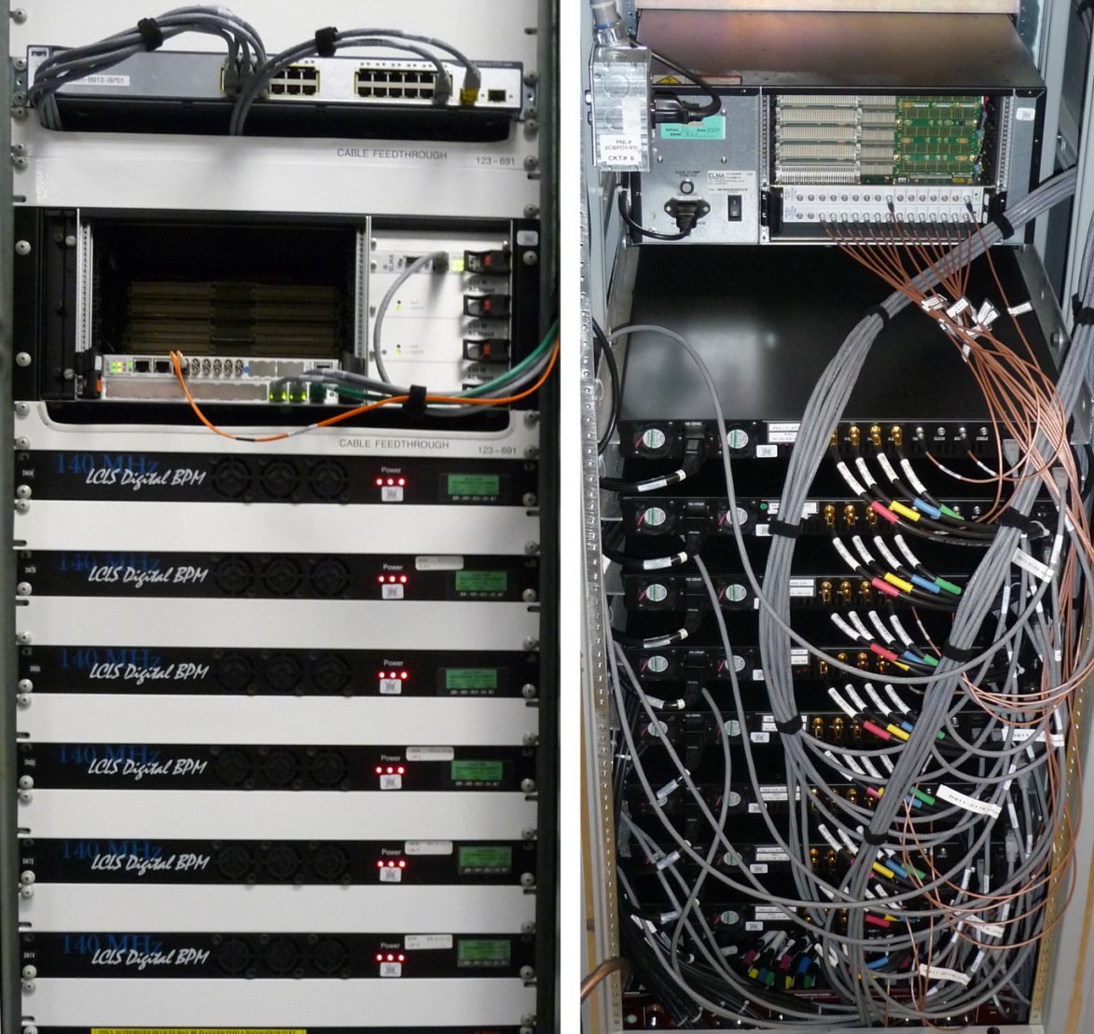
Installation

Slide 10
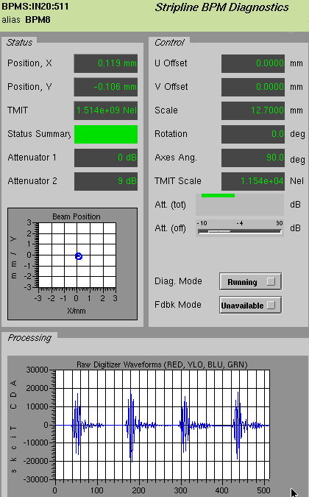
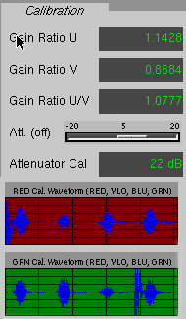
Online Diagnostic Displays

Slide 11
Configuration for ATF2
Build processor chassis containing Analog Frontend, without ADC board
Included:
Analog Frontend
Clock
Functions:
All analog processing
Including calibration
KEK to provide
ADC
digital processing
Control interface (SPI)
3- wire, TTL levels
Set attenuators
Set up calibration
SLAC KEK➔

Slide 12
ATF2 Multibunch Operation
BPM averages over train in multibunch mode
Resolution is approximately the same as single bunch for the same charge per bunch
Unless bunch spacing is near a subharmonic of BPM processing frequency

