Slide 1
Gamma Detector of Plastic Scintillator
Oct. 2, 2009
IP-BSM Group

Slide 2
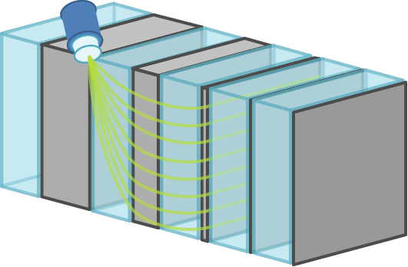
Schematic Drawing of new Gamma Detector
sandwich type calorimeter
SUS and plastic scintillation plate
wavelength-shifting fiber (WLSF) for light transmission
PMT
WLSF
Beam
plastic scintillator
SUS

Slide 3
Comparison with the CsI(Tl) Gamma Detector
same
different
multi-layer scintillator
BG separation by the difference between signal and BG in shower development
scintillator constituent: plastic
faster response time
non-deliquescent
lower energy resolution
sampling calorimeter

Slide 4
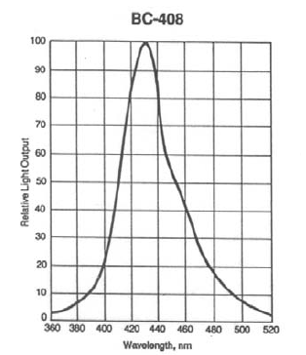
Scintillator
 | plastic scintillator | CsI(Tl)
Light Output [photon/MeV] | 1.1 x 10⁴ | 6.5 x 10⁴
Rise Time [ns] | 0.9 | 9.5 (66%), 41 (34%)
Decay Time [ns] | 2.1 | 1100
Wavelength of Max. Emission [nm] | 425 | 580
emission spectrum

Slide 5
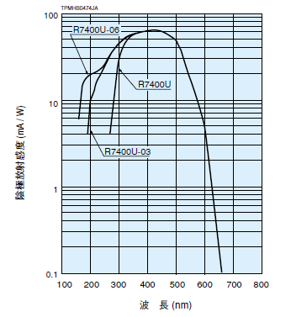
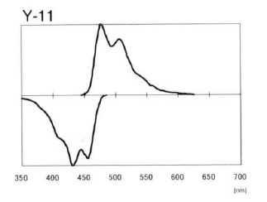
WLSF
Kuraray Y11
0.5mm-suquare
absorption and emission spectrum
PMT spectral response

Slide 6
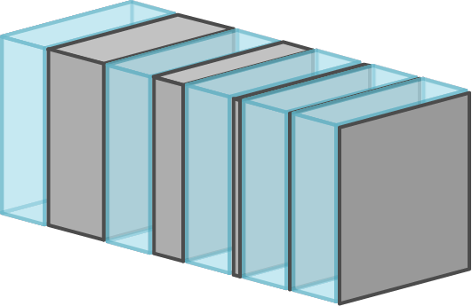
Geometry of the Calorimeter
100mm
100mm
Beam
30mm
SUS
plastic scintillator
number of layer: 5
SUS converter: 1-1-5-20-40mm thick
scintillator: 30mm thick (all layer)

Slide 7
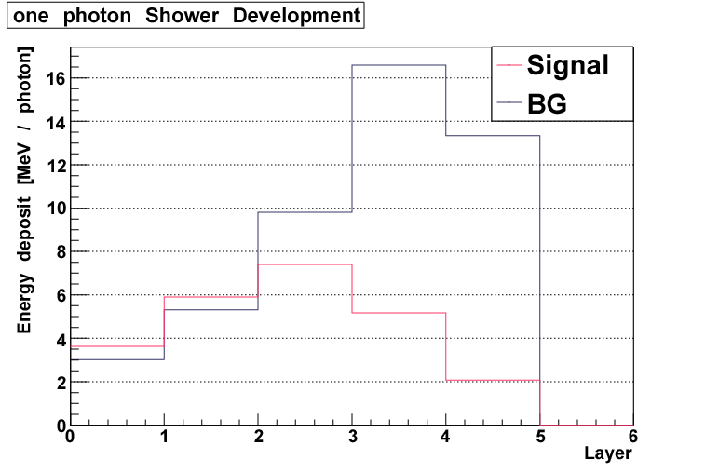
Geant4 Simulation: Shower Development

Slide 8
Comparison with the CsI(Tl) Gamma Detector in BG Separation
Signal: 500 photon
with Shot by Shot method
new detector
the CsI(Tl) gamma detector

Slide 9
Incident Energy vs. Deposit Energy Fraction
*fraction of the CsI(Tl) gamma detector is “Flat”

Slide 10
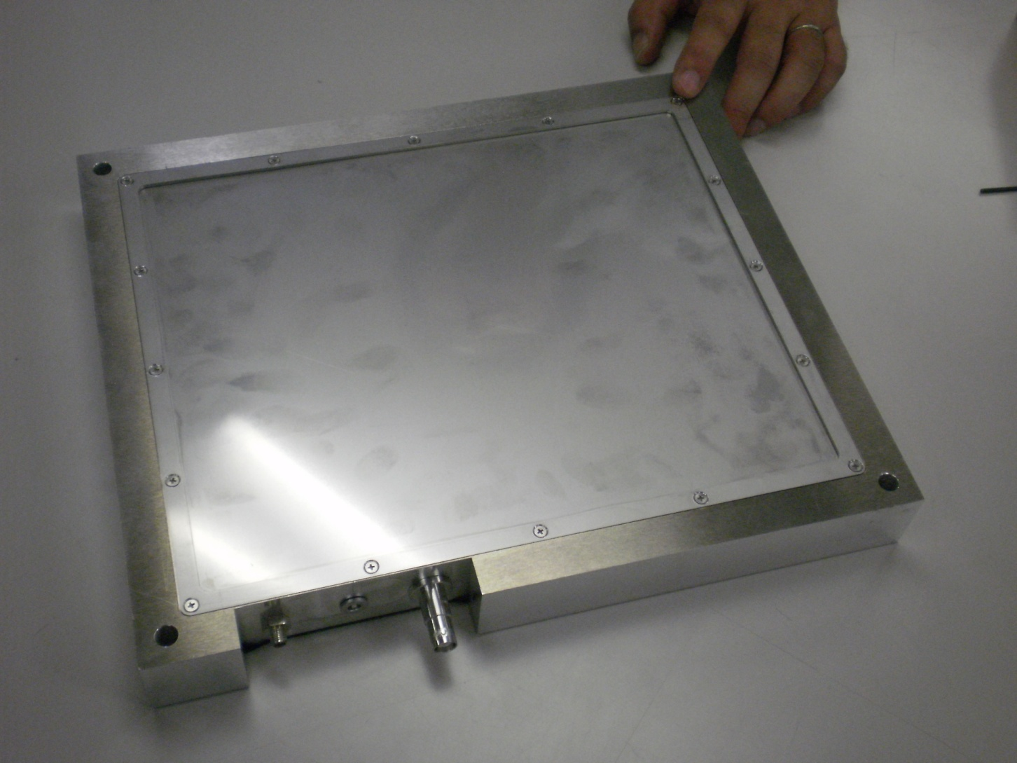
Scintillator Box
0.5mm SUS plate
Aluminum frame

Slide 11
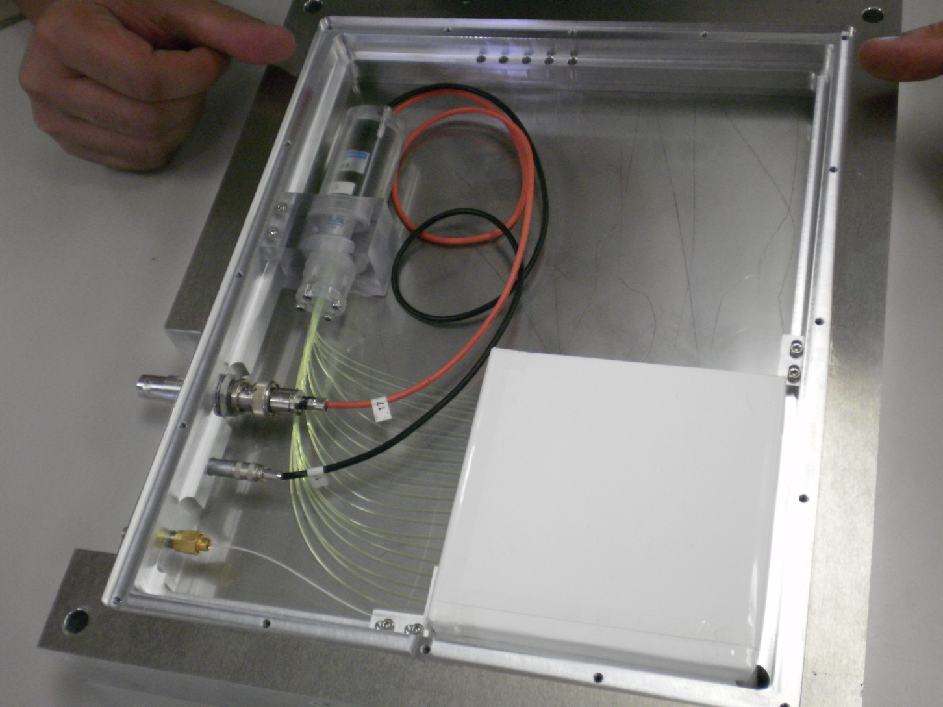
Scintillator Boxes are Independent of each other
PMT above the beam-line
to avoid radiation damage
LED for
calibration
100mm
100mm

Slide 12
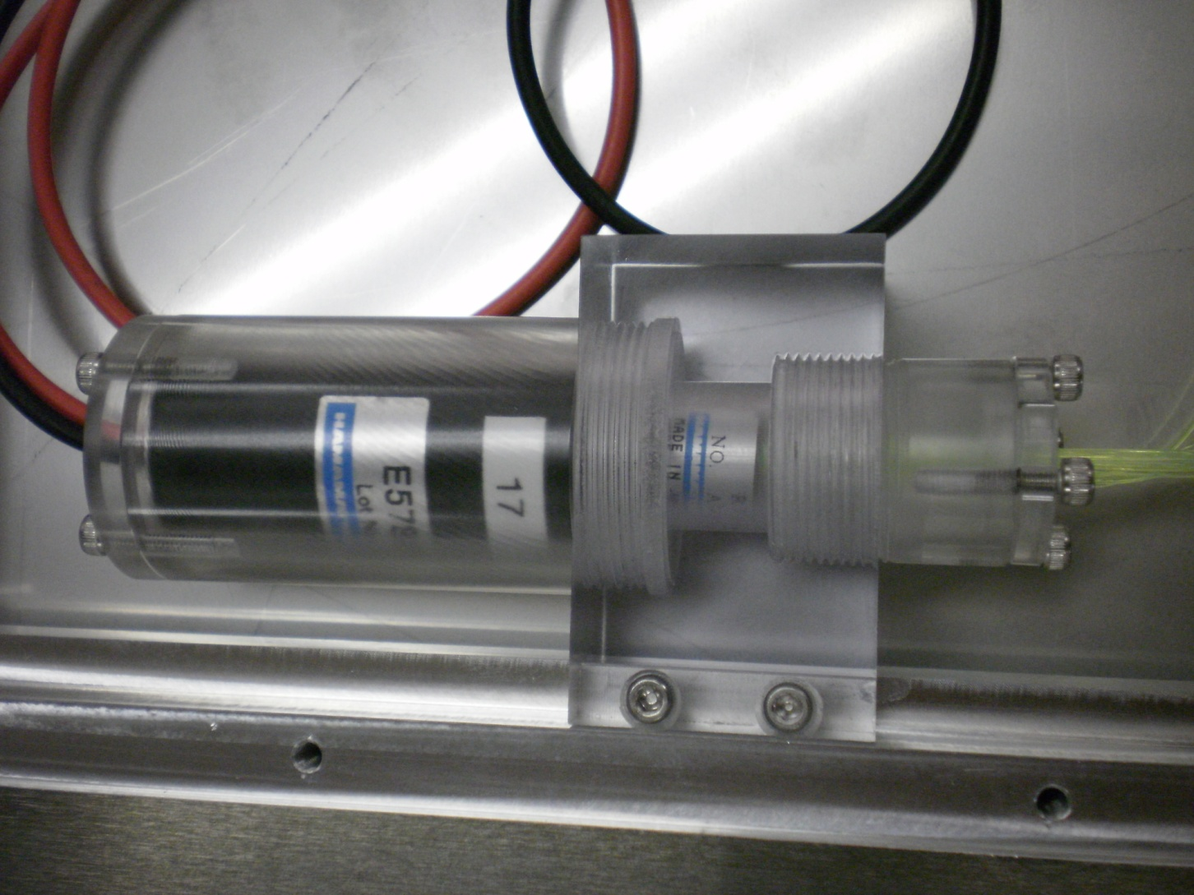
Connecting Jig for connecting PMT and WLSF

Slide 13
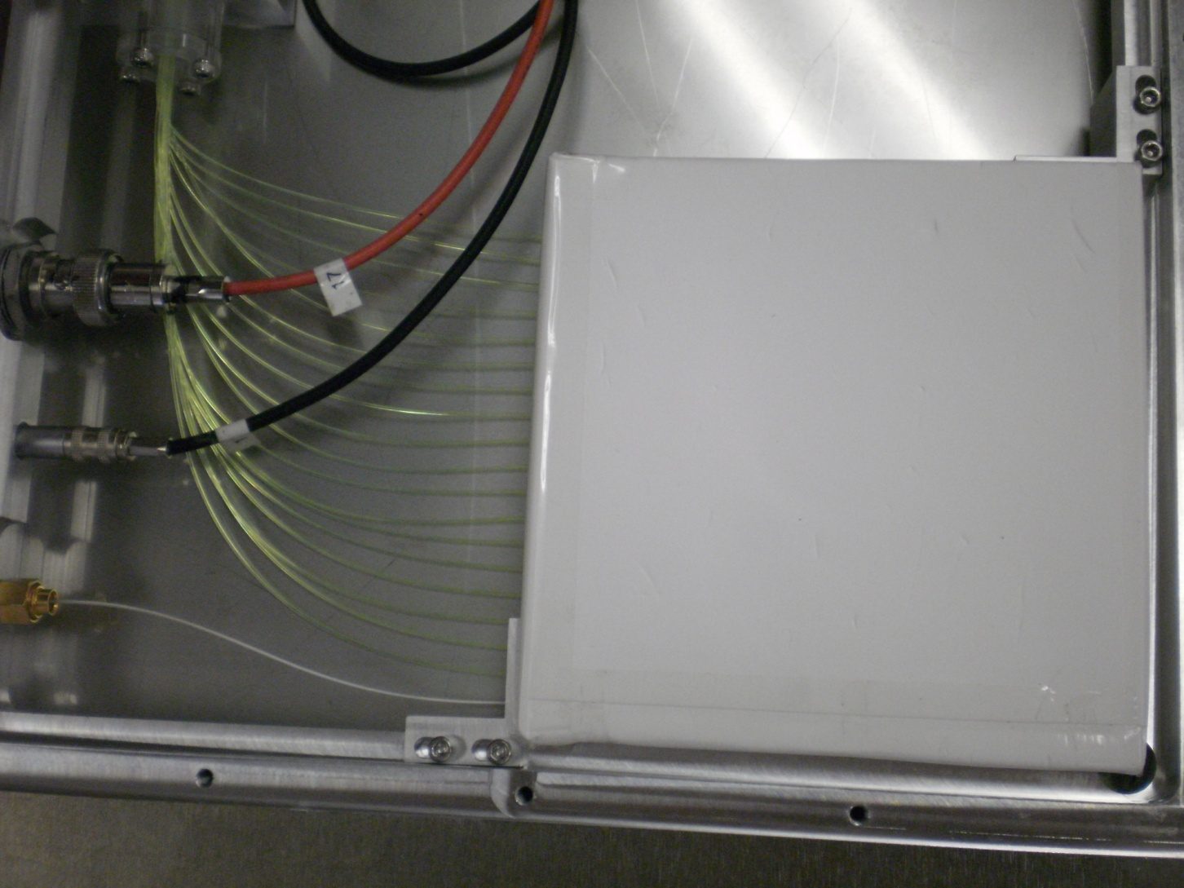
Scintillator
wrap: Goretex
Fiber: Y11 x 18 (green), calibration fiber x 1 (white)

Slide 14
Shower Development in SUS
Signal photon
BG photon
20mm
40mm
5mm
1mm
1mm
SUS converter 1-1-5-20-40mm thick

Slide 15
Shower Development of Monochrome Gamma (normalized to 1)

