Slide 1
Update on shintake background simulation
Hayg Guler
Marc Verderi
14th october, 2009
LLR – Ecole polytechnique

Slide 2
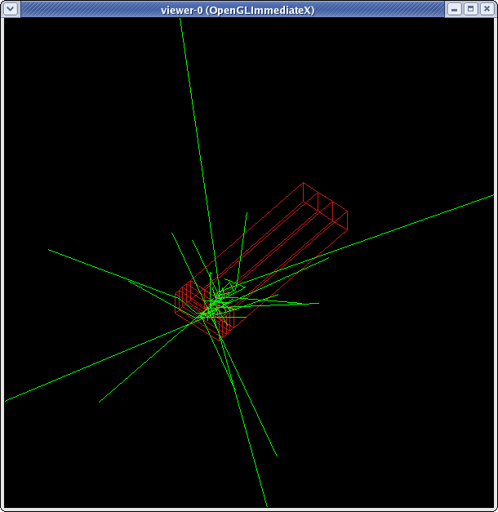
Shintake detector model
Geometry:
  4 CsI layers, 10 mm thick
    50 mm high
    100 mm wide
  3 CsI blocks, 30 cm long
    Correct ?
  In the following 4 front layers are labeled 1 to 4, the 3 CsI blocks are grouped all together to form “layer #5”

Slide 3
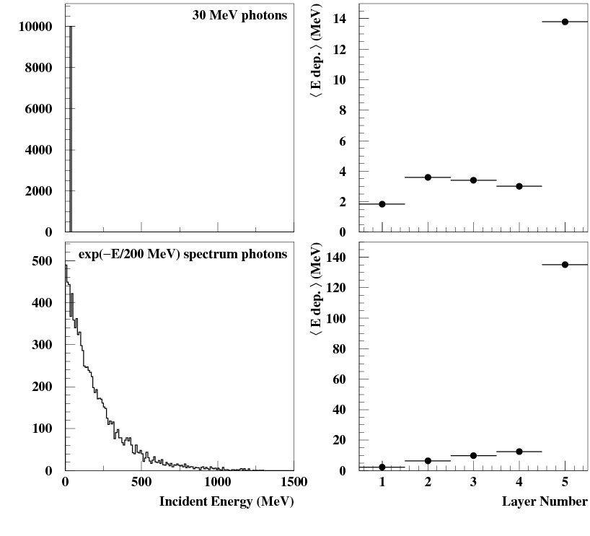
Check of simulated Shintake detector response
Shoot:
  Monochromatic 30 MeV photons
    To mimic the “signal” photons
  Exponentially decaying spectrum
    To mimic Brem photons
Plot related energy deposit profiles

Slide 4
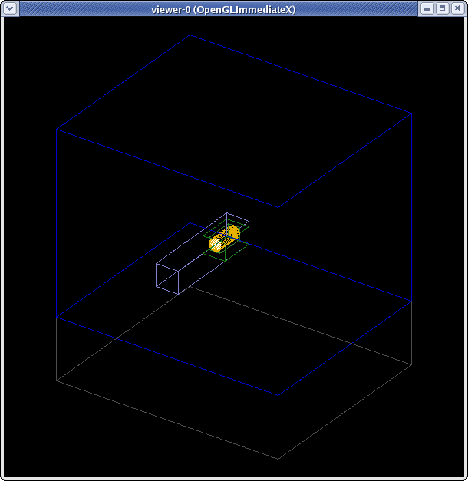
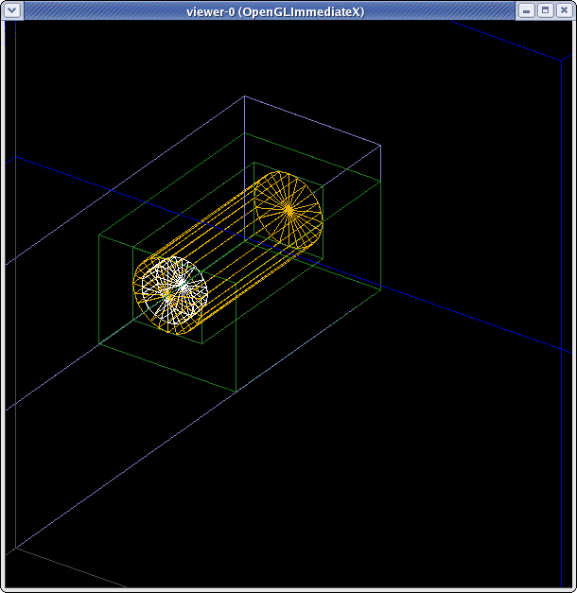
Beam dump model
Detail of central/copper part

Slide 5
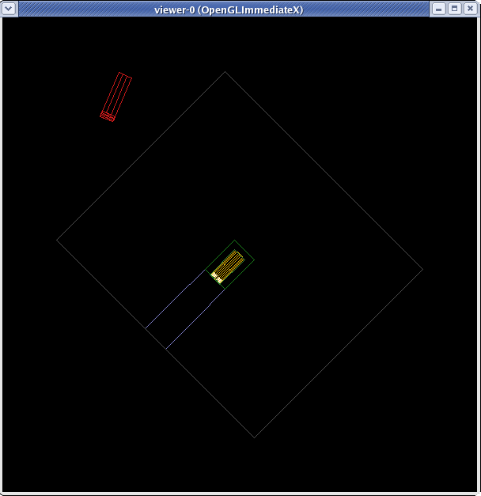
Beam dump + Shintake detector
(view from top)
Place (roughly) the Shintake detector with respect to the beam dump
  No shielding nor collimators placed here, but doable (models exist).
Note that only a macro file is used to place these beam dump and Shintake detector models

Slide 6
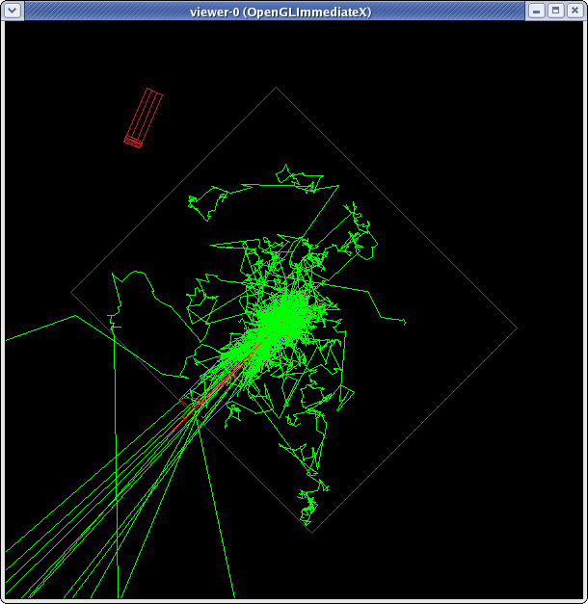
Same with 50 1.3 GeV e⁻ in dump
Left picture is obtained by shooting 50 electrons in dump.
  Leading background are
    photons, back shined from dump (not in Shintake detector direction)
    Neutrons (“brownian” aspect tracks)
Difficulty:
  Processing 10K electrons lead to only one deposit in the Shintake

Slide 7
Next
Simulate the end line with BDSIM
Merge our “standalone” simulation with BDSIM
Consider to bias the simulation
  Low statistics in simulation is expected for background from dump
    But will be likely the same with the BDSIM for EM background
  Options (not mutually excluding)
    Geometry biasing in dump
    Physics biasing elsewhere
      we started to investigate how we could bias the Geant4 brem process to enhance production towards detector direction(s).

