Slide 1
Beam Test and Detector R&D
LCWT 09
November 2, 2009
Takeshi MATSUDA
DESY/FLC & KEK/IPNS

Slide 2
Apologies
I am supposed not to discuss R&D’s themselves. But since I
still do not know what I should talk. So I started with TPC R&D!

Slide 3
Detector R&D: Beam Test
Goal of R&D:
The detector with specifications given by Physics at ILC.
Criteria well defined at each step of R&D.
Need & goal of beam test:
Test/Demonstrate new technology, new structure, new software.
Confirm/validate speculation, simulation, theory
Compare/select technologies, designs, software's.
Performance test large scale prototype, combined test
Calibration
Starting from a simple case: TPC

Slide 4
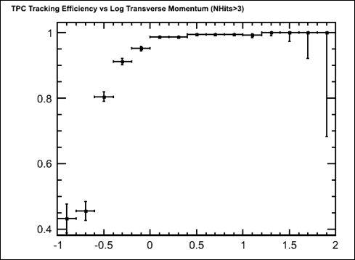
TPC R&D: Simple Case
High Momentum resolution: (a) δ(1/pt) ≦ 5 x 10-5
→ (b) ≧200 position measurements along each track with
the point resolution of (c) σ_{rφ} ~ < 100μm at 3-4T
→ from Wire TPC to MPGD TPC
High tracking efficiency down to low momentum
in a high backgrounds at ILC for jet energy measurement.
Minimum material of trucker, in particular, for PFA (challenging!)
dE/dX
> 99%
->
Preliminary
ttbar overlayed with 100BX of pair backgrounds
Tracking efficiency w pair background
(S. Aplin & F. Gaede)

Slide 5
Demonstration Phase
From wire TPC to MPGD TPC:
Comparison of wire TPC and MPGD TPC: This stage we knew that the wire TPC has poor resolution due to ExB in high B → but comic ray test in 1,5T magnetic field and beam tests in 1T were dispensable.
Beam tests and the cosmic ray tests with many small TPCs prototypes to study stable operation and point resolution of MPGD TPC: learned a lot about the basic structure of MOGD TPC → GEM: signal spread in the induction gap, Micromegas: bulk structure, resistive anode readout etc.
A full analytic formula of the point resolution of MPGD TPC “born from a beam test” giving a guidline for the point resolution of ILC TPC.
Some other issues (still remain even today!)
Search for the best gas for LC TPC
Ion feedback and gating- a simulation and (beam) tests.

Slide 6
Experiences for Stable Operation of MPGD TPC in Various Small Prototypes in LC TPC Collaboration
There are more ,, and d they are still in operation

Slide 7
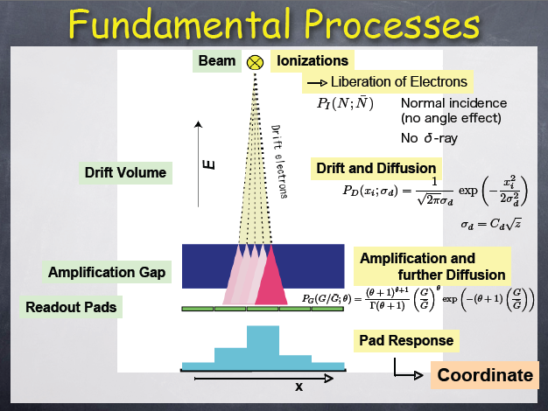
The fundamental process is known!
TPC Gas: Gas physics
No. of primary electrons
Fluctuation of ionization
Attachment
Diffusion
Drift velocity
(Aging)
Drift: Filed cage/Magnet
E & B field
Distortions (ExB)
Gas amplification: MPGD
MicroMEGAS or GEM
Gain fluctuation
Ion backflow
Position measurement:
Conductive pad
Resistive anode pads
Pixels
Low noise electronics:
Analog/digital
http://www-jlc.kek.jp/subg/cdc/lib/DOC/TPCSchool/200801/Fujii_Keisuke/TPCfundamentals-1.pdf (42MB)

Slide 8

Spatial Resolution of MPGD TPC:
Full Analytic Calculation
K may be dependent of the amplification scheme. If K is small, then Neff can be close to 35. in the case of GEM, Neff seems to be 20-25.

Slide 9
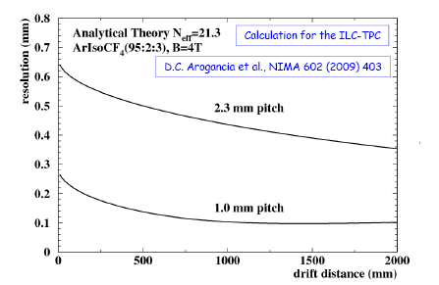
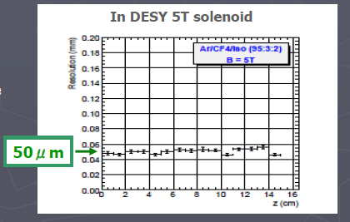
Position resolution: MaicroMEGAS
MicroMEGAS :
RMS (avalanche) on pads = 15μm
-→ need resistive anode
Not sufficient resolution for normal pads
MicroMEGAS with
resistive anode:
Pads of 2mm x 6mm
B=5T
Neff = around 24-25

Slide 10
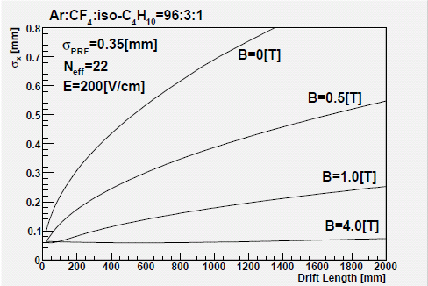
Position Resolution: GEM TPC
Analytic formula of position resolution
GEM
RMS (avalanche) on pads= 350μm (Adjustable)
Neff around 20 for 1mm x 6mm pads
If Neff < 20 → No GEM TPC fro ILC!

Slide 11
Options of MPGD for ILC TPC
Based on the studies with small MPGD TPC Prototypes
Analog TPC: Immediate options if the current ILC schedule
(1) Multi layer GEM + Narrow (1mm wide) pad readout:
Defocusing by multilayer GEM
Narrow (1mm) pads ➔ Larger readout channels
Effective No. of electrons (Neff):
(2) MicroMEGAS + Resistive anode pad (2-3mm wide)
Widening signal by resistive anode
Wider pads ➔ Less readout channels
Neff:
Digital TPC:
(3) Ingrid-MicroMEGAS + Timepix: Digital TPC
Digital → Free from the gas gain fluctuation
More information from primary electrons and
Thus better position resolution (to be demonstrated)
(4) Multilayer GEM + Timepix: More an analog TPC?
Need to improve the efficiency for primary electrons

Slide 12
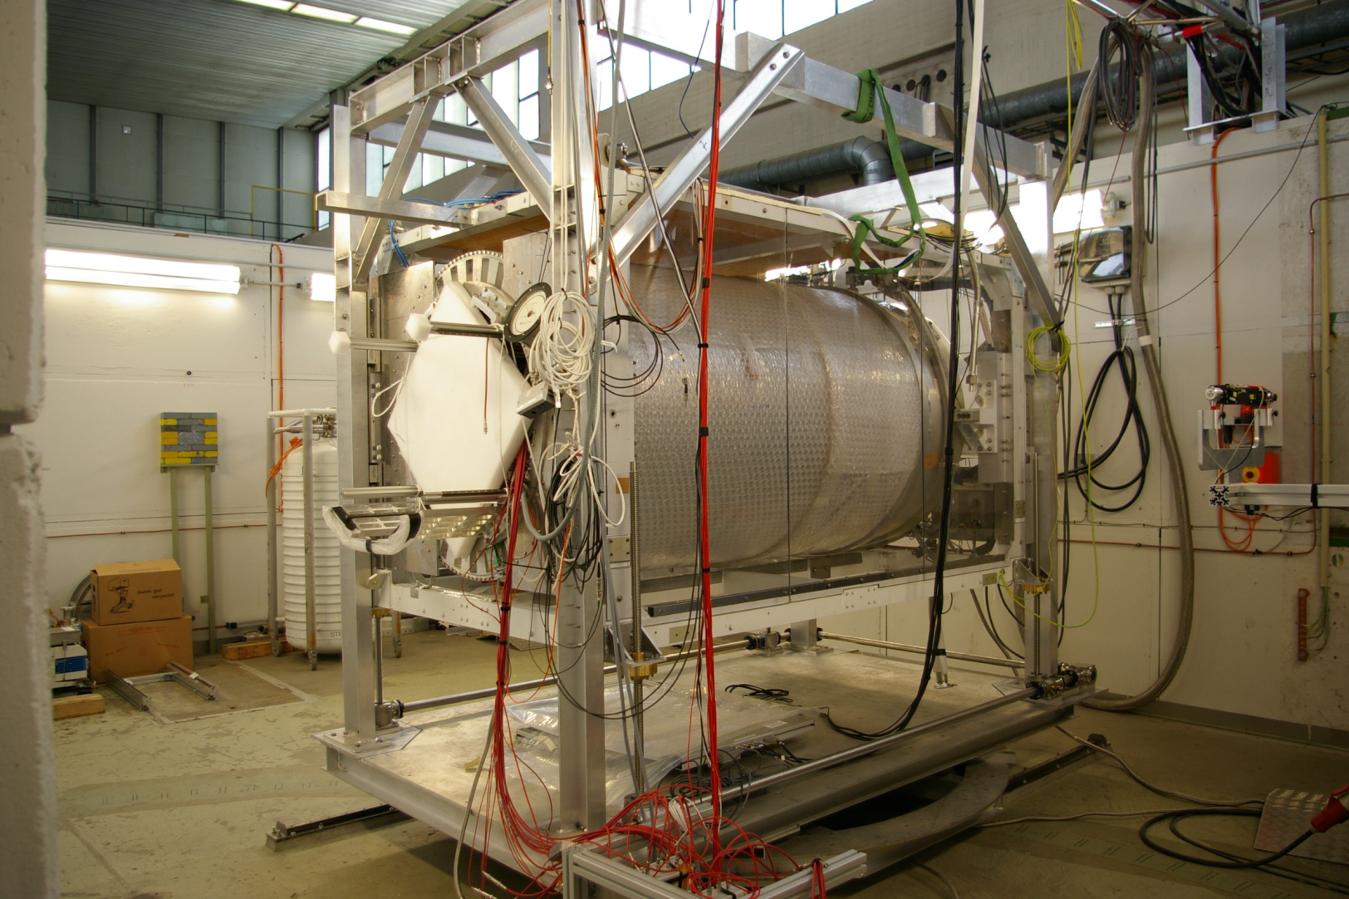
TPC Large Prototype Beam Test

Slide 13
TPC Large Prototype Beam Test at DESY :
Goals
  Study, in practice, design and fabrication of all components of MPGD TPC in larger scale; a field cage, an endplate, detector modules, front-end electronics and field mapping of non uniform magnetic field.
  Demonstrate full-volume trucking in non-uniform magnetic field, trying to provide a proof for the momentum resolution at LC TPC: R&D goal (1-a)
  Demonstrate dE/dX capability of MPGD TPC.
  Study effects of detector boundaries.
  Develop methods and software for (tracking,) alignment, calibration, and corrections.
(Beijing tracker review, Jan 2007)

Slide 14
Measurement of Momentum Resolution
LP
Two steps:
(1) σ_{rφ}: OK also at LP1 : Present status
← MPGD TPC
← Gas of low diffusion (high ωτ）： Ar:CF4:Isobutene （T2K gas)
(2) Momentum resolution: More difficult
← Non uniformity of PCMAG magnetic field (in purpose → ILC)
← Distortion of other sources: Field cage, endplate
← Distortion due to ion feedback (Ion disks)
→ Tracking Software for the non uniform magnetic field (Urgent!)
But also, eventually comparison/selection of technologies

Slide 15
TPC Large Prototype Beam Test (LP2) from 2011
Current Plan
2010 Continue LP1 test at DESY
2011 LP2: Move to a high momentum hadron beam:
← Limitation using electron beam to measure momentum.
→ Options of magnet
Move the current PCMAG
Find a proper high filed magnet accommodates
current LP1 TPC (Solenoid preferable).
→ Build also a new field cage with a laser track calibration
→ With TPC “Advanced Endplate” (need resources!)

Slide 16
TPC Large Prototype Beam Test (LP2)
Some issues
Momentum measurement :
A standard high momentum hadron beam line: where?
Liquid He supply & He gas recovery for PCMAG → Modify PCMAG with cryo-coolers
Double track separation (Jet environment)
In principle we may simulate the situation from single track parameters.
Base line shift (proper tune of readout electronics and MPGD system)
Ion issue -> simulation in the fisrt
Bunch structure
Back grounds and Ion disks → by a laser sauce
Power pulsing and cooling (“Advanced endplate”)
→ Pad plane with readout electronics may be tested in lab.
Actually many things can be done in lab. Or by simulation
based on the basic parameters checked also by beam tests.

Slide 17
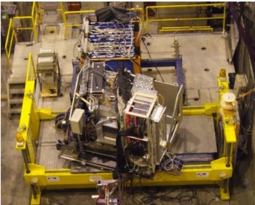
Calorimeter R&D
More technology options
Goals of R&D:
Demonstrate feasibility of (Particle Flow Approach) calorimeter for ILC
Well defined already? Do we need a proof for PFA?
Goals of beam Test:
Establish technology: basic performance of calorimeter
Tune the reconstruction algorithms
Validate/tune Monte Carlo models
Many detector options: → CALICE
PFA calorimeter: EM calorimeter
• CALICE Si-W ECAL
• SiD Si-W ECAL
• CALICE Scintillator-W ECAL
• CALICE MAPS Digital ECAL
PFA Calorimeter: HCAL
• CALICE Scintillator Analog HCAL (AHCAL)
• CALICE RPC Digital HCAL (DHCAL)
• CALICE MicroMegas DHCAL
• CALICE GEM DHCAL
• CALICE RPC Semi-Digital HCAL (sDHCAL)
Dream calorimeters

Slide 18
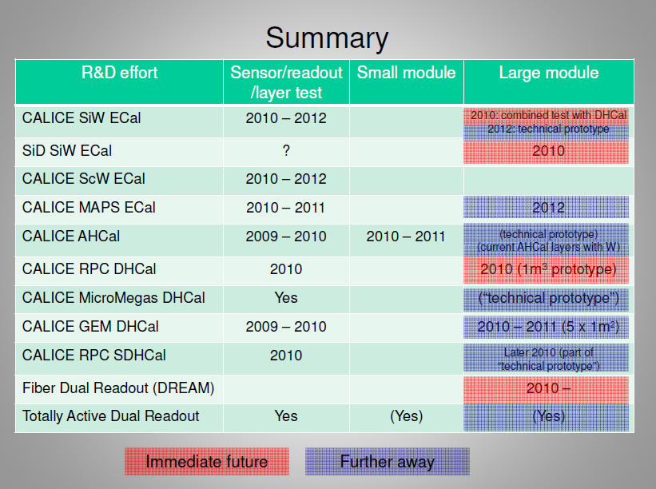
Calorimeter R&D
More technology options
(Lei Xia/ANL HEP

Slide 19
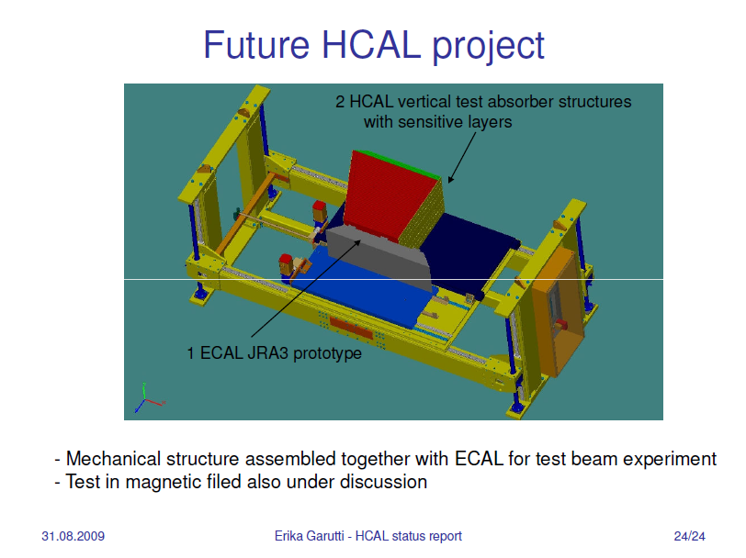
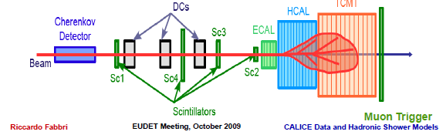
Calorimeter: Large Module Test
basically, or else?

Slide 20
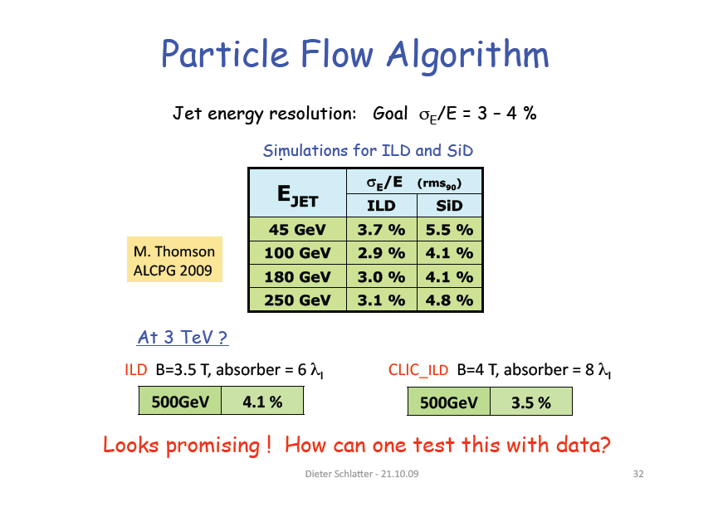
PFA Calorimeter: How Do We Test It?
Combined detector become very large.
Dieter Schlaｔer
→ The issue of Combined test

Slide 21
Vertex R&D: Beam Test
Marcel Vos, Carlos Marinas
Characterization using infra-red laser and gamma-sources in laboratory yields very valuable information.
But
TB is useful for measurement of response to MIPs, spatial resolution, time structure, two-track resolution, Lorentz angle, ...
Also: don't forget psychology, collaboration building, etc.

Slide 22
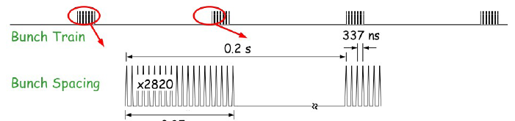
Vertex/Si tracker R&D: Beam Test
Marcel Vos, Carlos Marinas
Test beam:
Simple test beam EUDET telescope in high energy beams ?
Bunch structure
Needed to test pulsed power/readout scenarios.
Can we find a (cheap) workaround?
Magnet :
“Jet environment”
Combined test
Silicon-TPC (DESY, EUDET MEMO 2007-28)
Silicon-alignment system
Full VTX-tracker slice (in magnetic field)
VTX-Tracker-Calorimeter (Particle Flow TB)

Slide 23
Duplicated Conclusion: Issues to be answered
Test beam: Where? How long? Do we get support?
Bunch structure: (a) Do we really need it? , (b) If so how and where?
New Magnet : (a) Field? (b) Dipole or solenoid? (c) Which?
“Jet environment” (a) Do we really need it?
Combined test (a) Can we afford it? (b) what do we study? (c) How?
Silicon-TPC (DESY, EUDET MEMO 2007-28)
Silicon-alignment system
Full VTX-tracker slice (in magnetic field)
VTX-Tracker-Calorimeter (Particle Flow TB) : Issue of resource

