Slide 1
(I)LC Test Beam Accomplishments
LCTB09 @ IN2P3 – LAL
Nov. 3, 2009
Jae Yu
World-wide effort of ILC Detector R&D TB
Facilities’ Accomplishments
Detector R&D Accomplishments
Conclusions
Epilogue….

Slide 2
World-wide ILC TB Coordination
Creation of GDE and faster pace of ILC accelerator R&D demanded detector R&D to keep up
Many detector groups already have been performing beam tests but the intensity was brought up higher in 2003
  Fragmented efforts, concerned only on our own projects
Facilities needed to be able to provide the necessary beam capabilities to the R&D groups
No clear requirements or demands were known

Slide 3
World-wide ILC TB Coordination
Submitted a roadmap document to FNAL in 2006
  Defined what calorimeter and muon groups’ needs from the facilities
Led to concerted efforts of world-wide ILC test beam working group and a subsequent IDTB07
  Provided a forum for us to think about “US” and the common goals
  Ways to share our expertise and specified facilities
A lot of work have been done by the R&D groups and the facilities ➔ Apologies for not being able to cover them all!!

Slide 4
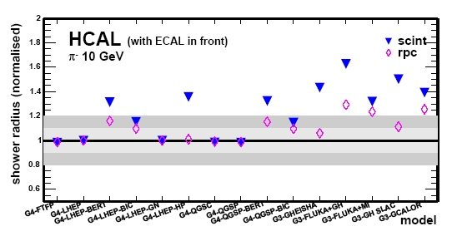
Some ILC Beam Test Goals in 2005
Detector performance measurement – Phase I
  Necessary to choose good detector technologies that meets the requirements optimized for PFA
Better simulation tools for more sophisticated PFA development
  Hadronic shower needs better understanding
~60%
G. Mavromanolakis et al.

Slide 5
Goals at the IDTB07
Review and assess the current status, capabilities and plans of facilities
Review and assess the current and planned detector test beam activities
Identify requirements for test beams to meet adequately the detector R&D needs
Plan and discuss for the future beam test activities
  What have we learned from LHC beam tests?
  What can we learn from existing ILC test beam activities?
  What should the future beam test activities focus?
Put together a team to write the ILC detector R&D test beam roadmap document which includes all sub-detector systems and the anticipated demands to facilities
This document was completed and released to the ILC leadership and to the facilities managers July 1, 2007

Slide 6
LC Detector Time Line in 2007
2005
2010
2015
2020
Det. R&D
Technology choices
ILC Construction
Selection
of ILC
Detectors
ILC Physics
Program
ILC Global Detector
Prototyping & calibration
We were here!!
ILCD CDR
ILC/ILCD TDR
Det. Construction
Detector R&D, ILC Detector Concept Development
ILC Detector prototype testing, Construction & Calibration
ILC Physics

Slide 7
R&D Groups’ Requests at IDTB07
Large bore, high field magnet (up to 5T)
  VTX and tracking groups
ILC beam time structure (1ms beam + 199ms blank)
  VTX, TRK and CAL electronics
Mimicking hadron jets
  VTX, TRK and CAL
Common DAQ hardware and software
Common online and offline software
  Reconstruction and analysis software

Slide 8
Point of Merge for Commonality
Det. 1
DAQ 1
Det. 2
Reco and
analysis
software
Event
Builder
Det. 3
Common
DAQ
……
LCIO
What is the reasonable level of common infra?
Who provides these?
On what time scale do we need this?
How can we have concerted and coordinated effort?
Do we need this at all?
Det. 4

Slide 9
R&D Groups’ Requests at IDTB07
Large bore, high field magnet (up to 5T)
  VTX and tracking groups
ILC beam time structure (1ms beam + 199ms blank)
  VTX, TRK and CAL electronics
Mimicking hadron jets
  VTX, TRK and CAL
Common DAQ hardware and software
Common online and offline software
  Reconstruction and analysis software
Tagged neutral hadron beam

Slide 10
Neutral Hadrons Beams??
Do we need beam test with neutral hadrons?
  Successful PFA means the HCAL measures neutral hadrons
  Simulation models need some neutral hadron data
  Hadron calorimeter calibration can use momentum tagged neutral hadrons
Can we trigger effectively?
What energy range?
  Which ones do we need to understand better?
We have been busy with what we have!!
FNAL moving forward with a proposal for this!

Slide 11
Detector R&D Needs @ IDTB07
Detectors | N_Groups | Particle Species | P (GeV) | Magnet (Tesla) | N_Weeks/yr | ILC time structure | Note
BI&MDI | 2E+8ESA+1F+2C+3BC | e | up to 100 | Not specified | 64 |  | Mostly low E elec
Vertex | 10 | e, π, p; μ | up to 100 | 1 – 3 | 40 | Yes
Tracker | 3TPC+ 2Si | e, π, p; μ | up to 100 | 1.5 - >3 | 20 | Yes
Cal* | 5 ECALs+3 DHCALs + 5 AHCALs | e, n, π, K, p; μ | 1 – >=120 | Not specified | 30 – 60 | Yes
Muon/TCMT | 3 | e, π, μ | 1 – >=120 | Not specified | 12
*Note: Most calorimeter R&D activities world-wide are organized under CALICE collaboration.
Some of these can work concurrently…

Slide 12
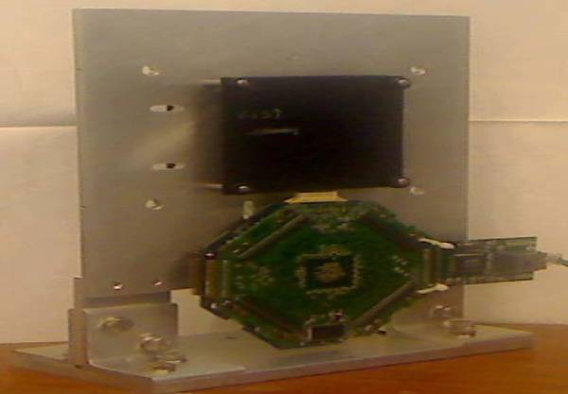
Facilities Accomplishments - FNAL
By far the most responsive facility
  Virtually all requests have been met
    Increased duty factor: Average duty factor of 5% policy has been altered at times to facilitate expeditious completion of beam test experiments
  Renovated MTBF user area (and fixed the roof leak problem…)
  Tried out “ping” structures to accommodate ILC like beam structure
    Not to the fine structure but to the macro-structure (1ms ping+199ms blank)
  Hadron and electron beam energy to as low as 1GeV
  High precision pixel telescope and TOF w/ 25ps resol.
  Tagged neutral hadron availability
    Meson Center Test Beam Facility Proposal

Slide 13
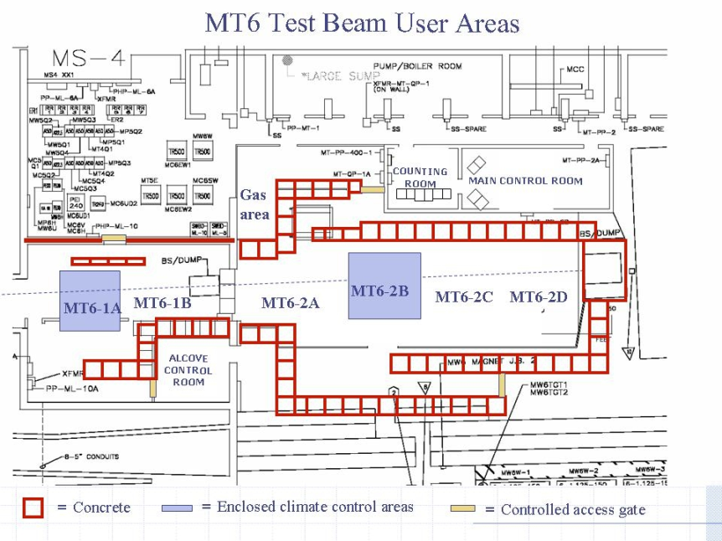
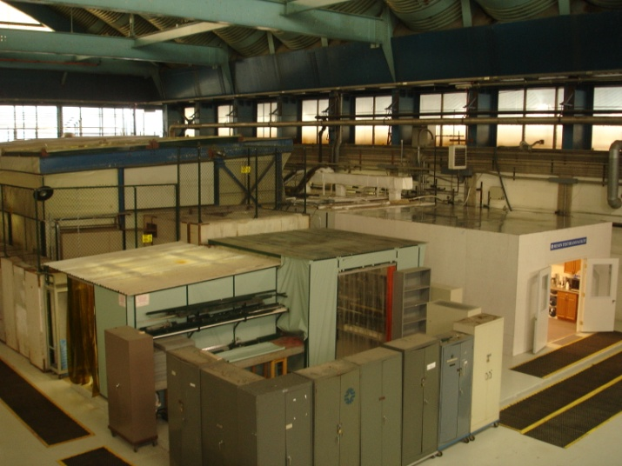
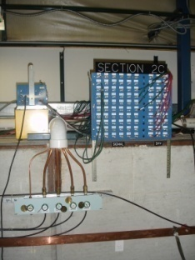
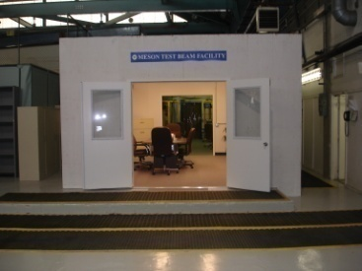
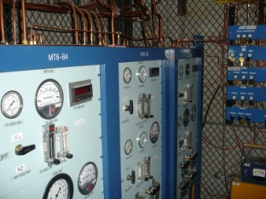
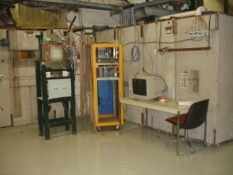
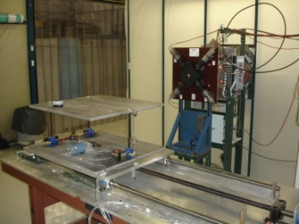
Fermilab Meson Test User Facility
Spacious control room
Signal and HV cables
Gas delivery to 6 locations
4 station MWPC spectrometer
Two motion tables

Slide 14
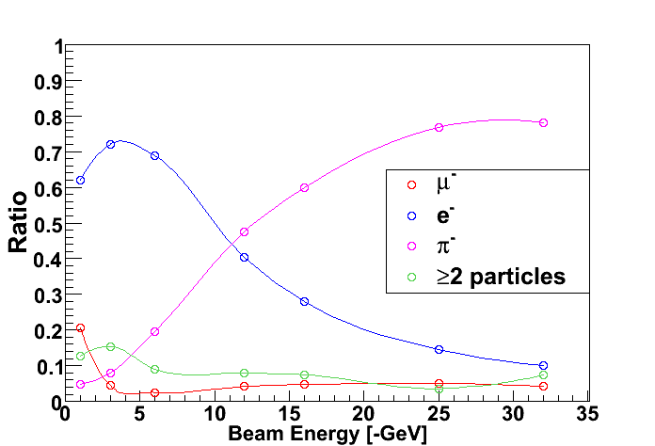
Beam Delivery for CALICE
The CALICE experiment (T978) has been the most comprehensive detector system to be installed at MTest and has summarized their results for beam composition.
The Fermilab Accelerator Division has created beam tunes for CALICE as follows:
Negative 1,2,3,4,6,8,10,12,15,20,30 GeV
Positive 32 GeV (high rate muon mode), 120 GeV (proton mode)

Slide 15
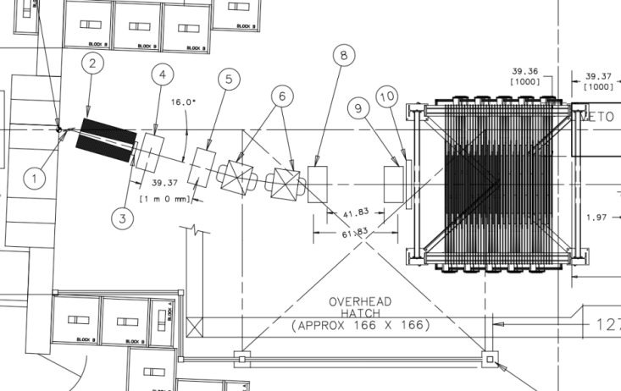
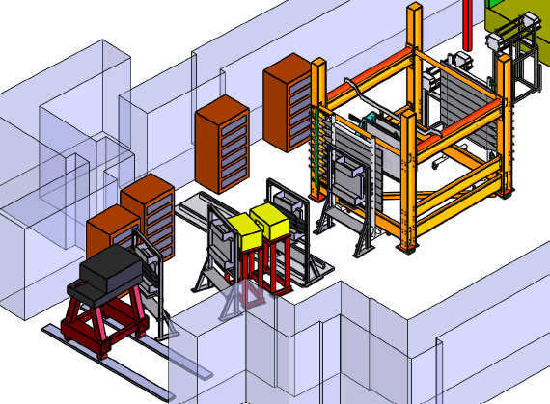
Tertiary 300 MeV/c Beamline for MINERVA
The MINERVA experiment requested space to create a new tertiary beamline that could deliver pions down to 300 MeV/c momentum.
The Particle Physics Division and Accelerator Division have agreed to help and are proceeding on installation.
Full tracking and TOF will allow for momentum measurement and particle i.d.
Target station rolls away for other users.
The full spectrometer will be tested in November, 2009

Slide 16
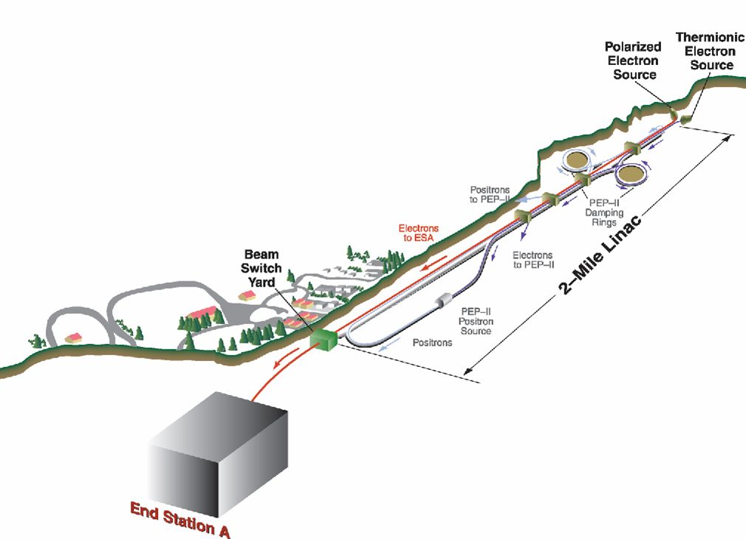
Facilities Accomplishments - SLAC ESA
Several beam monitoring and radiation damage beam test experiments in 2006 - 2007
BPM energy spectrometer (T-474/491)
Synch Stripe energy spectrometer (T-475)
Collimator design, wakefields (T-480)
Bunch length diagnostics (T-487)
IP BPMs—background studies (T-488)
LCLS beam to ESA (T490)
Linac BPM prototypes
EMI (electro-magnetic interference)
+ SiD KPiX Test during T-492
http://www-project.slac.stanford.edu/ilc/testfac/ESA/esa.html
~5 weeks of beam time in each of 2006 and 2007,
primary beam characteristics: 28.5 GeV, (0.6-1.5) ∙10¹⁰ e/bunch
ESA Test Beam facility shut down in 2007 for LCLS construction
SLAC colleagues have been working hard to re-start ESA

Slide 17
Facilities Accomplishments - CERN
Most frequently used facility for many ILC Detector R&D groups
Many experimental areas allow access to wide energy range
  PS: 5 areas with max E up to 3.5 GeV to 24 GeV
  SPS: 4 areas with max E range up to 400 GeV
Hosted several ILC detector beam tests
  CALICE Si/W ECAL+AHCAL+TCMT tool data in 2006 and 2007
  CALICE GRPC and micro-megas planes
  Large number of VTX and Tracking groups, LCTPC, SILC…
  DREAM calorimeter
Accommodates R&D groups’ needs and situations as much as possible
Well equipped facility with helpful staff
LHC’s schedule puts strain on demand to AD manpower for significant changes ➔ Continued availability expected

Slide 18
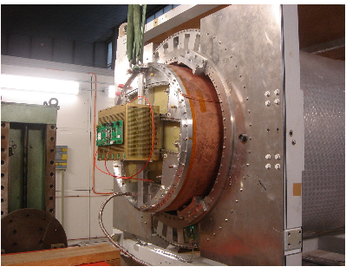
Facilities Accomplishments - DESY
Continued to provide 1 – 6 GeV e
  CALICE Si/W ECAL ran in 2005 and 2006
  CALICE AHCAL plane tests in 2006 – 2007
  CALICE TCMT plane test in 2006
  CALICE Scint/W ECAL test in 2007
  Numerous TPC end-plate tests in 2007 - 2009
Home of EUDET facilities
Test area 21: EUDET Pixel telescope
Test area 24: EUDET TPC Testing with large bore (1m dia) solenoid

Slide 19
Facilities: Asian and Russian
KEK FTBL: One beamline w/ 0.4 – 3.4 GeV e
  To be shut down for 3 years from 12/09 for KEKB upgrade
  Future operation not yet decided
JPARC: One beamline w/ 0.5 – 1.1 GeV hadrons
  Funding secured and PAC endorsement on 6/09
  Scheduled to complete mid 2010
IHEP Beijing: 3 areas 0.4 GeV – 1.5GeV
  Shut down 2008 – 2010 for upgrade
IHEP Protvino: 8 beam lines with electrons up to 34 GeV and hadrons up to 50 GeV
  Available 2 mo/year

Slide 20
Test Beam Availability
Laboratory | Energy Range | Particles | Availability (IDTB 2007) | Availability (LCTW 2009)
CERN PS | 1 - 15 GeV | e, h, μ | LHC absolute priority | Present + continuous
CERN SPS | 10 - 400 GeV | e, h, μ | LHC absolute priority | Present + continuous
DESY | 1 - 6.5 GeV | e⁻ | > 3 months per year | Present + continuous
Fermilab | 1-120 | e, π, K, p; μ | continuous (5%), except summer shutdown | continuous (5 - 6%), except summer shutdown, ILC time structure, many more improvements
Frascati | 25-750 MeV | e | 6 months per year | The same as before?
IHEP Beijing | 1.1-1.5 GeV (primary) 0.4-1.2 GeV (secondary) | e± e±, π±, p | Continuous after March 2008 (unavailable before then) | Shut down till 2010 for upgrade
IHEP Protvino | 1-45 GeV | e, π, K, p; μ | one month, twice per year | one month, twice per year
J-PARC | Up to 3GeV | ???? | Available in 2009 earliest | Available mid 2010
KEK Fuji | 0.5 - 3.4 GeV | e | Available fall 2007, 240 days/year | Shut down for 3yrs starting 12/09
LBNL | 1.5 GeV < 55 MeV < 30 MeV | e p n | Continuous
SLAC | 28.5 GeV (primary) 1.0 - 20 GeV (secondary) | e e±, p±, p | Parasitic to Pep II, non-concurrent with LCLS | Still trying to implement parasitic beam to Pep II, concurrent& non-concurrent with LCLS

Slide 21
Detector R&D Accomplishments - VTX
Many options for vertex detectors
  3 CCDs, 2 MAPs, DEPFET, CronoPix, VIP, 3D…
Performed beam tests of 1 – few weeks at CERN, FNAL, KEK, LBNL and INFN
  Requirements
    High energy beams
    Beams with ILC time structure
    High field (~3T) magnets needed
    High density particle environment
  An R&D collaboration would be helpful

Slide 22
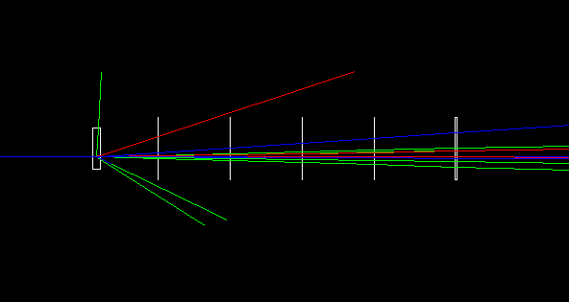
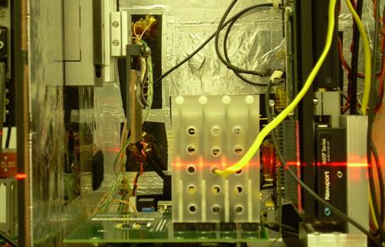
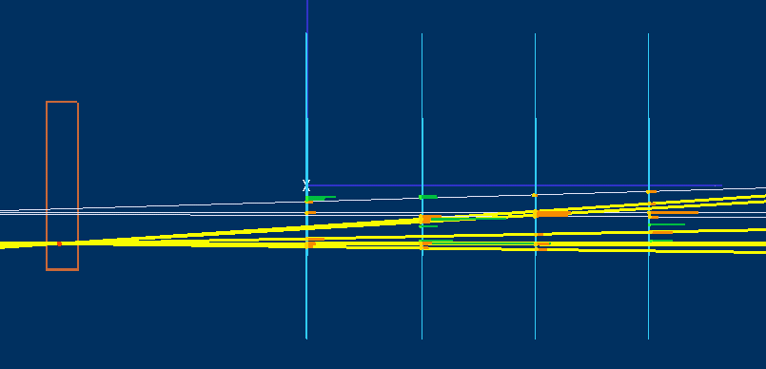
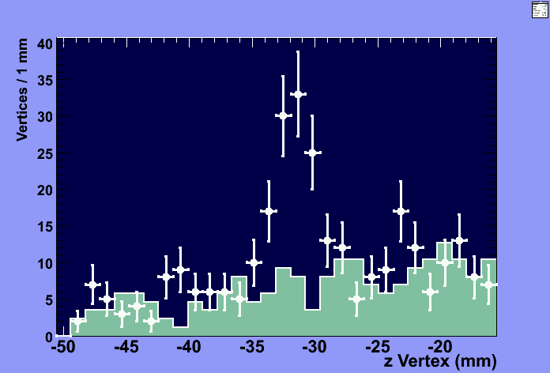
T-966 at FNAL MTest: Tracking and Vertexing
Tracking and Vertex Reconstruction with Thin CMOS Pixel Telescope (LBNL, Purdue U & INFN, Padova)
Reconstructed 120 GeV p
interaction in Cu target
4mm Cu Target
TPPT-2
DUT
Measured and ILC Requirement on
Track Extrapolation Resolution
4mm Cu Target
σ_{z} vertex = 230 μm
M Battaglia et al.
NIM A593 (2008)

Slide 23
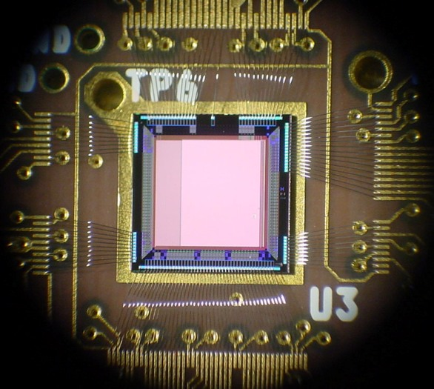
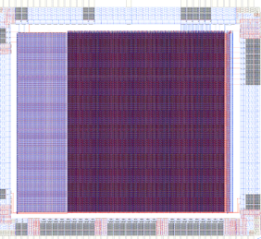
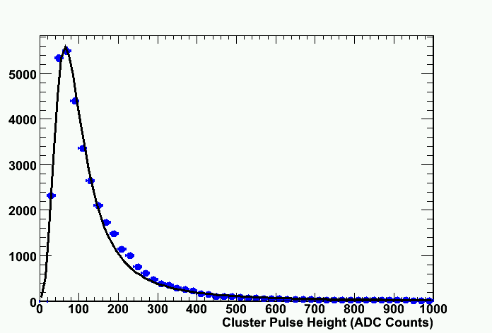
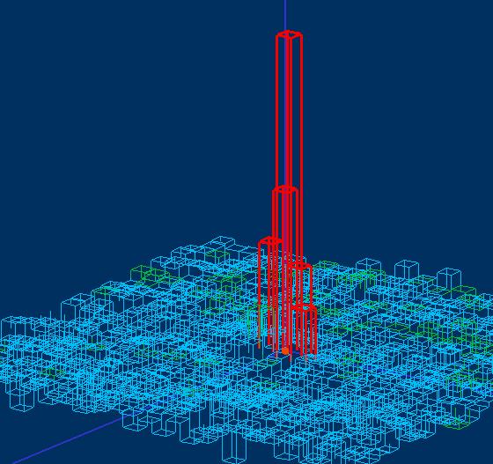
SOI R&D SOI Pixels Sensors Beam Tests at ALS
Test performance of novel SOI pixel sensors
(LBNL, KEK, INFN Padova)
LDRD-SOI1 and LDRD-SOI2
successfully tested;
Analog and binary pixels;
First test of an SOI sensor
on particle beam;
Measured S/N > 15
1.5 GeV e- beam
LBNL ALS - BTF
M Battaglia et al.,
NIM A583 (2007) and NIM A604 (2009)

Slide 24
Detector R&D Accomplishments - TRK
Several collaborations formed
  Silicon Tracker: SILC and SiD Si Tracker
  LCTPC Collaboration formed with 38 institutions
    LC TPC Collaboration performed many tests at KEK and DESY
    2007 – 2009: Tested field cage + 2 end plates (GEM + pixel and m-megas + Pixel configurations at DESY
  Large bore 1.2T solenoid installed in DESY T24 as part of the EUDET facility installments

Slide 25
TPC Collaboration 2009 (38 institutions)

Slide 26
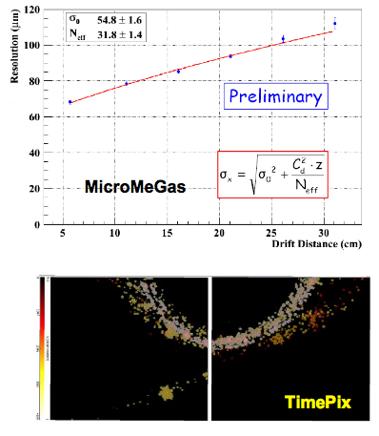
LCTPC Collaboration

Slide 27
High Field Large Bore Magnets
One of the requirements brought up in IDTB07
  Some candidates but no facilities had sufficient resources to pursue
    FNAL pursued somewhat
PCMAG
Triumf (Twist) Magnet (Madhu Dixit)
  2 T, 1m φ, 2.2m length
  Was available
KeK (Amy) Magnet (Takeshi Matsuda)
  3 T, 2.4m φ, 1.6m length
  Available now (in principle)
~3 T magnet from CERN?
A new solenoid with a hole on the side for beam incident?

Slide 28
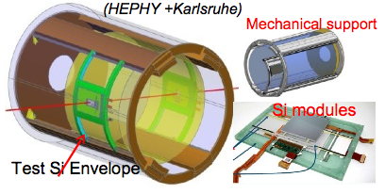
VTX+TRK Collaborative Facility
Large bore, high field magnet with Si tracker module on the beam position and large TPC inside the magnet

Slide 29
Detector R&D Accomplishments – CAL
CALICE
  Performed combined Si/W ECAL + AHCAL + TCMT runs at CERN in 2006 and 2007 in addition to 2005 and 2006 DESY runs
    Excellent opportunities for commissioning the system and performing high energy scans
  Performed combined Si/W ECAL & Si/Scint+AHCAL+TCMT @ MTBF 2008 and 2009
  RPC DHCAL slice test in 2007
  Three GEM DHCAL prototype chamber tests in 2006 - 2007
  Several GRPC single and multi-layers runs at CERN in 2007 – 2009
  MicroMegas single layer testing @ CERN in 2008 - 2009

Slide 30
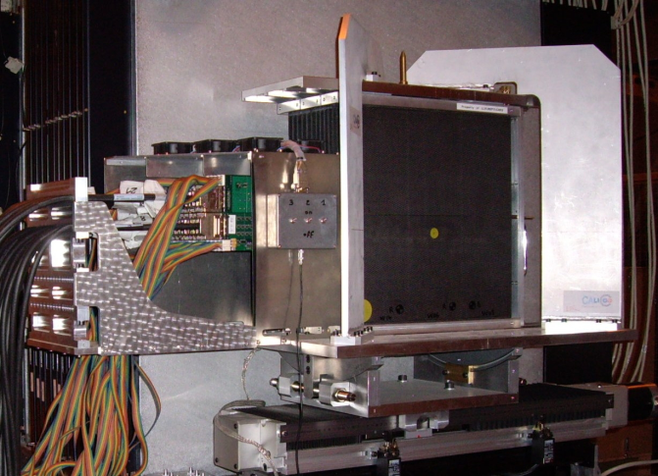
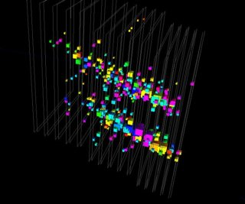
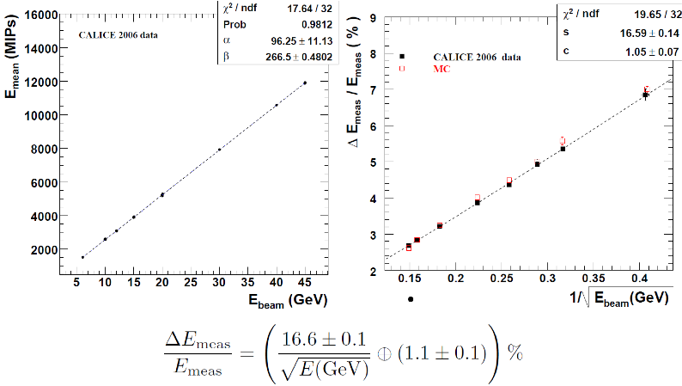
PFA ECAL: CALICE Si-W
Features Si active layer with fine readout cells (1x1cm²→0.5x0.5cm²)
Tested at beams several times
  At DESY 2005 and 2006
  At CERN 2006 and 2007
  At FNAL 2008
  Standalone test + combined test with CALICE AHCAL
  Analysis on-going
  Comparison with MC simulation

Slide 31
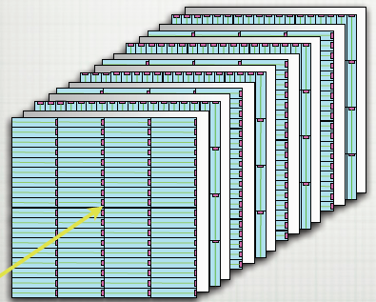
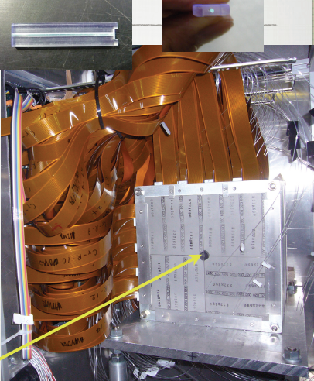
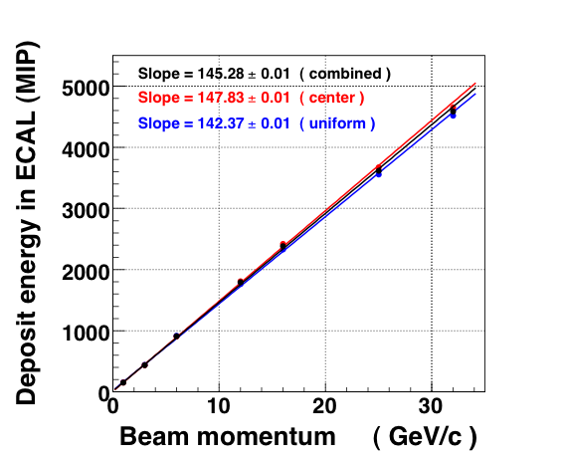
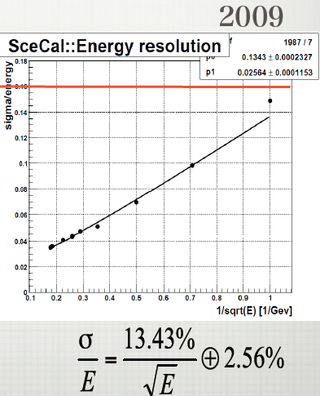
PFA ECAL: CALICE Scint/W ECAL
Features 30 layers of planes with small scintillator strips (10x45x3mm³) readout by MPP
Physics prototype constructed and tested
  At DESY in 2007 and at FNAL in 2008 and 2009

Slide 32
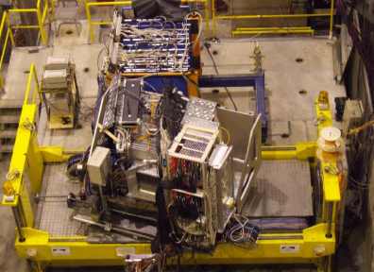
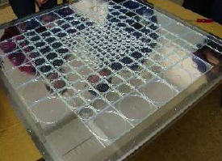
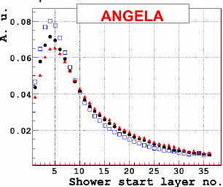
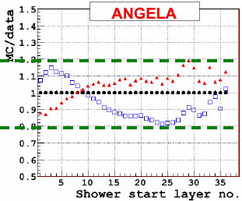
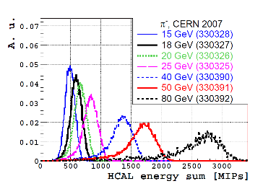

PFA HCAL: Scintillator AHCal
Features 3x3cm² scintillator tiles and SiPM readout
R&D well advanced: 1m³ physics prototype beam test done
  Scint plane tests at DESY starting 2005
  Commissioning run at CERN 2006 followed by a high energy run in 2007and FNAL in 2008
  Standalone and combined with Si/W and Scint/W ECALs

Slide 33
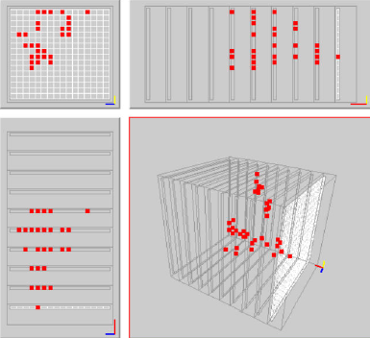
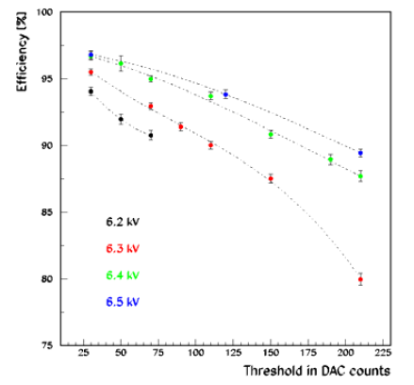
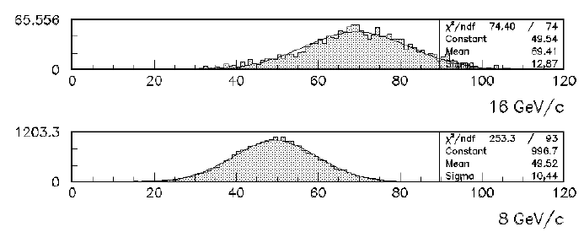
CALICE- RPC DHCAL Beam Test
Performed a slice test at MTBF in 2007
  Beams of 1 – 16 GeV hadrons and electrons
  120 GeV protons
  Muons
Published 4 papers in JINST
One Ph.D. thesis expected shortly
Another in the pipe
1m³ run planned in 2010
number of hits

Slide 34
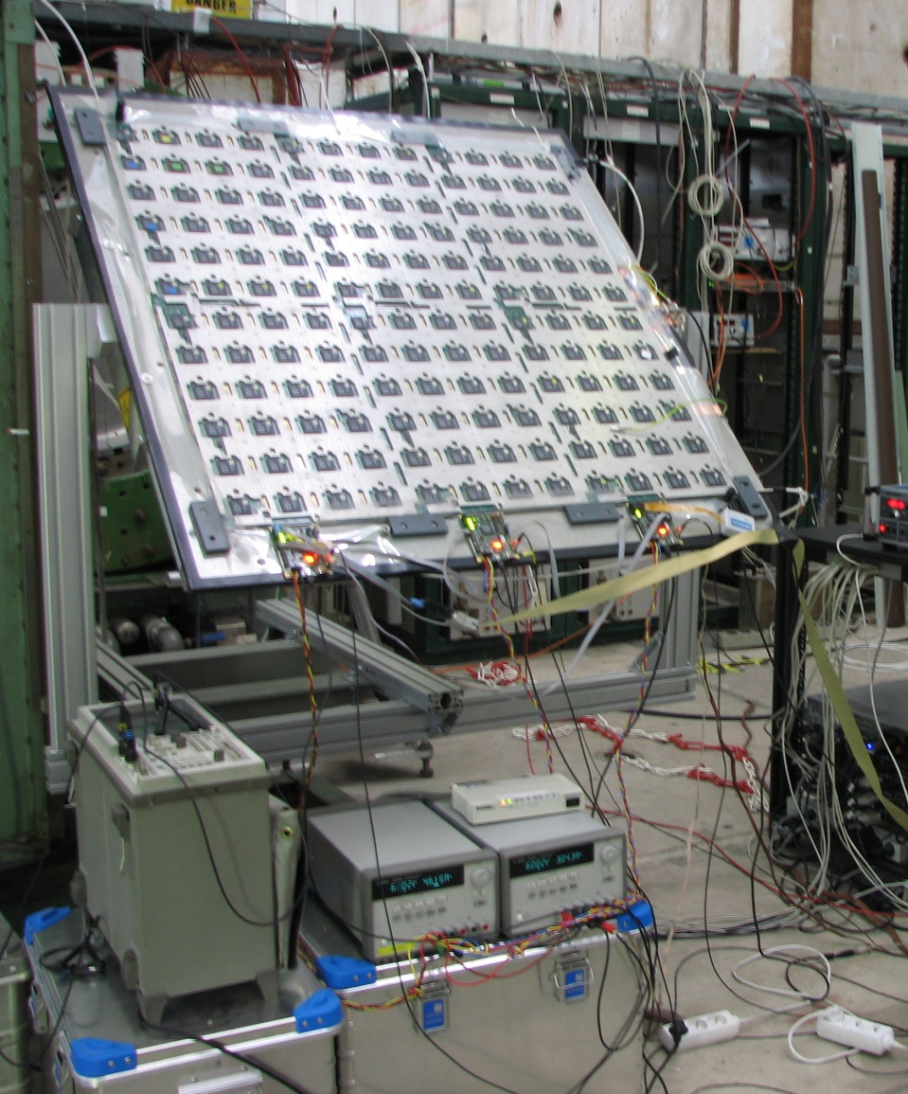
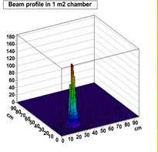
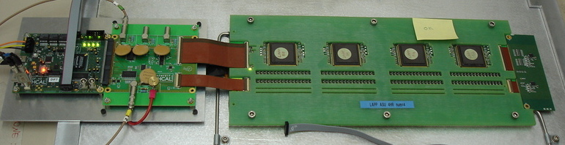
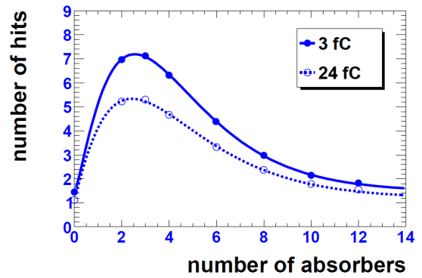
CALICE - Glass RPC and μ-megas DHCAL
2 beam tests @ CERN using mini-DHCAL with small GRPC
  Efficiency/multiplicity
  Hadronic shower study
  High rate tests with semi-conductive glass (1010 Ω.cm)
  1m² plane tests
μ-Megas
2008 with 4 GASSIPLEX chambers at CERN
2009 with 4 GASSIPLEX + absorbers

Slide 35
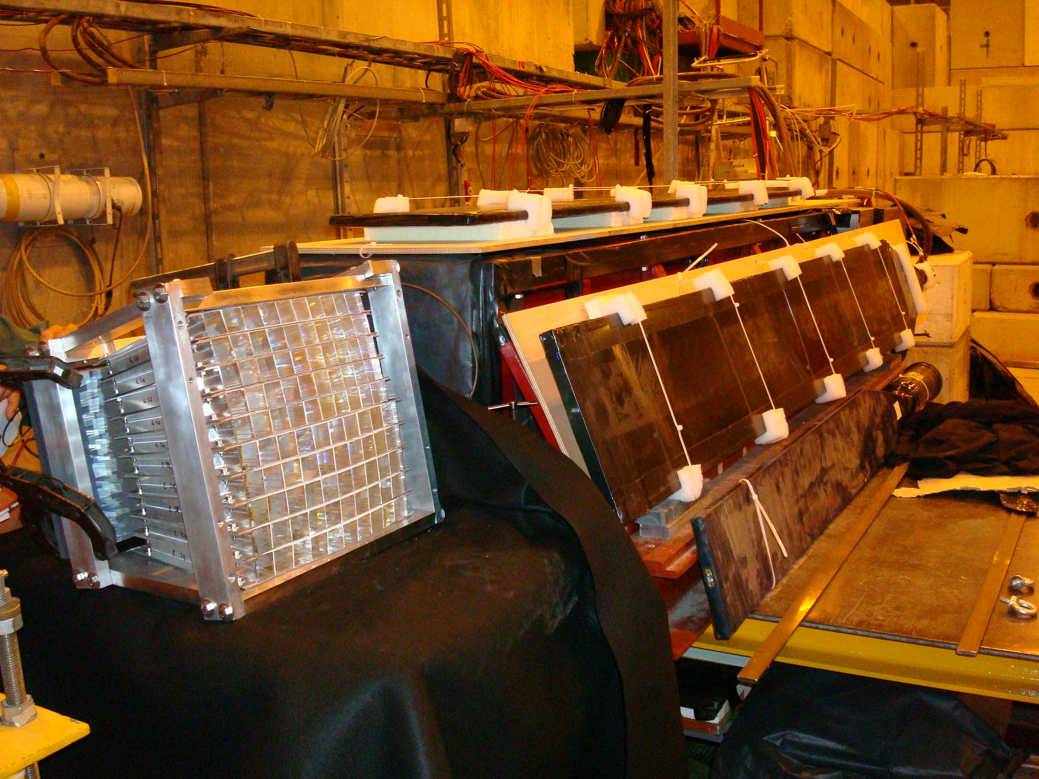
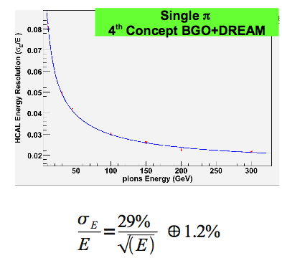
Detector R&D - Calorimeter
DREAM and 4th Concept
  Several beam tests @ CERN since 2006
  17 NIM papers and 4 Ph.D. thesis

Slide 36
Detector R&D - Muons
  NIU+FNAL+WSU+UW team performed scintillation counter based muon system tests in 2007
  SiD Muon system performed a test on a few extruded scintillation counter strip prototypes in 2008 at MTBF
  New test on 284” strips using new electronics (TB4) with higher rate capability and double end readout being prepared
  But other teams seem to have become lower priority

Slide 37
Total of 12 CAL & Mu Projects in 2005
Calorimeter | Project | Lead institution
ECAL | Silicon-Tungsten (CALICE) | LAL, LLR
 | Silicon-Tungsten (US) | SLAC, Oregon
 | Silicon-Tungsten (Asia) | Ehwa Univ., Korea
 | Scintillator-Tungsten | Shinshu
 | Scintillator-Tungsten | Colorado
 | Scintillator-Silicon-Tungsten | Kansas
 | Scintillator-Silicon-Lead | Padova
HCAL | Scintillator-Steel AHCAL | DESY
 | RPC-Steel (CALICE) | ANL
 | GEM-Steel (CALICE) | UTA
Muon-detectors/tail catcher | Scintillator-Steel (CALICE) | NIU/DESY/FNAL
 | Scintillator-Steel | FNAL/UCD/IU/NIU/ Notre Dame
 | RPC-Steel | Frascati
1
3
2
2
1
2
3
1
2
3
Some activities merged and new activities arose since 2005!!

Slide 38
Detector R&D Needs
Detectors | N_Groups | Particle Species | P (GeV) | Magnet (Tesla) | N_Weeks/yr | ILC time structure | Note
BI&MDI | 2E+8ESA+1F+2C+3BC | e | up to 100 | Not specified | 64 |  | Mostly low E elec
Vertex | 10 | e, π, p; μ | up to 100 | 3 – 6 | 40 | Yes
Tracker | 3TPC+ 2Si | e, π, p; μ | up to 100 | 1.5 → 2~3 →5~6 | 20 | Yes
Cal* | 5 ECALs+3 DHCALs + 5 AHCALs | e, n, π, K, p; μ | 1 → 120 | Not specified | 30 – 60 | Yes
Muon/TCMT | 3 | e, π, μ | 1 → 120 | Not specified | 12
Time to update this!!
*Note: Most calorimeter R&D activities world-wide are organized under CALICE collaboration.
Some of these can work concurrently!

Slide 39
ILC TB Roadmap Document Score Card
Outcome of the 1st ILC TB Workshop at Fermilab
  The document was released to the community, US funding agencies, facility managers and ILC leadership on Aug. 1, 2007
    FNAL-TM-2392/KEK-Report-2007-3
Recommendations
  Urged to take actions on the loss of SLAC ESA
  ILC-like beam time structure
  Momentum Tagged neutral hadron beam
  Trk-Vtx common beam test infrastructure w/ high field, large bore magnet
  High test beam duty factor
  Investigation into common DAQ hardware and software

Slide 40
Conclusions
Facilities have made continued improvements to meet the ILC detector R&D needs and are still working on making additional improvements
  Success of SLAC’s ESTB proposal will provide additional facilities in low E beams with LC time structure
Shutdown of two Asian facilities would put more stress on existing facilities
A lot of beam test activities in all detector groups
  Beam test results are being published
  Many R&D groups formed collaborations to take advantage of common needs
    LCTPC, FCAL, CALICE, SILC, LC detector concept groups, etc

Slide 41
Conclusions, cnt’d
  Groups are moving toward larger scale technical prototype testing
  Collaborations are considering combined testing
    TPC + SILC + VTX, CALICE ECAL+HCAL+TCMT
Different kind of needs arises at different times ➔ Time for updates in beam test needs
(I)LC’s fate tightly coupled to the success of the LHC
Times are hard and will not be easier but..
Most these detector R&D and facilities upgrades are commonly usable for generic R&D
Let’s look ahead and keep making progress!!

Slide 42
GDE ILC Technical Design Phase and Beyond
TDR
RDR Baseline
TDP Baseline Technical Design
TDP-1
TDP-2
Change
Request
New baseline inputs
RDR ACD concepts
R&D Demonstrations
MM studies
2009
2010
2011
2012
2013
Notes:
42

Slide 43
Epilogue… LC Detector Time Line in 2009???
2005
2010
2015
2020
Det. R&D
Technology choices
ILC Construction????
Selection
of ILC
Detectors
Very uncertain for detector R&D but…
ILC
Physics
Program
ILC Global Detector
Prototyping & calibration
We are here!!
ILC Acce. TDR
Det. Construction
Detector R&D, ILC Detector Concept Development
ILC Detector prototype testing, Construction & Calibration
ILC Physics

Slide 44
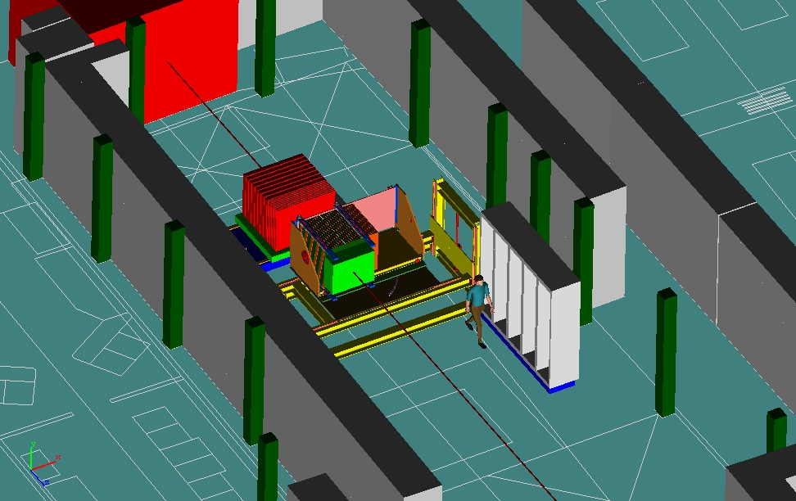
CALICE Setup V-Trial at FNAL MTBF - 2005
Tail Catcher
HCAL
Electronic Racks
ECAL
Beam

Slide 45
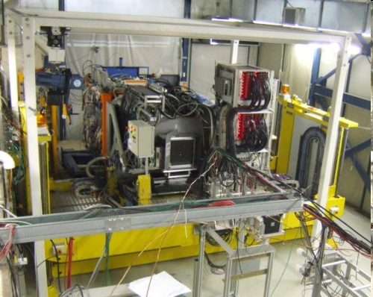
CALICE 2008
We are real now and will continue to be!!!

