Slide 1
Update of PhysSim → StdHep Interface
Akiya Miyamoto
23-July-2009
Physics-Soft Meeting

Slide 2
$JSFROOT/src/opt/stdhep/JSFWriteStdHep.cxx and .h were updated.
Previously: /JSESET/ → /HEPEVT/, /HEPEV4/ → stdhep file.
New feature:
JSFGeneratorBuf → /HEPEVT/, /HEPEV4/, → stdhep file
Algorithm:
Ndaughter=0 → Status=1
Mother<0 or Ndaughter > 1000 → Status=13
Ndaughter >0 → Status=2
Status=1 & 2 are simulated in Mokka, QuickSim
Status=13 are kept in StdHep and LCIO’s MCParticle collection, but
- Their firstDaughter and lastDaughter are set to 0. - It is hard to keep consistency between JSFGeneratorParticle, /JETSET/, LCIO & Mokka.

Slide 3
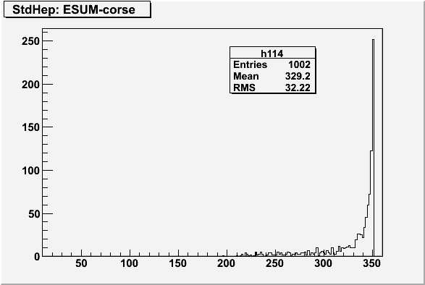
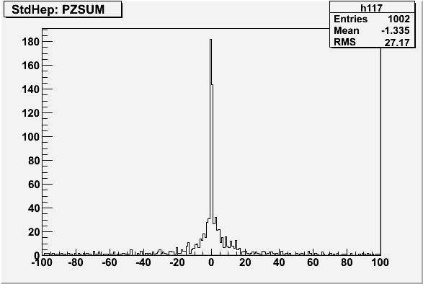
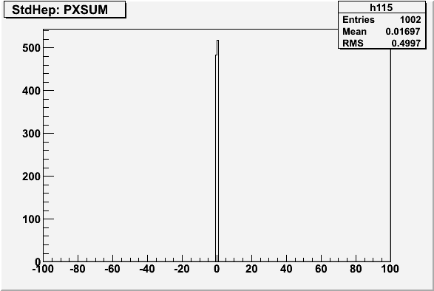
Example: PhysSim’s WWStudy ( e+e- → W+W-) at 350 GeV
generated stdhep file was analized.

Slide 4
Parameters for JSFWriteStdHep
JSFWriteStdHep.OutputFileName:file.stdhep
JSFWriteStdHep.OutputTitle:sample
JSFWriteStdHep.NTries:10
JSFWriteStdHep.DebugLevel:0
JSFWriteStdHep.EventSource: 2
# generator input data
# =0 : /hepevt/ common block
# =1 : /jetset/ are converted to /hepevt/ and written to stdhep
# =2 : JSFGeneratorBuf are stored to /hepevt/, then written to
# stdhep file.
JSFWriteStdHep.ProcessID:0
#!processid
# ProcessID which is written to then file, when HEPEV4 is not prepared.
JSFWriteStdHep.ConvertJetset
is not available !
To define your own HEPEV4, ( event weight, color flow, polarization …), use
static void JSFWriteStdHep::SetHEPEV4(THEPEV4 *hepev4)
Example : in $JSFROOT/examples/SimTools/exam06

Slide 5
Summer Schedule of KEK computing
KEK: Power Outage 17 Aug. (Mon) ~ 19 Aug. (Wed.)
JLCLOGIN system ( incl. servers ) shutdown ( plan ) 14 Aug(Fri) afternoon to 20 Aug.(Thu) Morning
KEKCC will be same as JLCLOGIN

