Slide 1
ScECAL for Mokka
A. Miyamoto
30 July 2009

Slide 2
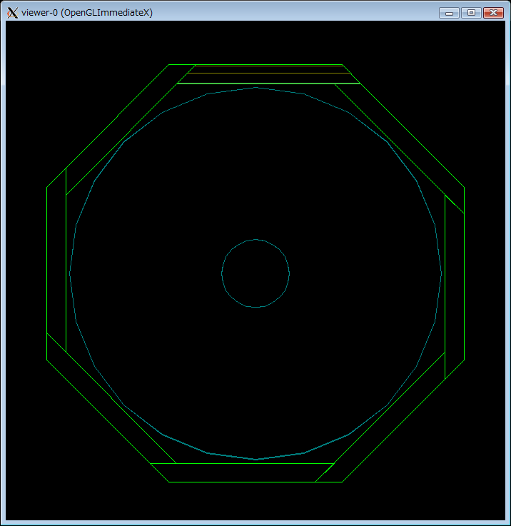
EcalModule 211
slab5020
EcalModule 221
EcalModule 271
TPC
EcalModule 231
EcalModule 261
EcalModule 231
EcalModule 251
EcalModule 241

Slide 3
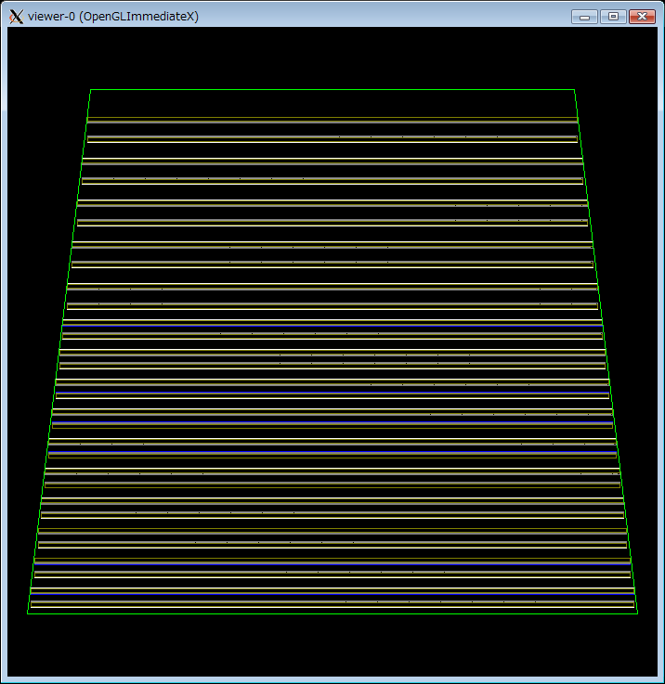
Ｇｒｅｅｎ：EcalBarrelModule
Slab5030
Slab5020
Slab5001

Slide 4
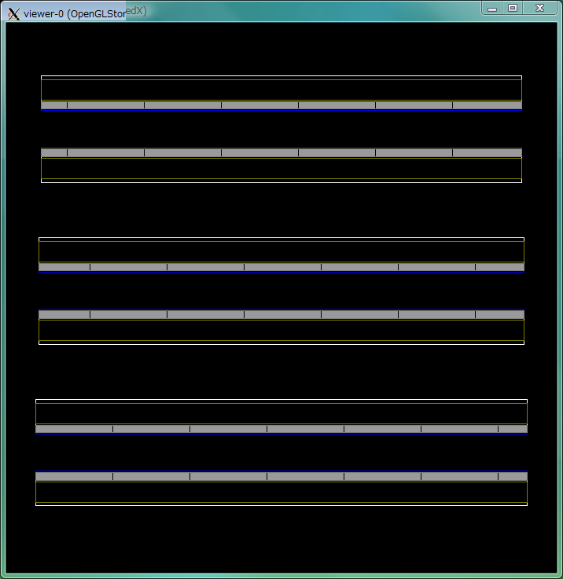
SLAB5006
SLAB5005
SLAB5004
SLAB5003
SLAB5002
SLAB5001
CommonSi
WaferSi
( CommonSiはまとめて全部）

Slide 5
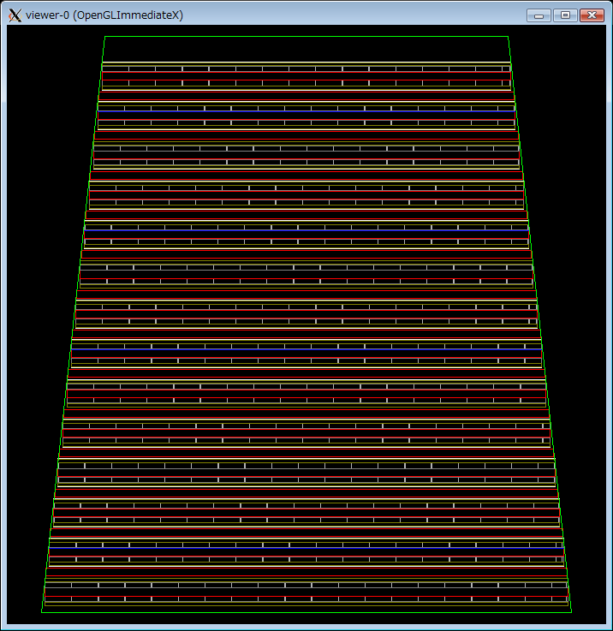
ＳｃＥｃａｌ
Ecal_Sensor_Material:polystyrene
Ecal_nlayers1:14
Ecal_nlayers2:13
Ecal_nlayers3:0
Ecal_Si_thickness:2.0
Ecal_radiator_layers_set1_thickness:3.0
Ecal_radiator_layers_set2_thickness:3.0
Ecal_radiator_layers_set3_thickness:0.0
Ecal_guard_ring_size:0.010

Slide 6
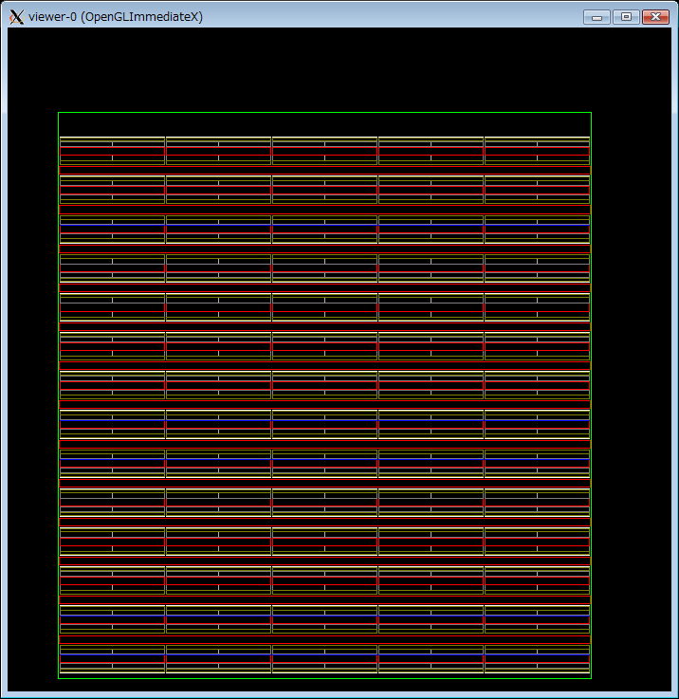
BarrelEcalModule 211
RZ view for ScEcal
Gap bewteen Tower
= N_FIBERS_ALVOULUS(3)*Produced by Ecal_fiber_thickness (=0.15)

