Slide 1
Availsim runs and questions
Tom Himel
August 4, 2009

Slide 2
Very Preliminary
Results have NOT been thoroughly checked.
There are quite a few guesses as to numbers of components. Likely to stay guesses.
Just ran out of time.

Slide 3
RDR simulation input deck
Did not have central injector (DRs were at low energy ends of linac)
Had long e+ transport in linac tunnel, but not long e+ and e- low emittance RTML transport lines
Had e+ source at 150 GeV
Did not have low P option (had 24 cavities per RF unit)
2 vs 1 tunnel changed almost everything from being accessible with beam on to not in all regions (including DR and BDS)

Slide 4
ILC105: Updated towards RDR and SB2009
Put DRs in single tunnel near the IP
Put transport lines from DRs through part of BDS, all of linac to turnaround and then into a single stage bunch compressor.
Solyak provided numbers of magnets. Accurate for compressor, scaled from RDR for transport lines.
Have used 1 PS per magnet as Solyak said to. (Turn-around bends will have some stringing but he did not say how much.)
May have too much MPS, controls, pumps in new sections as copied from an old one.
We end up with fewer PPS zones due to the transport lines. Can no longer have people in linac or BDS when beam is in compressor.
E+ source is now at 250 GeV point. Guessed at reduced magnet count of high emittance e+ transport which now only goes to near IP instead to low energy end of e+ linac (300->100)
Have slightly more tunetimefraction because of extra beamlines
Run 5 months then 1 month shutdown

Slide 5
Region definitions, PPS zones
Added ability to have each region independently be in one or two tunnels.
Note that 0.5% MD is 4 shifts per year.

Slide 6
How often to warm up?
In past have done it once per year, fixing all broken items that required warm-up
That was probably too often
Twice a year is clearly too often, also not sure 1 month down is really long enough.

Slide 7
Repairs during long downtime
6570.00 mainloop: Long shutdown repaired all 1 e- source linac Cavity tuner cavity Cavity tuner cavity
6570.00 mainloop: Long shutdown repaired all 4 e- source linac Cavity piezo tuner cavity Cavity piezo tuner cavity
6570.00 mainloop: Long shutdown repaired all 1 e- compressor Cavity tuner cavity Cavity tuner cavity
6570.00 mainloop: Long shutdown repaired all 1 e- compressor Cavity piezo tuner cavity Cavity piezo tuner cavity
6570.00 mainloop: Long shutdown repaired all 20 e- linac upstream Cavity tuner cavity Cavity tuner cavity
6570.00 mainloop: Long shutdown repaired all 38 e- linac upstream Cavity piezo tuner cavity Cavity piezo tuner cavity
6570.00 mainloop: Long shutdown repaired all 2 e- linac upstream power coupler disc coupler power coupler disc coupler
6570.00 mainloop: Long shutdown repaired all 12 e- linac downstream Cavity tuner cavity Cavity tuner cavity
6570.00 mainloop: Long shutdown repaired all 30 e- linac downstream Cavity piezo tuner cavity Cavity piezo tuner cavity
6570.00 mainloop: Long shutdown repaired all 3 e- linac downstream power coupler disc coupler power coupler disc coupler
6570.00 mainloop: Long shutdown repaired all 1 e+ source e+ linac Cavity piezo tuner cavity Cavity piezo tuner cavity
6570.00 mainloop: Long shutdown repaired all 1 e+ compressor Cavity piezo tuner cavity Cavity piezo tuner cavity
6570.00 mainloop: Long shutdown repaired all 1 e+ linac Cavities cavity Cavities cavity
6570.00 mainloop: Long shutdown repaired all 1 e+ linac Cavities cavity Cavities cavity
6570.00 mainloop: Long shutdown repaired all 45 e+ linac Cavity tuner cavity Cavity tuner cavity
6570.00 mainloop: Long shutdown repaired all 66 e+ linac Cavity piezo tuner cavity Cavity piezo tuner cavity
6570.00 mainloop: Long shutdown repaired all 3 e+ linac power coupler disc coupler power coupler disc coupler
In 9 month run this is about 1.7 GeV energy loss per linac.
MTBF of tuner is 1,000,000 hours, of piezo tuner is 500,000. Lose 31 and 5 MeV.

Slide 8
Availsim results

Slide 9
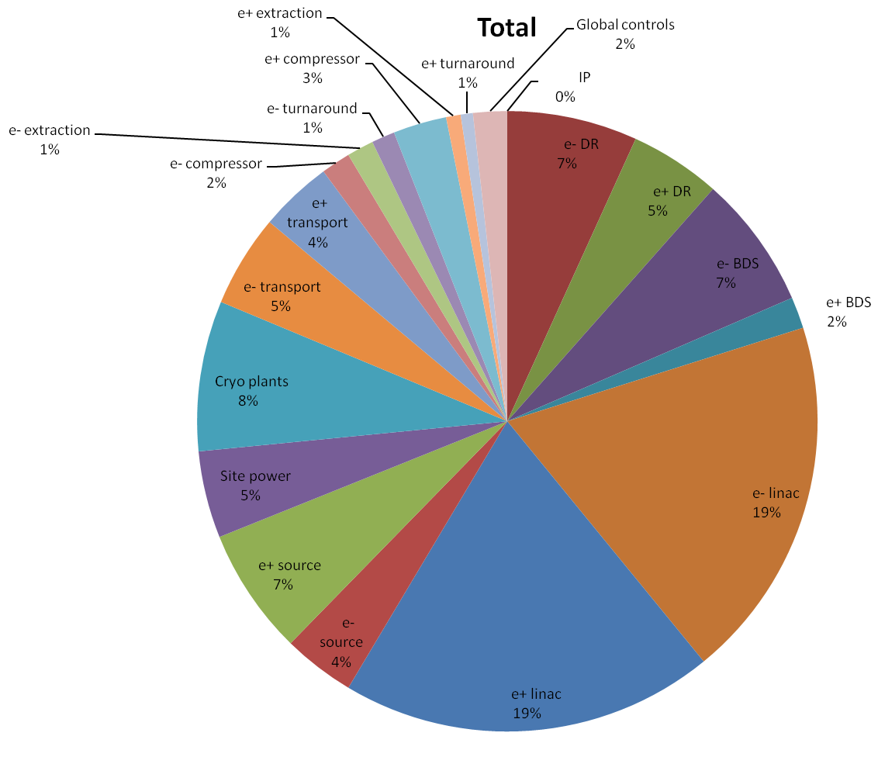
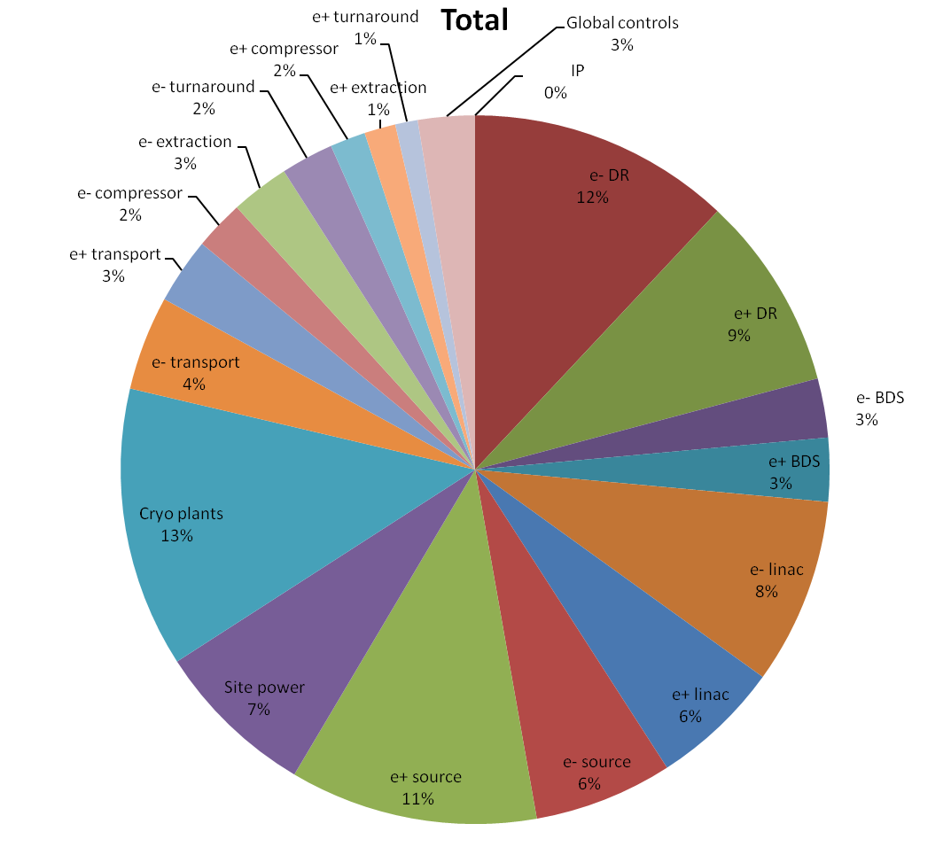
Compare 2 and 1 tunnel
ILC105: 2 tunnel, 21.1% down
ILC106: 1 tunnel, 30.8% down

Slide 10
Remaining questions
Should opportunistic repairs be done?
Do we want to have scheduled maintenance days?
Should we repair things on those days? Including klystrons?
Correct to assume running 5 months followed by 1 month downtime (including recovery)?
How should cryogenic repairs be handled?
Are there MTBF changes I should make in advance (e.g ignore flow switches, circuit breakers and what else)?

Slide 11
MTTF/MTTR Improvement Factors

