Slide 1
Jets and Jet-Jet Mass Reconstruction in a Crystal Calorimeter
Summary of work done by Nayeli Azucena Rodriguez Briones
Universidad Autonoma de Zacatecas, Mexico

Slide 2
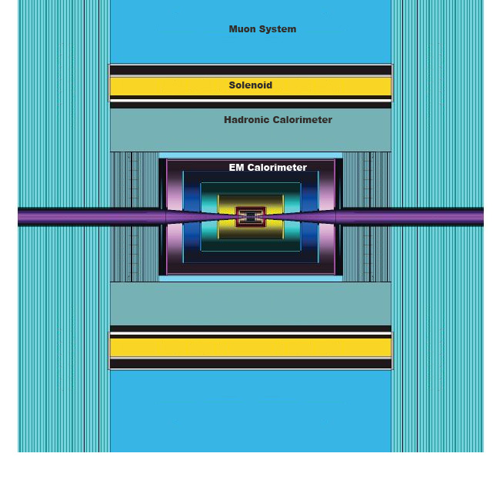
Crystal Calorimetry in SiD
Name | Layers | Thickness/Layer | Segmentation
 |  | [cm] | [cm x cm]
ECAL Barrel | 8 | 3 | 3 x 3
HCAL Barrel | 17 | 6 | 6 x 6
Total Barrel | 25
ECAL Endcap | 8 | 3 | 3 x 3
HCAL Endcap | 17 | 6 | 6 x 6
Total Endcap | 25
‘Fine’ detector. Simulated and Analyzed.
Also implemented ‘coarse’ detector:
EM 8x8x8 cm
HAD 13x13x13 cm
Is it a good choice of granularity?

Slide 3
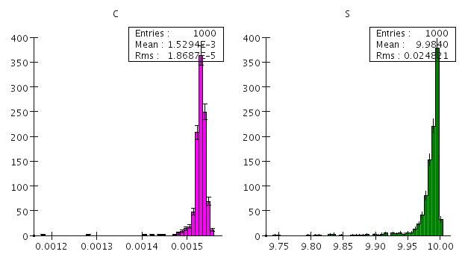
Analysis: Calibration
All cells used (no Digisim)
Calibrated using 10 GeV electrons
Cherenkov
Scintillation

Slide 4
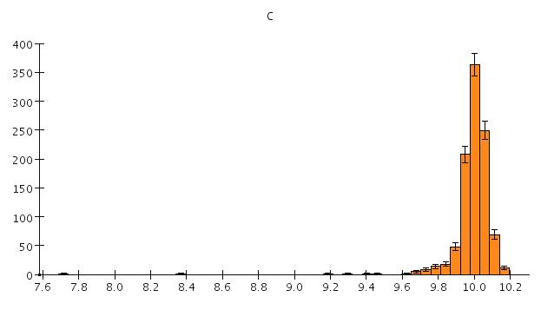
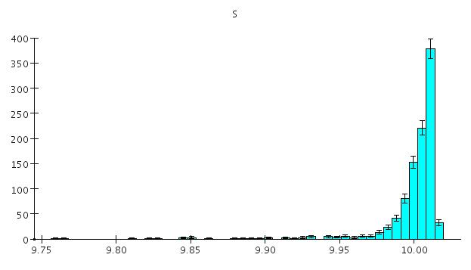
Calibrated Response : 10 GeV electrons
Cherenkov
Scintillation

Slide 5
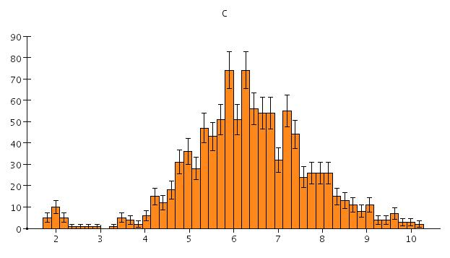
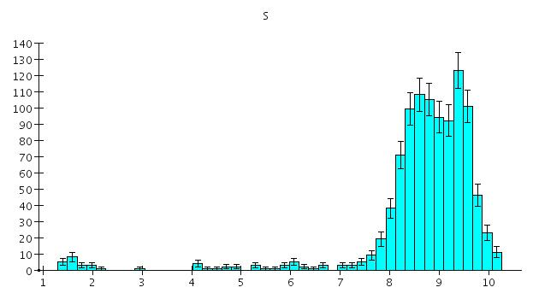
Calibrated Response: 10 GeV Pions
Cherenkov
Scintillation

Slide 6
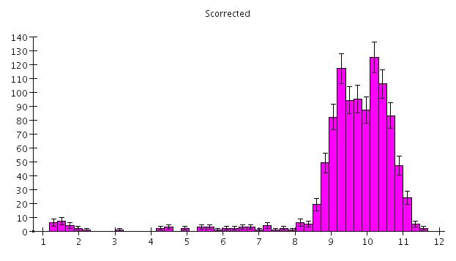
Dual Readout Correction
Use simple correction (Anna):
Punch through
Leakage
Two physics models (GEANT4)

Slide 7
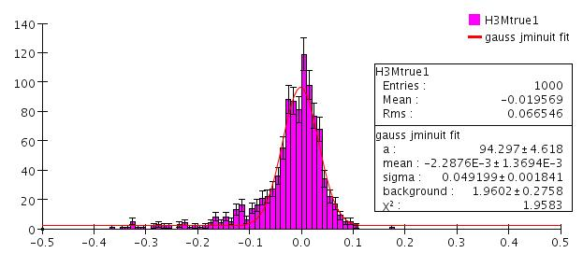
Di-jet Mass Reconstruction
Single W events, W momentum 0 – 100 GeV
Treat all cells as massless particles: (E,px,py,pz), with the direction of the momentum vector determined by the cell position (center)
No B field
ΔM/M ~ 0.049

Slide 8
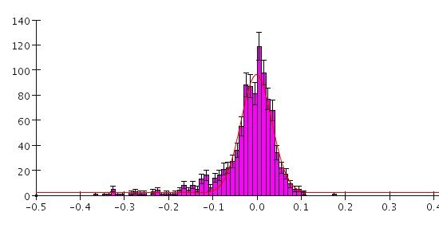
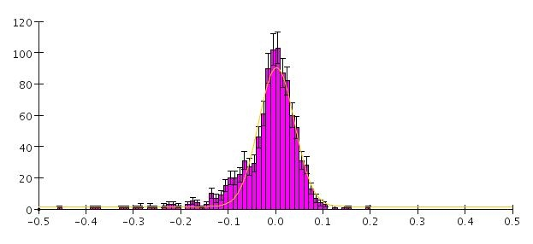
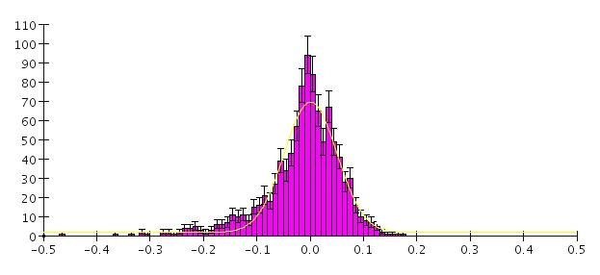
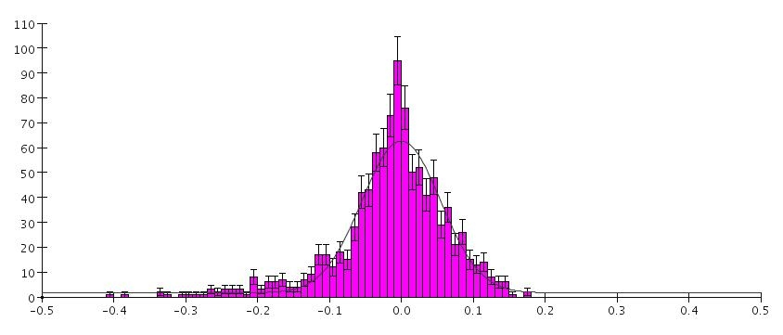
Mass Reconstruction in Magnetic Field
B = 0 T, σ = 0.049
B = 2 T, σ = 0.054
ΔM/M
ΔM/M
B = 4 T, σ = 0.070
B = 6 T , σ = 0.0 81
ΔM/M
ΔM/M

Slide 9
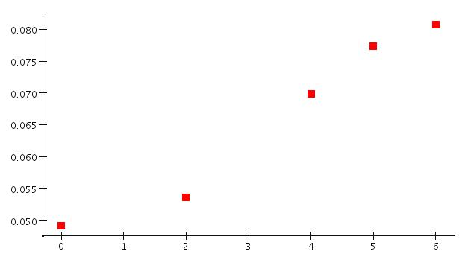
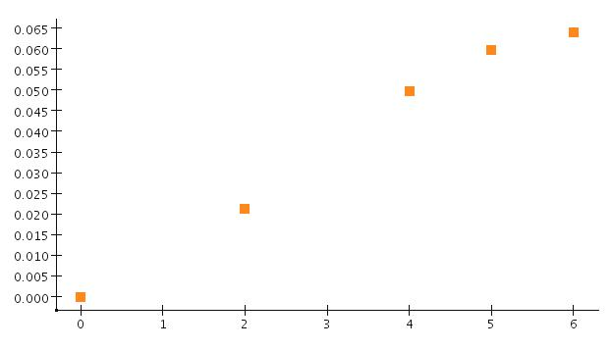
Magnetic Field Effect
ΔM/M
(ΔM/M)_{B}
B [T]
B [T]
Mass resolution as a function of B field
Contribution of the magnetic field to the mass resolution

Slide 10
Correcting for the B Field Effect
Magnetic field bends charged particles: the energy depositions are displaced with respect the their ‘true’ directions
The change of the invariant mass of a system is calculable for each individual event
(ΔM)_{B} = M_{Ch}(B=0) – M_{Ch} (B), where
And the direction of the momentum vector is given by the initial direction (B=0) or the impact point at the calorimeter (B)

Slide 11
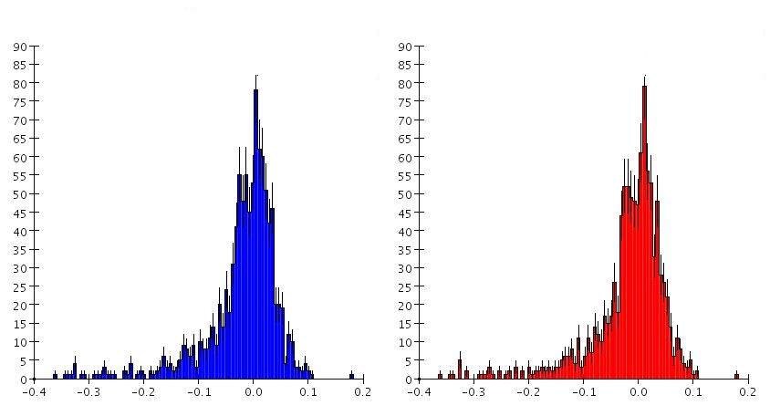
Mass Resolution: B=0 (Null correction)
uncorrected
corrected
ΔM/M
ΔM/M
σ = 0.049
σ = 0.045

Slide 12
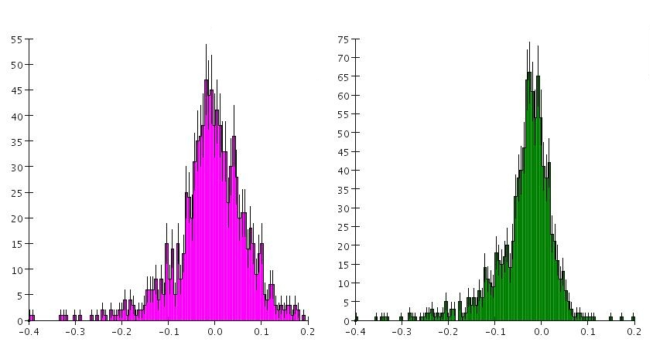
Mass Resolution: B = 6T
uncorrected
corrected
ΔM/M
ΔM/M
σ = 0.075
σ = 0.049

Slide 13
Dijet Mass: W + Z sample, B= 5T
M [GeV]
M [GeV]
Uncorrected mass
Corrected mass

Slide 14
WW vs ZZ final states, 5T Field

