Slide 1



Proposal for a LCIO format for the DHCALs
Vincent Boudry
Rémi Cornat
David Decotigny
LLR
Gérald Grenier
Robert Kieffer
IPNL
EUDET annual meeting
U. of Geneva
19/10/2009

Slide 2
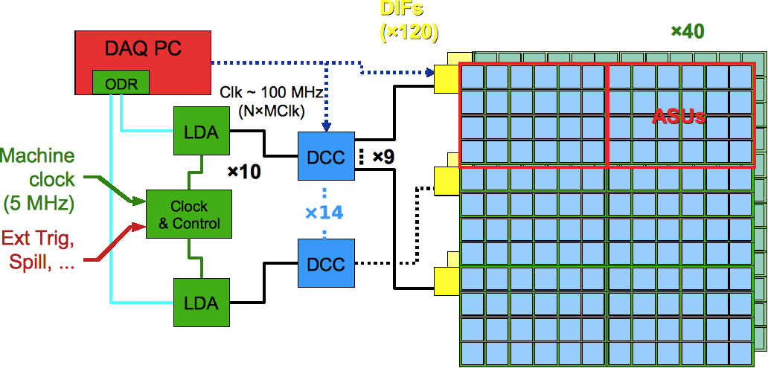
Raw data
Starting point: store the EUDET DAQ2 raw data originating from a DHCAL using ROC chips providing frame (≠ ROC ⇔ ≠ frame length)
Keep the frame order for each chip and DIF (and other intermediates cards) → counters, error & malfunctions tagging, full history
  Train by train
  1 train ≡ a complete set of auto-triggered frames from one ASIC, readout on an external signal [trigger, DAQ stop, RAM full]
  2 Acq modes
    ILC like
      Trig =
      Spill start
    Triggered
      Ext. Trig
      RAM full
      manag^{t}

Slide 3
RAW data proposal (suitable for ROCs)
* Event:
* - DetectorName <- runHdr::DetectorName
* - RunNumber <- runHdr::RunNumber
* - EventNumber <- ROEventId::toUnsigned()
* - TimeStamp: default
* - Weight: default
* - LCCollection "rawdata_DIF:str(DIF_id)":
* + param "id_ODR" (unsigned): from raw event
* + param "id_LDA" (u32b)
* + param "id_LDA_diflink" (unsigned)
* + param "id_DIF" (unsigned)
* + param "TrainNumber" (unsigned) // since DAQ start
* + param "BC_DIF" (unsigned) // since RUN start
* + param ”DeltaCounter” (unsigned) // 40 MHz counter
* + param optional extra DIF info (type, temp, adc) ???
* + elt[0]: LCGenericObject
* + int[0]: id_roc_chain
* + int[1]: id_roc
* + int[2]: index_in_dif_dump (starts at 0)
* + int[3]: chipType
* + int[4]: acqMode
* + For HR2 chips:
* + int[5]: nframes (< 128)
* + int[6 + i*5]: bcid for frame i (i in [0, nframes])
* + int[7 and 8 + i*5]: t0 vector (msb 7=t0_63, lsb 8=t0_0)
* + int[9 and 10 + i*5]: t1 vector (msb 9=t0_63, lsb 10=t0_0)
* + int[11 + i *5...]: additional data ??
* + elt[1]: other LCGenericObject (ROC event)
* ...
* - other LCCollection "rawdata_DIF:str(DIF_id)":
* ....
V. Boudry, R. Cornat,
D. Decotigny
LCIO format (source):
https://svn.in2p3.fr/calice/
online-sw/trunk/daq/
reassembler/
lcio_dump.hpp?view=markup
Physical address
(⊃ redundancy)
Event Counter/Tagging
Event Timing
Compacity
vs
Redundancy (debugging)
namespace IO
{
class LCWriter;
};
/**
*
* Run Header:
* - RunNumber: user-specified
* - DetectorName: user-specified
* - Description: user-specified
* - ActiveSubdetectors: [ "DIF_rawdata" ]
*
RAW Data ”in the tubes” format:
https://svn.in2p3.fr/calice/online-sw/trunk/daq/
calice_packets/calice_raw_formats.h?view=markup

Slide 4
LCIO format for reconstructed DHCAL
Header & DIF part (proposal v0.01)
EVENT::LCEvent
{
int _runNumber; //
int _eventNumber; // Global Trig Count == # evt
EVENT::long64 _timeStamp; // Mean timestamp from Hit/DIF
// TB: Large BC
// For ILC: Large BC since run start.
std::string _detectorName; // Detector version ??
LCCollectionMap _colMap; // List of collections
std::vector< std::string > _colNames; // Name of collections
LCParametersImpl _params; //
LCCollectionSet _notOwned; //
}
EVENT::LCGenericObject
{
// ->DIF Collection
// - int DIF_ID+Module_ID // DIF_ID (48-144 ==> 7-8b)
// // + Module_ID (40 barrel + 24 Endcap ==> 6b)
// - int ATC // delta GTC / DTC
// - int DTC // Diff Trig Counter == #evt vu par la DIF
//( - float TimeDiff // Time2Previous event )
// - int LargeBC // BC from run start.(32b)
}
back of envelop discussion
V. Boudry, G. Grenier, R. Kieffer
+ Lei Xia (US DHCAL)

Slide 5
LCIO format for reconstructed DHCAL
Calorimeter hits (proposal v0.01)
EVENT::RawCalorimeterHit
{
int _cellID0; // Chan (64 ==> 6b)
// + Asic (max 420 ==> 9-10b)
// + Dif_Id (48-144 ==> 7-8b)
// + Module_Id (40 Barrel + 24 Endcap ==> 6b)
// == 28-30b (remain 2-4b) [6+6+7 == 19b in TB]
int _cellID1; // Time2Previous (in BC) ==> 24b (remain 8b) (CHBIT_ID1 must be set)
int _amplitude; // 3 Thr ==> 2b (remains 30)
int _timeStamp; // Rec Time on 32b wrt (Spill start | Ext. Trigger)
}
EVENT::CalorimeterHit
// Recontructed Hits
{
int _cellID0; // Idem RAW
int _cellID1; // Idem RAW (CHBIT_ID1 must be set)
float _energy; // Rec Energy
float _time; // time from ref (in ns).(LCIO::RCHBIT_TIME must be set)
(float _position [3]); // Position (unit not fixed) (LCIO.CHBIT_LONG must be set)
int _type; // Deposit type (mip, EM, noise, ...)
EVENT::LCObject * _rawHit; // Link to RAW hit
}
One also needs the mapping functions: int[3] GetIJK(cellID);
float[3] GetXYZ(cellID);
Error on Energy => to be recalculated, or integrated to energy.
ILD and TB compatible

Slide 6
Comments ?
Very first draft
  to be discussed...
  being implemented for SDHCAL offline storage
to be implemented for the DAQ2
  Needs to be finalised before data taking
  Once validated → modification of LCIO ?
Additional point for any DAQ:
  Improvement of online writing
    Experience from EUDAQ:
      “Difficulty for keeping a LCIO file open for a long time”
  Flush + easy crash recovery (?)

