Slide 1
SiD R&D on PFA and Calorimetry
-> IDAG guidance.
-> Present PFA situation.
-> Developing a 2010-2012 timeline for PFA development.
-> Calorimetry aspects of Sakue’s Work Plan.
-> ECal critical R&D and timeline.
-> HCal critical R&D and timeline.

Slide 2
PFA planning through 2012
Relevant aspects of the Work Plan:
-> Timeline of PFA development and availability relevant to expected further benchmark requirements (yet to be defined)?
-> Convergence of: Simulation/Reconstruction/Optimization/Benchmarking

Slide 3
IDAG guidance on Cal/PFA
The R&D program should validate the expectations of PF analysis with
large detector set-ups and realistic conditions. It should also clarify
whether specific design values (e.g. the depth of the hadronic calorimeter)
or figures of merit related to jet reconstruction are fully understood.
Additionally, R&D programs should contribute to design choices in areas
where different options appear possible (e.g.: detector technology for
the vertex detector and its readout; for the active elements in the
hadronic calorimeter and in the muon detector/tail catcher; options for
digital readout of the electromagnetic calorimeter; options for
high-performance calorimeters based on the alternative approach of
multiple readout.)

Slide 4
PFA planning through 2012
Current PFA effort – aimed at regrouping after the LOI/validation effort.
Focusing effort on SiD (Iowa) algorithm.
Usha and Iowa deconstructing Mat’s algorithm and will provide detailed write-up, facilitating future work by others on development.
MIT has been working on optimization and will work on algorithm development. There is the possibility of getting some UG support.
SLAC – additional person/people for PFA?
ANL – contribution to SiD PFA development?

Slide 5
Norman is visiting University of Cambridge to discuss making an SiD compatible version of PANDORA/PFA – plans for using this version?
Steve is working on studies of dual-readout calorimetry with Adam – support for this effort in light of demise of 4th?
DoE/NSF via Kansas – additional support, what level, where??
-----------------------------------------------------------------------------
Initial period of reforming a team to work on SiD PFA: 2 months
Defining longer term goals
– who works on which pieces?
- who tests new versions?
- who assists with new benchmark specified processes?
- what higher energies do we study/interworking with CLIC?

Slide 6
Understanding dependency of PFA performance on technology choices.
Running PFA on fully detailed simulation(s) of calorimetry.

Slide 7
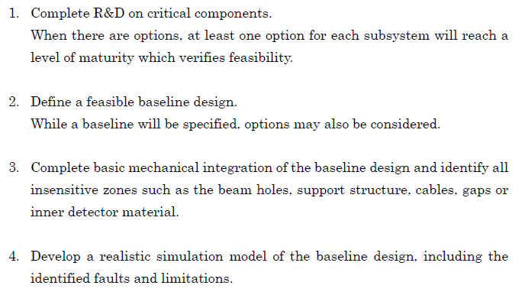
Calorimetry planning through 2012
Relevant aspects of the Work Plan:

Slide 8
IDAG guidance on Cal/PFA
The R&D program should validate the expectations of PF analysis with
large detector set-ups and realistic conditions. It should also clarify
whether specific design values (e.g. the depth of the hadronic calorimeter)
or figures of merit related to jet reconstruction are fully understood.
Additionally, R&D programs should contribute to design choices in areas
where different options appear possible (e.g.: detector technology for
the vertex detector and its readout; for the active elements in the
hadronic calorimeter and in the muon detector/tail catcher; options for
digital readout of the electromagnetic calorimeter; options for
high-performance calorimeters based on the alternative approach of
multiple readout.)

Slide 9
ECal planning through 2012
For the baseline silicon-tungsten Ecal design, the operability of a fully integrated
active layer inside the projected 1.25mm gap between absorber plates must be
demonstrated. Sufficient S/N, successful signal extraction, pulse powering, and
adequate cooling must be shown as well. Mechanical prototypes with steel rather
than tungsten will first be built, followed by a full depth tower appropriate for
beam tests. For the alternative MAPS technology being investigated in the U.K.,
a key need is production of large sensors with sufficient yield.
-> Timeline for the various Si/W ECal baseline development stages
-> Timeline for full simulation of Si/W ECal
-> Review of current R&D resources for Si/W baseline
-> Timeline for development of MAPS alternative
-> Review of resources for MAPS development

Slide 10
HCal planning through 2012
The priority for hadronic calorimetry is to demonstrate the feasibility of assembling
a fully integrated, full-size active layer within a ~8mm gap between absorber plates.
Several technologies are being investigated: RPC’s, μMEGAS, GEM’s, and scintillating
tiles/SiPM’s. A European project studies micromegas layers. All of this work is being
carried in conjunction with the CALICE Collaboration, and the results will form a critical
component of SiD’s future technology selection. An alternative approach, using
homogeneous crystal calorimetry with dual readout, is also being studied. This effort
needs to demonstrate good hadronic energy linearity and resolution in a test beam, to
develop suitable crystals, to produce a realistic conceptual design, and to simulate physics
performance.
-> Timeline for RPC/baseline – data taking in CALICE stack
-> Timeline for analysis of data from RPC stack
-> Timeline for full simulation for RPC baseline
-> Profile of support for complete data taking/analysis of RPC baseline
-> Timeline for fully integrated/full size active layer (readout??)
-> Repeat above for GEM, Micromegas, Scintillator and Dual readout
? What should be our requirements for alternative technologies for the TDR?

Slide 11
-> SiD policy on readout (KPiX,…) for the various technologies.
-> Arguments for support needed for alternative technologies (labs, universities).
->

