Slide 1
Revisit parameters for
Conventional sources
Tohru Takahashi
contribution for LCWS/ILC2010

Slide 2
Motivation
Preparation of positron sources by;
  well established scheme and/or developable with existing resources
300Hz scheme
  relaxes thermal problem on targets
    lower speed rotation target will do
  but still have the shock wave problem
survey (again)parameters of conventional targets in the
drive beam energy – target thickness plane
See if conventional sources survives the ILC criteria

Slide 3
Methods
Simulation by Ｇｅａｎｔ4 with Tungsten
  total positron yield
  accepted positron yield with AMD acceptance
    T.Kamitani, L.Rinolfi CLIC note 465
  Peak Energy Deposit Density (PEDD)
  Total Energy Deposit (TED)
In space Beam Energy – Target Thickness
  beam spot size at 1.0mm, 2.5mm, 4.0mm

Slide 4
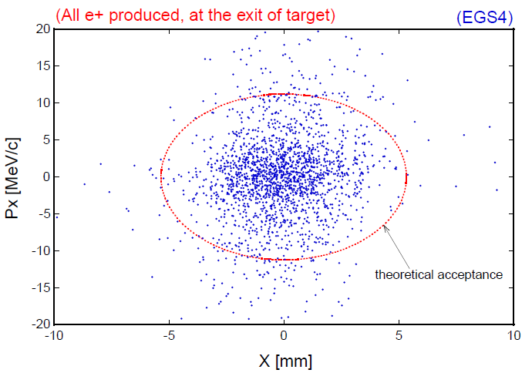
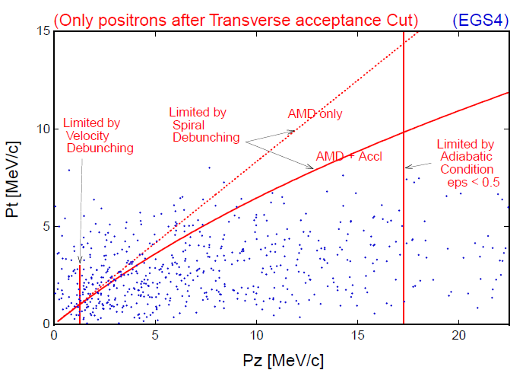
Acceptance estimate
CLIC note 465
[r/0.53]² + [pT/11]² =＜1
pT < 0.1875 MeV/c + 0.625 pL
1.5 MeV/c < pL < 17.5 MeV/c

Slide 5
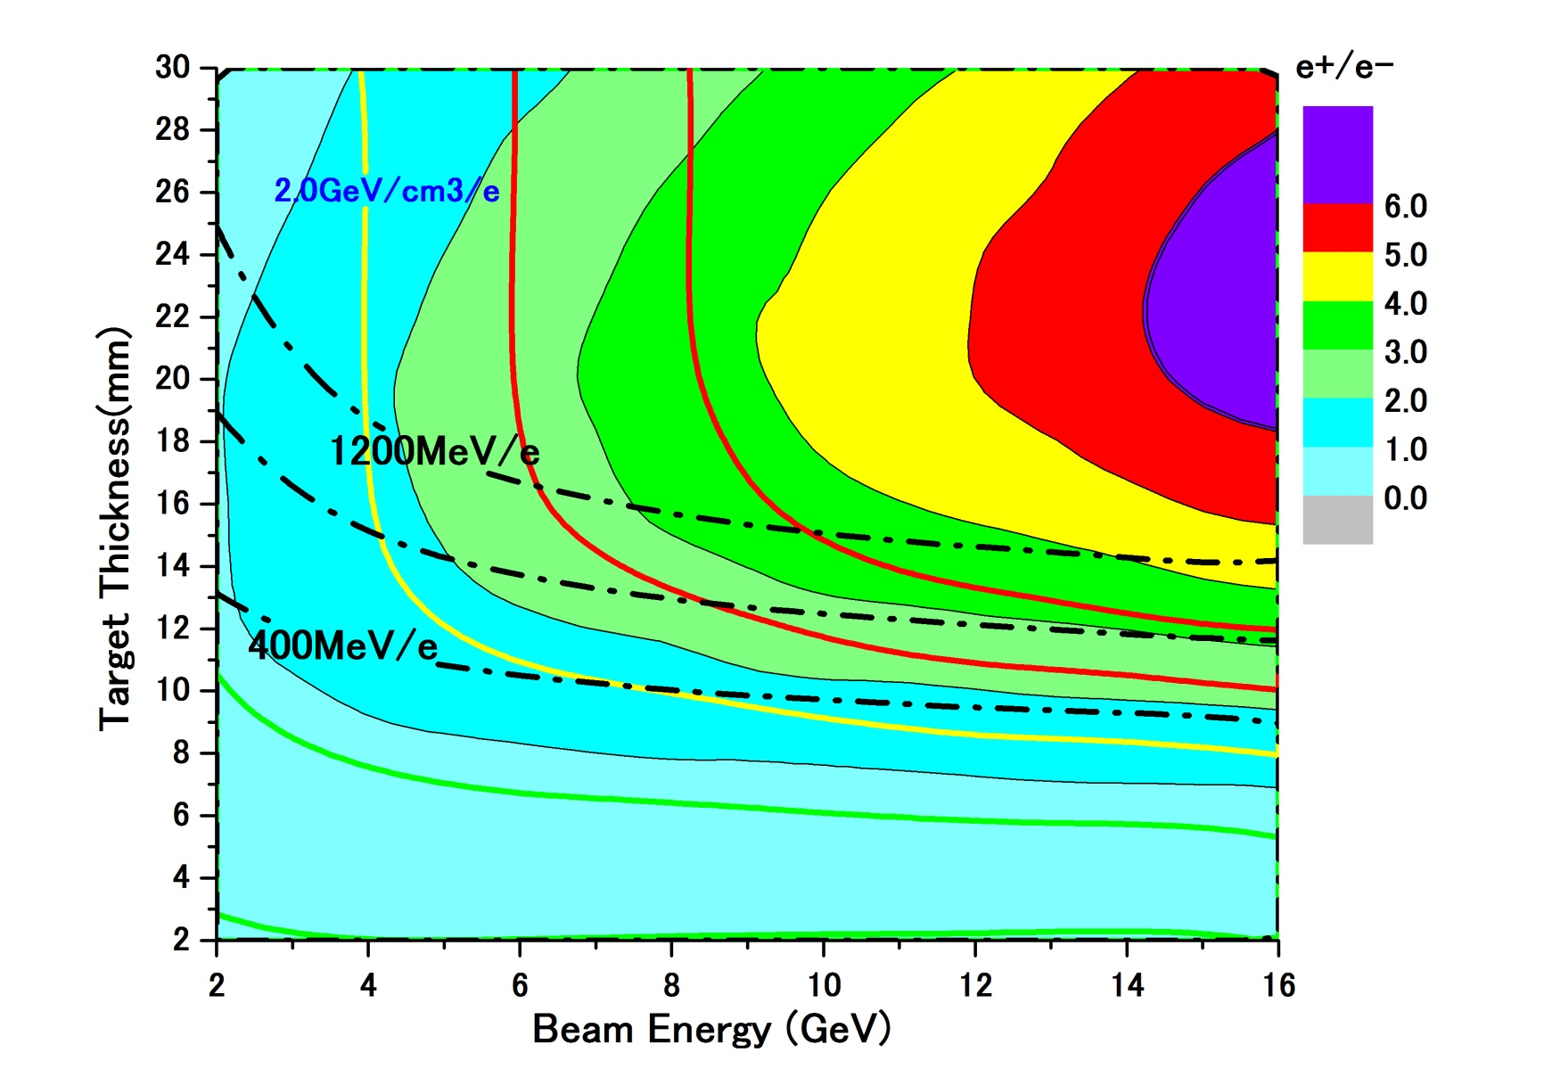
accepted e+ yield and PEDD with conventional scheme
e- directly on to Tungsten
σ=2.5mm

Slide 6
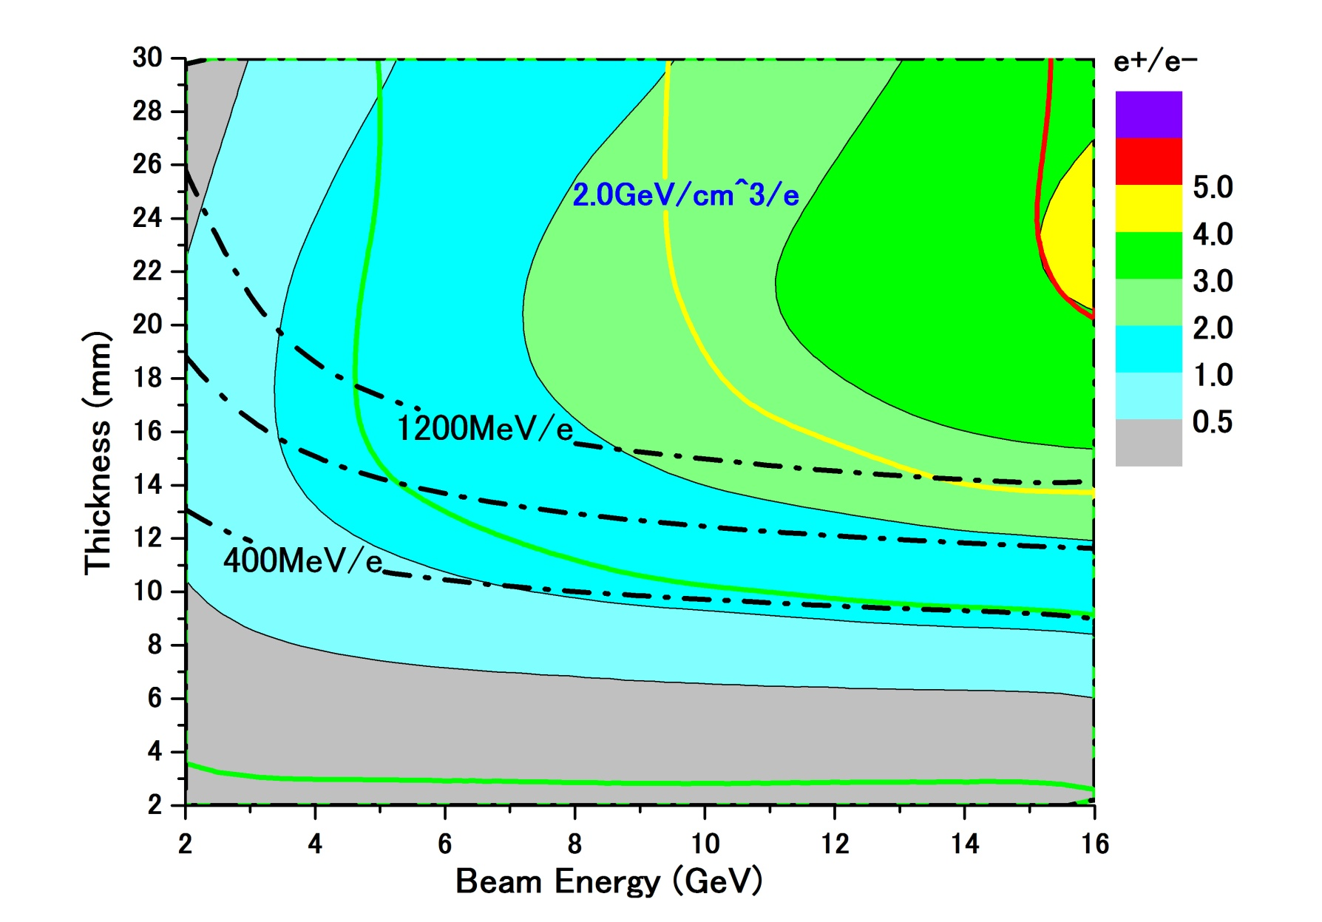
accepted e+ yield and PEDD with conventional scheme
e- directly on to Tungsten
σ=4.0mm

Slide 7
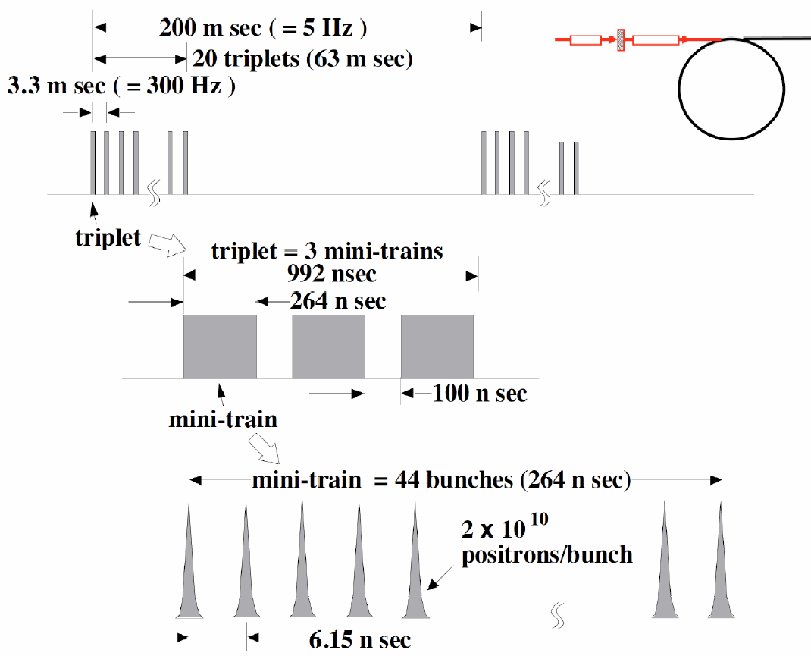
In the case of 300Hz scheme
different triplet hit
different position on
the target
132bunches in a triplet
hit the same position on
the target

Slide 8

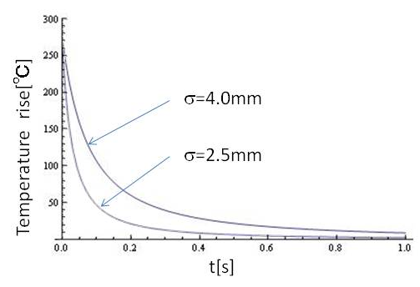
Thermal diffusion
time constant of the diffusion depends on beam spot size ~1/β
numerical calculation of
thermal diffusion shows
 |  | 1D | 2D | 3D
time constant | σ=2.5mm σ=4.0mm | 280ms 750ms | 80ms 200ms | 40ms 100ms
time constant is order of 100ms >> Ttriplet ~1μs

Slide 9
Assumption
each triplet hits different position on the target
relatively low (1~2m/s)rotational target
duration of a triplet ~ dumping time of shock wave
shoter than time scale of thermal dissusion
132 bunches in a triplet contributes both shock wave and thermal damage

Slide 10
Assumption
132 bunches
make a shock wave
heat same position on the target
a triplet: 132 bunches 992ns
each triplet hits
different position on the target
3.3ms
a train: 20 triplet
= 2640 bunches 63ms

Slide 11
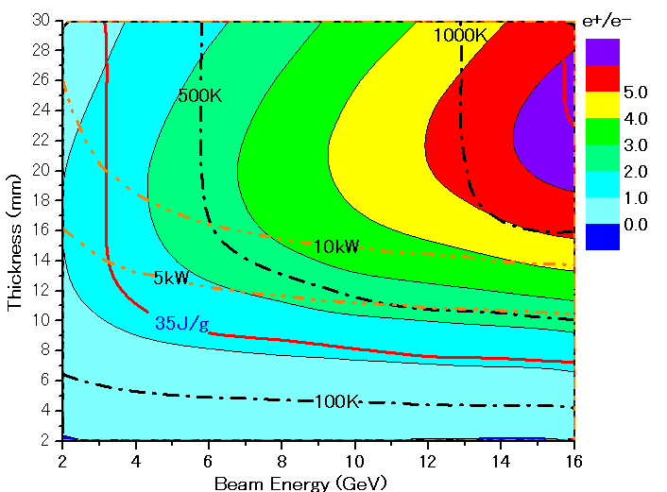
Parameter Plots for 300 Hz scheme
e- directly on to Tungsten
σ=2.5mm

Slide 12
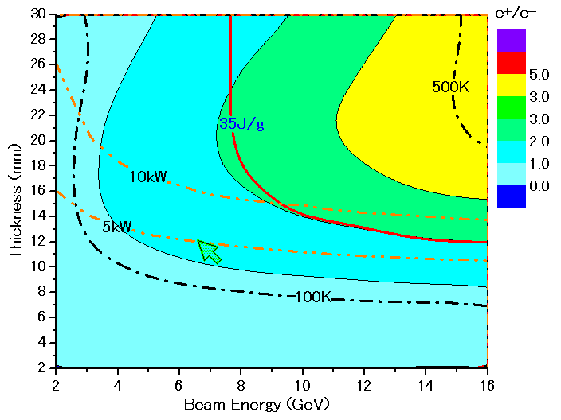
Parameter Plots for 300 Hz scheme
e- directly on to Tungsten
σ=4.0mm

Slide 13
summary
Conventional target might have solution for ILC with 300Hz scheme
to go forward
  need detail study for capture section as
    relatively large beam size is preferred
  heating has to be studied including cooling system
  shock wave threshold has to be understood particularly under multi bunch condition

