Slide 1
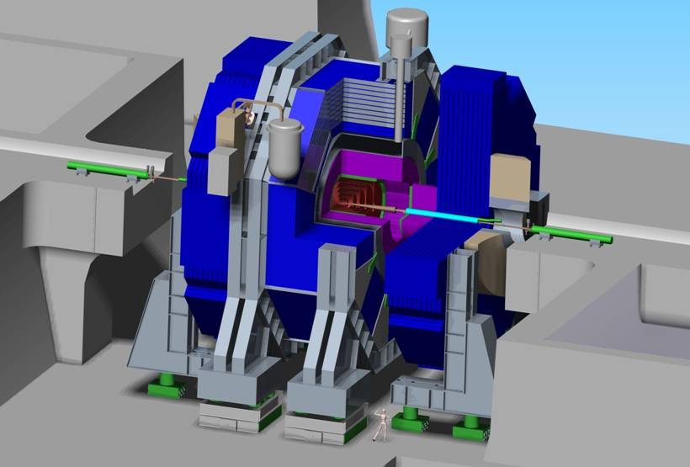



2010 Linear Collider Workshop & International Linear Collider Meeting
Tsinghua University, Beijing university, Institute of Theoretical Physics, University of Sciences and Technologies of China
Radiation Protection studies for SiD
Mario Santana, SLAC / RP
1

Slide 2
Overview
Geometry and Monte Carlo Settings
Dose limits and Beam Conditions
Interface pacman-cavern
Pacman and penetration
SiD detector
Ongoing studies
Provisional conclusions

Slide 3
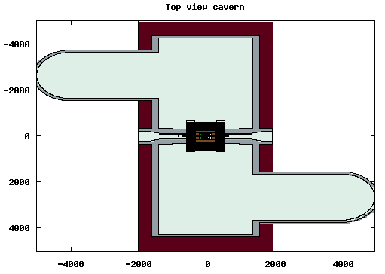
SiD Geometry implementation
D
A
A’
B
b
B’
b’
C
C’
D’

Slide 4
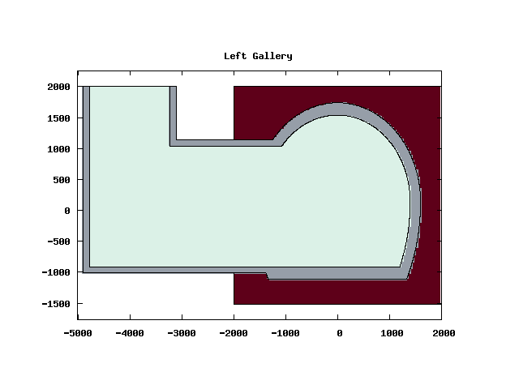
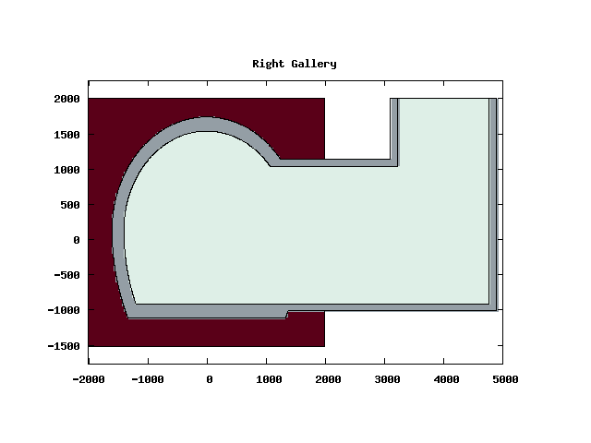
Geometry: end shafts
A-A’
C-C’

Slide 5
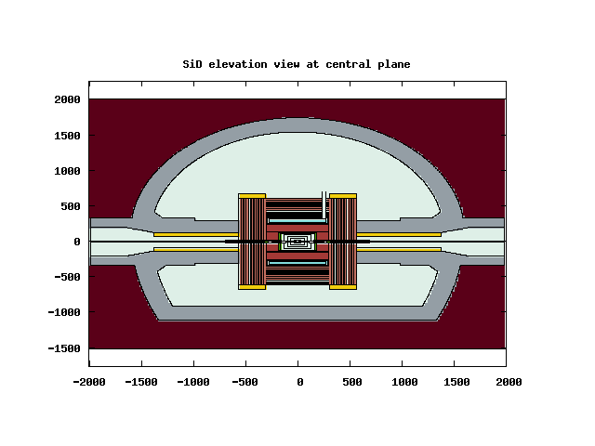
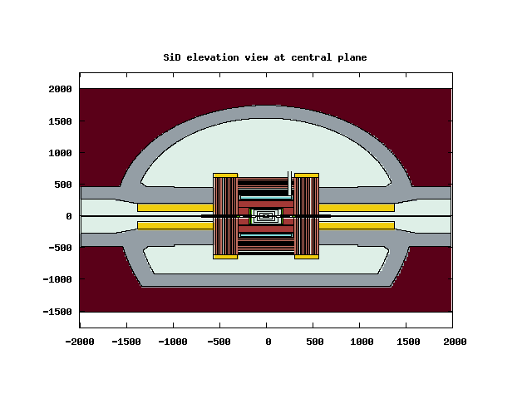
Geometry: pacman and SiD
B-B’
SiD elevation at beam plane Small PACMAN
SiD elevation at beam plane Large PACMAN
SiD elevation at beam plane Large PACMAN
50 cm steel +
170 cm concrete
120 cm steel +
250 cm concrete

Slide 6
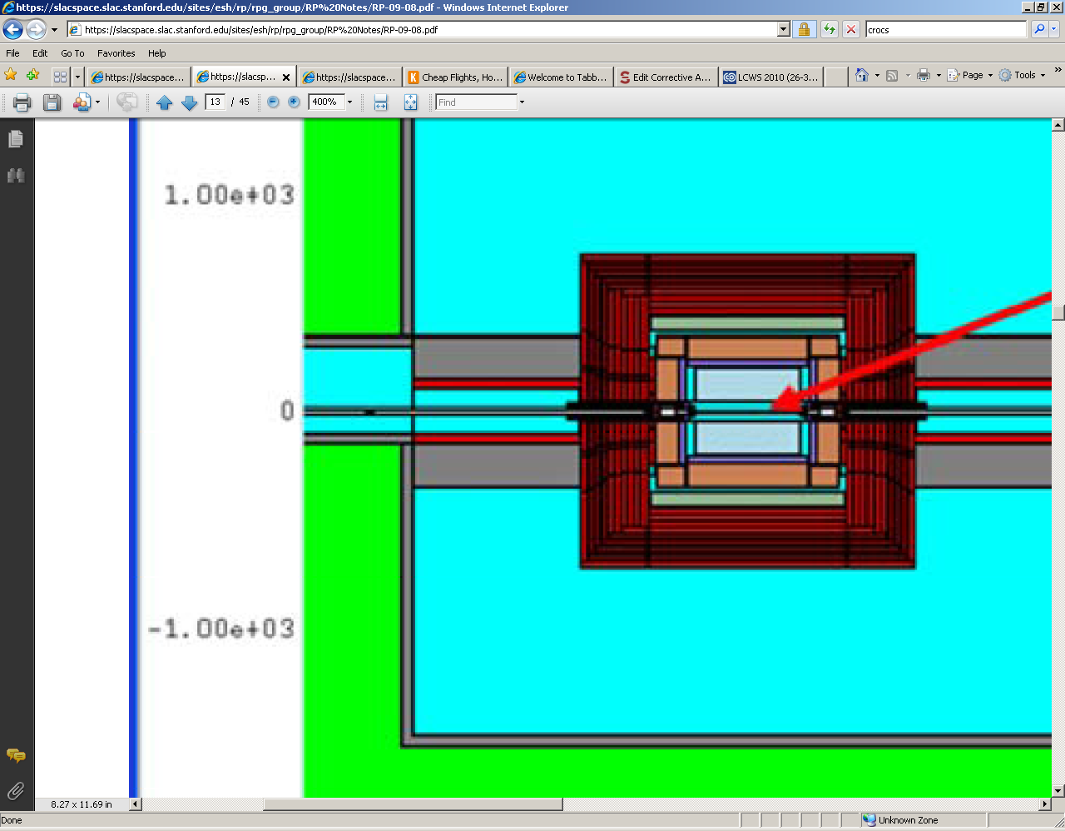
Geometry: pacman-cavern interface
PREVIOUS DESIGN
CURRENT DESIGN

Slide 7
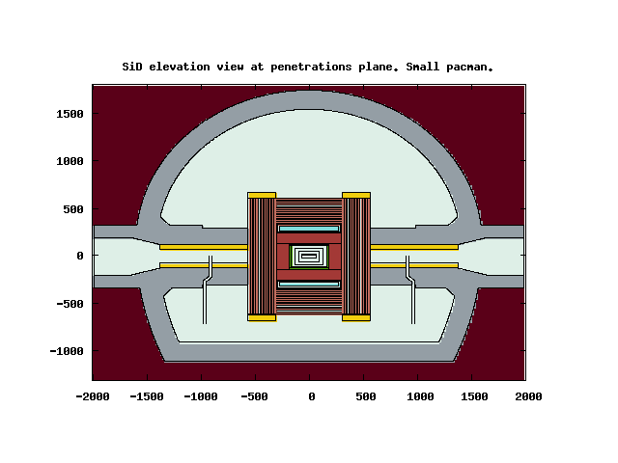
Geometry: pacman penetrations
b-b’

Slide 8
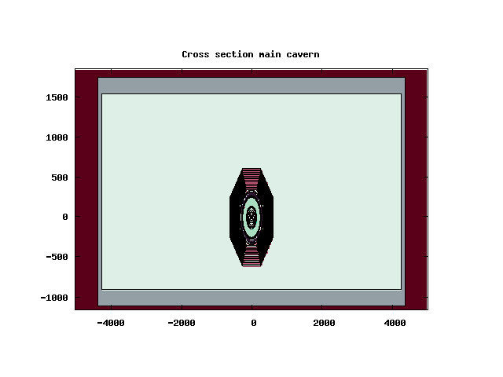
Geometry: cross section at IP
D-D’
Cavern cross section at IP Small PACMAN

Slide 9
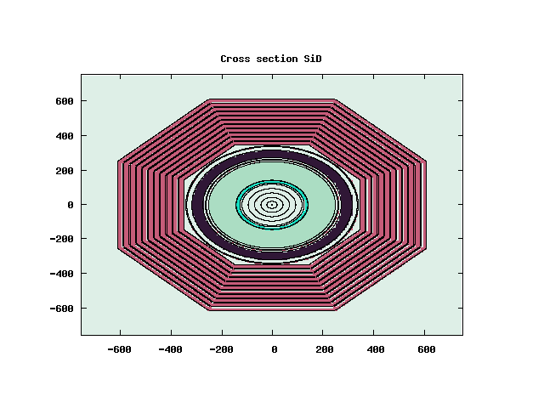
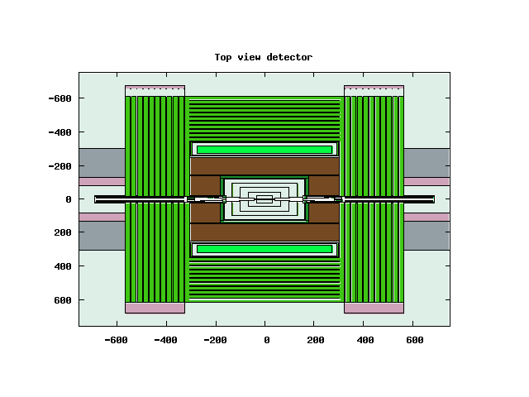
Geometry: SiD
SiD cross section at IP
SiD top view

Slide 10
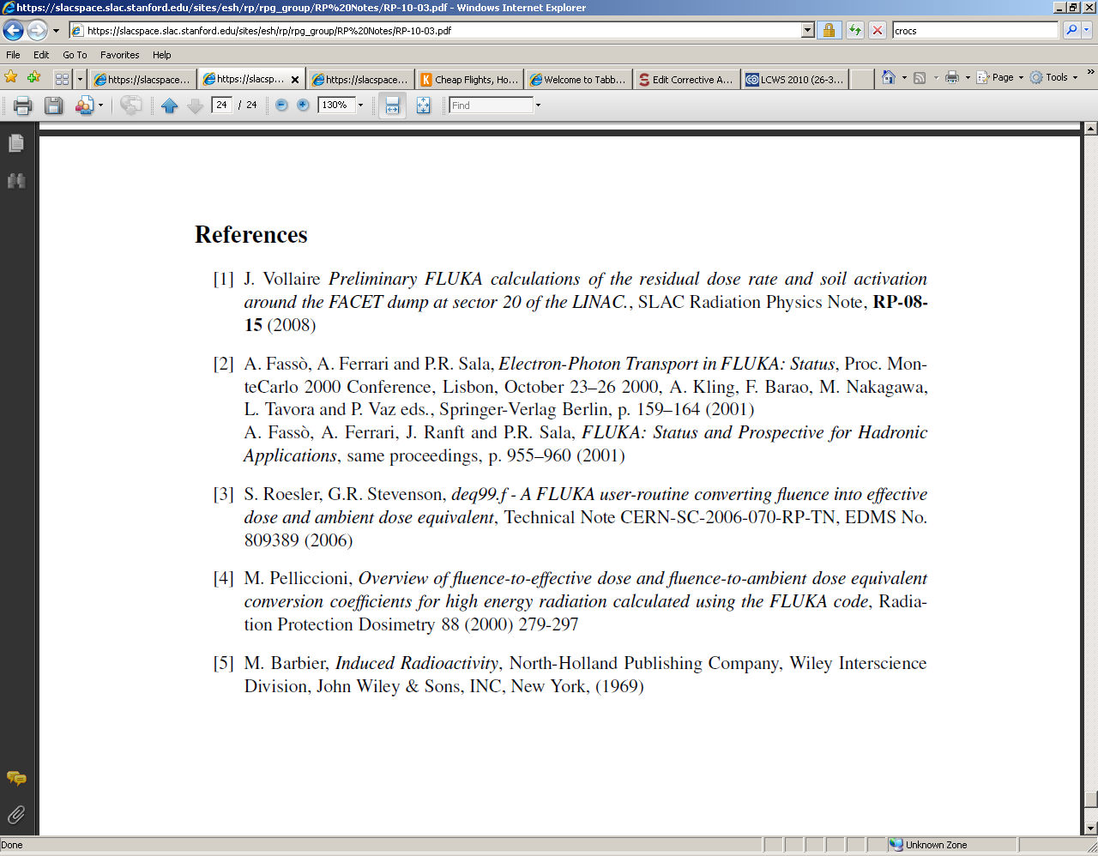
Monte Carlo tools and methods
FLUKA Intra Nuclear cascade code
  Latest version
  LAM-BIASING, Photonuclear/Photomuon reactions
Deq99 fluence to dose conversion routine
FLAIR GUI
PARALLEL simulations at SLAC farm: about 76000 CPU-hour (some more biasing required…)
V.Vlachoudis "FLAIR: A Powerful But User Friendly Graphical Interface For FLUKA“ Proc. Int. Conf. on Mathematics, Computational Methods & Reactor Physics M&C 2009), Saratoga Springs, New York, 2009

Slide 11
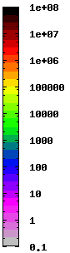
Dose limits
µSv/event
Annual Occupational Dose Limits (Radiation Worker):
DOE/DOD: 50 mSv (5000 mrem). Rad worker.
ICRP: 20 mSv (2000 mrem). Rad worker.
SLAC: 5 mSv (500 mrem). Rad worker.
1 mSv (100 mrem). GERT.
Dose limit per accident:
SLAC: 30 mSv (3000 mrem)
Dose rate limit for an accident:
- SLAC: 250 mSv/h (25 rem/h)
For our beam conditions: 1 µSv/event → 18 mSv/h
MSL - SLAC
11

Slide 12
Beam conditions / accident conditions
500 GeV / beam
9 MW / beam
Typical accidents:
  Beam1 AND beam2 hit thick target at IP-14 m
    Weakness cavern-pacman interface?
  Beam1 AND beam2 hit thick target at IP-9 m
    Pacman is sufficiently thick? Weakness in penetration.
  Beam1 hits tungsten mask at IP-3 m (unsteered)
    SiD is sufficiently shielded?
Beam aborted after one train = up to 3.6 MJ
MSL - SLAC
12

Slide 13
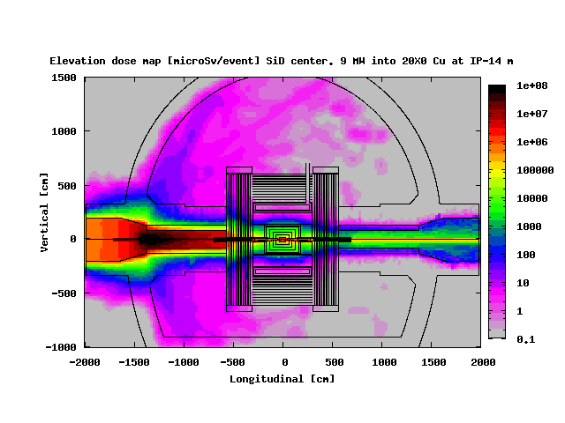
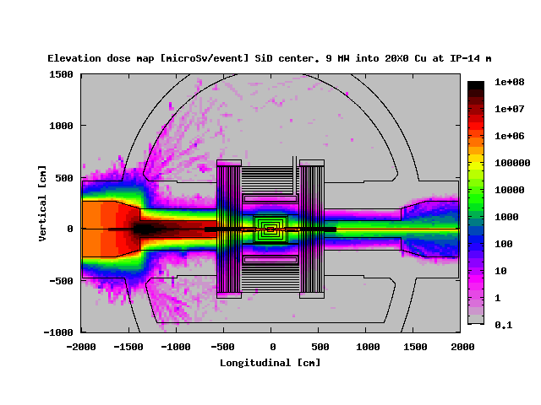
20 R.L. Cu target in IP-14 m. Pacman size.
Smaller pacman
Larger pacman
MSL - SLAC
13

Slide 14
20 R.L. Cu target in IP-14 m. Small pacman.
9 MW
µSv/1_train
Dose limits
Maximum dose
The maximum integrated dose per event is ~100 µSv << 30 mSv
The corresponding peak dose rate is 1800 mSv/h >> 250 mSv/h
MSL - SLAC
14

Slide 15
20 R.L. Cu target in IP-14 m. Large pacman.
9 MW
µSv/1_train
Dose limits
Maximum dose
The maximum integrated dose per event is ~8 µSv << 30 mSv
The corresponding peak dose rate is ~140 mSv/h < 250 mSv/h
MSL - SLAC
15

Slide 16
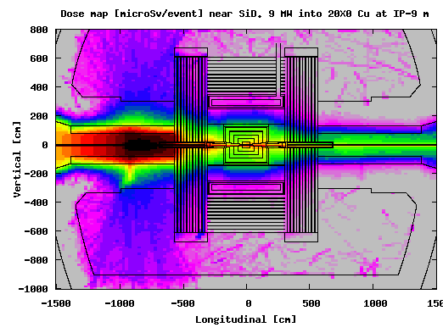
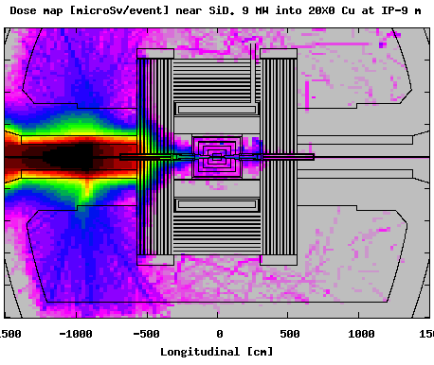
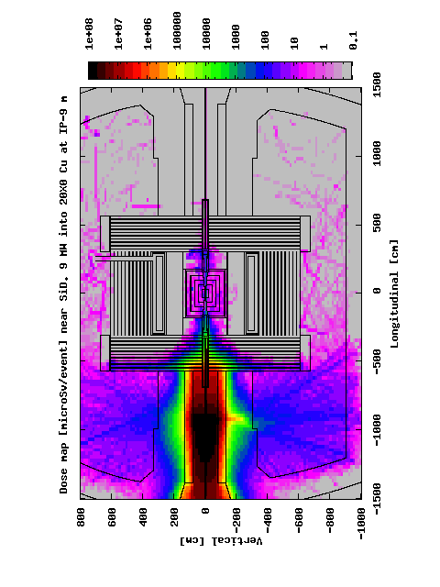
20 R.L. Cu target in IP-9 m. Small pacman.
BEAM PLANE
Beam 1
Beam 2
+
µSv/event

Slide 17
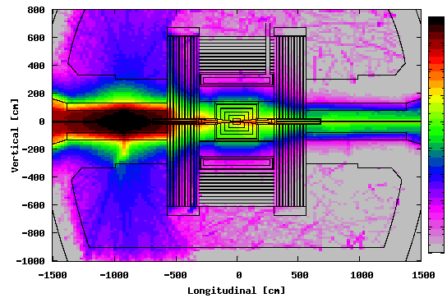
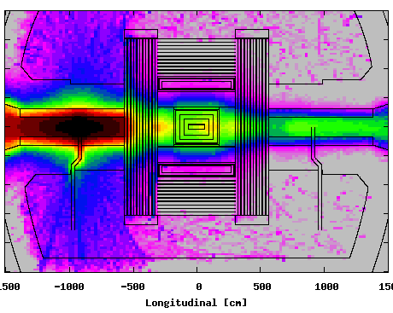
20 R.L. Cu target in IP-9 m. Small pacman.
BEAM PLANE
PENETRATION PLANE
9 MW
9 MW
9 MW
9 MW
1000 µSv/event
18000 mSv/h
µSv/event
MSL - SLAC
17

Slide 18
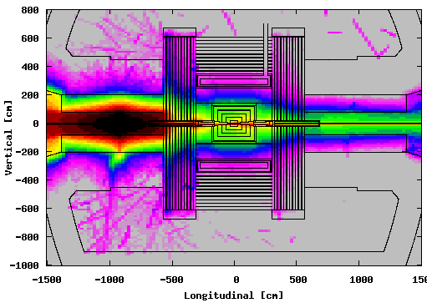
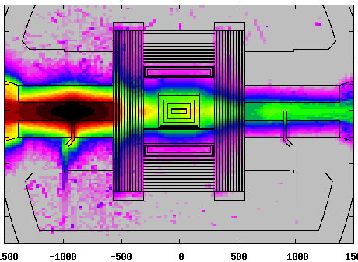
20 R.L. Cu target in IP-9 m. Large pacman.
BEAM PLANE
PENETRATION PLANE
9 MW
9 MW
9 MW
9 MW
10 µSv/event
180 mSv/h
µSv/event
MSL - SLAC
18

Slide 19
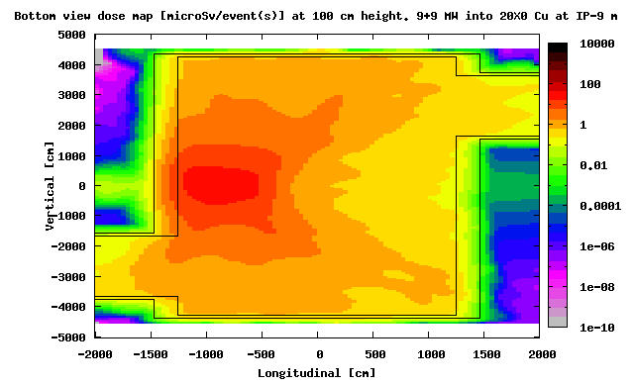
20 R.L. Cu target in IP-9 m. Small pacman.
BOTTOM VIEW AT 100 CM HEIGTH (FROM FLOOR)
9 MW
9 MW
µSv/2_train
~ 30 µSv/event
~ 540 mSv/h
Scale is different from that of elevation plots !!
MSL - SLAC
19
19

Slide 20
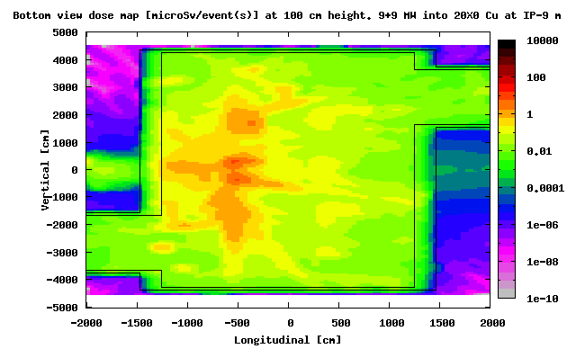
20 R.L. Cu target in IP-9 m. Large pacman.
BOTTOM VIEW AT 100 CM HEIGTH (FROM FLOOR)
9 MW
9 MW
µSv/2_trains
~ 10 µSv/event
~ 180 mSv/h
MSL - SLAC
20
20

Slide 21
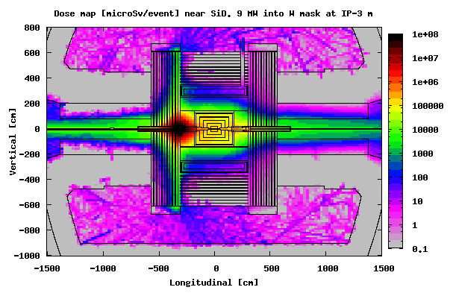
Beam 1 hits tungsten mask at IP-3 m
9 MW
µSv/1_train
~ 100 /event
~ 1800 mSv/h
The spaces between the door plates are empty in the model, but in the real detector they will be partially filled

Slide 22
Ongoing studies
Better resolution: Customized biasing + weight windows
Mis-steering studies
Analysis of other possible weakness
…

Slide 23
Provisional conclusions
Small pacman and pacman-cavern interface are sufficient in terms of dose per event.
However, the dose rates for the small pacman are very high:
  Proven mechanisms should be installed to:
    avoid these accidents to occur
    shut off beam after 1 train (200 mS)
  Possible Debates
The large pacman complies with all criteria.
The penetrations in the pacman don’t require local shielding.
The shielding of the detector may be insufficient to comply with dose rate limit. Exclusion area?
More studies ongoing (mis-steering…)

