Slide 1
ILC CFS & GLOBAL SYSTEMS MEETING
CONVENTIONAL FACILITIES
AND SITING GROUP
CFS Status Report in Preparation for the
September, Albuquerque Meeting
V. Kuchler, J. Osborne, A. Enomoto

Slide 2
Overview
Update from Previous Meeting
Main Linac Tunnel Configuration Study
Single Tunnel Life Safety Issues
Single Tunnel Diameter Comparison
CFS and the EDMS System
DESY AD&I Meeting Action Items
Summary

Slide 3
Update from Previous Meeting
AD&I Central Region Layout
The CFS Group has Concluded a Comprehensive System of Meetings with Area Systems
A Complete Machine Layout has been Developed
2D Layout Drawings and Tunnel Sections will be Finalized and Distributed Prior to the ALCPG 09 Meeting
Cost Estimates, Based on the Americas Region, will be Completed by the ALCPG 09 Meeting
Klystron Cluster and DRSF Alternatives
Americas Region has Developed a Klystron Cluster Design
Asian Regions has Developed a DRSF Design
All Regions will Adapt These Designs
Costs for Both Alternative RF Sources will be Completed by the ALCPG 09 Meeting

Slide 4
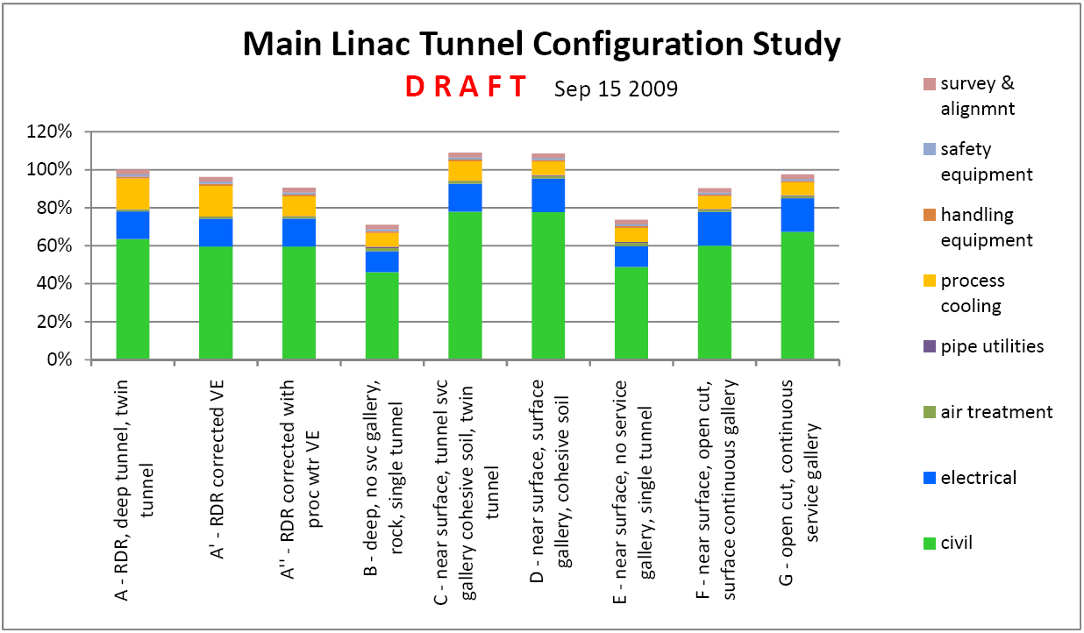
Main Linac Tunnel Configurations
Tunnel Cross Sections are Complete
Detailed Cost Estimates Based on the Americas Region Criteria for Each Alternative are Complete

Slide 5
Regional Differences in Tunnel and Life Safety Design
Single Tunnel Design
Americas and European Regions Continue to Use Vertical Shafts for Tunnel Access
Asian Region Continues to Use Horizontal Tunnels for Tunnel Access
RF Systems and Life Safety Solutions will be the Primary Criteria to Determine Tunnel Diameters
Life Safety and Egress - General Approaches
Americas Region Requirements Focus on Protected Enclosures and Alcoves for Safe Transit to Vertical Egress to Surface
European Region Requirements Focus on Compartmentalization for Smoke Control and to Establish Safe Transit to Vertical Egress to Surface
Asian Region Requirements Also Focus on Compartmentalization for Smoke Control but may Also Require Additional Tunnel or Protected Enclosures for Safe Transit to Horizontal Egress to Surface
All Regions have a Main Linac Single Tunnel Solution, Although Each Region will Require Distinctions to Comply with Local Regulations

Slide 6
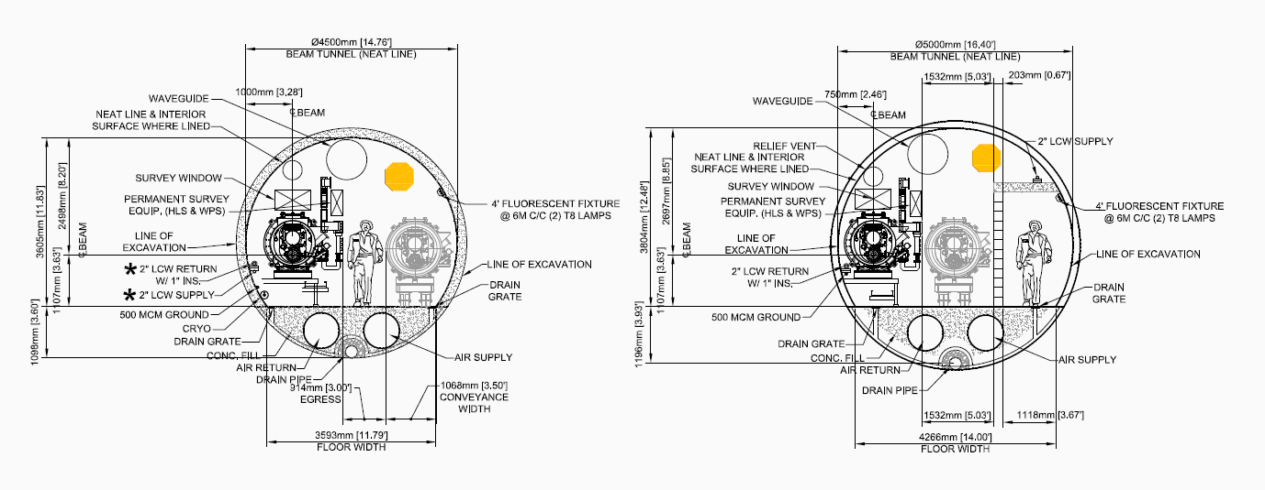
Americas Region Tunnel Comparison

Slide 7
CFS EDMS Effort
The CFS Group is Committed to Utilize the EDMS System to Manage Documentation
A CFS Parallel Session at ALCPG 09 is Dedicated to Establishing CFS Competence in the Use of the EDMS System
Training Requirements will be Revisited and Arranged as Needed to Establish Competence within the CFS Group
A Filing System will be Established to Organize CFS Documentation and Provide Access to Area and Technical Systems
This Filing System will Also Provide Security for Sensitive Cost Estimate Information

Slide 8
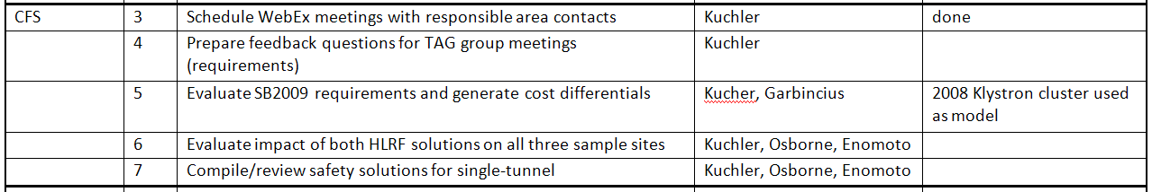
DESY AD&I CFS Action Items
#4 - CFS AD&I Meetings were Held at SLAC and Daresbury for Interactive Discussions with All Area Systems
#5 - SB 2009 Requirements have been Incorporated Into the Current CFS Layout and Cost Estimates with Differential Comparisons will be Completed by ALCPG 09
#6 - The Evaluation of the Klystron Cluster and DSRF Solutions for All Three Sample Sites will be Completed by ALCPG 09
#7 – Safety Solutions have been Developed for all Three Regional Design Solutions and Although Different, Establish a Viable Egress Model for the Single Tunnel Solution in All Regions

Slide 9
Summary
The CFS Group has Developed a Comprehensive Machine Layout that Incorporates All of the SB 2009 Working Assumptions
Definitive Information Regarding the Choice of RF Systems and the Influence of Regional Life Safety on Tunnel Design and Diameter will be Available for ALCPG 09
Participation in the EDMS System is a Top Priority for the CFS Group and will be Addressed in an ALCPG 09 Parallel Session
All CFS Action Items from the DESY AD&I Meeting have Been Addressed and Completed

