Slide 1
Laser upgrade for NML
Jinhao Ruan

Slide 2

Current A0 IR table layout
10’
NEW MP
48’
6’
F
F
12’
12’
F
PP
F
3’
PD
7’
OLD MP
10’
13’
96’
F stands for Flipper mirror, PP stands for second pulse picker to clean up the pulse after MP

Slide 3
Old MP long pulse train output

Slide 4
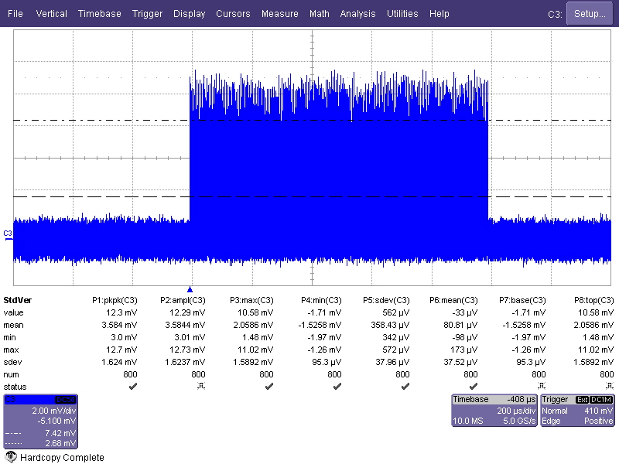
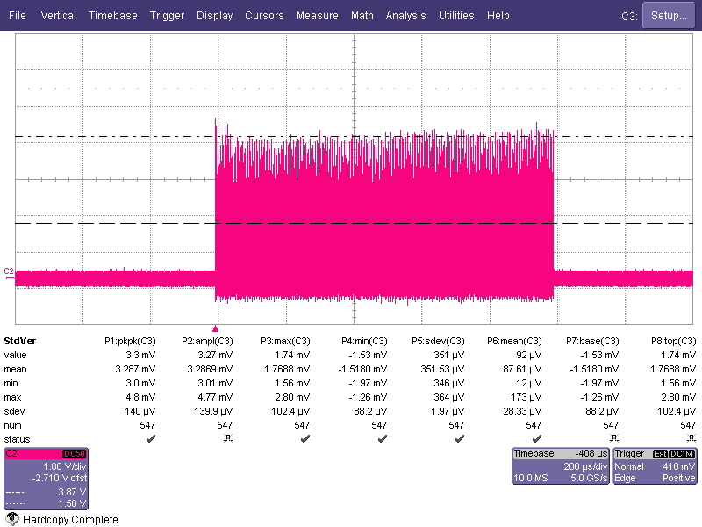
1000 1MHz pulse train before new MP
1000 1MHz pulse train before new MP at the beginning of this year

Slide 5
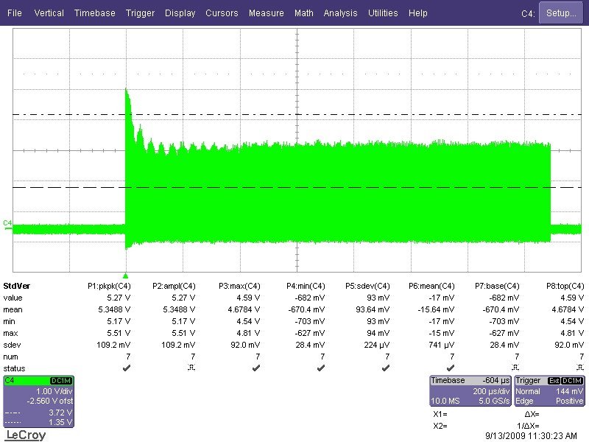
Improvement
1ms long train we plan to use
1.5 ms long
1MHz train, each pulse is about 2-3 uJ which is a little higher than the way we are running in A0 right now. Pulse-pulse fluctuation is about 3.6%.

Slide 6
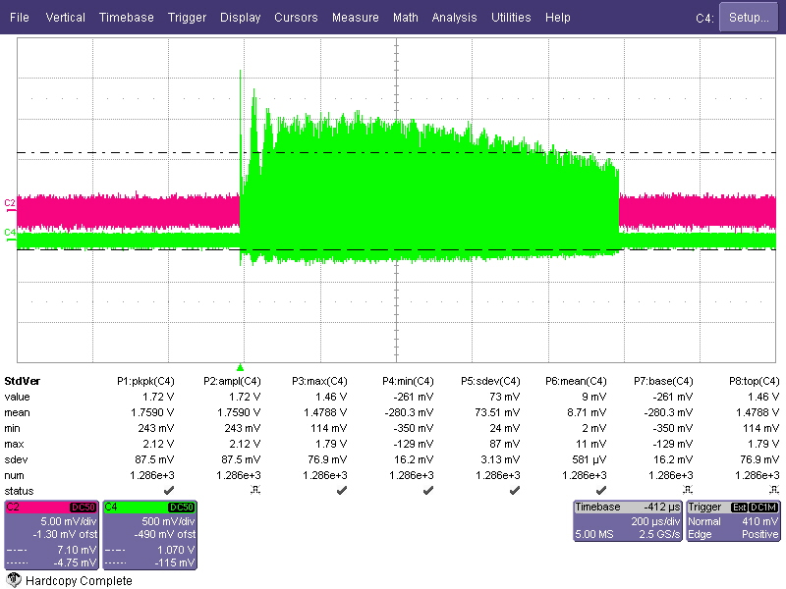
3MHz train from the initial test
1.5 ms long

Slide 7
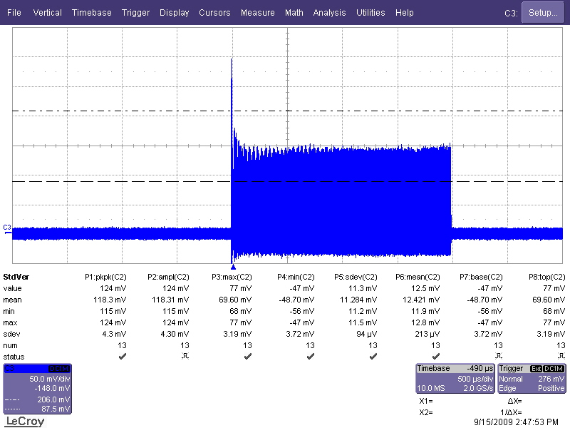
3MHz train now
1ms long train we plan to use
2 ms long

Slide 8
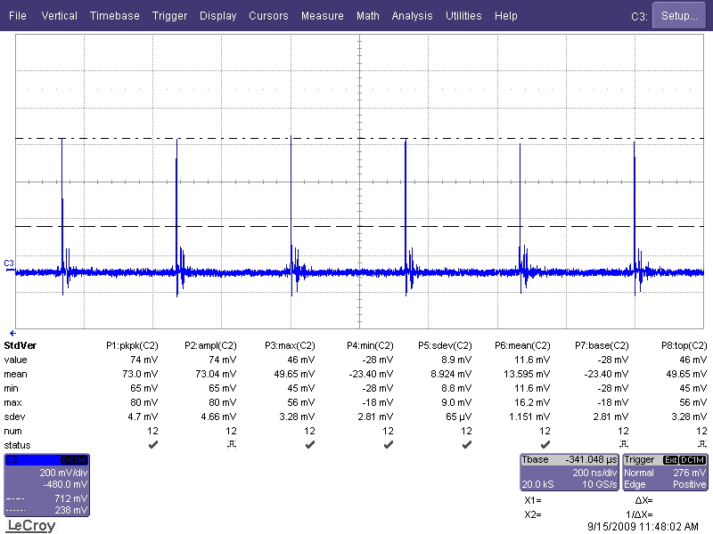
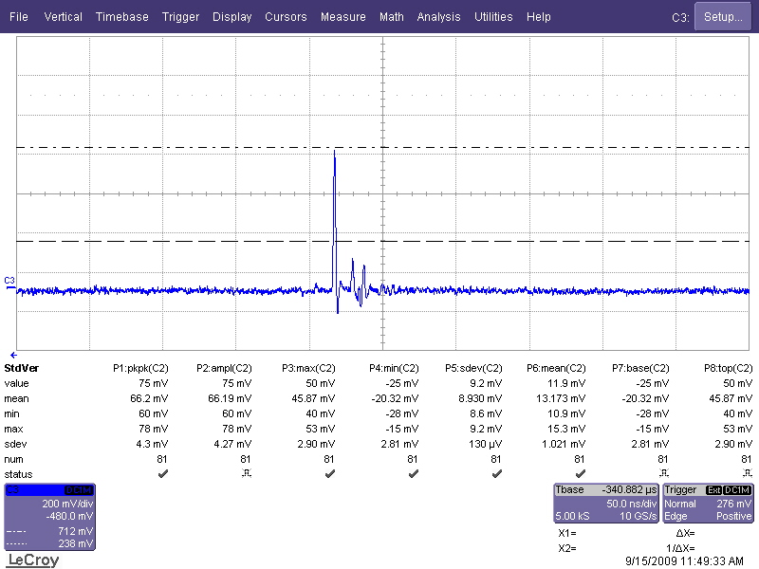
3MHz train now
333ns
Each pulse is about 1uJ right now This probably will meet the 3.2nC for NML if we need it right now.

Slide 9
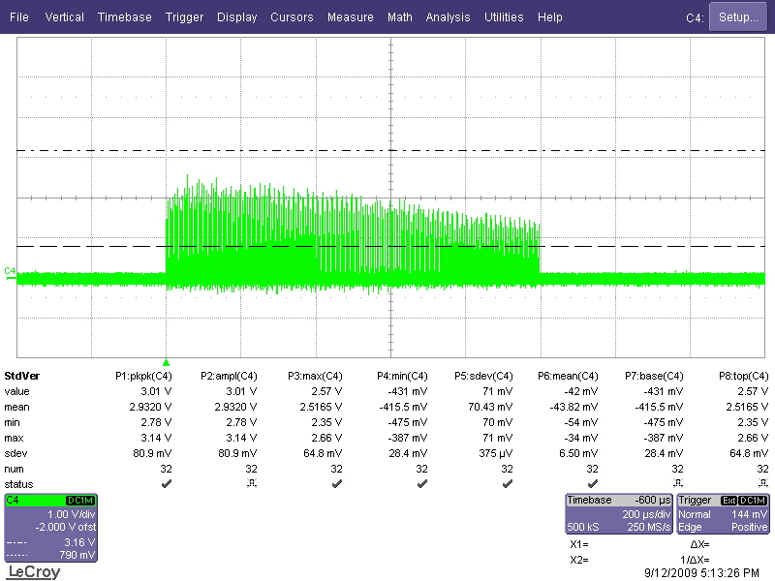
With 2P amplification – flash pump
This is the picture of 1000 1MHz pulse train after 2P. The energy after 2P is about 40uJ/ pulse for the beginning 500 pulse and slowly dropping to 30uJ or so at the end.
1 ms long

Slide 10
So far
Diode pumped MP structure was able to deliver 3MHz flat pulse train
Current power level is probably enough for 3.2 nC charge . However there’s not too much margin for error. Laser diode is already working at the 90% of the power level.
Flash lamp pumped diode was not able to keep the flatness over the train. More effort is on the way.

Slide 11
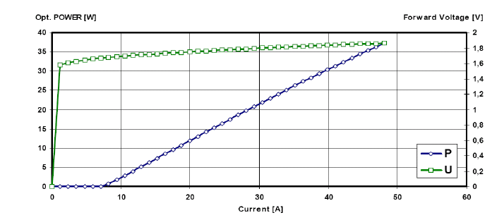
Current diode working position

Slide 12
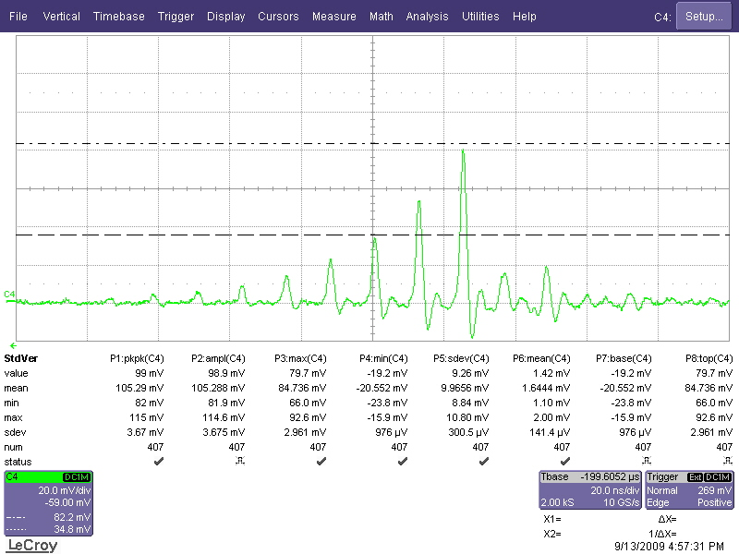
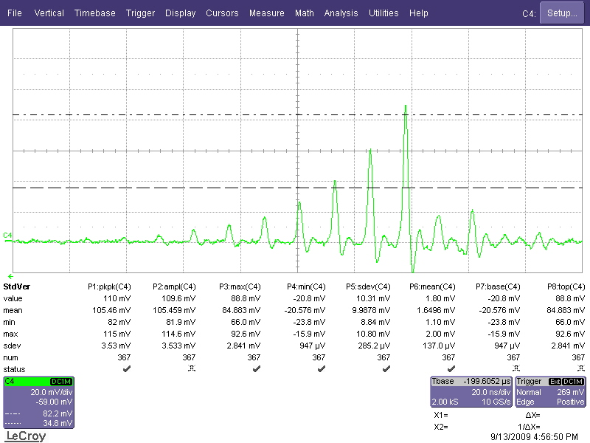
MP performance
18 round trip inside cavity
19 round trip inside cavity

Slide 13
Some thoughts
New powerful pump diode
100W QCW diode ?
I will use this to double our current energy by 2 but the diode will work at 60% level instead of 90%.
Current diode will be still be used to make another 1 pass structure to double the energy again

Slide 14
Some thoughts
Flash lamp 2-pass booster (Booster energy in the range of 30-40 times)
We already get into touch with power supply group(Dan wolf) to see what we can do on the flash lamp power supply. By changing the waveform of the flash lamp power supply we may flatten the train.
We also have a pulse train shape available.
Is it possible to upgrade to all diode pump version?

Slide 15
DESY laser structure – all diode pump
Seed
500
λ/2
Iris
Iris
λ/2
Faraday Rotator
30 W laser diode amplifier I
750
30 W laser diode amplifier II
Pulse picker
PD
PD
λ/2
λ/2
pickup
175
Pinhole
30 W laser diode amplifier III
175
Faraday Rotator
100 W laser diode amplifier I
300
200
100 W laser diode amplifier III
300
200
100 W laser diode amplifier II
300
Pulse picker
PD

Slide 16
NML version
Seed laser
100W MP
Pulse picker
100W SP*
100W SP
100W SP
Frequency conversion
The last 100W SP amplifying stage may not be necessary. We need 6 more QCW laser diode plus diode power supply which is about 10k each.

Slide 17
Possibility for 81.25MHz train
Current MP configuration is not going to work with 81.25MHz train.
Current seed laser is too weak to get amplified stage by stage.
We can convert our MP configuration to a mode lock laser, with 100W diodes.
How to lock the laser within 200fs? We already have a little bit experince now
Then with multiple amplify stage get to the desired energy
However still can’t guarantee 200 pc at the end because we may approach the YLF rod damage threshold with that much energy. Maybe 100pc.
My estimate will be about 500k US $ is needed for more study

