Slide 1
New Muon Lab control
Proposal v1

Slide 2
Overall control structure
Acnet infrastructure with Synoptic Display(Java)
Additional standard alone Java program for special control task

Slide 3
Synoptic Display
Client-Server system for graphical data representation
Platform independent
Can access directly from Web borrower, even from a mobile devices
Light-weighted on client side
Current Major problems
NOT Scalable
Plotting feature
Can’t perform complicated control tasks

Slide 4
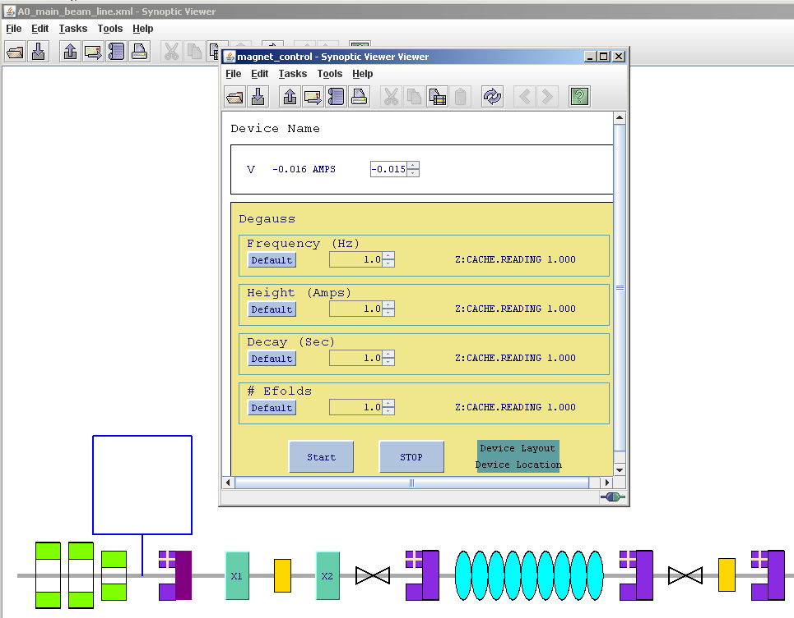
Synoptic Display Snapshot

Slide 5
General Group of Controlled Devices
Power supplies – IRM
Various type of magnets, solenoid …
LLRF – vmelx board (DOOCS? Or ??)
CC1, CC2…
Cameras – Linux system with camera server
Giga E Camera
Laser components – ???
BPM – ???

Slide 6
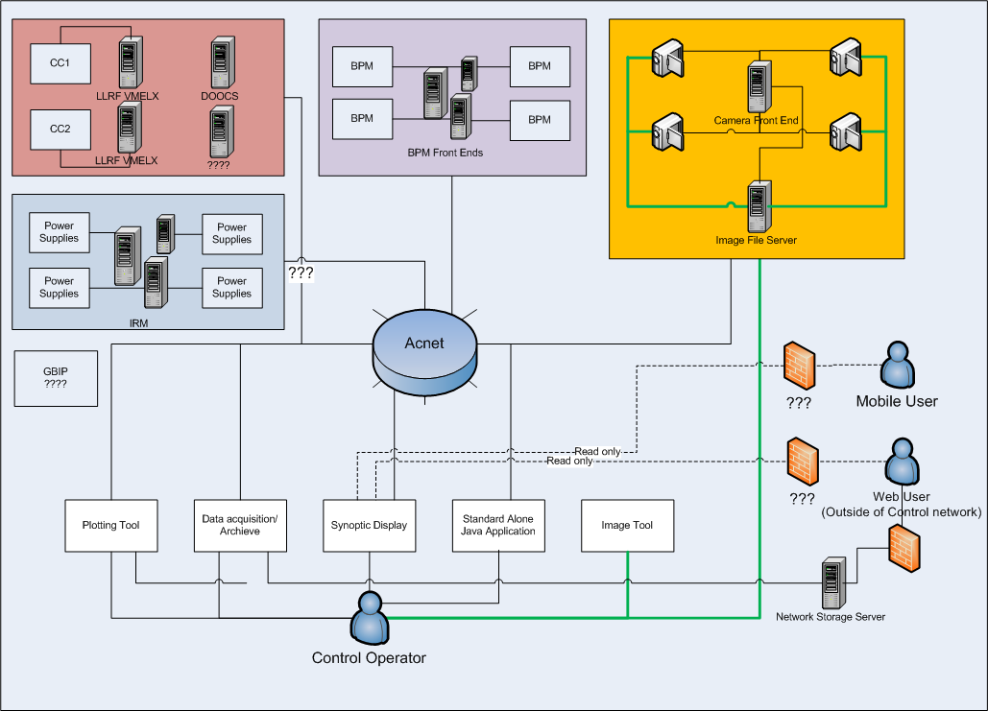
Proposed Structure

Slide 7
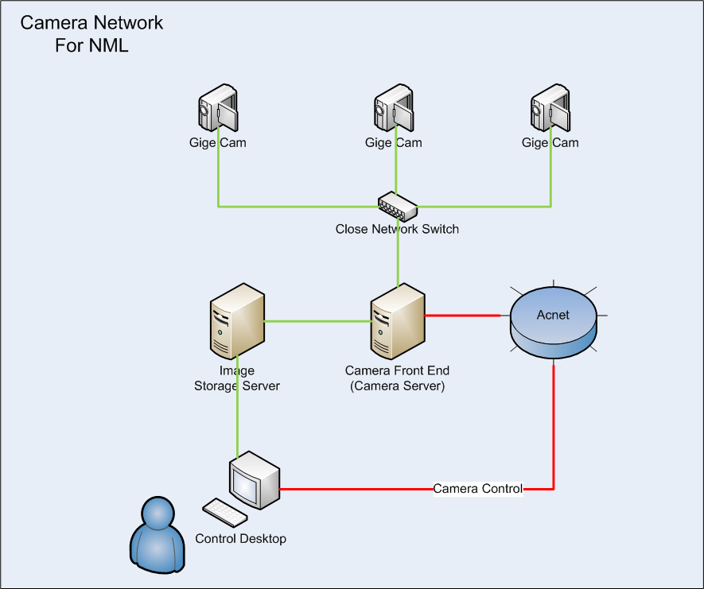
Proposed Camera network in Detail

Slide 8
Camera Front End
The software will developed in Linux environment with camera’s SDK
Compatible with Acnet infrastructure
Control physical camera through Acnet
Image collection and recording
Collection image per operator’s demand
Integrate with Image Tool

Slide 9
To Do
Once camera is decided
Review camera specs and get familiar with its Gige E SDK and setup develop/test env
Develop User stories
What are the functions we need?
GUI’s look and feels
Starting development iteration
Providing min-releases toward to final release

