Slide 1
Camera Options for A0/NML
Purchase camera to match Radiabeam prototype optical design
  Field of view at Object – 18 x 18 mm
  Field of view at camera – ½” sensor
  Object pixel resolution – 20 microns
  Requires at least 1000 pixels for each axis
  Electronic shutter speed?
Look for GIGe cameras

Slide 2
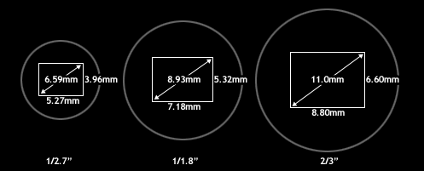
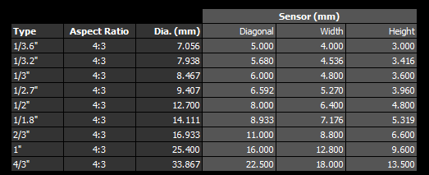
CCD
Sensor
Sizes

Slide 3
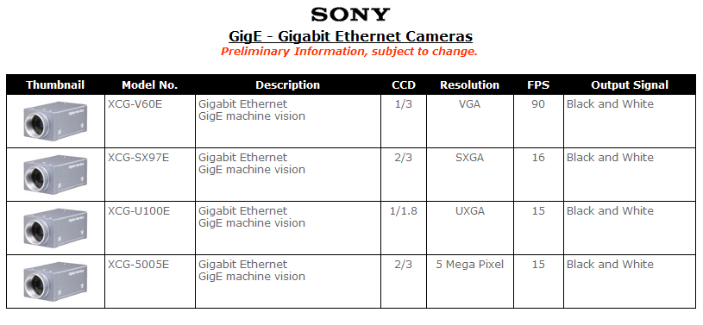
Sony GIGe Cameras
No ½” sensor?

Slide 4
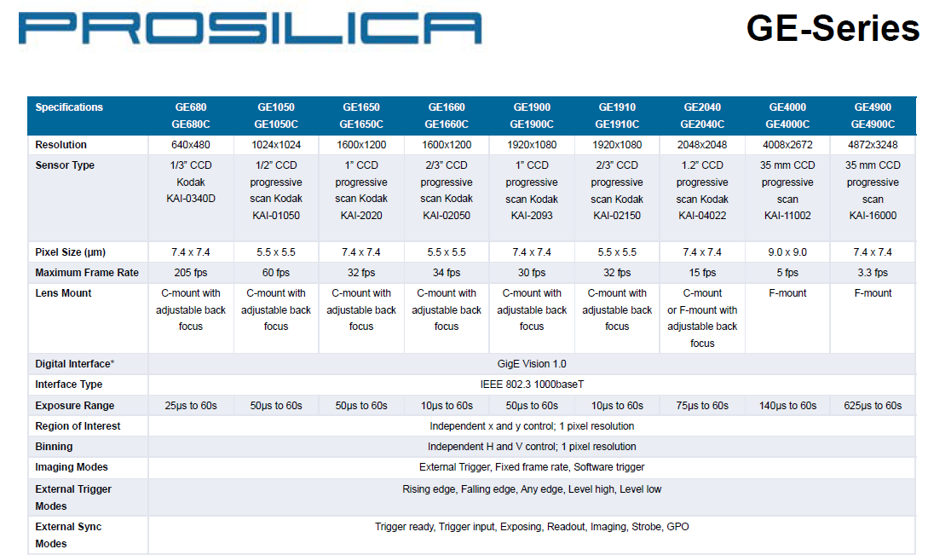

Slide 5
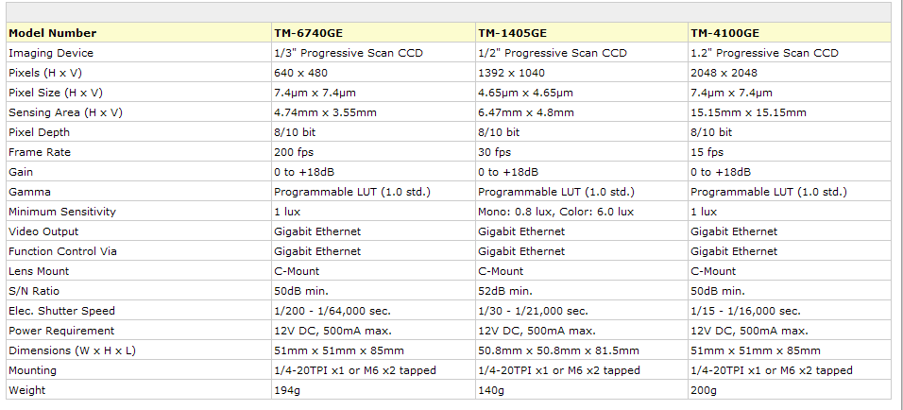
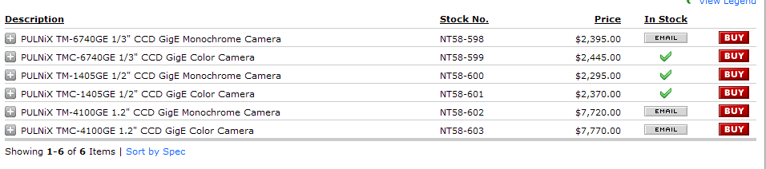
Pulnix GIGe Cameras

Slide 6
GIGe Camera Manufactures
Sony – Japan
PixeLINK – Canada
Pulnix - ???
Toshiba Teli – Japan
IDS (Ueye cameras) – Germany
Prosilica – Canada
Dalsa – Canada
CIS Americas – USA
Others??

Slide 7
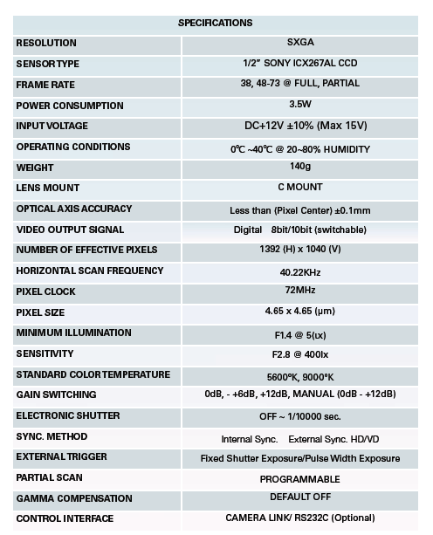
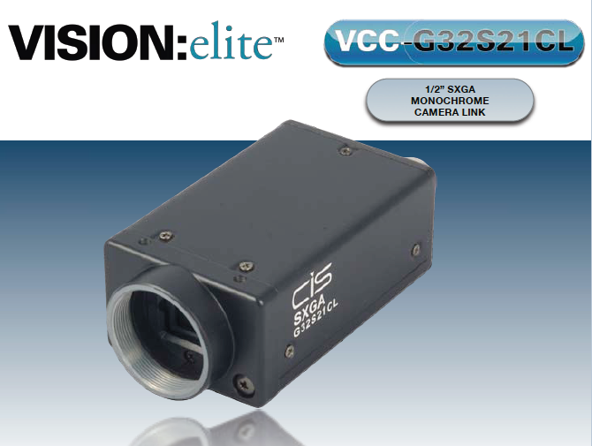
CIS Americas GIGe Camera

Slide 8
What to do Now
If non-US company ok then many vendors to choose from
If US vendor required then may not have many choices for camera
  Consider Firewire?
Purchase one or two ½” sensor cameras to develop software and test with Radiabeam prototype
Before picking camera for NML, optical design should be determined
  Optimize sensor to optics

Slide 9
Firewire vs GigE
When using industrial FireWire® cameras, users find that:
*Cables are less expensive (they can be obtained from a local computer retailer),
*The standardized software interface for industrial cameras (DCAM or IIDC) offers the ability for any compliant camera to be operated by any compliant driver,
*There are minimal framegrabber costs or connectivity issues since many computers are now including built-in FireWire® ports,
*PCI or Cardbus FireWire® interface can be purchased for less than a hundred dollars at your local computer retailer if your computer does not have a built in FireWire® port,
*The software offerings and maturity of the technology's standardization also makes FireWire® IEEE1394 a good long-term investment in a technology future for your application.
GigE does offer some attractive advantages over FireWire®:
*Cable lengths are available up to 100 meters long (compared to FireWire®'s 5 meters),
*Faster transfer speed (1000 Mbps),
*Provides a truly plug and play interface standard,

