Slide 1
A Study of SB2009 by CAIN
Akiya Miyamoto
14-Oct-2009
KEK
ILD-Optimization meeting

Slide 2
Introduction
Study of ILD performance with new ILC beam parameter is urgent.
Comments on SB2009 should be by early December(?)
No solid official parameters yet
  250 GeV parameter
  Energy spread at 500/250 GeV, …
While waiting, I have created a few plots by CAIN.
  SB2009, 500 GeV parameter
  CAIN version 240, include simulation with traveling focus
I expect that
  SLAC colleagues will create standard samples by GunieaPig as soon as
  parameters are fixed.

Slide 3
Beam Parameters
Parameters used for CAIN. SB2009 parameters are taken from ALCPG09 talk
by N.Walker.
 |  | RDR LowP | RDR Nominal | SB2009
Beam and RF Parameters
No. of bunches |  | 1330 | 2625 | 1312
Bunch spacing | ns |  | 370 | 740
IP Parameters
Norm. horizontal emittance | mm.mr | 10 | 10 | 10
Norm. vertical emittance | mm.mr | 0.035 | 0.040 | 0.035
bunch length | mm | 0.2 | 0.3 | 0.3
horizontal b* | mm | 10 | 20 | 11
horizontal beam size | nm | 452 | 640 | 470
 |  |  |  | no trav. focus | with trav. focus
vertical b* | mm | 0.2 | 0.40 | 0.48 | 0.2
vertical beam size | nm | 0.38 | 5.7 | 5.8 | 3.8
Luminosity | cm⁻²s⁻¹ | 2×10³⁴ | 2×10³⁴ | 1.5×10³⁴ | 2×10³⁴

Slide 4
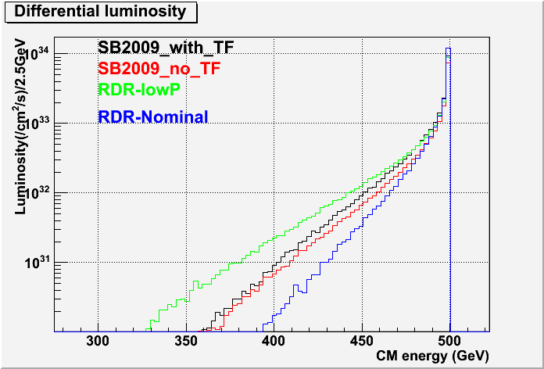
Differential Luminosity
SB2009 is about in the middle of RDR nominal and RDR lowP

Slide 5
Differential Luminosity: Values
E₀=500GeV, Lum. in unit of 10³⁴cm⁻²s⁻¹
 | Total Lum | Lum. in E₀~E₀-2.5GeV |  | Lum in E₀~E₀-25.0GeV
 |  | Lum | Lum/Total(%) | Lum. | Lum/Total(%)
RDR LowP | 2.01 | 0.89 | 44 | 1.68 | 84
RDR nominalA | 2.00 | 1.20 | 60 | 1.90 | 95
SB2009 w/o TF | 1.55 | 0.74 | 48 | 1.37 | 88
SB2009 w.TF | 2.01 | 0.96 | 48 | 1.77 | 88
Peak luminosity ( with in 2.5GeV) of SB2009 w. TF (0.96x10³⁴) is about
20% less than that of RDR nominal (1.2x10³⁴)
Lum. with Traveling Focus/ Lum. without Traveling Focus ~ 1.3

Slide 6
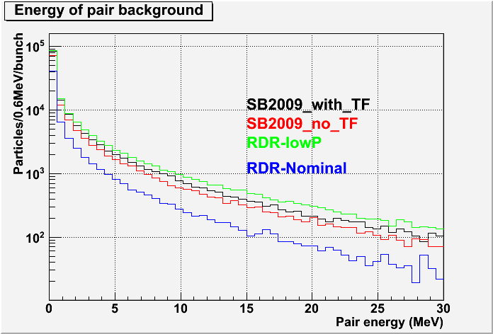
Pair : Energy spectrum
Pair energy is 2~3 times larger than RDR nominal, but lower than RDR lowP
( Number of bunch of SB2009 is a half of the RDR nominal )

Slide 7
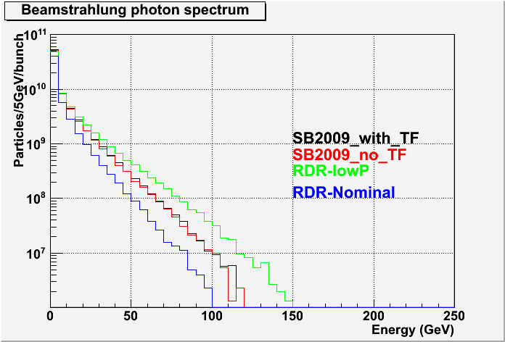
Beamstrahlung Photon : Energy Spect.

Slide 8
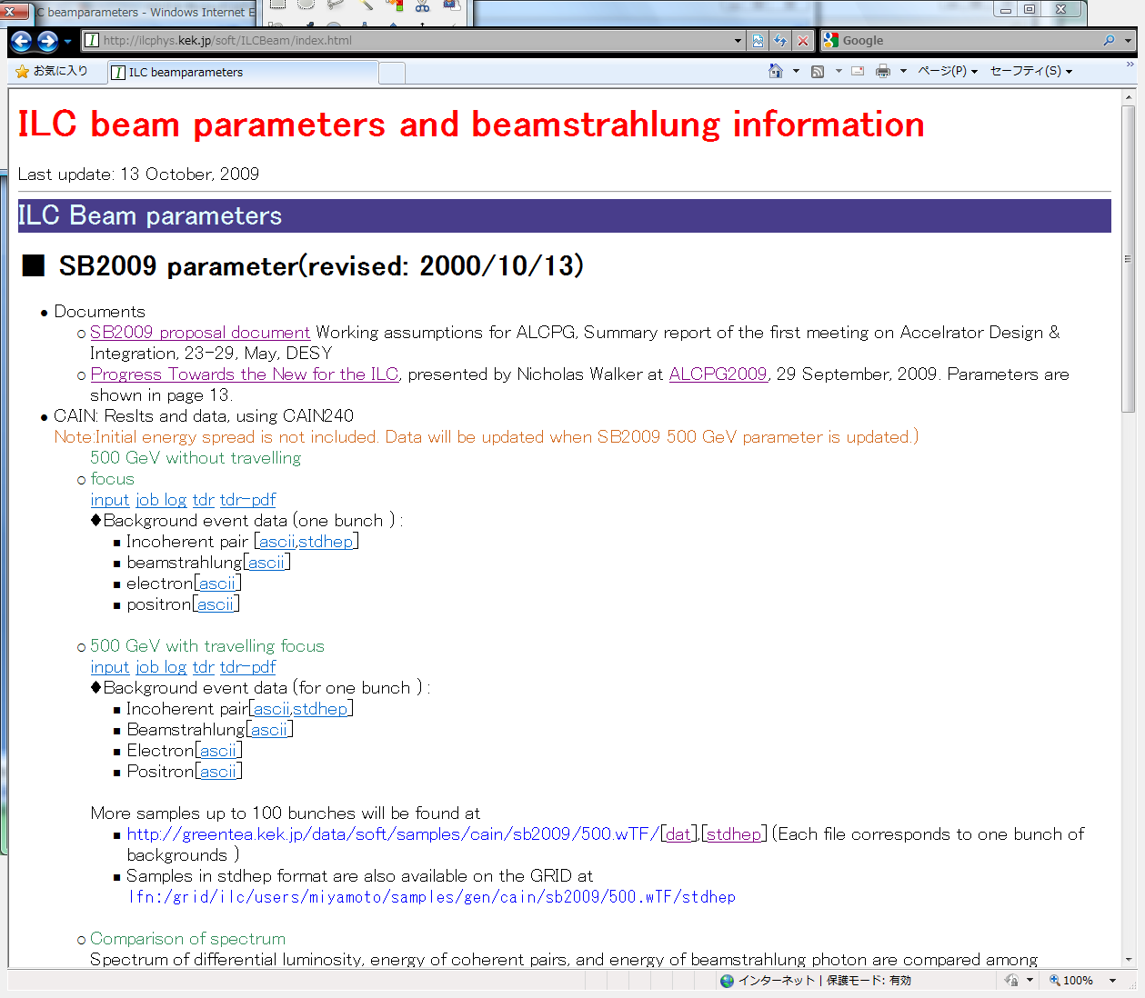
CAIN samples
Information about CAIN background data are available at
http://ilcphys.kek.jp/soft/ILCBeam/index.html

Slide 9
Summary
Luminosity and background distribution were studied by CAIN.
(Total) luminosity of SB2009 w. TF is same as the RDR nominal, but
luminosity within 2.5GeV from the nominal energy is about 20% less than the RDR nominal.
Pair backgrounds per bunch of SB2009 w.TF is 2~3 larger
than RDR nominal.
Backgrounds per pulse would be 1~1.5 lager than RDR nominal.

Slide 10
Next step
Coordinate efforts in ILD to study new ILC parameter is necessary
Background study by Mokka/Marlin, etc.
  Samples for background study at 500 GeV are available.
    CAIN
    GunieaPig samples produced by SLAC colleague
  Some study would be possible
Study impact on physics
  Concrete parameters are not available.
    500 GeV physics:
      Need information about the energy spread ?
    Parameter for 250 GeV
  If StdHep samples have to be re-created, we need to start to negotiate
  with SLAC colleagues soon.

