Slide 1
Crystals in a Test Beam: Status Report
Adam Para
October 20, 2009

Slide 2
Short Term Program
Single crystal studies:
  Scintillation and Cherenkov light yield
  With different filters
  With different photodetectors
  Position dependence
  Angular dependence
  Angular distribution of Cherenkov light in a shower
  Time profiles

Slide 3
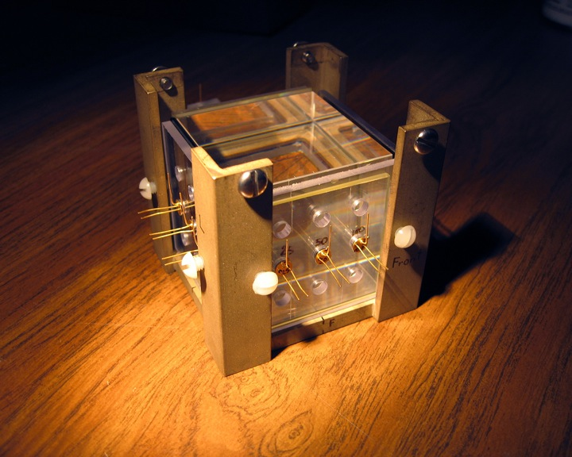
Crystal and Photodetectors
BGO crystal, 5x5x5 cm. More BGO and PbF2 crystals coming (variuos sizes)
Flexible filters and photodetectors arrangement on all sides of the crystals
Up to 9 photodetectors per side
Different photodetectors can be mounted
Photodetectors available:
Hamamatsu 1x1 mm, 25m, 50m, 100m pixels
Hamamatsu 3x3 mm 50m pixels
IRST 1x1 mm
PMT’s

Slide 4
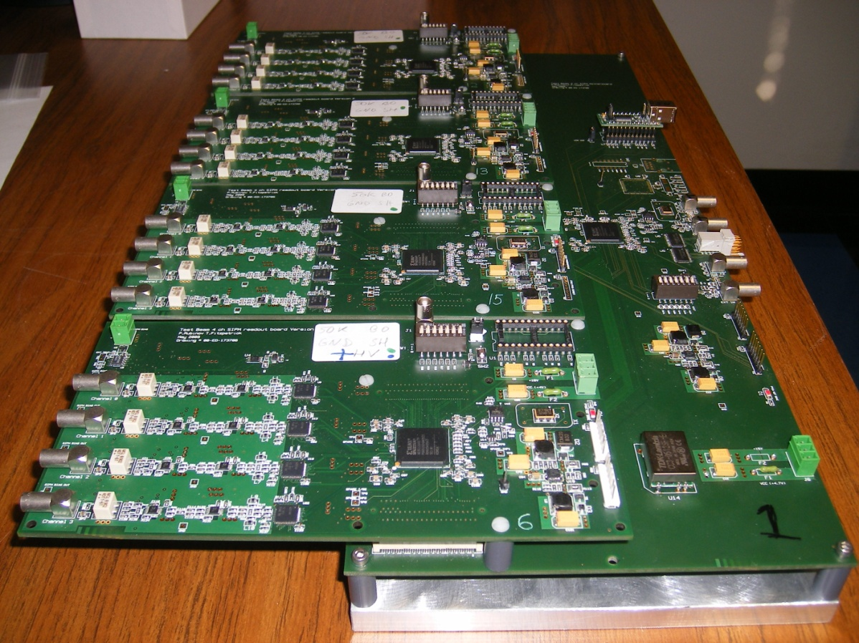
Readout Board: TB4
One motherboard (three more coming)
Four daughter cards
12 chanels
Paul’s data acquisition program

Slide 5
Segmented Crystal Calorimeter
CMS EM test module (University of Iowa)
49 PbWO4 crystals, photomultipliers, lightguides
Sent over from CERN
Support structure under construction
(Short term) plan:
  Re-assemble the test beam module
  Establish the performance (resolution) for electrons using the original PMT’s
  Equip crystals with IRST SiPM’s, direct comparison of the resolution

Slide 6
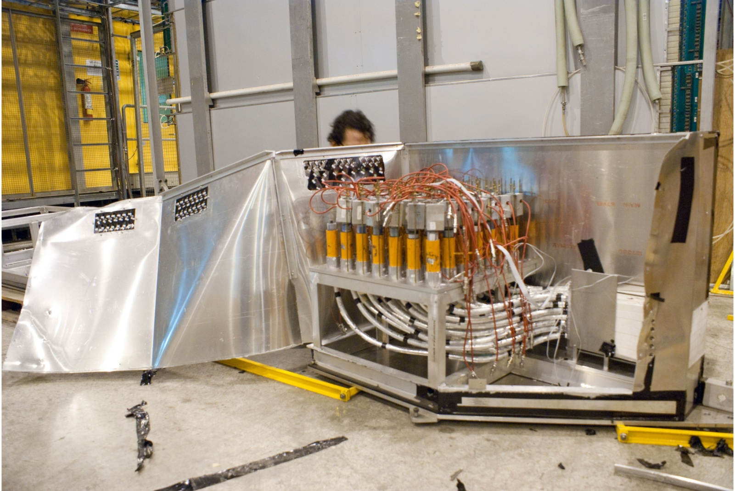

Slide 7
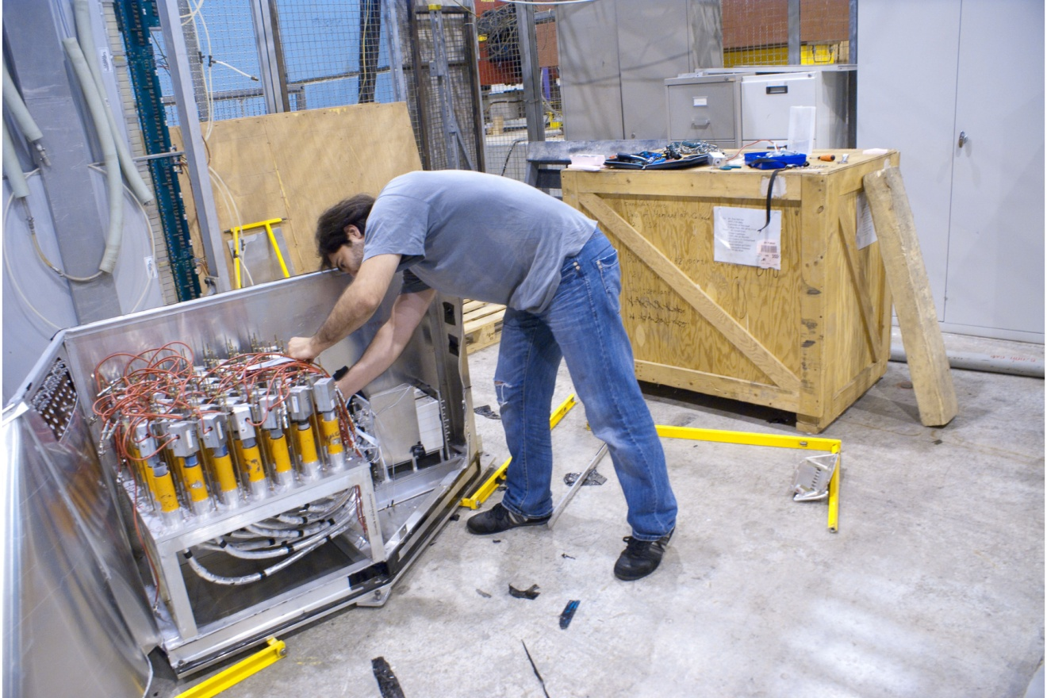

Slide 8
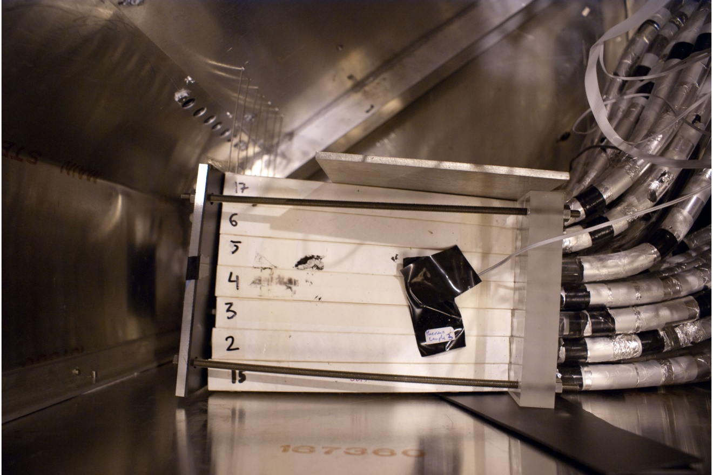

Slide 9
