Slide 1
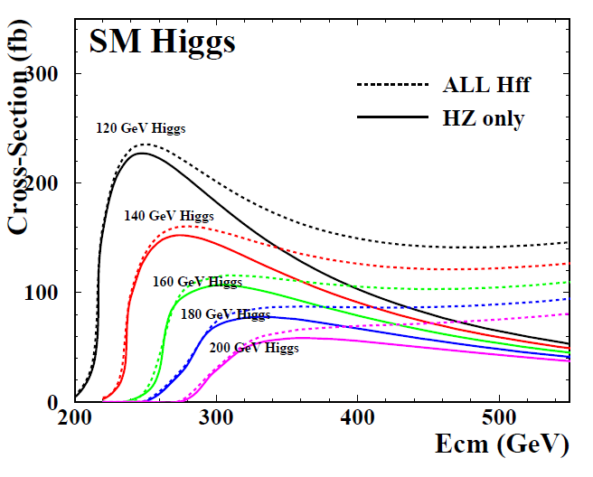
Higgs Production Rate ( Fig. 2.4, KEK-Report 2001-11)
: Lum ∝ E
Det. Eff. ?
Mh>120GeV?
250→500GeV
x1.25 Stat.
x 2 cost.
better to run
longer at 250?
: Lum 1/2

