Slide 1
Signal port flange and beam pipe
Norihito Ohuchi

Slide 2
Signal cable assignment on A and B flanges
Original design of signal cables for A and B flanges
A flange
2 ×Piezo
4 ×WPMs
B flange
2×e‐pickup coupler
2 ×cavity HOM
1 ×cavity pickup
2 ×PT1000 coupler
1 ×STC He vessel
D flange
Stepping motor, BPM, Piezo vibration sensors
Signal cables from cavities for S1-G Module-C
A flange
2 ×Piezo
B flange
2 × e‐pickup coupler
2 ×cavity HOM
1 ×cavity pickup
D flange
Stepping motor
Signals for WPMs and temperature sensors go through the KEK terminal ports.

Slide 3
A-flange
2 ×Piezo
No use
No use
No use
No use

Slide 4
B-flange
spare
cavity Pickup
cavity HOM2
No use
e‐pickup coupler
e‐pickup coupler
cavity HOM1

Slide 5
D-flange
Stepping motors
No use

Slide 6
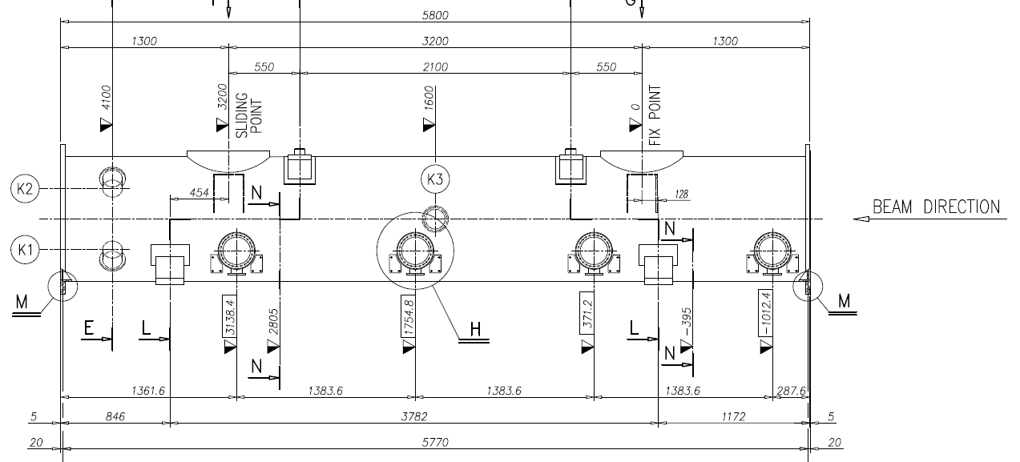
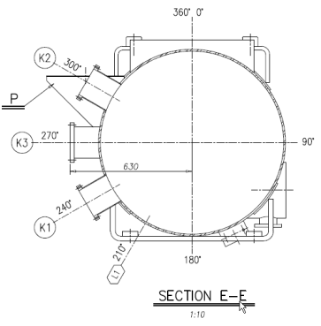
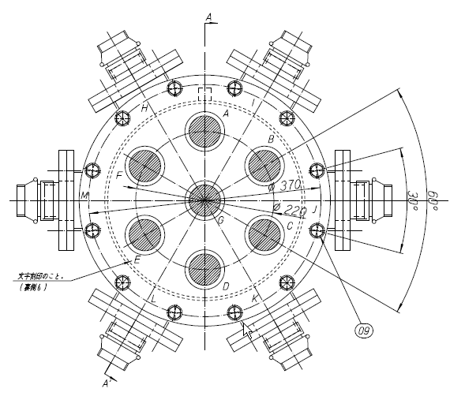
D-flange location
WPMs and D-flange
Upper side
Temperature sensors, strain gauges, pin diodes

Slide 7
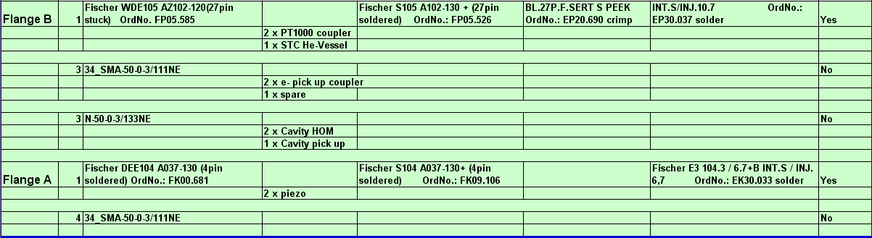
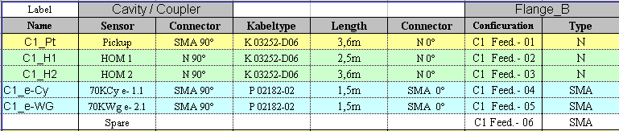
Feedthroughs (From data of #M9)

Slide 8
Confirmation for feedthroughs
Assignment of the cables to the A and B flanges is basically same as the #M9.
#M9 is the module which DESY sent to FNAL as CM1.
However, the cables for WPMs and temperature sensors go out via the KEK terminal ports.
D-flange locates at the downstream of Module-C.
The cable lengths are same as the #M9 including the stepping motors.
The machine process of the A, B and D flanges
The blind A and B flanges will be sent to KEK with Module-C components from INFN/Zanon.
Proposal: the flanges would be machine-processed by FNAL or DESY, and be checked with feedthroughs for leak tightness.

Slide 9
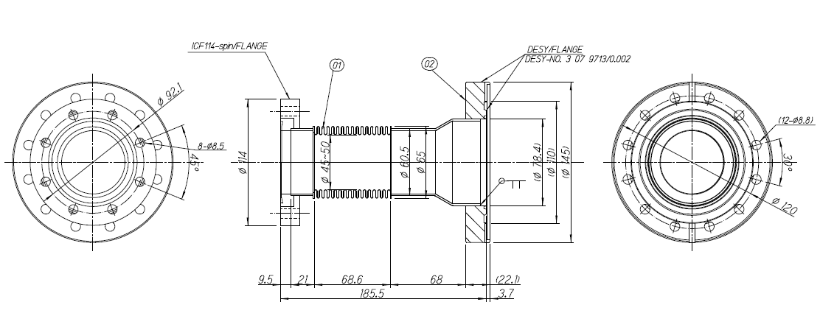
Beam pipe between gate valve and FNAL cavity
KEK gate valve
: rotatable flange
FNAL cavity
: fixed flange
KEK cavity group will prepare this components.
For checking leak tightness, the group needs the hexagon seals and the blind flange.

