Slide 1
2009.10.27: Hayano
Cavity status; recent KEK activities
(1) MHI-07 was vertical tested on Oct. 15.
→ 33MV/m, stopped by field emission and quench.
Heating at #9cell equator and strong radiation observed.
(2) AES-003 cavity was treated by guided repair and 50um EP, degreaser rinse, HPR.
It is in transporting back to FNAL, now in Narita for custom.
(3) MHI-08 cavity was treated by guided repair on #2cell equator.
It will be tested on Oct. 29, in this week.
*MHI-05,06,07,08,09 are S1G candidates.

Slide 2
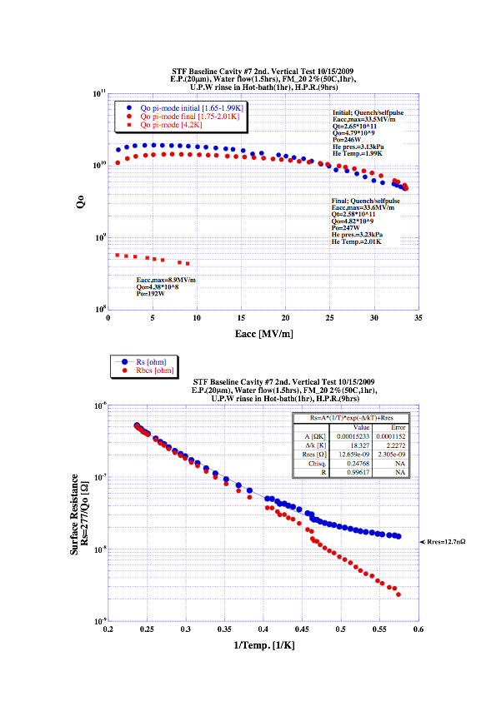
MHI-07
MHI-07 cavity : 2nd VT
(20µm EP + Degreaser (with U.S.) )
Final power rise Max: 33MV/m
strong field emission

Slide 3
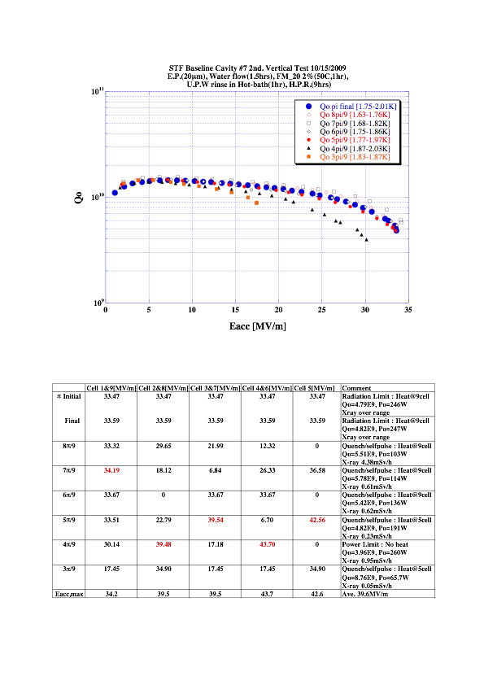
MHI-07
limited by #9cell

Slide 4
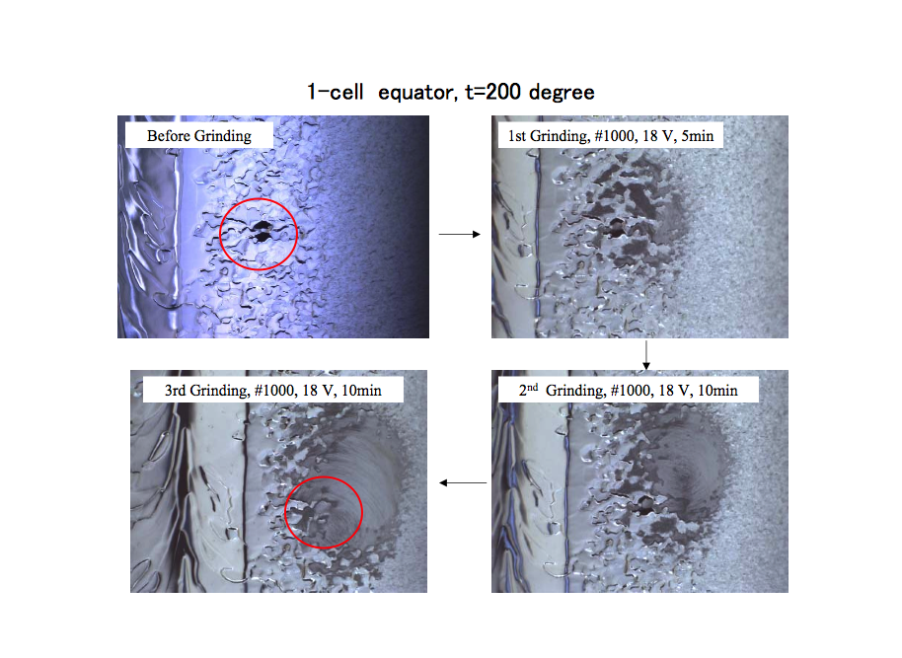
AES-003
70um bump

Slide 5
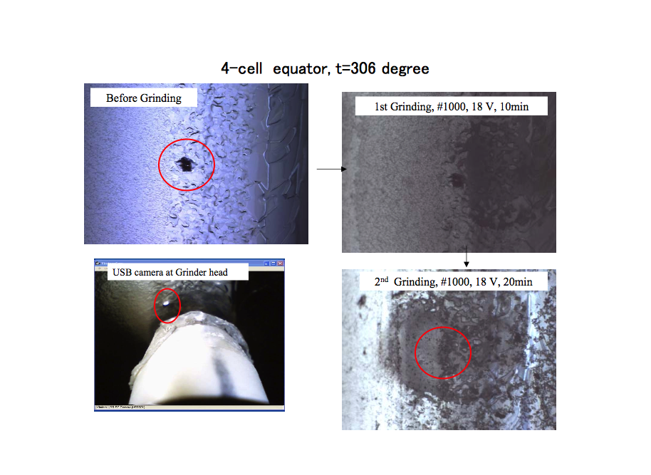
AES-003
40um??
bump

Slide 6
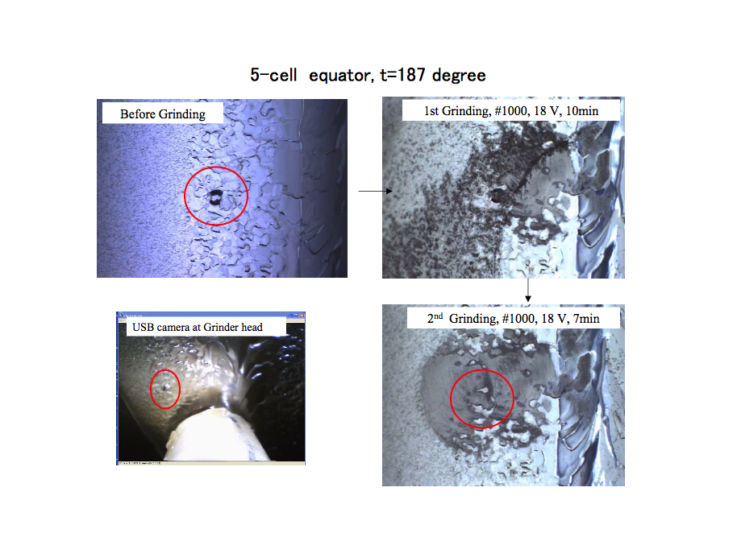
AES-003
60um bump

Slide 7
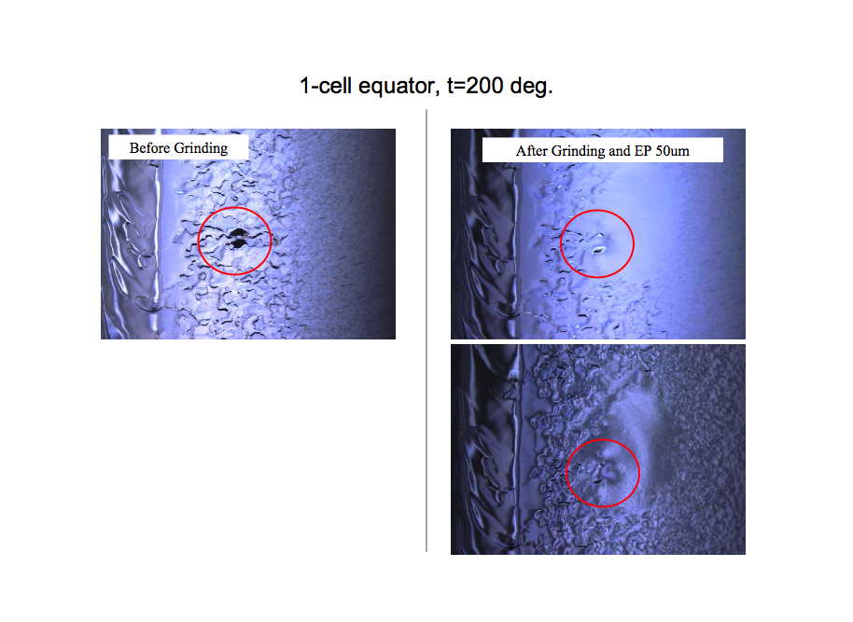
AES-003
bright image
dark image

Slide 8
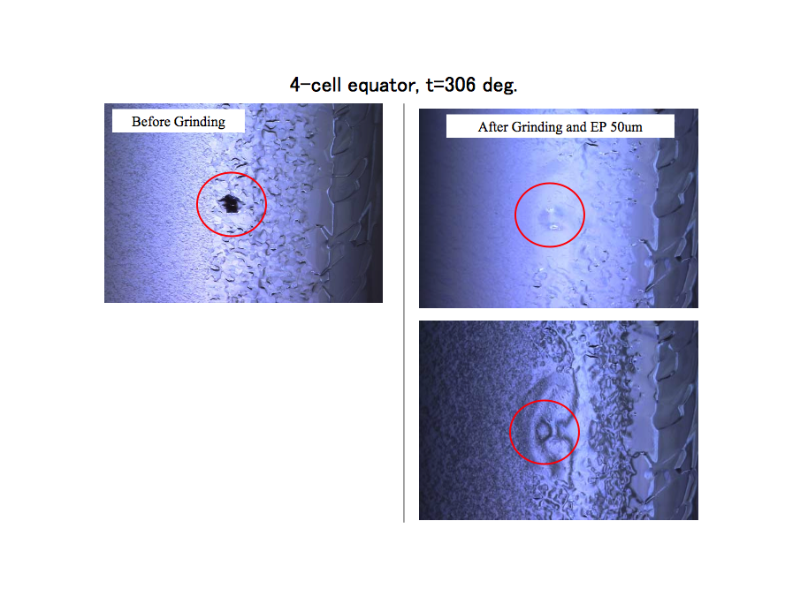
AES-003
bright image
dark image

Slide 9
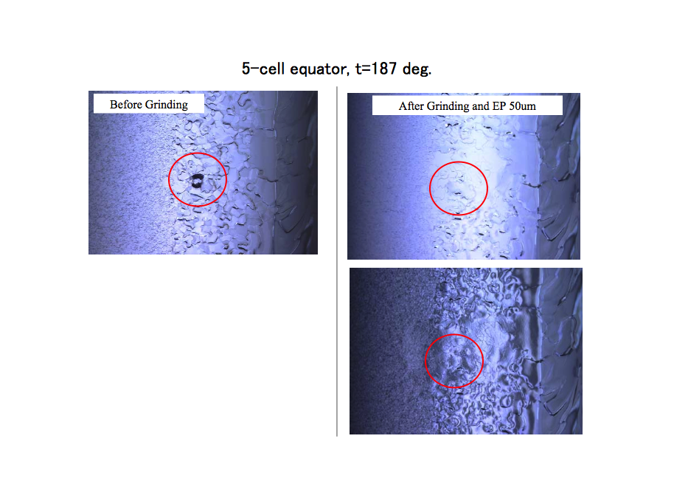
AES-003
bright image
dark image

Slide 10
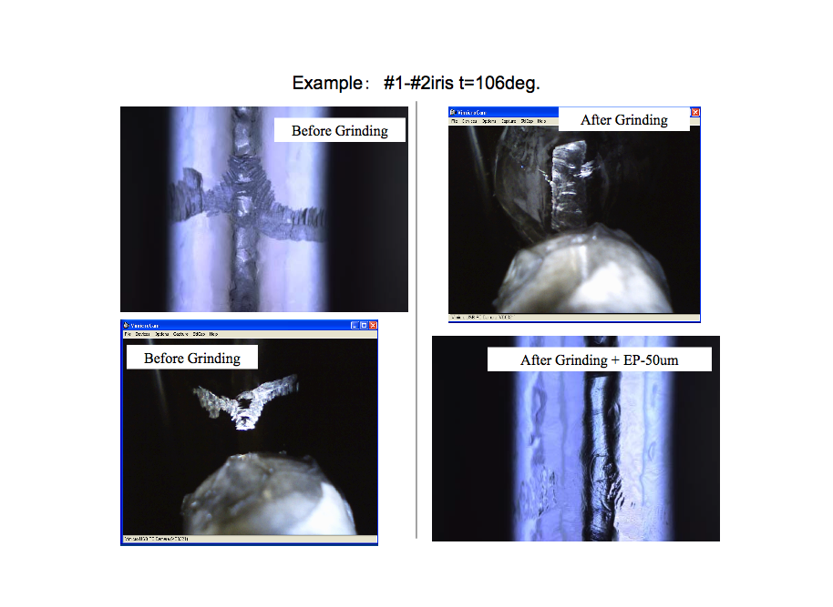
AES-003
Iris repairs were done only heavy scratch

Slide 11
end

