Slide 1
Running at Lower Energies
Jim Clarke
ASTeC & Cockcroft Institute
Daresbury Laboratory

Slide 2
Schematic Layout
Abort Dump
Auxiliary
Source 500MeV Drive Beam
125MeV NC Linac
5GeV SC Linac
To DR (spin rotation & energy compressor)
Fast Abort
Kicker
400MeV NC Linac
Target
BDS
To IP
Undulator
High Power Dump
Switching Magnet (2.5 Hz)
Low Energy Electron Dump
Photon Dump
150 GeV Electron Transport to Dump (Switched Mode)
500MeV Electron Dump

Slide 3
Normal Operation
125MeV NC Linac
5GeV SC Linac
To DR (spin rotation & energy compressor)
400MeV NC Linac
Target
BDS
To IP
Undulator
Low Energy Electron Dump
Photon Dump

Slide 4
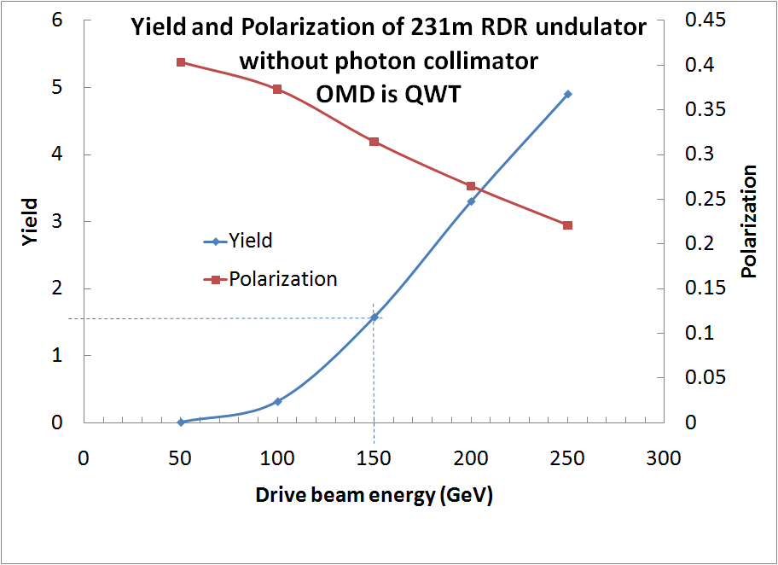
Positron Yield

Slide 5
Switched Mode
BDS
To IP
Undulator
High Power Dump
Switching Magnet (2.5 Hz)
150 GeV Electron Transport to Dump (Switched Mode)

Slide 6
Number of Positrons per Bunch
SB2009
RDR

Slide 7
Energy Spread Assumptions
Energy spread at the entrance to the main linac is 1.5% at 15 GeV for RDR and 1.08% at 15GeV for SB2009 (N Solyak)
No growth due to linac etc
In RDR case e+ are generated by e- at 150GeV
  e- are either accelerated or decellerated after the undulator to achieve their required energy at the IP
In SB2009, energy of e- is variable in the undulator
  125 to 250GeV @ 5Hz operation or
  150 GeV @ 2.5Hz operation
  Length of undulator is varied (modules are switched on/off) to keep yield at 1.5e+/e-

Slide 8
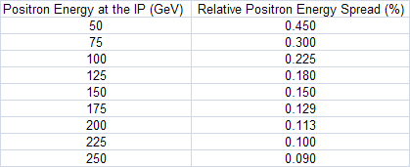
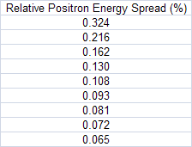
Positron Energy Spread
e+ energy spread is independent of the source (set by DR & RTML)
  Scales as inverse of IP energy
  RDR and SB2009 are different
RDR
SB2009

Slide 9
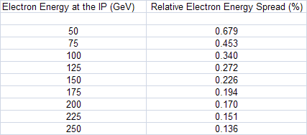
Electron energy spread
When e⁻ emit SR in undulator energy spread is increased
The SR induced contribution is added in quadrature to inherent energy spread
RDR

Slide 10
Electron energy spread
SB2009 has two modes of operation
  First mode (5Hz) have to account for changing undulator length
  Second mode (2.5Hz), although e- beam for IP is not used to generate e+ it still travels through the undulator and emits SR

Slide 11
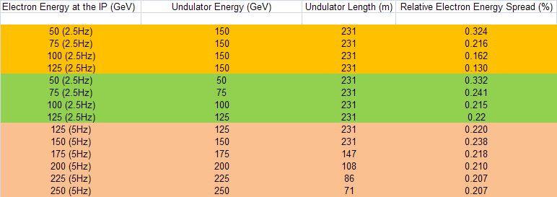
Electron energy spread
SB2009

Slide 12
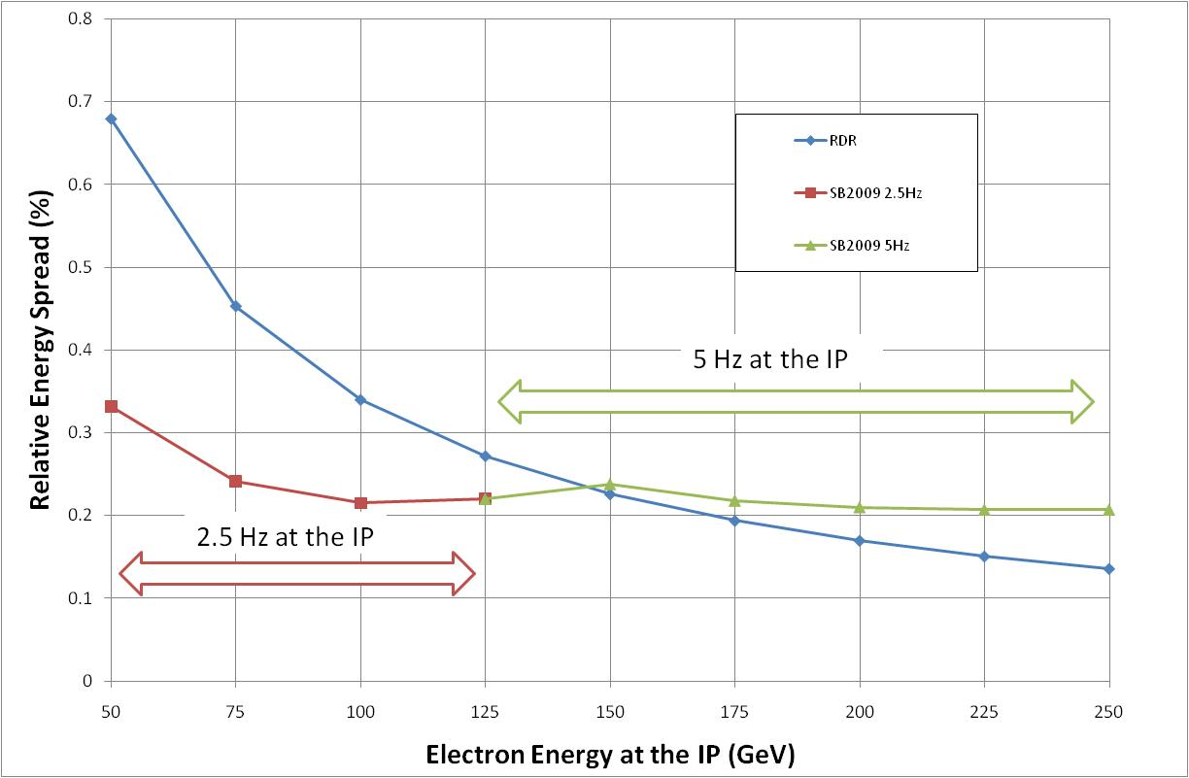
Electron energy spread

Slide 13
Mitigating the Low Energy Impact
The present ‘breakpoints’ of 150 GeV and 125 GeV are somewhat arbitrary
Once the mass of Higgs is known the ILC can be tailored to provide improved performance
If the mass is ~120 GeV then higher rep rate operation of the ILC (ie >5 Hz) during pulse switching is an option
If the mass is ~140 GeV then a ~20% longer undulator would restore the present loss in positron yield

