Slide 1
2. SCRF General
Preparation for the AD&I
  SB2009 document, and DESY meeting, Dec. 2-3,
  Cavity gradient (operational) to be re-evaluated by Quarter-1, 2009
Preparation for AAP Review
  at Oxford, Jan. 6-8, 2010,
Next SCRF meeting
  Dec. 9, 2009: last meeting before SB2009, AAP

Slide 2
Global Plan for SCRF R&D
Year | 07 | 2008 |  | 2009 |  | 2010 |  | 2011 | 2012
Phase | TDP-1 |  |  |  |  |  | TDP-2
Cavity Gradient in v. test to reach 35 MV/m | → Yield 50% |  |  |  |  |  | → Yield 90%
Cavity-string to reach 31.5 MV/m, with one-cryomodule |  | Global effort for string assembly and test (DESY, FNAL, INFN, KEK)
System Test with beam acceleration |  |  | FLASH (DESY) , NML (FNAL) STF2 (KEK, extend beyond 2012)
Preparation for Industrialization |  |  |  |  | Production Technology R&D

Slide 3
New Production Yield after 1st and 2nd Pass (RF) Test
Yield at 35 MV/m:
22 % at 1st pass
33 % at up to 2nd pass
1st pass
2nd pass
improvement
degradation
ILC Operation at <31.5 MV/m>
Yield reaching ~ 40 %
Reported by C. Ginsburg and GDB team

Slide 4
Alternate Yield Plot
Yield is estimated assuming a specific lower cut-off in cavity performance, below which cavities are assumed 'rejected’.
Error bar is +/- one RMS value (standard deviation of the population) of the remaining (accepted) cavities (gradient above cut-off).
Additional bars (min, max) inidcated the minimum and maximum gradients in the remaining (accepted) cavities.

Slide 5
Progress and Prospect of
Cavity Gradient Yield Statistics
 | PAC-09 Last/Best 2009-05 | FALC 1st Pass 2009-07 | ALCPG 2nd Pass 2009-10 | To be added (2009-11) | Coming Prod. Y. (2010-06) | Research cavities
DESY | 9 (AC) 16 (ZA) | 8 (AC) 7 (ZA) | 14 (AC/ZA) | 10 (Prod-4) | 5 | 8 (large G.)
JLAB FNAL/ANL/Cornell | 8 (AC) 4 (AE) 1 (KE-LL5) 1 (JL-2) | 7 (AC) | 7 (AC) | ~ 5 (AE) | 12 (AC) 6 (AE) | 6 (NW) (including large-G)
KEK/IHEP |  |  |  | 5 (MH) | 2 (MH) | ~5 (LL) 1 (IHEP)
Sum | 39 | 22 | 21 | 20 | 25 | ~ 20
G-Sum |  |  |  | 41 | 66
Statistics for Production Yield in Progress to reach > 60, within TDP-1.
We may need to have separate statistics for ‘production’ and for ‘research’,

Slide 6
Cavity Gradient Study - Status
Yield at 35 MV/m (w/ established vendors: RI, Zanon)
  22 % at 1st pass (statistics 22)
  33 % at 2nd pass (statistics 21, as of 2009-07))
    Average Gradient reaching 30 MV/m
  DESY Prod-4 data to be added, (10 more statistics)
New statistics coming (w/ potential vendors)
  AES: to be counted from #5 (to be confirmed)
  MHI: to be counted from #5 (to be confirmed)
Selecting statistics needed for ‘Production Yield’
  to evaluate readiness of industrialization and cost
Note: Numbers of Cavities for ‘gradient research’: need to be separately counted.

Slide 7
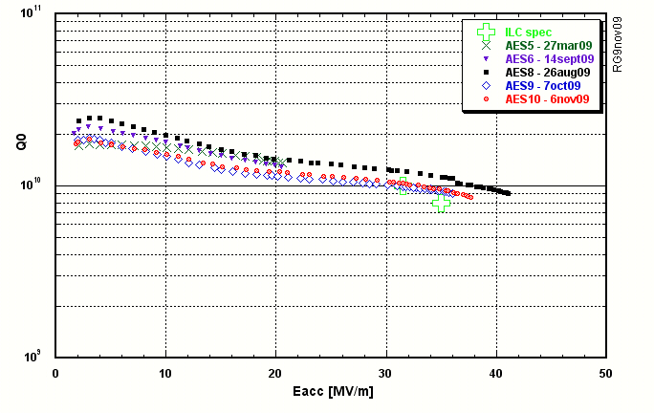
AES-JLAB/FNAL Progress
Reported by R. Geng

Slide 8
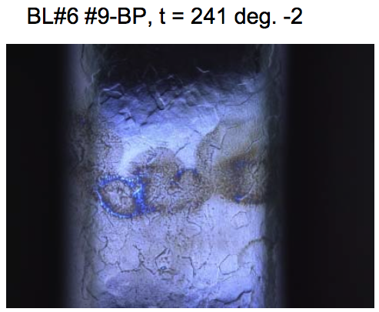
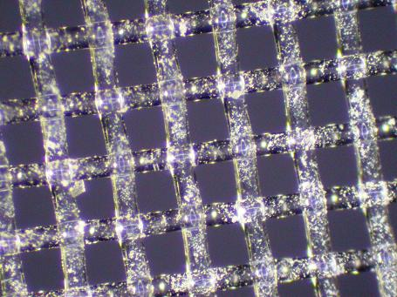
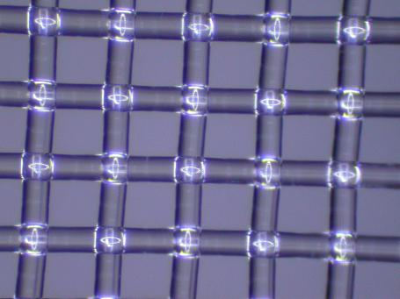
Achievement with Contribution of basic R&D for surface conditions
洗浄
Possible reasons for improvement:
・Water rinsing (increased flow rate, time)
・Detergent rinsing．
・EP solution condition (aged)．

Slide 9

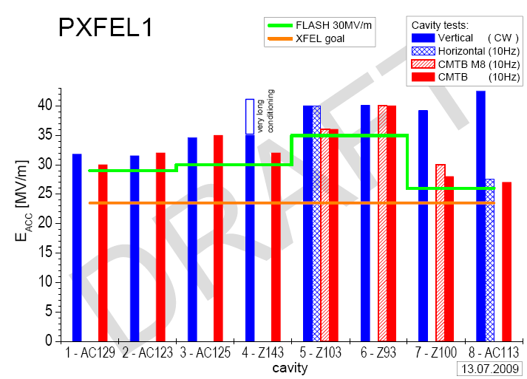
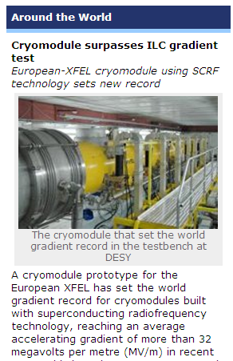
S1 Goal: Achieved at DESY/XFEL
Average field gradient at CMTB
: > 31.5 MV/m
- First XFEL prototype module exceeds 31.5 MV/m average
- Module will see beam in FLASH in 2010 (av. of 30MV/m)
- Cryostat (cryomodule cold-mass) contributed by IHEP

Slide 10
A Proposal for Re-baseline
Cavity Gradient and Yield, in TDP-2
S0: Maximum gradient of 35 MV/m (@ Q0 = 8E9) in vert. test
  Keep R&D goal: yield of 90 % at 35 MV/m, and
  Recognize that the yield may be acceptable to be ~ 50 % with the +/-20 % distribution (i. e., b/w 28 and 42 MV/m) of the gradient.
S1: Cavity-string: E = <31.5 MV/m> (@ Q0 = 1E10) in cryomodule
  Keep the ‘averaged field gradient’ in cryomodule string, and
  Recognize Acceptable gradient spread of ~ 20 % in operation
    See the recent progress at DESY PXFEL cryomodule test result
S2: Cryomodule string w/ RF operationability
  Need to re-evaluate the level of operational margin to be required in accelerator beam operation,
  It may need to take into account to determine the ILC operational field gradient, (>> we need to discuss it)

