Slide 1
SCRF WebEx Meeting focusing on Preparation for S1-Global
2009-11-11
Preparation for S1-Global (100 min)
SCRF general issues (20 min.)

Slide 2
1. S1-Global Cooperation and Preparation
Objectives of the Meeting, Today:
Report the preparation and
Confirm the work-sharing/cooperation
Agenda
S1-Global General Plan (A.Y.)
Cavity/cromodule preparation: FNAL, DESY, KEK, INFN
Integration work at KEK and work-sharing plan: (E.K., N.O.)
Q&A, and Further work-assignment

Slide 3
2. SCRF General
Preparation for the AD&I
SB2009 document, and DESY meeting, Dec. 2-3,
Cavity gradient (operational) to be re-evaluated by Quarter-1, 2009
Preparation for AAP Review
at Oxford, Jan. 6-8, 2010,
Next SCRF meeting
Dec. 9, 2009: last meeting before SB2009, AAP

Slide 4
Global Plan for SCRF R&D
Year | 07 | 2008 |  | 2009 |  | 2010 |  | 2011 | 2012
Phase | TDP-1 |  |  |  |  |  | TDP-2
Cavity Gradient in v. test to reach 35 MV/m | → Yield 50% |  |  |  |  |  | → Yield 90%
Cavity-string to reach 31.5 MV/m, with one-cryomodule |  | Global effort for string assembly and test (DESY, FNAL, INFN, KEK)
System Test with beam acceleration |  |  | FLASH (DESY) , NML (FNAL) STF2 (KEK, extend beyond 2012)
Preparation for Industrialization |  |  |  |  | Production Technology R&D

Slide 5
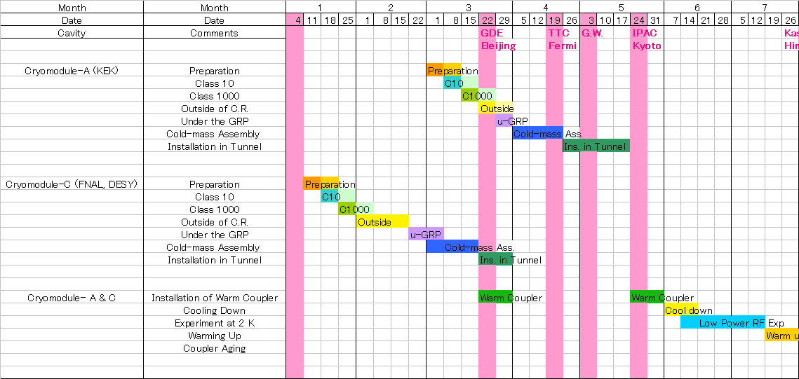
Revised Schedule of Cavity Assembly
Nov. 10, 2009
KEK
String
Assembly
Tuner
Installation
DESY
& FNAL
STF-2 Warm Coupler
Installation
String
Assembly
Tuner &
Mag. Shield
Installation
TTF-3 Warm Coupler
Installation

Slide 6
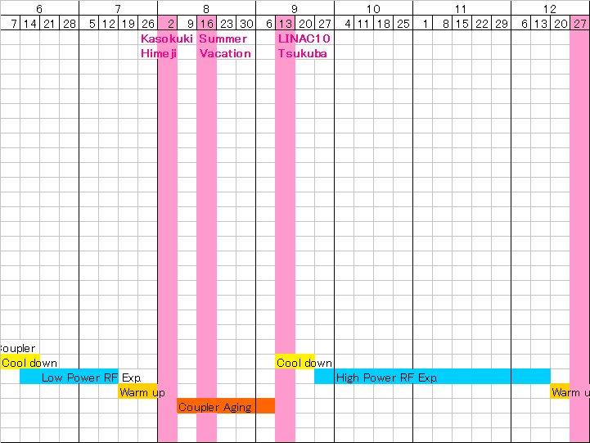
Cryomodule Tests Plan
Nov. 10, 2009
High RF Power Measurements
RF meas. (Q_{L}, Q_{t}, Q_{HOM})
Cavity conditioning with 1.5 ms
Cavity conditioning with 0.6 ms
Mechanical vibration modes (5Hz)
RF feedback on/off by LLRF
Observation of Lorentz Detuning
Compensation of Lorentz Detuning
Dynamic RF loss measurement
4 Cavity operation with vector-sum
8 Cavity operation with vector-sum
Long time operation at 31.5 MV/m
etc.
Low RF Power Measurements
Slide-Jack Tuner stroke
Piezo tuner stroke
RF meas. (Q_{L}, Q_{t}, Q_{HOM})
HOM Q_{ext}
Frequency stability
Mechanical vibration modes
Pulse response by Piezo drive
etc.
Coupler conditioning
at room temp.

Slide 7
Meeting for S1-G preparation
KEK visit of Jim Kerby (FNAL), 10th -12th, Nov.
Video/Webex meeting for S1-G preparation
pm.10:00~12:00 in 11th, Nov. at KEK,
in participation of DESY and FNAL colleagues
Main topics on discussion;
(Share of collaboration works for S1-G)
. Cavity string assembly
. Tuner & mag. shield assembly
. Tuner testing
. Input coupler assembly (warm parts)
. Conditioning of input coupler at room temp.
. etc.

Slide 9
Cavity- and Cryomodule-String Program (S1G, S2) at KEK, Japan
C. Year | 2008 | 2009 | 2010 |  | 2011 |  | 2012 |  | 2013 |  | 2014
Cavity String (S1-Global) | Cavity | >> | Ins | Test
Cryomodule String Test (S2) | *High Pressure Code Regulation/Stamp to be applied
Quant. Beam* (Compact L.S.) |  | Cavity | >> |  | Inst. | Test
Cryomodule 1* |  | Cavity | >> |  | >> |  |  | Ins & T
Cryomodule 2,3* |  |  | Cavity |  | >> |  | >> |  |  | Ins | Ins & T
 | Technical Design Phase |  |  |  |  |  |  |  | Development to be continued
R&D/Prepare for Industrialization

Slide 10
KEK-STF: Long Term Plan
CY
2009
2010
2011
2012
2013
2014
2015
Jacketing
GDE-TDP2
S1 Global
VT
Ass
Op.
Q. Beam
2 Cav. Fab.
VT
Ass
Op
Jacketing
HPC-Ins.
S2 (STF-Phase2)
CM1
9 Cac. Fab.
VT
Ass
Op
CM2
8 cav. Fab.
V. Test
Ass
Op.
CM3
4+5 cav. Fab.
V. Test
Ass.
Op.
運転
Cav. Product. R&D
(EBW parameter，etc.)
Cab. Fab.
(by Ind. & KEK)
Installation, Assembly
EBW
Fab.
運転
Pilot Plant
Contract.

