Slide 1
Cryomodule assembly schedule and job sharing plan
Norihito Ohuchi
KEK

Slide 2
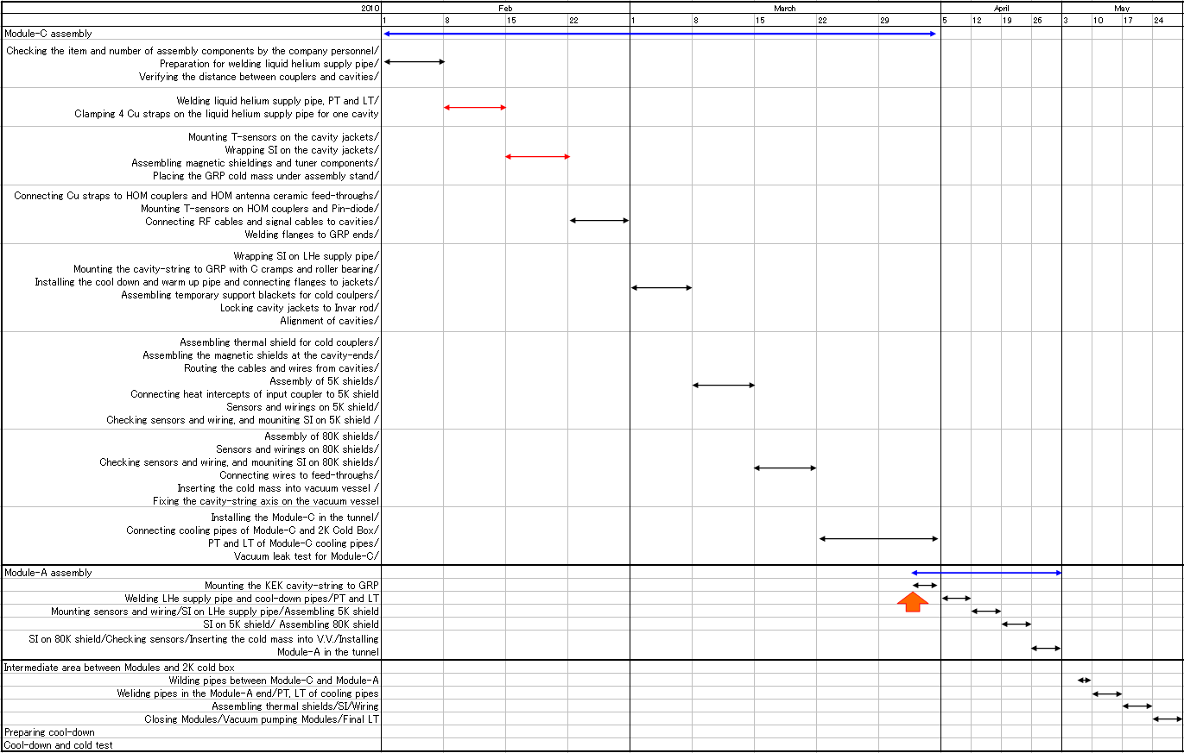
Total cryomodule assembly schedule plan

Slide 3
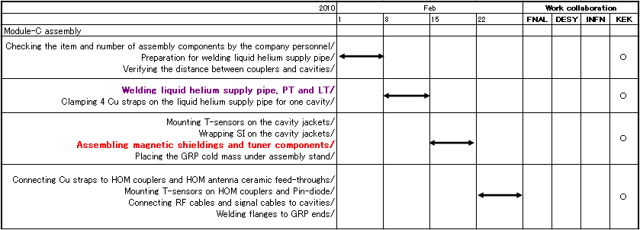
Job sharing of Module-C assembly

Slide 4
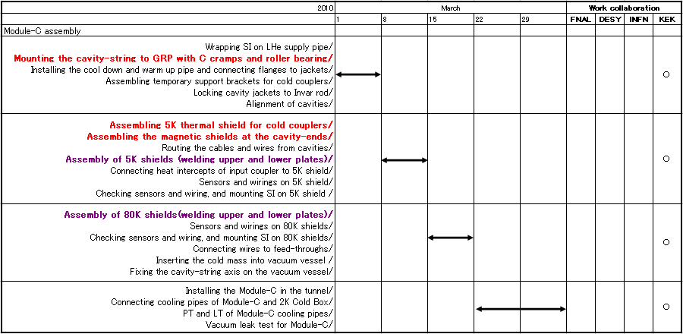
Job sharing of Module-C assembly

