Slide 1
2009.11.17: Hayano
Cavity status; recent KEK activities
(1) MHI-08 cavity was inspected on #2cell heated location.
Local ground cavity. Max gradient was 27MV/m, which was improved from 16MV/m (by pit),
The limitation was still #2 cell heating, but different place.
Optical inspection on heated location and found small bump.
It will be EP treated again and 3rd vertical test in the next week.
(2) MHI-09 cavity 2nd vertical test limited at 16MV/m.
Tested on November 12, 2009.
Optical inspection on heated location was done today, and nothing found.
Cavity has two straight brown traces on the cell taper along beam direction.
It will be EP treated again and will have 3rd test in December.

Slide 2
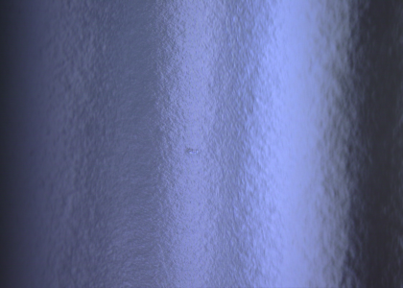
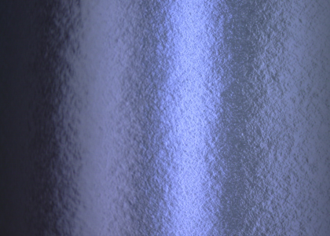
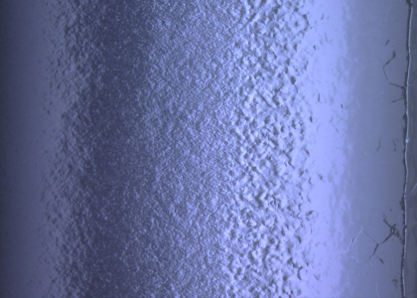
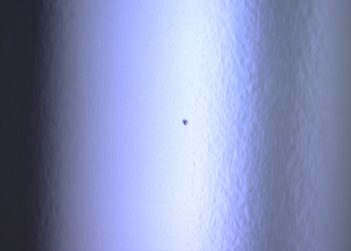
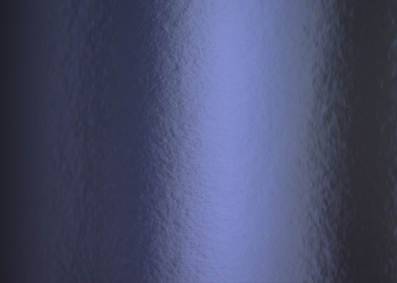
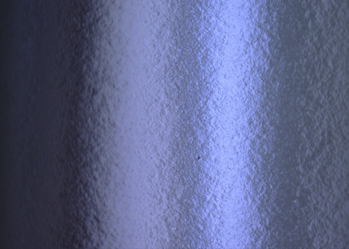
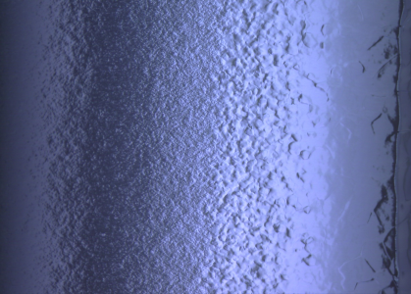
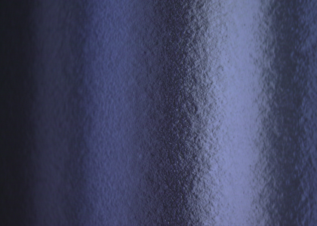
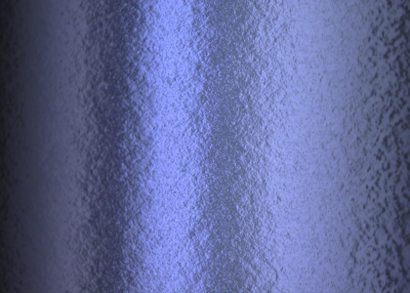
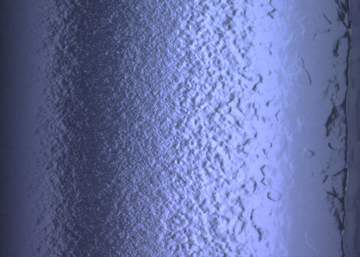
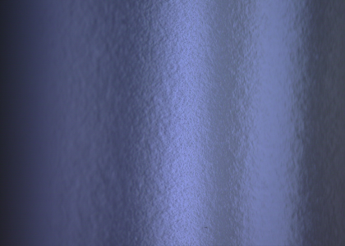
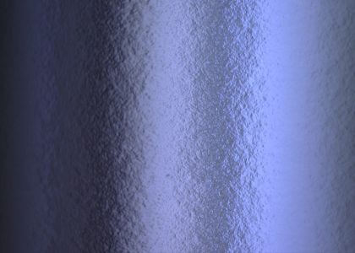
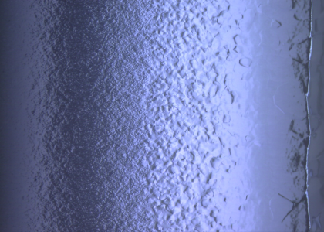
Inspection after 2nd V.T.
MHI-08 2-cell equator, t=90deg.
T=79
EBW seam
T=86
40 mm away from joint point of equator
T=90
T=94

Slide 3
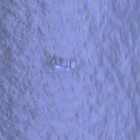
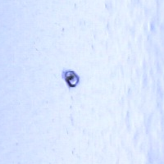
T=79, about 30mm away from EB weld
T=86, about 40mm away from EB weld
Molding, Shape analysis was done.
very faint spot

Slide 4
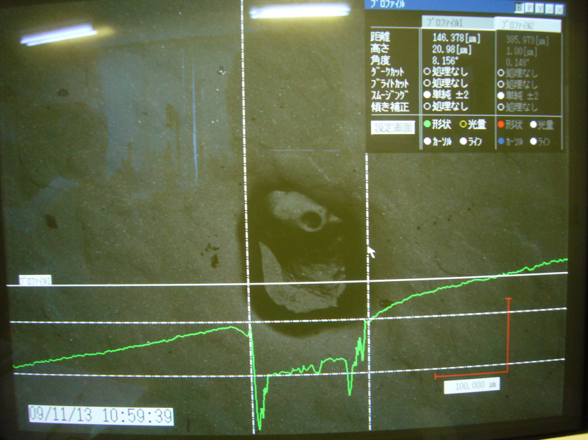
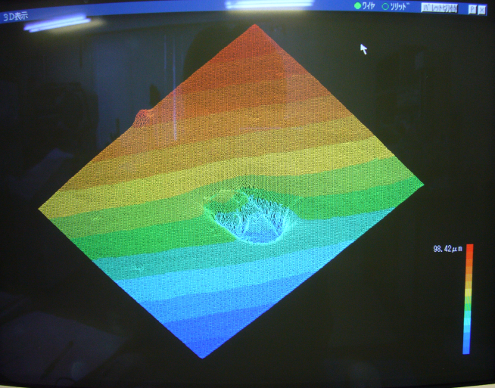
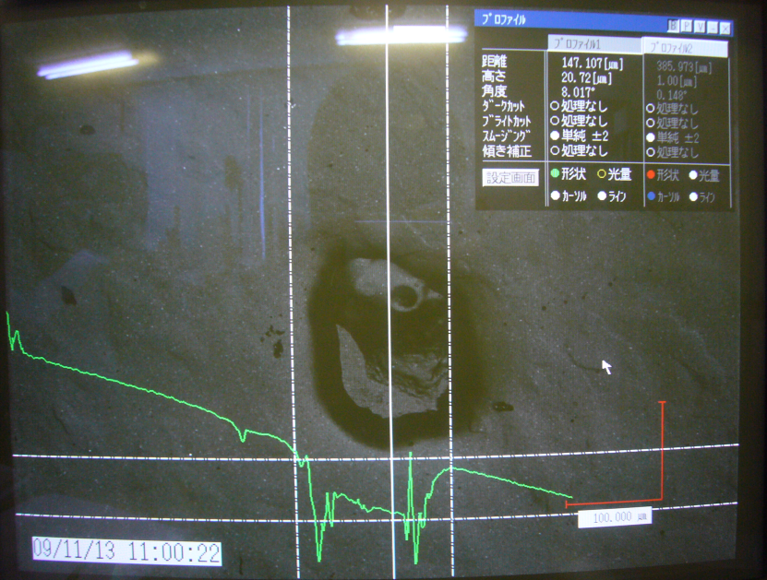
MHI-08 #2-cell t=086, outside weld area at equator, 40mm away from EB seam
Replica was viewed by Keyence VK-8500 laser microscope
Shape of defect: Bump
diameter = 150μm,
Height = 20μm

Slide 5
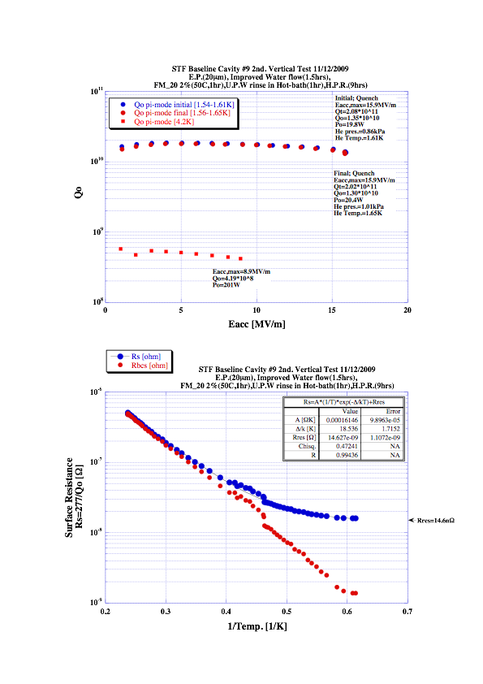
MHI-09
2nd VT
MHI-09 cavity : 2nd VT
(20µm EP + Degreaser (with U.S.) )
HPR accident
(rotation was stopped for a while)
Final power rise Max: 16MV/m
(It was 25MV/m in 1st VT,
and #2cell and #9 cell was heated,
and strong radiation)

Slide 6
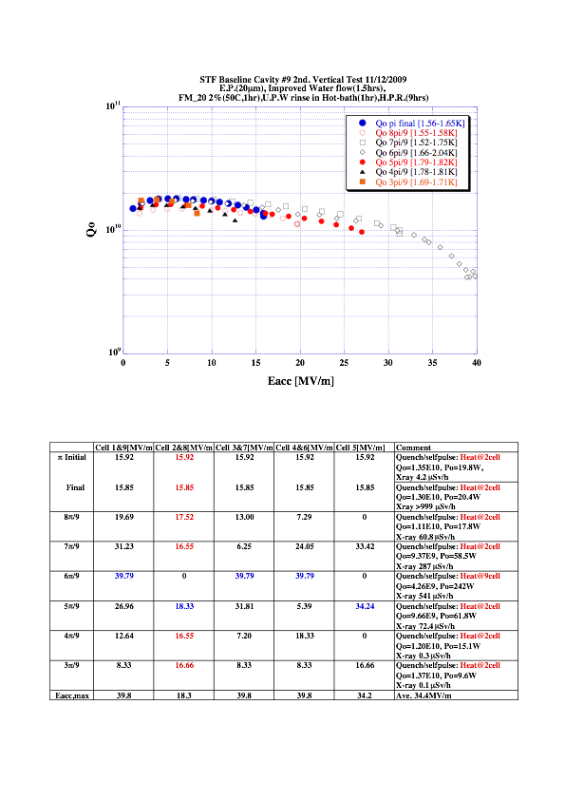
MHI-09
2nd VT

Slide 7
end

